Slide 1
CMSC 491/691 Knowledge Graphs Administrivia
Fall 2019

Slide 2
Course Objectives
Understand concepts, motivation, goals underling knowledge graphs (KGs)
Gain familiarity with popular property graphs like Neo4j
In-depth understanding of Semantic Web (SW) languages & tools
Ability to create & use ontologies & schemas using SW languages
Familiarity with major usecases: Wikidata, Google knowledge graph, schema.org
Create, consume and manipulate KG data
Ability to define and implement a KG project

Slide 3
Grading
Grades will be based on homework, quizzes, exams and a project
5-6 short homework assignments
Submissions will be via github classroom
Project (individual or group) with proposal and final report
Midterm, comprehensive final, possible quizzes on readings
Probable weighting: 40% homework, 15% project, 10% quizzes, 15% midterm, 20% final

Slide 4
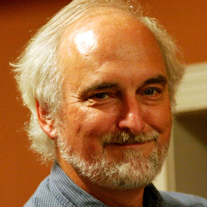
Instructor availability
Instructor: Professor Tim Finin
Pronounced like fine + in, not like fin + in
Office: ITE329, finin@umbc.edu, phone:410-455-3522
Office hours: Tuesday 12-1; Wednesday 10-11
Direct general questions (i.e., those that other students may also have and that a Web search can’t answer) to Piazza first
We’ll try to respond to postings on the discussion list or private email messages within 24 hours

Slide 5
Programming, etc.
Homework requires using various systems/tools
We’ll use GitHub Classroom for starter code & submissions
Some will require programming; can be done in any language (e.g., Java, Python); Python preferred
Examples demonstrated in Unix (Linux or MAC OS X); most can be made to work on Windows
A web server on your computer may be useful

Slide 6
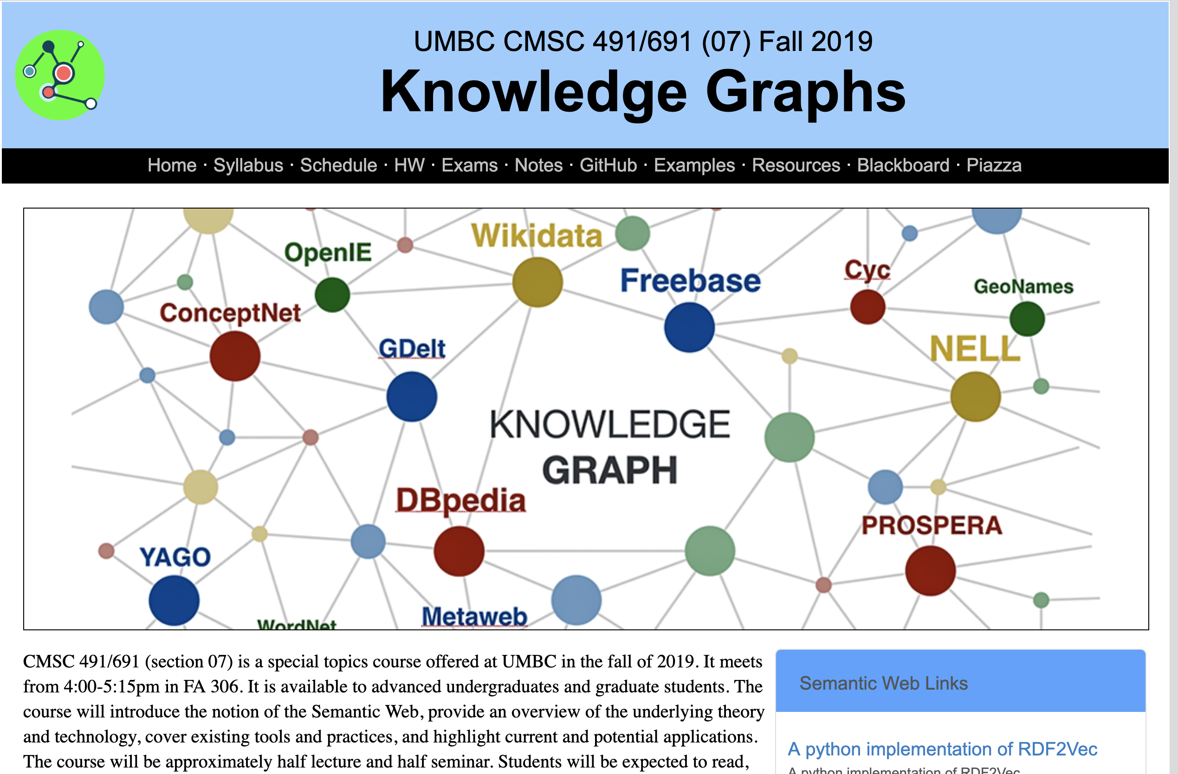
Web Site: http://bit.ly/691f19

