Slide 1
Introduction to the
Semantic Web example applications

Slide 2
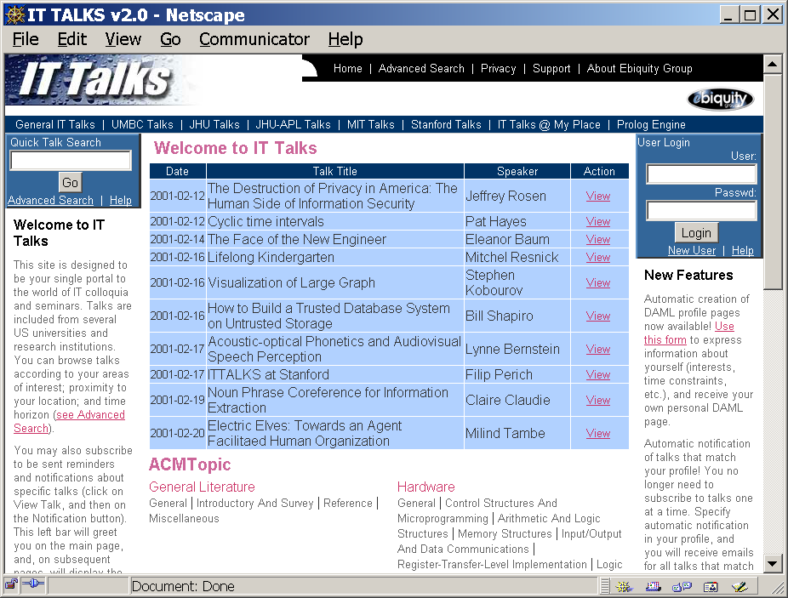
ITTALKS
ITTALKS is a database driven web
site of IT related talks at UMBC and
other institutions. The database
contains information on
  Seminar events
  People (speakers, hosts, users, …)
  Places (rooms, institutions, …)
Web pages with DAML markup are generated
The DAML markup supports agent-based services relating to these talks.
Users get talk announcements based on the interests, locations and schedules.
http://ittalks.org/

Slide 3
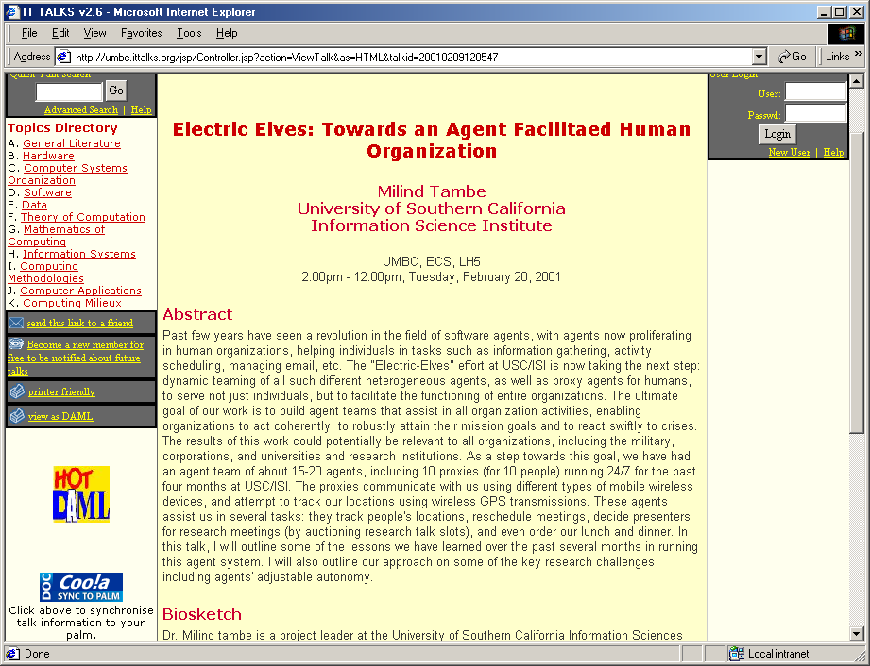
human
view

Slide 4
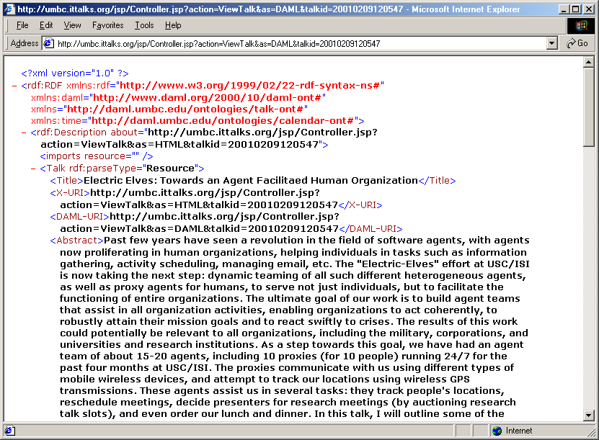
machine
view

Slide 5

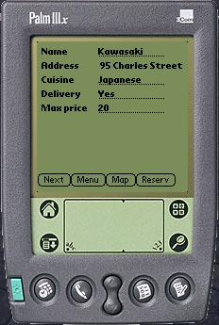


ITTALKS Architecture
Web server + Java servlets
Web Services
People
MapBlast, CiteSeer,
Google, …
HTTP
Email, HTML,
SMS, WAP
HTTP, WebScraping
Apache
Tomcat
FIPA ACL, KQML, DAML
Agents
RDBMS
SQL
DB
<daml>
</daml>
HTTP, KQML, DAML, Prolog
<daml>
</daml>
<daml>
</daml>
DAML
reasoning
engine
<daml>
</daml>
Databases
DAML files

Slide 6


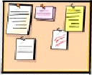



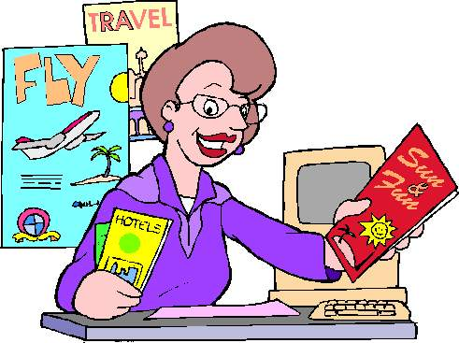


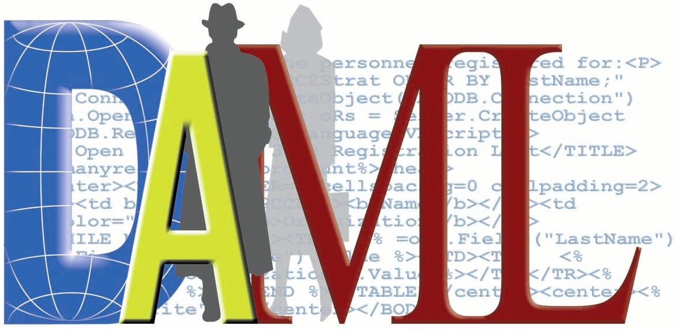



TAGA
Travel Agent Game in Agentcities
Motivation
Market dynamics
Auction theory (TAC)
Semantic web
Agent collaboration (FIPA & Agentcities)
Features
Open Market Framework
Auction Services
OWL message content
OWL Ontologies
Global Agent Community
Technologies
FIPA (JADE, April Agent Platform)
Semantic Web (RDF, OWL)
Web (SOAP,WSDL,DAML-S)
Internet (Java Web Start )
Ontologies
http://taga.umbc.edu/ontologies/
travel.owl – travel concepts
fipaowl.owl – FIPA content lang.
auction.owl – auction services
tagaql.owl – query language
Report Contract
Report Direct Buy Transactions
Report Auction Transactions
Market Oversight
Agent
Request
CFP
Bid
Bulletin Board
Agent
Report Travel Package
Bid
Auction Service
Agent
Customer
Agent
Proposal
Direct Buy
Travel Agents
Web Service
Agents
FIPA platform infrastructure services, including directory facilitators enhanced to use DAML-S for service discovery
http://taga.umbc.edu/
Acknowledgements: DARPA contract F30602-00-2-0591 and Fujitsu Laboratories of America.
Students: Y. Zou, L. Ding, H. Chen, R. Pan. Faculty: T. Finin, Y. Peng, A. Joshi, R. Cost. 4/03

Slide 7
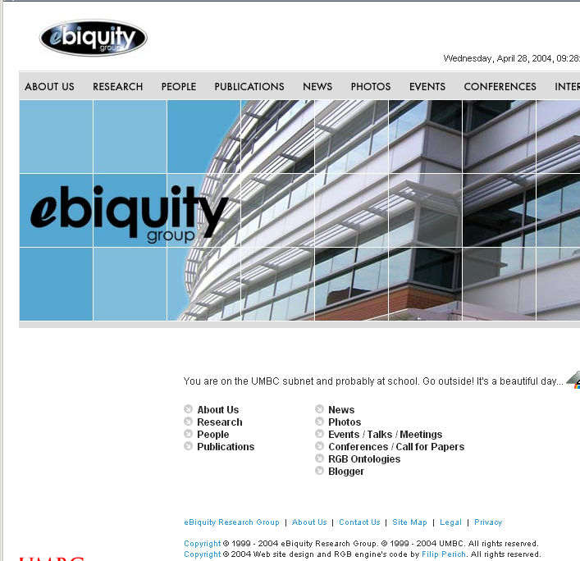
http://ebiquity.umbc.edu/
Our research group’s web site generate both HTML and OWL.
HOW? This is relatively easy since the content is in a database.
PHP is sufficient for the job.
HTML pages have links to corresponding OWL
WHY? This exposes the information to programs and agents – no more web scraping.

Slide 8
Mobile & Pervasive Computing Uses

Slide 9
How does OWL Help?
ontology
language
context
model
service
description
lang.
{ PerCom }
meta lang
(policy)
interop
language
XSLT/XML
friendly
OWL provided a uniformed language which met many needs in developing a complex pervasive computing system.

Slide 10

OWL as an Ontology Language
Key Benefits
  Helps to separate the task of knowledge engineering and system engineering
  Helps to define “semantic” specifications for applications that exploit KR and reasoning
  Opens the door to the Semantic Web for mobile and pervasive computing applications
    Gaining access to a vast amount of information on the Web
    Applications will be less restricted by their sensing capability

Slide 11
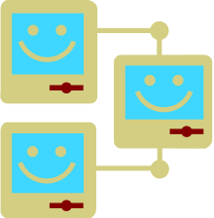
OWL as a Service Description Lang.
Key benefits
  Enables semantic service discovery and matching
    Expressing more detailed and more precise service description
  Provides a means for ubiquitous service composition
  Allows intelligent applications to have fine-grain control over system execution
    E.g. is it economic to print using a close by printer?
    E.g. is it polite to display my email using the room’s project?

Slide 12

OWL as a Language for Interoperability
Key benefits
  Encourages independently developed systems to interoperate
    A standard language backed up the W3C
    Industrial organizations tend to follow W3C standards
    Amateurs tend to develop programs based on W3C standards
  Enables knowledge sharing and reasoning
    APIs for processing RDF/XML -- the normative exchange syntax of OWL -- are widely available and suitable for building commercial strength applications
    OWL has well defined language semantics for building OWL reasoners. A few number of OWL reasoners are now available.
  Provides standard constructs for ontology mapping
    Multiple ontologies will likely to exist in a shared PerCom space
    Ontology mapping can help apps. that adopt different ontologies to interoperate

Slide 13
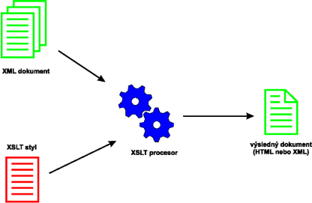
OWL is XSLT/XML Friendly
Key benefits
  Information expressed in OWL can be transformed into other languages for external processing
    OWL => Prolog rules or Jess rules
    OWL => XHTML
    OWL => PHP, JavaScript
  Maximizes the reusability of the knowledge that is encoded in OWL
    Not all useful tools and applications can process OWL
    Not all XML developers are willing to switch to OWL
    Not all users think OWL (esp. in RDF/XML) is easily readable

Slide 14
OWL as a Meta Language
Key benefits
  Helps to define new languages to control the high level behavior of a complex system (e.g. policy languages)
    It’s inflexible to adjust the dynamic behavior of a complex system by writing low level code
    Using meta languages, users can change system behavior without needing to change the low-level system implementation
  Meta languages (e.g. policy) defined using OWL can be used to work with other knowledge that is expressed in OWL
    Security -- define policy to control actions that are expressed in OWL
    Privacy protection -- define policy to protect user private information that are expressed in OWL

Slide 15
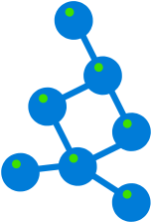
OWL for Defining Context Model
Key benefits
  Helps to overcome semantic ambiguities in representing contexts using programming languages
    Java representations of contextual knowledge has limited expressiveness
    OWL representations have well defined semantics
  Encourages the reuse of previously defined context model
    Generic context models (e.g., time, space, actions, policy) can shared and reused by different context-aware systems
    Tools (e.g., reasoners, APIs) associated with these generic context models often can also be used by different system implementations

Slide 16
Ontology-Driven PerCom Systems
How Different Systems Use Ontology
 | Context modeling | Interop. Language | Define Meta-Lang. (Policy) | Enhance service discovery | XML/XSLT Integration
myCampus (CMU) | X | X | X |  | X
Task Computing (Fujitsu) |  | X |  | X
EasyMeeting (UMBC) | X | X | X
Context Broker Architecture (UMBC) | X | X | X

Slide 17

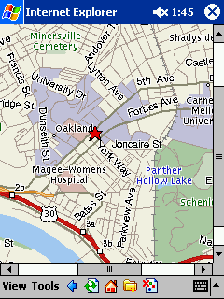
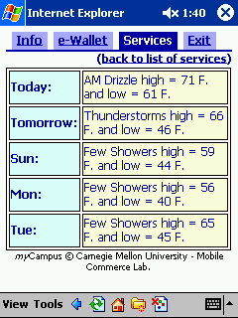
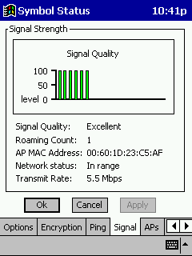
CMU MyCampus Project
Objective: Enhance campus life through context-aware services accessible over the WLAN
Ontologies
  Personal/contextual: location, calendar, organizational etc.
  Privacy preferences: who has access to what, “obfuscation” rules
  Web services: automated service identification and access (OWL-S)
http://www.cs.cmu.edu/~sadeh/mycampus.htm#Video

Slide 18




MyCampus Architecture
Contextual
Ontologies
Personal
Preference
Ontologies
Personal
Resource
Ontologies
Service
Ontologies
Semantic
Web-enabled
Context Resources
User’s Personal
Environment
Internet and Intranet Semantic Web-enabled Services
Calendar
e-Wallet
Personal Resource
Directory
(incl. Privacy Pref.)
Location Tracking
Semantic Web
Service Directory
Wireless LAN
Social Context
Preferences
Task-Specific
Agents
Copyright © 2001-2004 Norman Sadeh

Slide 19



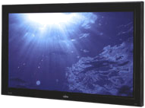





Fujitsu Task Computing
http://www.taskcomputing.org/
Objective: Make computing available throughout the physical environment while it is effectively invisible to the users
Play Jeff’s Video
Dial Contact from Outlook
Weather Info of FLA, CP
…
e-Services
Device
OS/Application
Dial
Dial
Video from DV
Video from DV
Open
Open
Save
Save
Print
Print
Add into Outlook
Add into Outlook
Aerial Photo of
Aerial Photo of
Weather Info of
Weather Info of
Play (Audio)
Play (Audio)
Play (Video)
Play (Video)
View
View
Jeff’s Video
Jeff’s Video
Contact from Outlook
Contact from Outlook
Web Pages
Devices
OS/Application

Slide 20
STEER-SIS for Web Services
User
SVG/JavaScript
HTML/VBScript
Web Service Calls
Web Service API
TC Function
Layer
Discovery
Engine
Execution &
Execution Monitoring
Engine
Service
Composition
Engine
Management
Tools
Semantic
Service
Description
Semantic
Service
Description
Semantic
Service
Description
Semantic
Service
Description
Service
Layer
Service
Service
Service
Service
Realization
Layer
Device
E-service
Application
Content

Slide 21
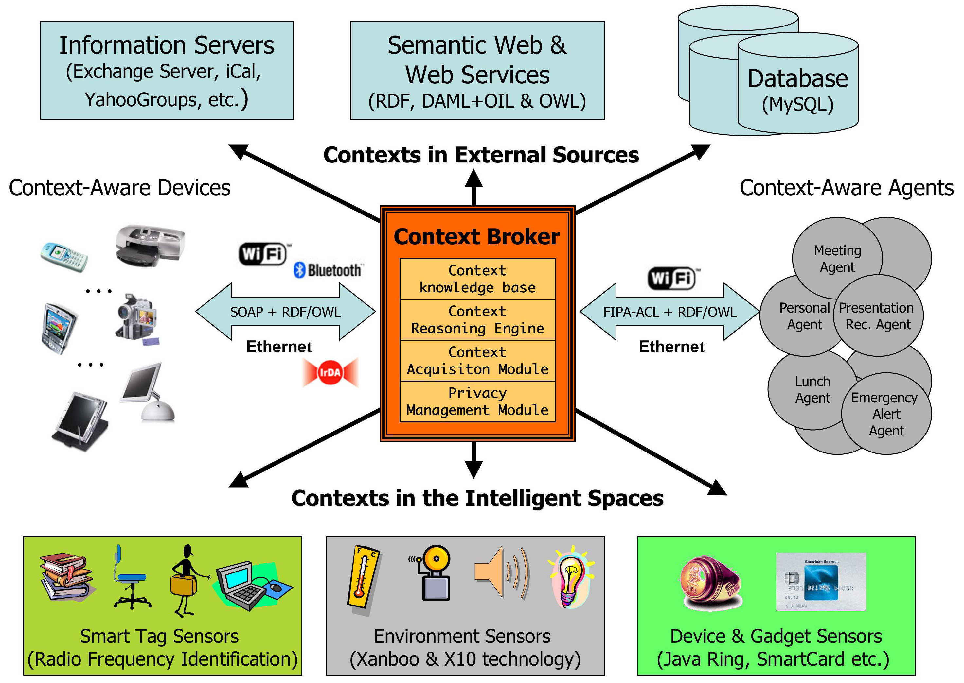
The Context Broker Architecture
http://cobra.umbc.edu/
Access to more
information
Knowledge sharing
Policy

Slide 22
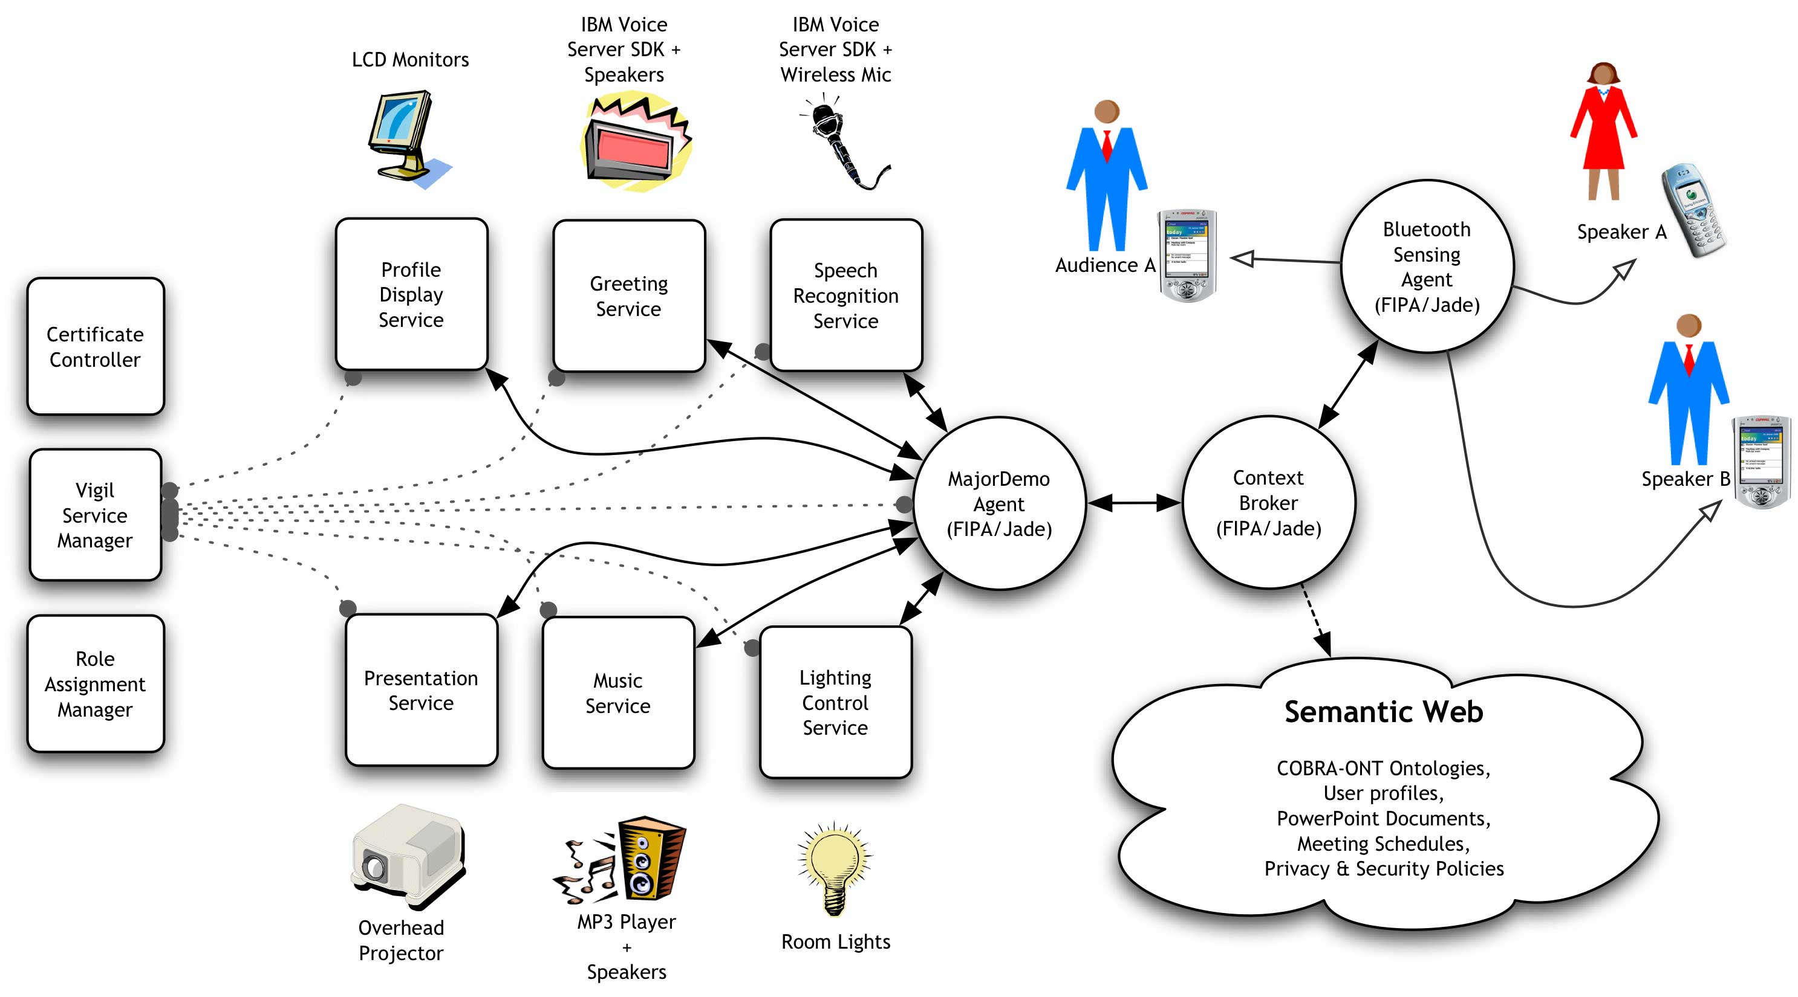
The EasyMeeting System

Slide 23


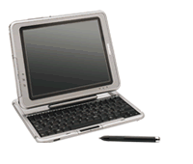

An EasyMeeting Scenario
People enter the conference room
They “beam” their
policy to the broker
The broker builds
the context model
B
B
Web
The broker detects
people presence
Alice’s policy says,
“inform my personal
agent of my location”
The broker tells her
location to her agent
B
»
»
A
»
B
.. isLocatedIn ..
A

Slide 24





An EasyMeeting Scenario
Her agent informs
the broker about her
role and intentions
Alice’s policy says,
“can share with any
agents in the room”
The broker informs
the subscribed agents
+
B
A
The Greeting Srv. greets
Alice & the others
When all expected
participants hv arrived
The projector agent
sets up the slides
Hello! [xyz]
OFF
DIM

Slide 25
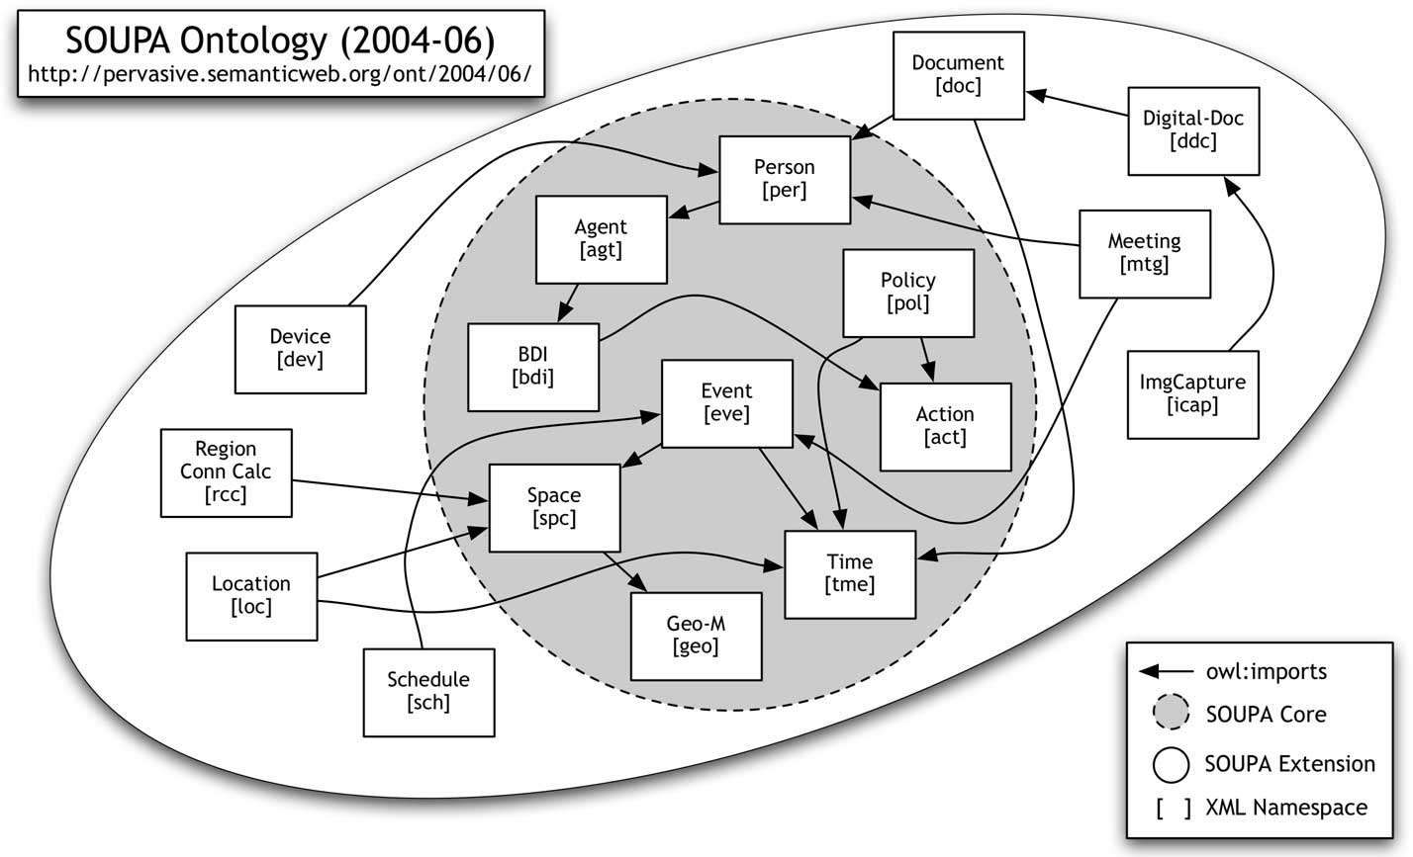
The SOUPA Ontology

