Slide 1

Chapter 2 RDF Syntax 2

Slide 2
Topics
Basic concepts of RDF
Resources, properties, values, statements, triples
URIs and URIrefs
RDF graphs
Literals, qnames
Vocabularies and modeling
Vocabularies
Blank nodes, data modeling, types, reification
Lists, bags, collections
Serialization of RDF graphs
XML, Turtle, Ntriples
Critique of RDF

Slide 3
Types

Slide 4
RDF type
RDF has a type predicate that links a resource to another that denotes its type
ex:john rdf:type foaf:Person .
<http://example.org/john > <http://www.w3.org/1999/02/22-rdf-syntax-ns#type> <http://xmlns.com/foaf/0.1/Person> .
RDFS adds sub-type concept & constraints between predicates & types of their arguments
OWL adds still more concepts operating on types

Slide 5
Data Modeling

Slide 6
Structured Values in RDF
Given the triple like:
ex:857 exstaff:address "15 Grant Ave, Bedford, MA 01730".
How can we best represent separate informa- tion for the street, city, state and zip code?
Two possibilities:
Use four predicates (e.g., exstaff:street_address, …) to associate values with exstaff:857
Create an address resource to attach the four predicates to and link that to exstaff:address with the ex:address predicate

Slide 7
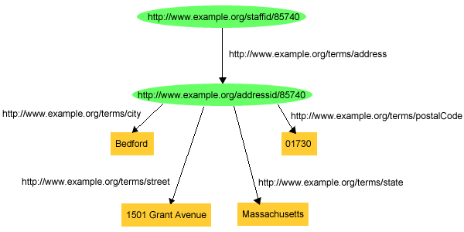
Structured Values in RDF

Slide 8
Structured Values in RDF
Pr as triples:
exstaff:85740 exterms:address exaddressid:85740 .
exaddressid:85740 exterms:street "1501 Grant Ave" .
exaddressid:85740 exterms:city "Bedford" .
exaddressid:85740 exterms:state "MD" .
exaddressid:85740 exterms:postalCode "01730" .

Slide 9
Structured Values in RDF
This approach involves adding many “inter-mediate” URIrefs (e.g., exaddressid:85740) for aggregate concepts like John's address
Such concepts may never need to be referred to directly from outside a particular graph, and hence may not require “universal” identifiers
RDF allows us to use blank nodes and blank node identifiers to deal with this issue
Node IDs in the _ namespace are bnodes, e.g. _:

Slide 10
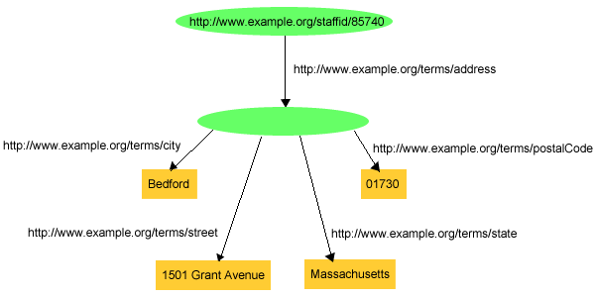
Blank Node, aka bnode

Slide 11
Blank Nodes Using Triples
exstaff:85740 exterms:address ?? .
?? exterms:postalCode "01730" .
Exstaff:72120 exterms:address ??? .
??? exterms:postalCode "01702" .
We want to ensure that the bnodes for 85740’s and 72120’s addresses are distinct
The graphical notation does this by using two different objects for the bnodes
RDF allows us to assign an special ID to a bnode while still maintaining its blank node nature

Slide 12
Blank Node Identifiers
exstaff:85740 exterms:address _:johnaddress .
_:johnaddress exterms:street "1501 Grant Avenue" .
_:johnaddress exterms:postalCode "01730" .
Distinct bnode must have different bnode ids
Bnode ids have significance only in a single graph
dbpedia:Alan_Turing refers to the same thing in every graph, but a bnode _:1 in two different graphs may not
Merging two graphs requires us to rename their bnode ids to avoid accidental conflation (e.g., _:1 => _:100)
Bnode ids may only appear as subjects or objects and not as predicates in triples

Slide 13
Semantics of Blank Nodes
In terms of first-order logic, blank nodes correspond to existentially quantified variables
Another example: “John’s mother is 50”
FOL: ∃x mother(john, x) ∧ age(x, 50)
RDF: :john :mother _32 . :_32 :age “50” .
:john
:mother
:age
“50”

Slide 14
Blank nodes are good for
Representing n-ary relationships in RDF
e.g., the relationship between John Smith and the street, city, state, and postal code components of his address
To make statements about resources that don’t have URIs but are described by relationships with other resources that do
e.g., John’s mother

Slide 15
Example
To make statements about Jane Smith we could use her email address URI (mailto:jane@example.org) to denote her
Well, if we do so, how are we going to record information both about Jane's mailbox (e.g., the server it is on) as well as about Jane herself (e.g., her current physical address)? Similarly, if we use her Web page URI etc.

Slide 16
Bnode Example
When Jane herself does not have a URI, a blank node provides a better way of modeling this situation
_:jane exterms:mailbox <mailto:jane@example.org> .
_:jane rdf:type exterms:Person .
_:jane exterms:name "Jane Smith" .
_:jane exterms:empID "23748" .
_:jane exterms:age "26" .

Slide 17
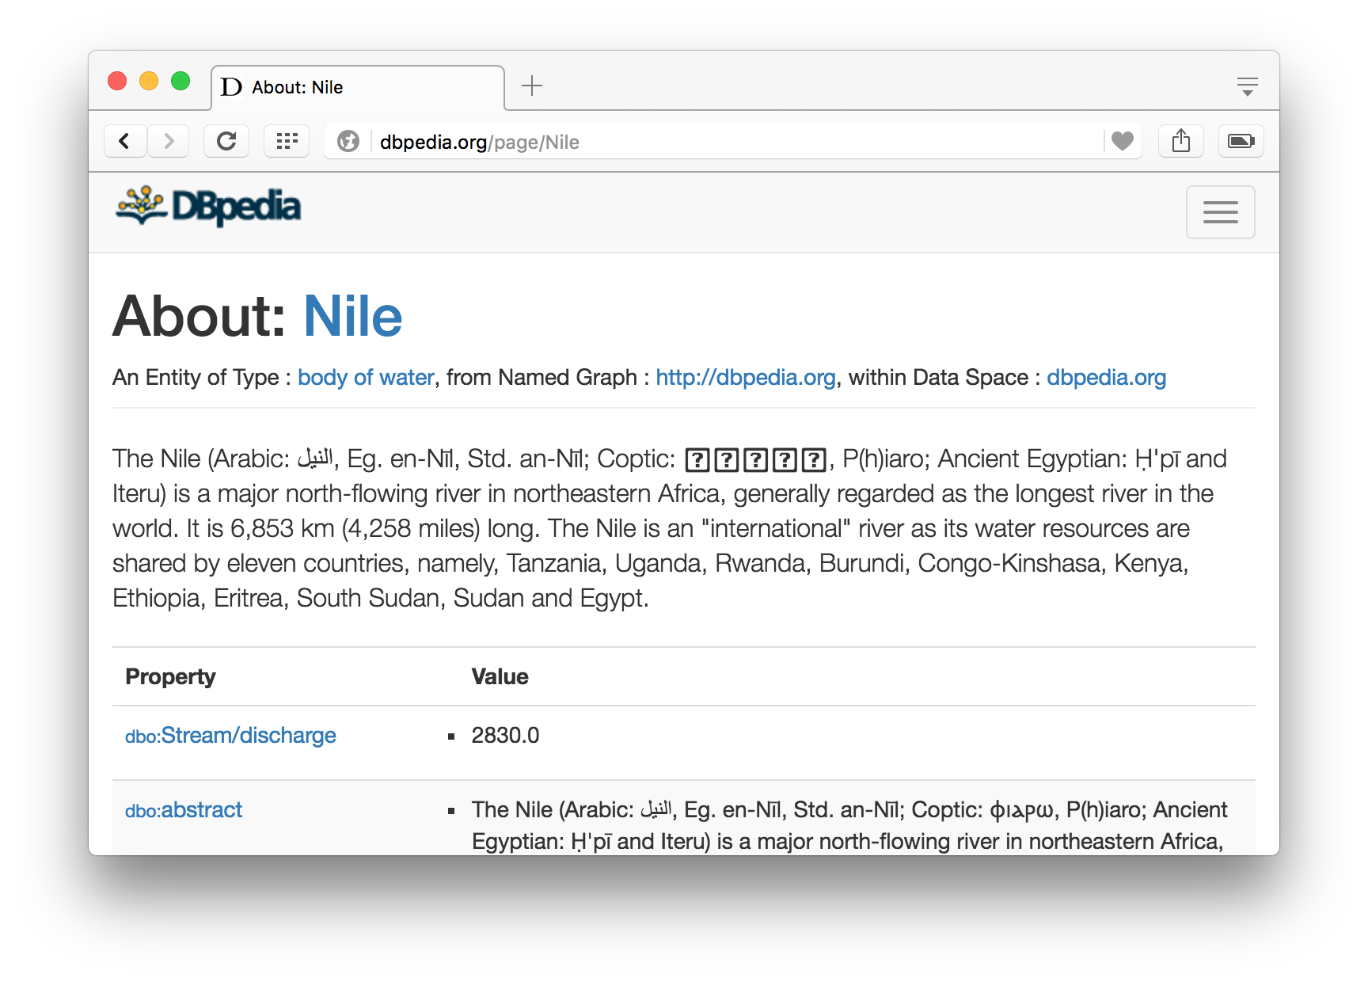
Another use case: Measurements
What does this mean?
dbr:Nile dbp:length "6853"^^xsd:integer
Click on dbp:length to see its definition

Slide 18
Another use case: Measurements
What does this mean?
dbr:Nile dbp:length "6853"^^xsd:integer
We can click on dbp:length to see its definition
dbp:length rdf:type rdf:Property .
dbp:length rdfs:label "Length"@en .
Unfortunately, the definition doesn’t specify the unit of measurement ☹

Slide 19
Another use case: Measurements
What does this mean?
dbr:Nile dbp:length "6853"^^xsd:integer
Measurements typically have a numeric value and a unit
Weight: 2.4 pounds vs. 2.4 kilograms
Length: 5 miles vs. 5 kilometers
Price: 29.00 in US Dollars vs. 21.16 Euro
Time: 30 years vs. 3 milliseconds
We can use a bnode to represent a measurement as a pair with a value and unit

Slide 20
Measurements
Nile
What does this mean?
dbr:Nile dbp:length _:1 .
_:1 rdf:type ex:Measure .
_:1 rdf:value ”6853"^^xsd:integer .
_:1 un:units dbr:Kilometre .
The RDF namespace has a value property but assigns no specific meaning to it
ex:Measure
dbp:length
rdf:type
un:unit
rdf:value
dbr:Kilometre
6853

Slide 21
Serialization

Slide 22
RDF Serialization
Abstract model for RDF is a graph
Serialize as text for exchange, storage, viewing and editing in text editors
The big three
XML/RDF – the original
Ntriples – simple, but verbose; good for processing
Turtle – compact, easy for people to read and write
Special formats
Trig – a format for named graphs
RDFa – embed RDF in HTML attributes
JSON-LD – RDF statements as a JSON object

Slide 23
XML encoding for RDF
<rdf:RDF xmlns:rdf="http://www.w3.org/1999/02/22-rdf-syntax-ns#"
xmlns:dc="http://purl.org/dc/elements/1.1/"
xmlns:bib="http://daml.umbc.edu/ontologies/bib/">
<rdf:Description about="http://umbc.edu/~finin/talks/idm02/">
<dc:title>Intelligent Information Systems on the Web </dc:Title>
<dc:creator>
<rdf:Description >
<bib:name>Tim Finin</bib:Name>
<bib:email>finin@umbc.edu</bib:Email>
<bib:aff resource="http://umbc.edu/" />
</rdf:Description>
</dc:creator>
</rdfdescription>
</rdf:RDF>
RDF/XML is a W3C
Standard widely used for storage and exchange
Being supplanted by other forms
Complex and confusing so we won’t spend time on it

Slide 24
Ntriples
Good for ingesting into a program or store
Sequence of triples each terminated with a “.”
URIs encased in angle brackets; no QNames; literals in double quotes
Trivial to parse/generate; common download format for RDF datasets (e.g., DBpedia)
Uses lots of characters due to repeated URLs, but compresses well
W3C Specification
<http://example.org/Turing><http://www.w3.org/1999/02/22-rdf-syntax-ns#type> <http://xmlns.com/foaf/0.1/Person> .
<http://example.org/Turing> <http://xmlns.com/foaf/0.1/name> "Alan Turing" .
<http://www.w3.org/2001/sw/RDFCore/ntriples/> <http://xmlns.com/foaf/0.1/mbox> <mailto:alan@turing.org> .

Slide 25
Turtle
Ntriples ⊂ Turtle ⊂ N3
Compact, easy to read and write and parse
Qnames, [ ] notation for blank nodes, ; and ,
@prefix rdf: <http://www.w3.org/1999/02/22-rdf-syntax-ns#> .
@prefix dc: <http://purl.org/dc/elements/1.1/> .
@prefix foaf: <http://xmlns.com/foaf/0.1/> .
<http://www.w3.org/TR/rdf-syntax-grammar>
dc:title "RDF/XML Syntax Specification (Revised)" ;
dc:creator [ foaf:name "Dave Beckett";
foaf:mbox <mailto:dave@beckett.org> , <mailto:dbeck@gmail.com> ] .

Slide 26
Some details
@PREFIX lines define namespace abbreviations
Basic pattern is
Subj pred1 value1;
pred2 value2;
pred3 value3, value4 .
Special notation for the rdf:type predicate
:john a foaf:Person; foaf:name "John Smith" .
Special notation for anonymous bnodes
:john foaf:knows [ a foaf:Person; foaf:nick "Bob" ].

Slide 27
Notation3 or N3
N3 was an early turtle-like notation developed by Sir Tim_Berners Lee himself
Included support for inference rules
See CWM for software
Never became a recommended W3C standard
Some of its features were problematic for OWL
Supplanted by Turtle

Slide 28
Try…
Some simple RDF serialization examples
Simple.ttl
# A simple Turtle example
@prefix foaf: <http://xmlns.com/foaf/0.1/> .
@prefix : <#> .
:john a foaf:Person;
foaf:gender "Male";
foaf:name "John Smith", "Johnny Smith";
foaf:knows :mary,
[a foaf:Person;
foaf:mbox <mailto:mary.smith@gmail.com>] .
:mary a foaf:Person;
foaf:name "Mary Smith" .

Slide 29
Notation translation
Most modern Semantic Web software can read and write rdf in all major serializations
E.g., Protégé, Jena, Sesame,
There are also simple programs that can convert between them
rdf2rdf is an example written in Java

Slide 30
Reification

Slide 31
Reification
Sometimes we wish to make statements about other statements
E.g., to record provenance data, probability, or to assert :john :believes { :mary :loves :john }
We must be able to refer to a statement using an identifier
RDF allows such reference through a reification mechanism which turns a statement into a resource

Slide 32
Reify
Etymology: Latin res thing
Date: 1854
To regard (something abstract) as a material or concrete thing

Slide 33
Wikipedia: reification (computer science)
Reification is the act of making an abstract con-cept or low-level implementation detail of a pro-gramming language accessible to the program-mer, often as a first-class object. For example,
The C programming language reifies the low-level detail of memory addresses
The Scheme programming language reifies continua-tions (approximately, the call stack)
In C#, reification is used to make parametric polymor-phism implemented as generics a first-class feature of the language
…

Slide 34
Reification Example
:949352 uni:name “Grigoris Antoniou” .
reifies as
[a rdf:Statement; rdf:subject: :949352 rdf:predicate uni:name; rdf:object “Grigoris Antoniou” ] .

Slide 35
Reification Example
<rdf:Description rdf:about="#949352”>
<uni:name>Grigoris Antoniou</uni:name>
</rdf:Description>
reifies as
<rdf:Statement rdf:ID="StatementAbout949352">
<rdf:subject rdf:resource="#949352"/>
<rdf:predicate rdf:resource="http://example.org/uni-ns#name"/>
<rdf:object>Grigoris Antoniou</rdf:object>
</rdf:Statement>

Slide 36
Another reification example
“Alice suspects that Bob loves Carol”
@prefix ep: <http://example.com/epistimology>
@prefix rdf: <http://www.w3.org/1999/02/22-rdf-syntax-ns#>.
@prefix xsd: http://www.w3.org/2001/XMLSchema
:bob :loves :carol .
[:alice ep:believes
[a rdf:Statement;
rdf:subject :bob;
rdf:predicate :loves;
rdf:object :carol;
ex:certainty “0.50”^^xsd:integer]

Slide 37
Reification
rdf:subject, rdf:predicate & rdf:object allow us to access the parts of a statement
The ID of the statement can be used to refer to it, as can be done for any description
We write an rdf:Description if we don’t want to talk about a statement further
We write an rdf:Statement if we wish to refer to a statement

Slide 38
Containers

Slide 39
Container Elements
RDF has some vocabulary to describe collections of things and make statements about them
E.g., we may wish to talk about the courses given by a particular lecturer
The content of container elements are named rdf:_1, rdf:_2, etc.
Alternatively rdf:li
Containers seem a bit messy in RDF, but are needed
:john :teaches [a rdf:Bag; rdf:li :cmsc201, :cmsc202, cmsc345 .] .

Slide 40
Three Types of Container Elements
rdf:Bag an unordered container, allowing multiple occurrences
e.g., members of the faculty, documents in a folder
rdf:Seq an ordered container, which may contain multiple occurrences
e.g., modules of a course, items on an agenda, alphabetized list of staff members
rdf:Alt a set of alternatives
e.g., the document home site and its mirrors, translations of a document in various languages

Slide 41
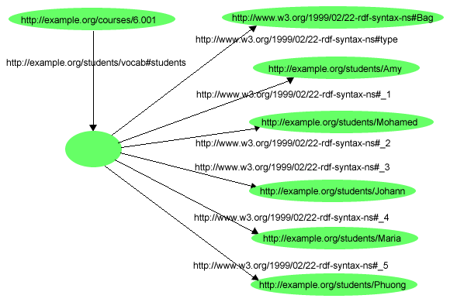
Example for a Bag
Let’s describe a course with a collection of students

Slide 42
Example for a Bag
@prefix rdf: <http://www.w3.org/1999/02/22-rdf-syntax-ns#>.
@prefix s: <http://example.org/students/vocab#>.
<http://example.org/courses/6.001>
s:students [
a rdf:Bag;
rdf:_1 <http://example.org/students/Amy>;
rdf:_2 <http://example.org/students/Mohamed>;
rdf:_3 <http://example.org/students/Johann>;
rdf:_4 <http://example.org/students/Maria>;
rdf:_5 <http://example.org/students/Phuong>.
].

Slide 43
Example for Alternative
<uni:course rdf:ID="CIT1111"
uni:courseName="Discrete Mathematics">
<uni:lecturer>
<rdf:Alt>
<rdf:li rdf:resource="#949352"/>
<rdf:li rdf:resource="#949318"/>
</rdf:Alt>
</uni:lecturer>
</uni:course>

Slide 44
Rdf:ID Attribute for Container Elements
<uni:lecturer rdf:ID="949318"
uni:name="David Billington">
<uni:coursesTaught>
<rdf:Bag rdf:ID="DBcourses">
<rdf:_1 rdf:resource="#CIT1111"/>
<rdf:_2 rdf:resource="#CIT3112"/>
</rdf:Bag>
</uni:coursesTaught>
</uni:lecturer>

Slide 45
Bags and Seqs are never full!
RDF’s semantics is “open world”, so…
Not possible ”to close” the container, to say: “these are all elements, there are no more”
RDF is a graph, with no way to exclude the possibility that there is another graph somewhere describing additional members
Lists are collections with only the specified members mentioned.
Described using a linked list pattern via:
rdf:List, rdf:first, rdf:rest, rdf:nil

Slide 46
Open vs. closed world semantics
Reasoning systems make a distinction between open and closed world semantics
OWS: being unable to prove that something is true or false says nothing about its veracity
CWS: what cannot be proven to be true is false
Default model for Semantic Web is OWS
This was a design decision made early on

Slide 47
Open vs. closed world semantics
Classical logic uses Open World Semantics
Being unable to prove P=NP doesn’t convince us that it’s false
Database systems typically assume CWS
The DB includes all trains between NYC and DC
Prolog’s unprovable operator (not or \+) supports CWS
flys(x) :- bird(x), \+ flightless(x).
flightless(x) :- penguin(x); ostrich(x); emu(x).
Some systems let us specify for which predicates we have complete knowledge and for which we don’t
If UMBC’s DB doesn’t list you as registered for CMSC691, you are not registered
UMBC’s DB system knows some of your minors but not all

Slide 48
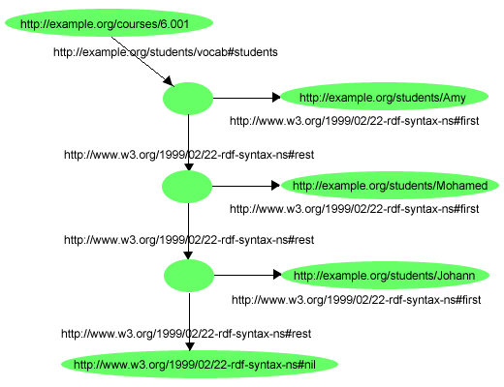
RDF Lists
An ordered list of the three students in a class

Slide 49
RDF Lists
@prefix rdf: <http://www.w3.org/1999/02/22-rdf-syntax-ns#>.
@prefix s: <http://example.org/students/vocab#>.
<http://example.org/courses/6.001>
s:students
[a rdf:List;
rdf:first <http://example.org/students/Amy>;
rdf:rest [a rdf:list
rdf:first <http://example.org/students/Mohamed>;
rdf:rest [a rdf:List;
rdf:first <http://example.org/students/Johann>;
rdf:rest rdf:nil ] ] ] .

Slide 50
RDF Lists
Turtle has special syntax to represent lists:
@prefix rdf: <http://www.w3.org/1999/02/22-rdf-syntax-ns#>.
@prefix s: <http://example.org/students/vocab#>.
<http://example.org/courses/6.001>
s:students (
<http://example.org/students/Amy>
<http://example.org/students/Mohamed>
<http://example.org/students/Johann>
).

Slide 51
Critique of RDF

Slide 52
RDF Critique: Properties
Properties are special kinds of resources
Properties can be used as the object in an object-attribute-value triple (statement)
Defined independent of resources
This possibility offers flexibility
But it is unusual for modelling languages and OO programming languages
It can be confusing for modellers

Slide 53
RDF Critique: Binary Predicates
RDF uses only binary properties
This is a restriction because often we use predicates with more than two arguments
But binary predicates can simulate these
Example: referee(X, Y, Z)
X is the referee in a chess game between players Y and Z

Slide 54
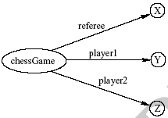
RDF Critique: Binary Predicates
We introduce:
a new auxiliary resource chessGame
the binary predicates ref, player1, and player2
We can represent referee(X,Y,Z) as:

Slide 55
RDF Critique: Reification
The reification mechanism is quite powerful
It appears misplaced in a simple language like RDF
Making statements about statements introduces a level of complexity that is not necessary for a basic layer of the Semantic Web
Instead, it would have appeared more natural to include it in more powerful layers, which provide richer representational capabilities

Slide 56
RDF Critique: Graph Representation
The simple graph or network representation has more drawbacks
Linear languages introduce ways to represent this with parentheses or a way to represent a block structure
Scoping, for example, is clumsy at best in RDF
believe(john, and (love(bob, carol), love(carol, bob))
Some of these are addressed through the notion of a named graph in RDF

Slide 57
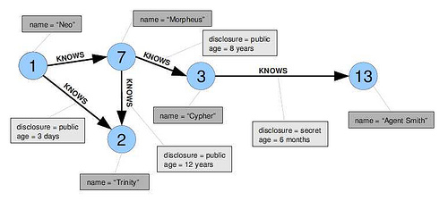
RDF graph model is simple
RDF’s graph model is a simple one
Neo4J is a popular graph database where both nodes and links can have properties

Slide 58
RDF Critique: Summary
RDF has its idiosyncrasies and is not an optimal modeling language but
It is already a de facto standard
It has sufficient expressive power
Reasonable foundation on which to build
Using RDF offers the benefit that information maps unambiguously to a model

Slide 59
Conclusion

Slide 60
Topics
Basic concepts of RDF
Resources, properties, values, statements, triples
URIs and URIrefs
RDF graphs
Literals, qnames
Vocabularies and modeling
Vocabularies
Blank nodes, data modeling, types, reification
Lists, bags, collections
Serialization of RDF graphs
XML, Turtle, Ntriples
Critique of RDF

