Slide 1
Ontology Editors

Slide 2
IDEs for Ontologies
Some people use simple text editors
Working with XML serialization will drive you crazy
Using Turtle or an abstract syntax works well
Others prefer an IDE
Good IDEs include support for reasoning, visualization, and more
Protégé is a very popular IDE
From Stanford, free, lots of plugins
TopQuadrant Composer is also good
Feature rich but expensive ($600 for a single license)

Slide 3
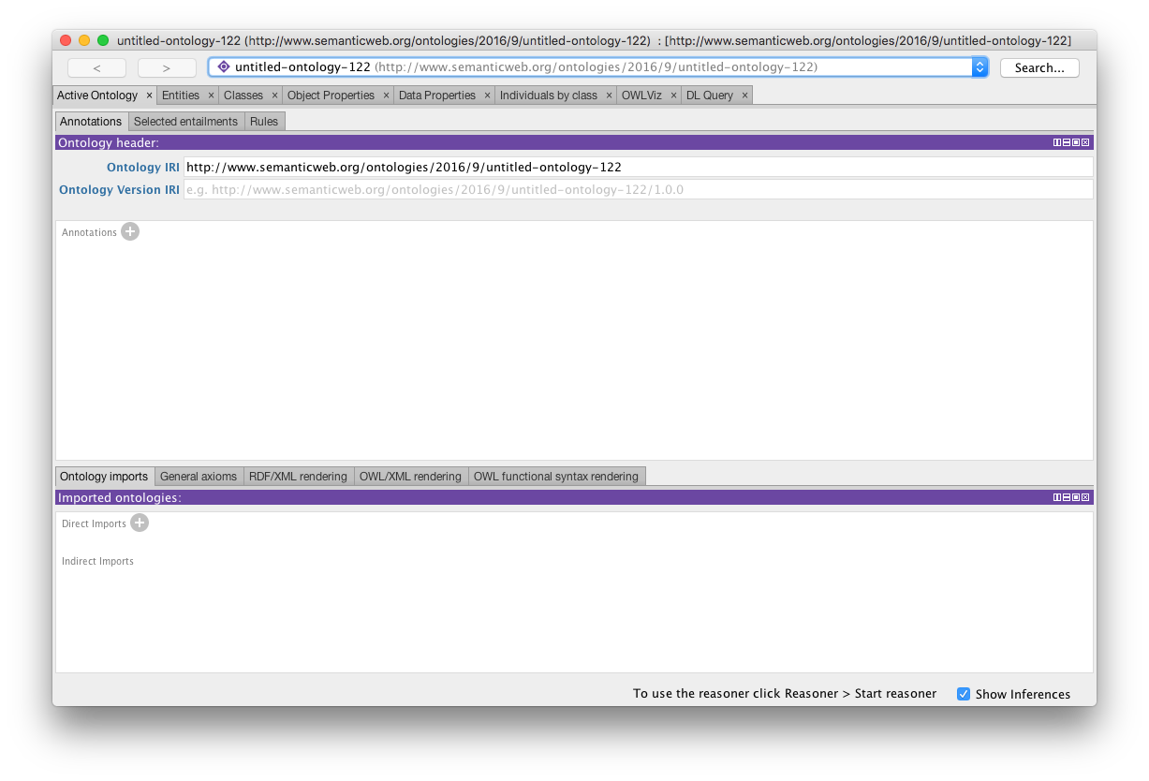
Protégé 5.1

Slide 4
Protégé 5.2
http://protege.stanford.edu/
Free, open source ontology editor and KB framework
Predates OWL, still supports earlier Frames representation
In Java, extensible, large community of users
Desktop and Web versions
Works will under Linux, Mac OS X and Windows

Slide 5
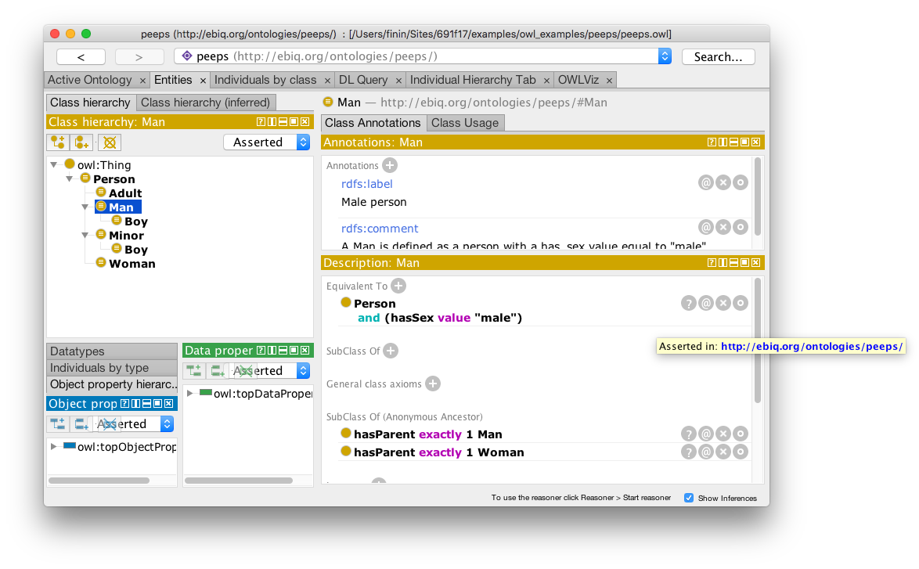
Desktop Protégé

Slide 6
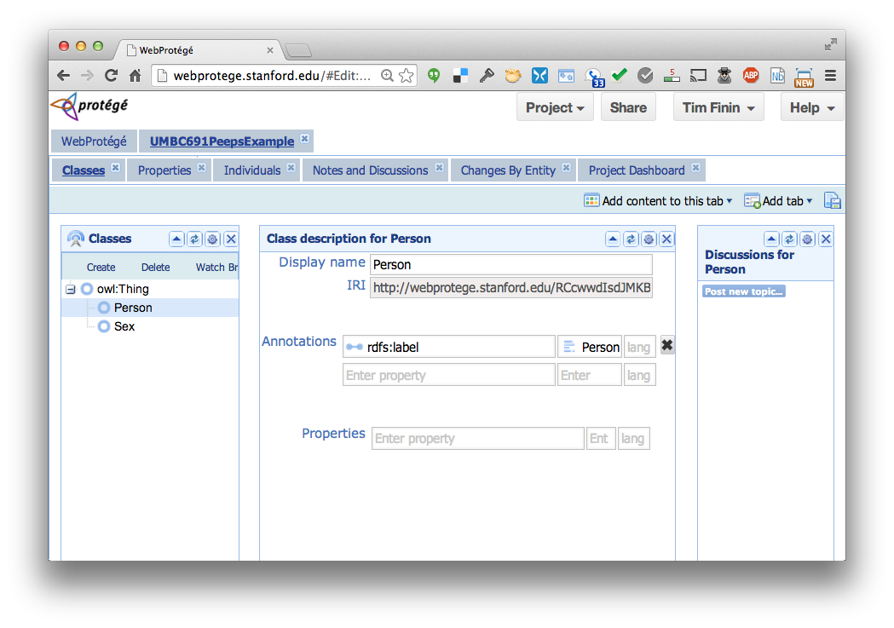
Web Protégé

Slide 7
YAS: Yet Another Syntax
Neither OWL's official abstract syntax nor XML serialization is easy to read or use
Protégé uses the Manchester syntax
Simpler and more compact: “some” and “only”, not “someValuesFrom” and “allValuesFrom”
A W3C recommendation (http://bit.ly/manSyn), used in the OWL 2 Primer (http://bit.ly/OWL2Pri)
Class: man
Annotations: rdfs:label "man"
EquivalentTo: adult and male and person

Slide 8
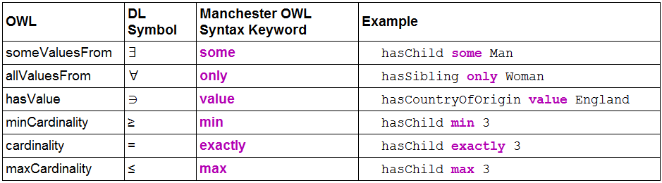
Manchester OWL syntax

Slide 9
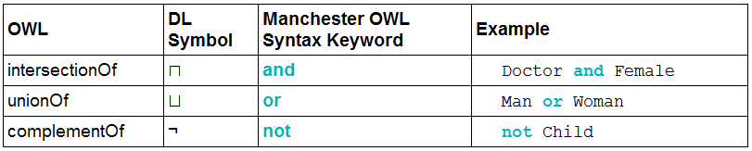
Manchester OWL syntax

Slide 10
Example
Person and
hasChild some
(Person and
(hasChild only Man) and
(hasChild some Person))
The set of people who have at least one child that has some children that are only men (i.e., grandparents that only have grandsons)

Slide 11
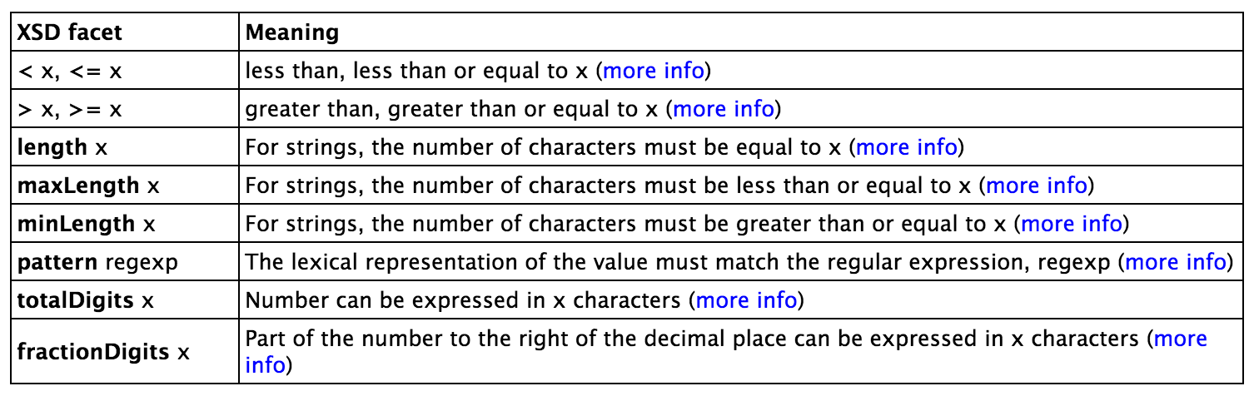
Data values and datatypes
Data values typed or untyped (e.g., int, boolean, float)
Constants with or w/o type, e.g.: hasAge value "21"^^long
Use datatype names as classes: hasAge some int
XSD facets, e.g.: Person and hasAge some int[>= 65]
Ranges: Person and hasAge some int[>= 18, <= 30]

Slide 12
Demonstration
We’ll use Protégé OWL v5.2 to implement a tiny ontology for people
Start by downloading and installing Protégé 5.2(You will need Java)
You may want to install Graphviz
Configure Protégé
E.g., select a reasoner to use (e.g., HermiT)

Slide 13
A basic workflow
Think about usecases
Preliminaries
Choose namespace URL, import other ontologies used
Identify and define classes
Place in hierarchy, add axioms and run reasoner to check for errors or omissions
Identify and define properties
Place in hierarchy, add axioms, run reasoner
Add individuals & reasoner to check for problems
Add comments and labels
Export in desired formats, maybe upload to Web

Slide 14
More workflow steps
Use OOPS to find common ontology pitfalls
Link concepts (and individuals) to common ontologies (e.g., DBpedia, Freebase, foaf)
Use owl:sameAs
Generate visualizations
Produce documentation
Develop examples with your use case(s)
Encode data, describe in VoID (Vocabulary of Interlinked Datasets), add to LOD cloud

Slide 15
Demonstration/HW4
Use Protégé OWL (v5.2) to build a simple ontology for people based on the following
People have just one sex that’s either male or female, an integer age, and two parents, one male, one female
A person’s grandparent is the parent of their parent
Every person is either a man or a woman but not both
A man is defined as any person whose sex is male and a woman as any person whose sex is female
A boy is defined as a person whose sex is male and whose age is less than 18, a girl is …
A person is either an adult or (age >18), minor (age <18), …

Slide 16
Test cases
AllDifferent people
Alice F
Bob M
Carol F
Don M
Edith F
Pat ?
Other people
Frank M
Gwen F
Some possible test cases
Alice parent Bob . Bob parent Carol
Alice grandparent Carol
Alice parent Bob . Alice parent Don.
Contradiction
Alice parent Bob . Pat parent Bob
Pat a female
Alice parent Bob . Gwen parent Bob .
Alice owl:sameAs Gwen

