Slide 1
Rules, RIF and RuleML

Slide 2
Rule Knowledge
Rules generalize facts, making them conditional on other facts (often via chaining through further rules)
Rules generalize taxonomies via multiple premises, n-ary predicates, structured arguments, etc.
Two uses of rules: top-down (backward-chaining) and bottom-up (forward-chaining) − represented only once

Slide 3
The interchange approach
W3C’s RDF stack is an integrated solution for encoding & interchanging knowledge
  Supporting OWL (DL) constrains it quite a bit
  E.g., preventing adoption of an OWL rule standard
There are other approaches to standardiz-ing rule languages for knowledge exchange
  RuleML: Rule Markup Language, an XML approach for representing rules
  RIF: Rule Interchange Format, a W3C standard for exchanging rules
Neither tries to be compatible with OWL

Slide 4
Many different rule languages
There are rule languages families: logic, logic programming, production, procedural, etc.
  Instances in a family may differ in their syntax, semantics or other aspects
Jess production rule language
  (defrule r42 (parent ?a ?b) (male ?a)
  => (assert (father ?a ?b)))
Prolog logic programming language
  father(A,B) :- parent(A,B), Male (A).
Common Logic logic format
  (=> (and (parent ?a ?b) (male ?a)) (father ?a ?b))

Slide 5
X Interchange Format
Rather than have N² translators for N languages, we could
  Develop a common rule interchange format
  Let each language do import/export mappings for it
Two modern interchange formats for rules
  RuleML: Rule Markup Language, an XML approach for representing rules
  RIF: Rule Interchange Format, a W3C standard for exchanging rules

Slide 6

RuleML
RuleML's goal: express both forward (bottom-up) and backward (top-down) rules in XML
See http://ruleml.org/
Effort began in 2001 and has informed and been informed by W3C efforts
An “open network of individuals and groups from both industry and academia”

Slide 7
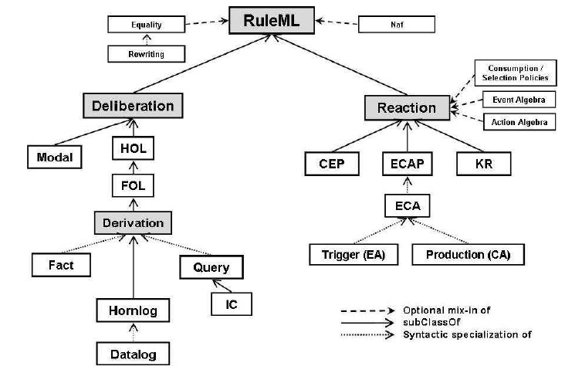
Taxonomy of RuleML rules
from Boley et. al., RuleML 1.0: The Overarching Specification of Web Rules, 2010. http://bit.ly/RuleML

Slide 8
RIF
W3C Rule Interchange Format
Three dialects: Core, BLD, and PRD
  Core: common subset of most rule engines, a "safe" positive datalog with builtins
  BLD (Basic Logic Dialect): adds logic functions, equality and named arguments, ~positive horn logic
  PRD (Production Rules Dialect): adds action with side effects in rule conclusion
Has a mapping to RDF

Slide 9
An example of a RIF rule
From http://w3.org/2005/rules/wiki/Primer
Document(
Prefix(rdfs <http://www.w3.org/2000/01/rdf-schema#>)
Prefix(imdbrel <http://example.com/imdbrelations#>)
Prefix(dbpedia <http://dbpedia.org/ontology/>)
Group(
Forall ?Actor ?Film ?Role (
If And(imdbrel:playsRole(?Actor ?Role)
imdbrel:roleInFilm(?Role ?Film))
Then dbpedia:starring(?Film ?Actor) ) ) )

Slide 10
Another RIF example, with guards
From http://w3.org/2005/rules/wiki/Primer
Document(
Prefix(rdf <http://www.w3.org/1999/02/22-rdf-syntax-ns#>)
Prefix(rdfs <http://www.w3.org/2000/01/rdf-schema#>)
Prefix(imdbrel <http://example.com/imdbrelations#>)
Prefix(dbpedia http://dbpedia.org/ontology/)
Group(
Forall ?Actor ?Film ?Role (
If And(?Actor # imdbrel:Actor
?Film # imdbrel:Film
?Role # imdbrel:Character
imdbrel:playsRole(?Actor ?Role)
imdbrel:roleInFilm(?Role ?Film))
Then dbpedia:starring(?Film ?Actor) )))

Slide 11
Rif document can contain facts
The following will conclude bio:mortal(phil:Socrates)
Document(
Prefix(bio <http://example.com/biology#>)
Prefix(phil <http://example.com/philosophers#>)
Group(
If bio:human(?x)
Then bio:mortal(?x) )
Group(
bio:human(phil:Socrates) ))

Slide 12
Another RIF example (PRD)
From http://w3.org/2005/rules/wiki/Primer
Document(
Prefix(rdfs <http://www.w3.org/2000/01/rdf-schema#>)
Prefix(imdbrelf <http://example.com/fauximdbrelations#>)
Prefix(dbpediaf <http://example.com/fauxibdbrelations>)
Prefix(ibdbrelf <http://example.com/fauxibdbrelations#>)
Group(
Forall ?Actor (
If Or(Exists ?Film (imdbrelf:winAward(?Actor ?Film))
Exists ?Play (ibdbrelf:winAward(?Actor ?Play)) )
Then assert(dbpediaf:awardWinner(?Actor)) )
imdbrelf:winAward(RobertoBenigni LifeIsBeautiful) ))
Notes:
This document has a rule and a fact

Slide 13
Why do we need YAKL
YAKL: Yet another knowledge language
Rules are good for representing knowledge
Rule idioms have powerful features that are not and can not be supported by OWL
  Non-monotonic rules
  Default reasoning
  Arbitrary functions, including some with with side effects
  etc.
Notes:
YA from YACC from Steve Johnson's "Yacc: Yet Another Compiler-Compiler" circa 1970

Slide 14
Non-monotonic rules
Non-monotonic rules use an “unprovable” operator
This can be used to implement default reasoning, e.g.,
  assume P(X) is true for some X unless you can prove hat it is not
  Assume that a bird can fly unless you know it can not

Slide 15
monotonic
canFly(X) :- bird (X)
bird(X) :- eagle(X)
bird(X) :- penguin(X)
eagle(sam)
penguin(tux)

Slide 16
Non-monotonic
canFly(X) :- bird (X), \+ not(canFly(X))
bird(X) :- eagle(X)
bird(X) :- penguin(X)
not(canFly(X)) :- penguin(X)
not(canFly(X)) :- dead(X)
eagle(sam)
penguin(tux)

Slide 17
Default rules in Prolog
In prolog it’s easy to have
  default( ?head :- ?body ).
Expand to
  ?head :- ?body, +\ not(?head) .
So
  default(canFly(X) :- bird(X))
Expands to
  canFly(X) :- bird(X), \+(not(canFly(X))).

Slide 18
Rule priorities
This approach can be extended to implement systems where rules have priorities
This seems to be intuitive to people – used in many human systems
  E.g., University policy overrules Department policy
  The “Ten Commandments” can not be contravened

Slide 19
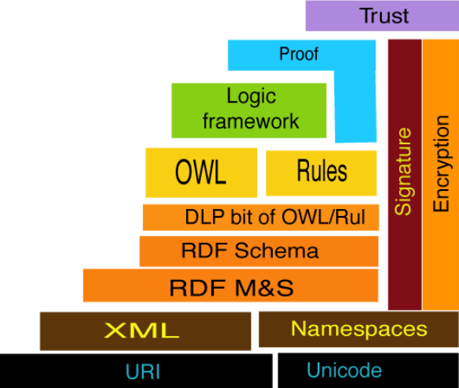
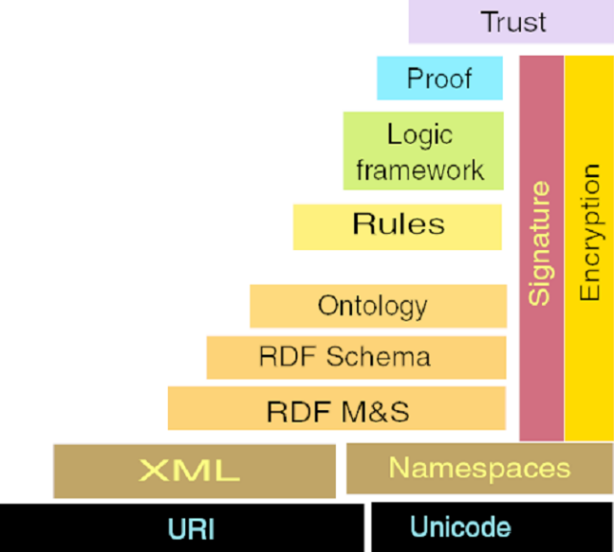
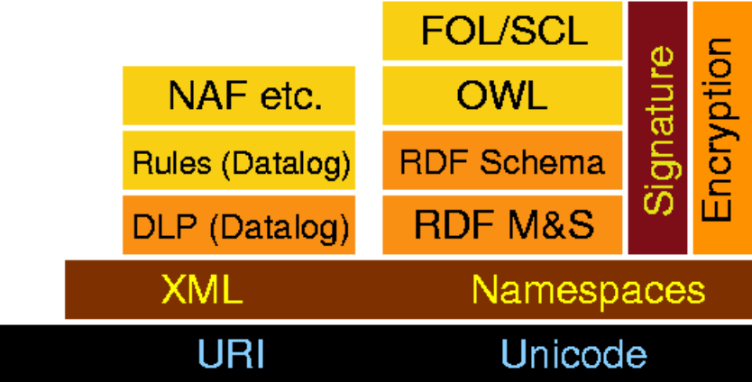
Two Semantic Webs?

Slide 20
Limitations
The rule inference support not integrated with OWL classifier
  New assertions by rules may violate exist-ing restrictions in ontology
  New inferred knowledge from classification may produce knowledge
  useful for rules
Inferred
Knowledge
1
2
Ontology
Classification
Rule Inference
4
Inferred
Knowledge
3

Slide 21
Limitations
Existing solution: solve possible conflicts manually
Ideal solution: a single module for both ontology classification and rule inference
What if we want to combine non-monotonic features with classical logic?
Partial Solutions:
  Answer set programming
  Externally via appropriate rule engines

Slide 22
Summary
Horn logic is a subset of predicate logic that allows efficient reasoning, orthogonal to description logics
Horn logic is the basis of monotonic rules
DLP and SWRL are two important ways of combining OWL with Horn rules.
  DLP is essentially the intersection of OWL and Horn logic
  SWRL is a much richer language

Slide 23
Summary (2)
Nonmonotonic rules are useful in situations where available information is incomplete
They are rules that may be overridden by contrary evidence
Priorities are sometimes used to resolve some conflicts between rules
Representation XML-like languages is straightforward

