Slide 1
OWL, DL and rules
Based on slides from Grigoris Antoniou, Frank van Harmele and Vassilis Papataxiarhis

Slide 2
OWL and Rules
Rule based systems are an important and useful way to represent and reason with knowledge
Adding rules to OWL has proved to be fraught with problems
We’ll look at the underlying issues and two approaches
SWRL: a failed standard that is none the less widely used
RIF: a successful standard that’s not yet widely used

Slide 3
Semantic Web and Logic
The Semantic Web is grounded in logic
But what logic?
OWL Full = Classical first order logic (FOL)
OWL-DL = Description logic
N3 rules ~= logic programming (LP) rules
SWRL ~= DL + LP
Other choices are possible, e.g., default logic, fuzzy logic, probabilistic logics, …
How do these fit together and what are the consequences

Slide 4
We need both structure and rules
OWL’s ontologies based on DL (and thus in FOL)
The Web is an open environment
Reusability / interoperability
An ontology is a model easy to understand
Many rule systems based on logic programming
To achieve decidability, ontology languages don’t offer the expressiveness we want. Rules do it well
Efficient reasoning support already exists
Rules are well-known and often more intuitive

Slide 5
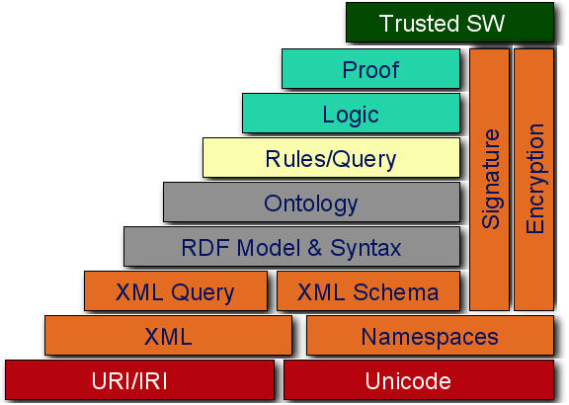
A common approach
High Expressiveness
Rules
Layer
SWRL
Ontology
Layer
OWL-DL
Conceptualization
of the domain

Slide 6
Description Logics vs. Horn Logic
Neither is a subset of the other
Impossible to say that people who study & live in same city are local students in OWL, but can be done using a rule
studies(P,U), lives(P,C), loc(U,C) → localStud(P)
Rules cannot assert the information that every person is either a man or a woman
This is easily expressed in OWL using disjoint union

Slide 7
Basic Difficulties
Classical logic and logic programming differ along several key issues
Monotonic vs. non-monotonic features
Open-world vs. Closed-world assumption
Negation-as-failure vs. classical negation
Non-ground entailment
Strong negation vs. classical negation
Equality
Decidability

Slide 8
What’s Horn clause logic
Prolog and most ‘logic’-oriented rule languages use horn clause logic
Defined by UCLA mathematician Alfred Horn
Horn clauses are a subset of FOL where every sentence is a disjunction of literals (atoms) where at most one is positive
~P V ~Q V ~R V S
~P V ~Q V ~R
Atoms are propositional variables (isRaining) or predicates ( married(alice, ?x))

Slide 9
An alternate formulation
Horn clauses can be re-written using the implication operator
~P V Q = P➔Q
~P V ~Q V R = P ∧ Q ➔R
~P V ~Q = P ∧ Q ➔
What we end up with is ~ “pure prolog”
Single positive atom as the rule conclusion
Conjunction of positive atoms as the rule antecedents (conditions)
No not operator
Atoms can be predicates (e.g., mother(X,Y))

Slide 10
Where are the quantifiers?
Quantifiers (forall, exists) are implicit
Variables in rule head (i.e., conclusion or consequent) are universally quantified
Variables only in rule body (i.e., condition or antecedent) are existentially quantified
Example:
isParent(X) ← hasChild(X,Y)
forAll X: isParent(X) if Exisits Y: hasChild(X,Y)

Slide 11
We can relax this a bit
Head can contain a conjunction of atoms
P ∧Q ← R is equivalent to P←R and Q←R
Body can have disjunctions
P←R∨Q is equivalent to P←R and P←Q
But something are just not allowed:
No disjunction in head
No negation operator, i.e. NOT

Slide 12
Facts & rule conclusions are definite
Definite means not a disjunction
Facts are rule with the trivial true condition
Consider these true facts:
P ∨ Q # either P or Q (or both) are true
P ➔ R # if P is true, then R is true
Q ➔ R # if Q is true, then R is true
What can you conclude?
Can this be expressed in horn logic?
Notes:
R follows since either P or Q is true and both imply that R is true

Slide 13
Facts & rule conclusions are definite
Consider these true facts where not is classical negation rather than “negation as failure”
not(P) ➔ Q, not(Q) ➔P # i.e. P∨Q
P ➔ R, Q ➔ R
A horn clause reasoner can’t prove that either P or Q is necessarily true or false so can’t show that R must be true
Treating not as negation as failure yields a loop
Notes:
This seems to get did of the disjunction, but if we treat not as prolog’s negation as failure, it does not help

Slide 14
Open- vs. closed-world assumption
Logic Programming – CWA
If KB |= a, then KB = KB a
Classical Logic – OWA
It keeps the world open.
KB:
Man ⊑ Person, Woman ⊑ Person
Bob ∈ Man, Mary ∈ Woman
Query: “find all individuals that are not women”

Slide 15
Non-ground entailment
The LP-semantics is defined in terms of minimal Herbrand model, i.e., sets of ground facts
Because of this, Horn clause reasoners can not derive rules, so that can not do general subsumption reasoning

Slide 16
Decidability
The largest obstacle!
Tradeoff between expressiveness and decidability
Facing decidability issues from
In LP: Finiteness of the domain
In classical logic (and thus in DL ): combination of constructs
Problem:
Combination of “simple” DLs and Horn Logic are undecidable. (Levy & Rousset, 1998)

Slide 17
Rules + Ontologies
Still a challenging task!
A number of different approaches exists: SWRL, DLP (Grosof), dl-programs (Eiter), DL-safe rules, Conceptual Logic Programs (CLP), AL-Log, DL+log
Two main strategies:
Tight Semantic Integration (Homogeneous Approaches)
Strict Semantic Separation (Hybrid Approaches)

Slide 18
Homogeneous Approach
Interaction with tight semantic integration
Both ontologies and rules are embedding in a common logical language
No distinction between rule predicates and ontology predicates
Rules may be used for defining classes and properties of the ontology
Example: SWRL, DLP
Ontologies
Rules
RDFS

Slide 19
Hybrid Approach
Integration with strict semantic separation between the two layers
Ontology used to conceptualize the domain
Rules can’t define ontology classes & properties, but some application-specific relations
Communication via a “safe interface”
Example: answer set programming (ASP)
?
Ontologies
Rules
RDFS

Slide 20
SWRL
Semantic Web Rule Language
SWRL is the union of DL and horn logic + many built-in functions (e.g., math)
Submitted to the W3C in 2004, but failed to become a recommendation
W3C pursued a more general solution: RIF
Problem: full SWRL specification leads to undecidability in reasoning
SWRL is well specified and subsets are widely supported (e.g., in Pellet, HermiT)
• SWRL is based on OWL: all rules are expressed in terms of OWL concepts (classes, properties, individuals, literals…).

Slide 21
SWRL
OWL classes are unary predicates, properties are binary ones
Person(?p) ^ sibling(?p,?s) ^ Man(?s) → brother(?p,?s)
As in Prolog, bulit-ins can be booleans or do a computation and unify the result to a variable
swrlb:greaterThan(?age2, ?age1) # age2>age1
swrlb:subtract(?n1,?n2,?diff) # diff=n1-n2
SWRL predicates for OWL axioms and data tests
differentFrom(?x, ?y), sameAs(?x, ?y), xsd:int(?x), [3, 4, 5](?x), …

Slide 22
SWRL in Protege
Protégé 4.x has minimal support for SWRL
Can add/edit rules, some reasoners (Pellet, HermiT) use them
Protégé 3.x has Jess, an internal rules engine
Jess is a production rule system with a long ancestry
And good tools for editing, managing and using rules
See the SWRL tab
Reasoning (Fwd Chaining)
Jess Rule Engine
New Facts
Rules
Facts
Convert to
Jess Syntax
Convert to
OWL Syntax
Rule Base (SWRL)
Rules
Ontology Base (OWL)
Protégé
Class
Individual
Prop.
Reasoning
(Subsumption, Classification)
SWRL architecture for Protégé 3.x

Slide 23
The Essence of SWRL
Combines OWL DL (and thus OWL Lite) with function-free Horn logic
Thus it allows Horn-like rules to be combined with OWL DL ontologies

Slide 24
Rules in SWRL
B1, . . . , Bn → A1, . . . , Am
A1, . . . , Am, B1, . . . , Bn have one of the forms:
C(x)
P(x,y)
sameAs(x,y) differentFrom(x,y)
where C is an OWL description, P is an OWL property, and x,y are variables, OWL individuals or OWL data values.

Slide 25
Drawbacks of SWRL
Main source of complexity:
arbitrary OWL expressions, such as restrictions, can appear in the head or body of a rule
Adds significant expressive power to OWL, but causes undecidability
there is no inference engine that draws exactly the same conclusions as the SWRL semantics

Slide 26
SWRL Sublanguages
SWRL adds the expressivity of DLs and function-free rules
One challenge: identify sublanguages of SWRL with right balance between expressivity and computational viability
A candidate OWL DL + DL-safe rules
every variable must appear in a non-description logic atom in the rule body

Slide 27
DL-safe rules
(all?) reasoners support only DL-safe rules
Rule variables bind only to known individuals
Example (mixing syntaxes):
:Vehicle(?v) ^ :Motor(?m) ^ :hasMotor(?v,?m) -> :MotorVehicle(?v)
:Car = :Vehicle and some hasMotor Motor
:x a :Car
The reasoner will not bind ?m to a motor since it is not a known individual

Slide 28
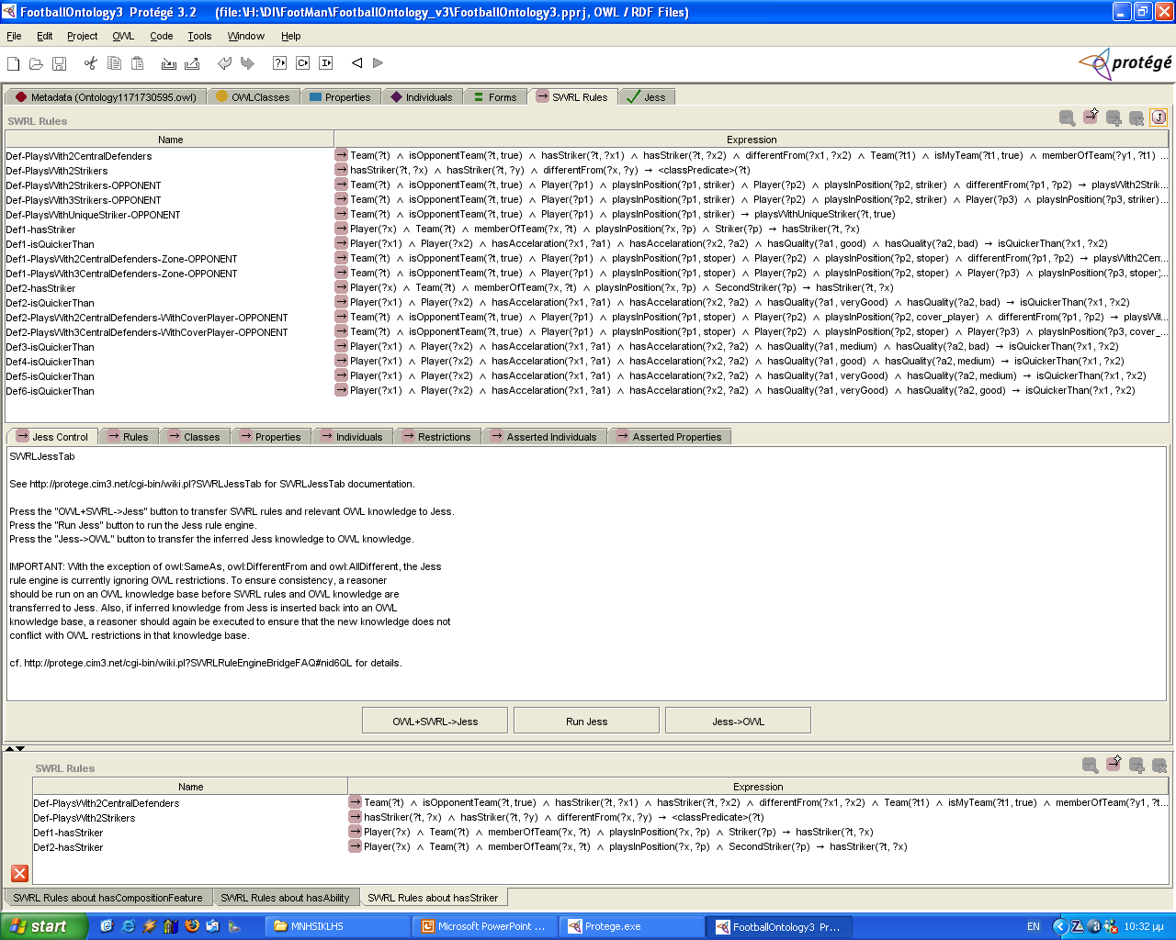
Protégé 3.x had SWRL-Tab
Good support for creating and editing SWRL rules

Slide 29
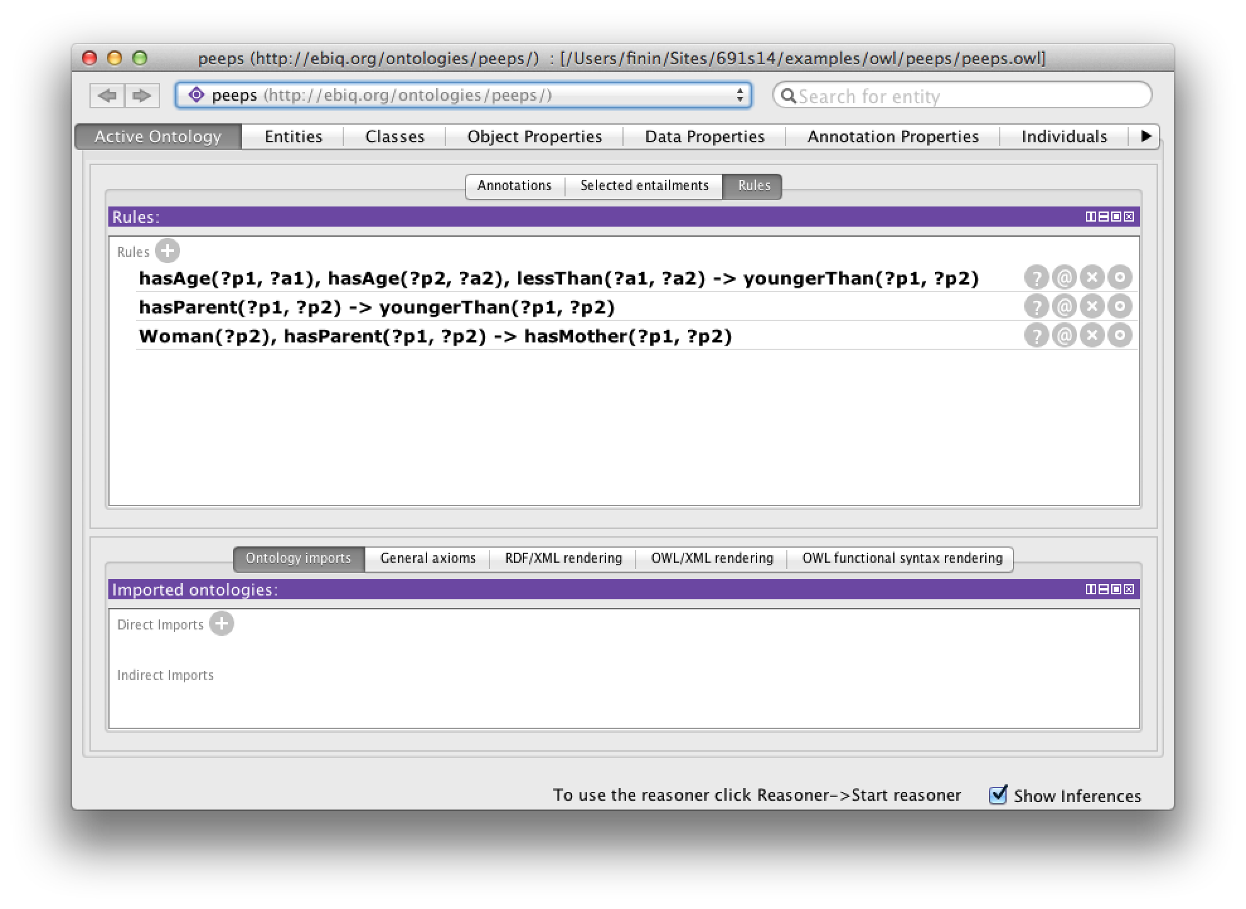
Protégé 4.3 bare-bones SWRL support
Simple interface to add and edit SWLR rules

Slide 30
SWRL limitations
SWRL rules do not support many useful features of of some rule-based systems
Default reasoning
Rule priorities
Negation as failure (e.g., for closed-world semantics)
Data structures
…
The limitations gave rise to RIF

Slide 31
Summary
Horn logic is a subset of predicate logic that allows efficient reasoning, orthogonal to description logics
Horn logic is the basis of monotonic rules
DLP and SWRL are two important ways of combining OWL with Horn rules.
DLP is essentially the intersection of OWL and Horn logic
SWRL is a much richer language

Slide 32
Summary (2)
Nonmonotonic rules are useful in situations where the available information is incomplete
They are rules that may be overridden by contrary evidence
Priorities are sometimes used to resolve some conflicts between rules
Representation XML-like languages is straightforward

Slide 33
LP and classical logic overlap
(1)
(2)
(4)
(5)
(6)
(3)
(7)
FOL: (All except (6)), (2)+(3)+(4): DLs
(4): Description Logic Programs (DLP), (3): Classical Negation
(4)+(5): Horn Logic Programs, (4)+(5)+(6): LP
(6): Non-monotonic features (like NAF, etc.) (7): ^head and, ∨body

