Slide 1

Example: Jena and Fuseki

Slide 2
Jena and Fuseki
Jena is a solid and widely used system
  Scales reasonably well using its TDB native store
  Has support for reasoning via a native rules engine and an API for DIG-compliant reasoners
  Subsets run on Android phones
Fuseki is a sparql endpoint that comple-ments Jena
Both are easy to install and use with Java or any other language via the API or endpoint

Slide 3
Download jena and fuseki
curl -O http://www.apache.org/dist/jena/binaries/apache-jena-2.11.1.tar.gz
curl -O http://www.apache.org/dist/jena/binaries/jena-fuseki-1.0.1-distribution.tar.gz
> tar -xzf jena-fuseki-0.2.6-distribution.tar.gz
> tar -xzf apache-jena-2.10.0.tar.gz
> rm *.gz
> ls
apache-jena-2.10.0 jena-fuseki-0.2.6
> export JENA=/Users/finin/.../apache-jena-2.10.0/
export FUSEKI=/Users/finin/S.../jena-fuseki-0.2.6/
export TS=/Users/finin/S…/examples/triplestore/
Notes:
RDF stores can be divided into 3 broad categories based upon how they are implemented. These are not precisely defined terms with rigid boundaries but something that can serve as rough guide to what a triple store is.
Native Stores: Provide support for transactions, own SQL compiler and generally their own procedure language.
Will explain in detail what I mean by this term in the later slides.

Slide 4
Start the Fuseki server
# create directory for the RDF data
> Mkdir $TS/MYTDB
# launch server allowing updates, using our data directory
# and naming the default store ds
> cd $FUSEKI
> fuseki-server --update --loc=/Users/finin/MYTDB /ds &
17:01 INFO Server :: TDB dataset: directory=/Users/finin/MYTDB
17:01 INFO Server :: Dataset path = /ds
17:01 INFO Server :: Fuseki 0.2.5 2012-10-20T17:03:29+0100
17:01 INFO Server :: Started 2013/03/31 17:01:20 EDT on port 3030
# put some data into it from a file
> s-put http://localhost:3030/ds/data default Data/books.ttl

Slide 5
Add some data
> Head Data/books.ttl
@prefix dc: <http://purl.org/dc/elements/1.1/> .
@prefix vcard: <http://www.w3.org/2001/vcard-rdf/3.0#> .
@prefix ns: <http://example.org/ns#> .
@prefix : <http://example.org/book/> .
> s-put http://localhost:3030/ds/data default Data/books.ttl
18:00 INFO Fuseki :: [2] PUT http://localhost:3030/ds/data?default
18:00 INFO Fuseki :: [2] 204 No Content

Slide 6
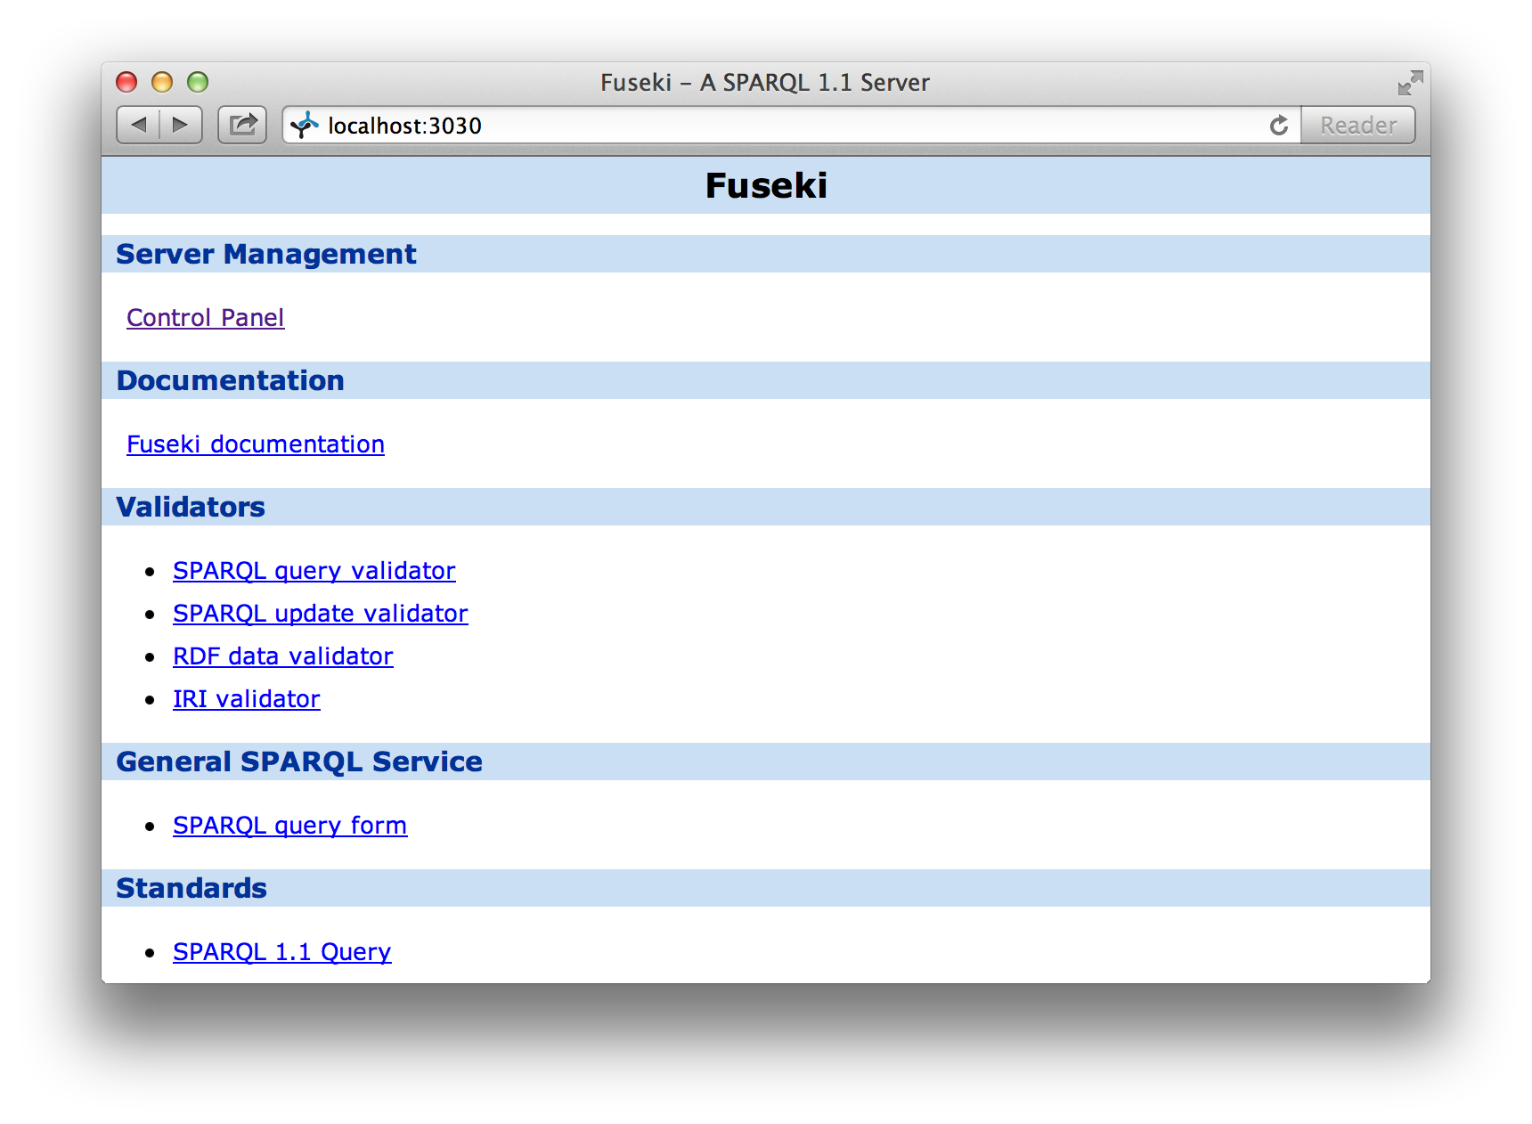
Access Fuseki via Browser

Slide 7
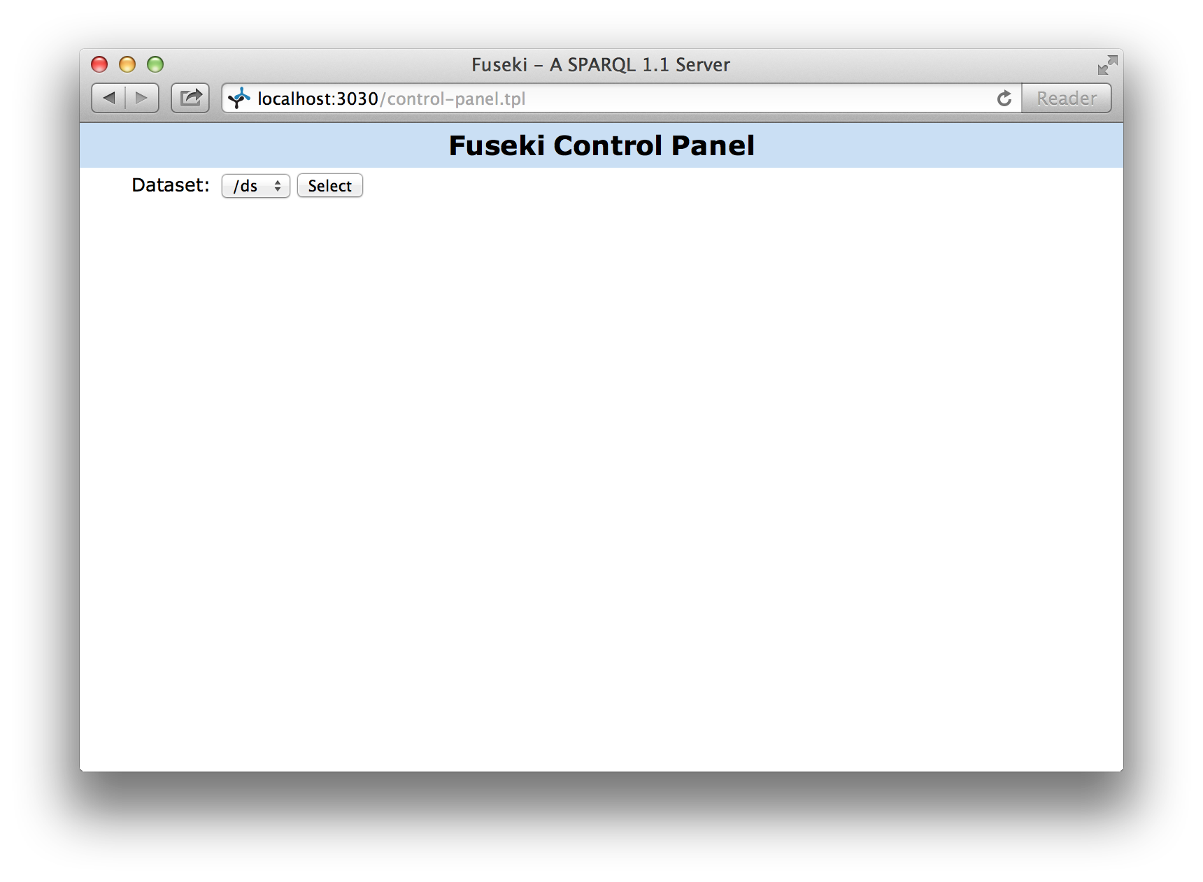
Control panel: select the store

Slide 8
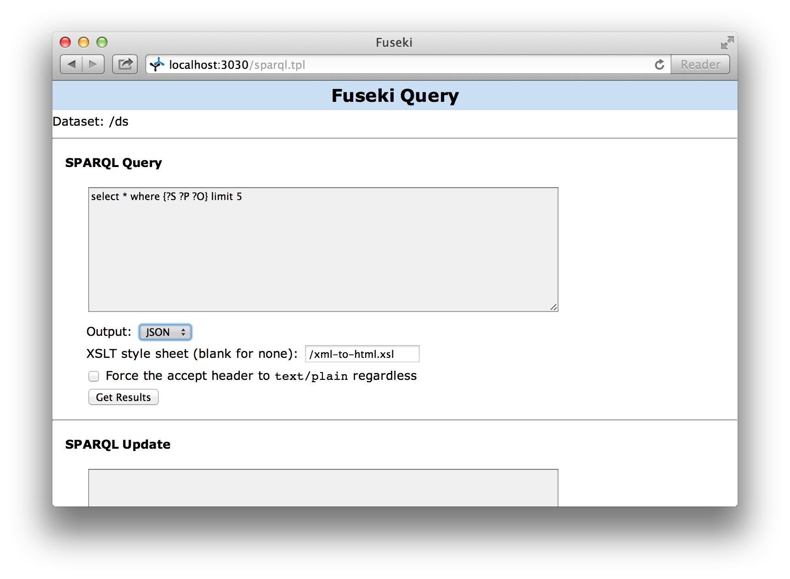
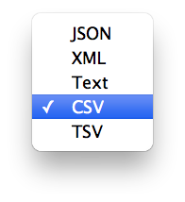
Enter a SPARQL query

Slide 9
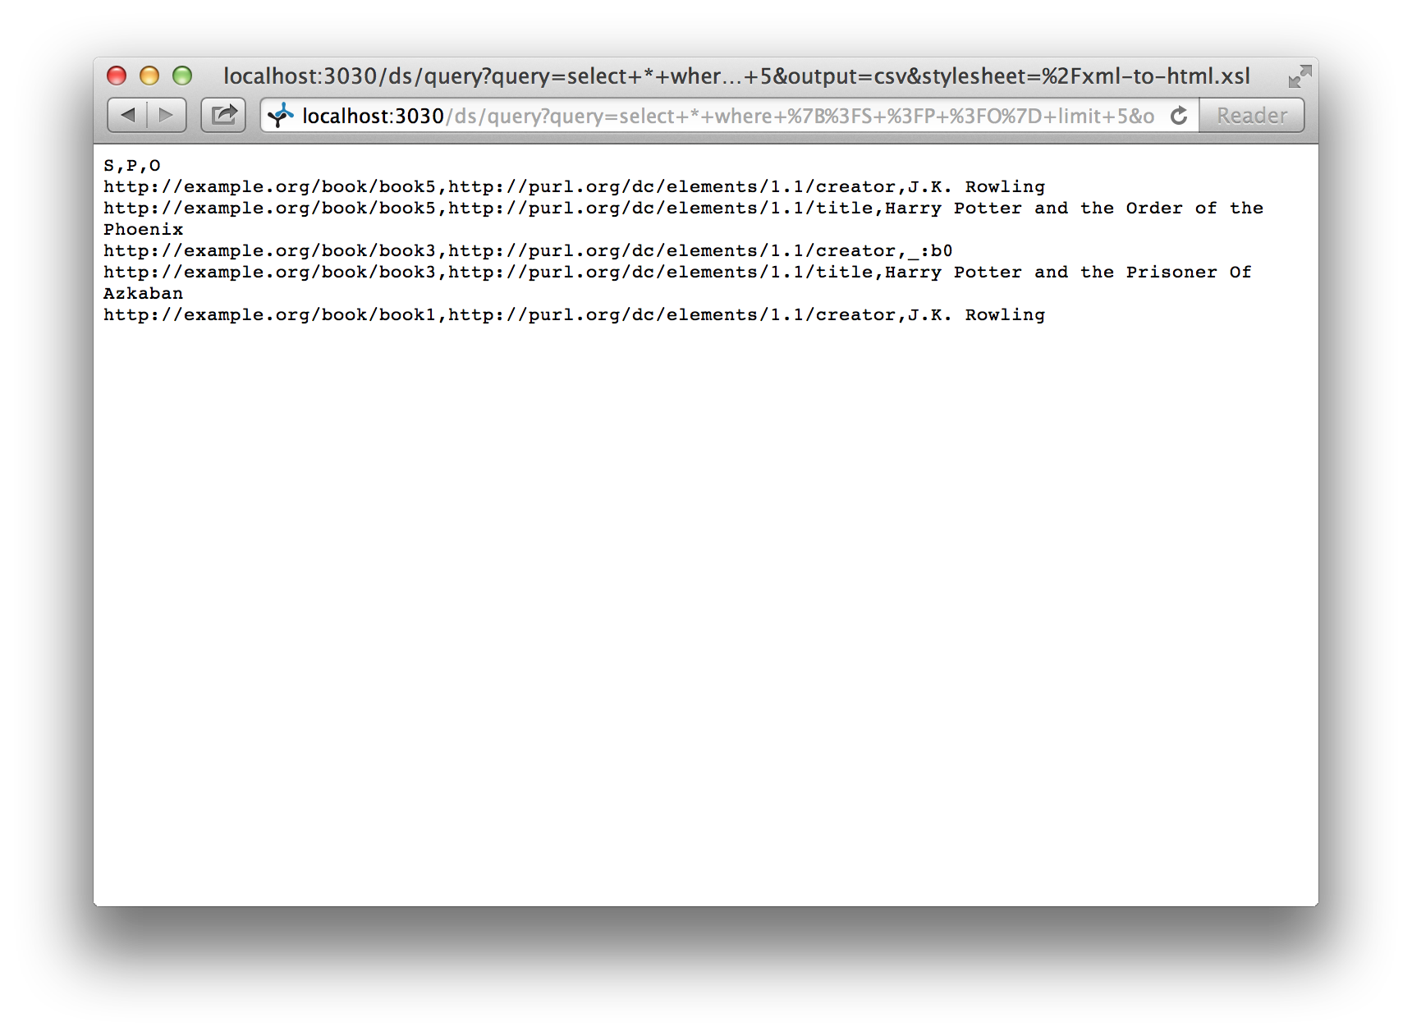
Here are the results

Slide 10
Other interactions
From the control panel you can also
  Enter SPARQL update queries
  Upload a file of RDF data into the store
To bulk load data, use Jena’s tdbloader command
  Loads at ~50K triples/sec
  ~ 80 minutes to ~250M triples in DBpedia’s dataset

Slide 11
For CIA Fact Book
PREFIX rdf: <http://www.w3.org/1999/02/22-rdf-syntax-ns#>
PREFIX rdfs: <http://www.w3.org/2000/01/rdf-schema#>
PREFIX ciafb: <http://www.cia.gov/cia/publications/factbook#>
SELECT *
WHERE {
?C ciafb:Name ?N;
ciafb:Area ?A
}
limit 10

