Slide 1
Linked Data browsers

Slide 2
Linked Data Browser
One reason DBpedia is successful is its data browser for humans
Given a URL to a DBpedia resource, shows triples with that URL as a subject or object
A generic version of the browser software is available as Pubby
Elda is a similar and more sophisticated system

Slide 3
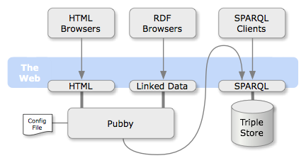
Pubby
Pubby adds a Linked Data interface to a SPARQL endpoint

Slide 4
How Pubby Works
Pubby is relatively simple and does the following
Maps published URLs an appropriate URL on the SPARQLserver
  http://localhost:8080/page/book1 to ??
Sends a SPARQL describe query to get triples where the URL is either subject or object
  Problem: Fuseki’s describe returns only those where URI is subject, by default
Converts the URLs to a CURI (prefixed form)
  http://localhost:8080/page/book1 to ex:book1
Displays results as hypertext

Slide 5
How to set up
Download jetty http://download.eclipse.org/jetty/
  Launch by invoking java -jar start.jar
  Check it it’s running at http://localhost:8080/
Download pubby from http://bit.ly/PubbY
  ln -s jetty-distribution-8.1.10.v20130312 jetty
  ln -s pubby-0.3.3/ pubby
Copy pubby's webapp directory into Jetty's webapps folder and rename to root
  cp -R pubby/webapp jetty/webapps/root
Modify the configuration file to use Fuseki, etc.
Visit http://localhost:8080/

Slide 6
Config File
<> a conf:Configuration;
# Project name for display in page titles
conf:projectName "UMBC CMSC691s13 example";
# Homepage for the link in the page header
conf:projectHomepage <http://bit.ly/691S13>;
# Pubby root where the webapp is running
conf:webBase <http://localhost:8080/>;
# URL of an RDF file with prefix mapping
conf:usePrefixesFrom <http://umbc.edu/~finin/prefixes.n3>;
# Prefered language for labels
conf:defaultLanguage "en";
# When server homepage is accessed, use this
conf:indexResource <http://example.org/book/collection>;
conf:dataset [
# URL of SPARQL endpoint for dataset
conf:sparqlEndpoint <http://localhost:3030/ds/query>;
# Common URI prefix of resource URIs in SPARQL dataset
conf:datasetBase <http://example.org/book/>; ] .

Slide 7
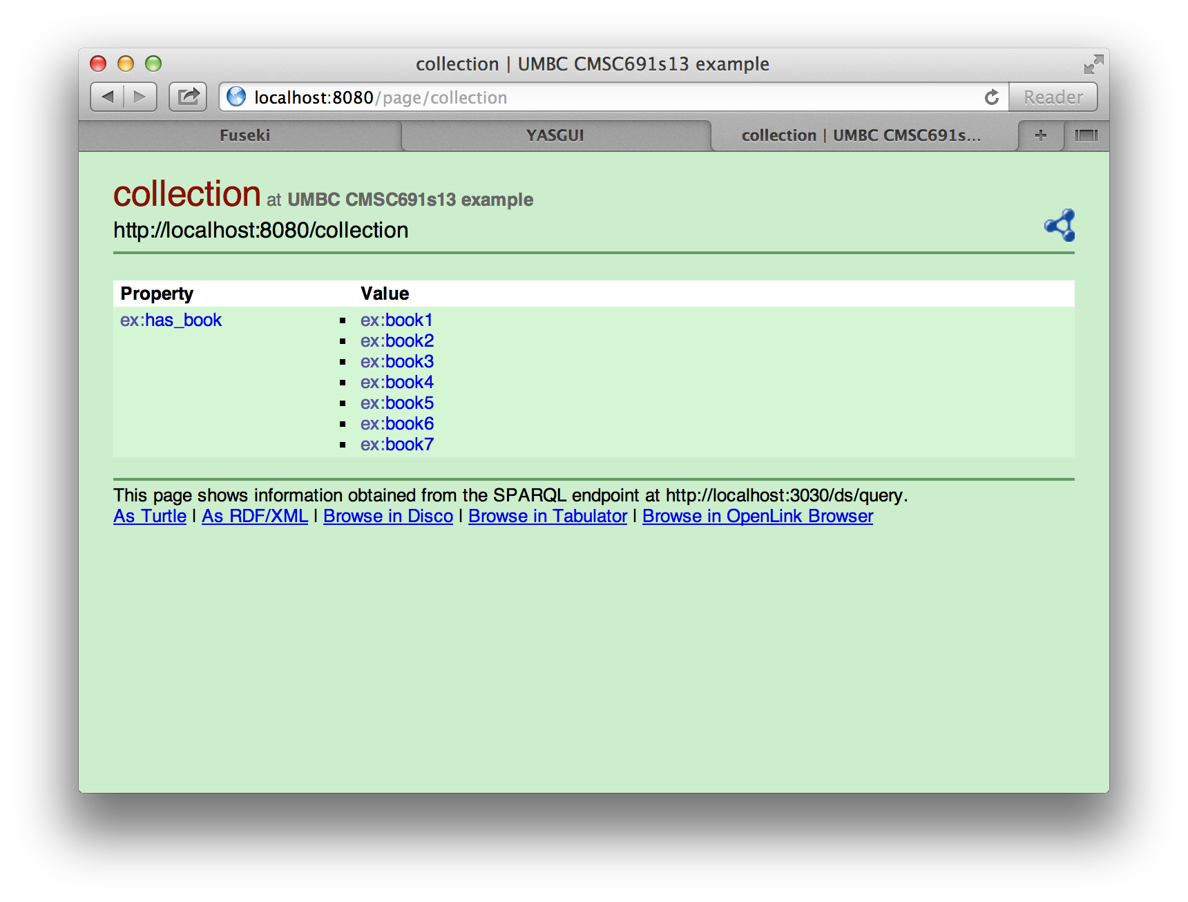
An example

Slide 8
Two issues
I had to create an external web-accessible file with prefix declarations due to a minor Pubby bug
  may be fixed in the newest version
Fuseki’s response to a describe doesn’t include triples where the URI is the object
  You can recompile Fuseki, including an option for this
  Or use another triple store, e.g., Sesame

