Slide 1
Triple Stores

Slide 2


Slide 4
What is a triple store?
A database for RDF triples
Can ingest RDF in a variety of formats
Supports a query language
  SPARQL is the W3C recommendation
  Other RDF query languages exist (e.g., RDQL)
  Might or might not do inferencing
Triples stored in memory in a persistent backend
Persistence provided by a relational DBMS (e.g., mySQL) or a custom DB for efficiency.

Slide 5
Architectures
Can be divided into several categories: In-memory, Native store, Non-native store
In memory: RDF Graph is stored as triples in main memory
Native store: Persistent storage systems with custom DBs, e.g.: JENA TDB, Sesame Native, Virtuoso, AllegroGraph, Oracle 11g
Non-Native store: Persistent storage systems set-up to run on third party DBs, e.g., Jena SDB using mysql or postgres
Notes:
RDF stores can be divided into 3 broad categories based upon how they are implemented. These are not precisely defined terms with rigid boundaries but something that can serve as rough guide to what a triple store is.
Native Stores: Provide support for transactions, own SQL compiler and generally their own procedure language.
Will explain in detail what I mean by this term in the later slides.

Slide 6
Architecture trade-offs
In memory is fastest, obviously, but load time has to be factored in
Native stores are fast, scalable, and popular now
Non-native stores may be better if you have a lot of updates and/or need good concurrency control
See the W3C page on large triple stores for some data on scaling for many stores

Slide 7
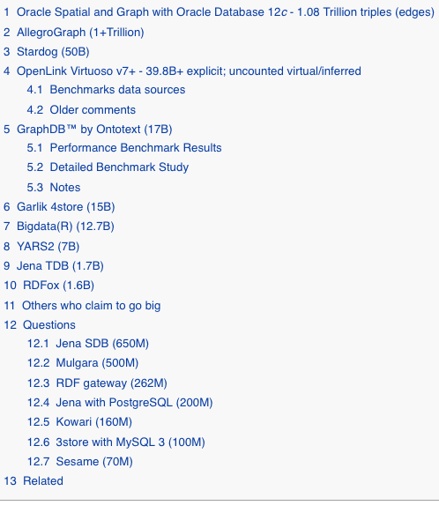
Large triple stores
in 2018
http://www.w3.org/wiki/LargeTripleStores

Slide 8
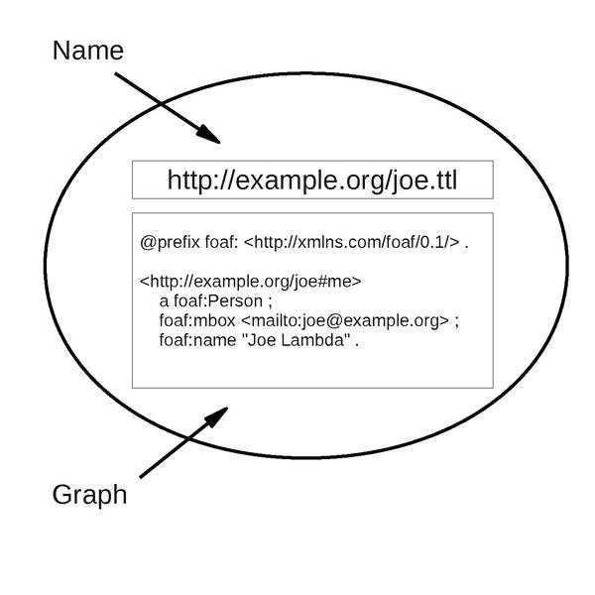
Quads, Quints and Named Graphs
Many triple stores support quads
for named graphs
A named graph is just an RDF with a
URI name often called the context
Such a triple store divides its data a default graph and zero or more additional named graphs
SPARQL has support for named graphs
De facto standards exist for representing quad data, e.g., n-quads and TriG (a turtle/N3 variant)
AllegroGraph stores quints (S,P,O,C,ID), the ID can be used to attach metadata to a triple

Slide 9
Support for Reasoning
Most triple stores don’t do much (or any) reasoning and use a simple model:
  You do the reasoning to materialize all of the triples you want, which you then load into the store
  Triple store provides query and update APIs, access control, SPARQL interface, efficient indexing, etc.
Some do support reasoning, e.g.,
  Jena has a native rules engine and an API for external reasoners (e.g., Pellet, Fact++)
  Sesame has a native RDFS reasoner
  Stardog supports OWL DL reasoning via query expansion

Slide 10

Example: Jena Framework
An open software Java system originally dev-eloped by HP (2002-2009)
  Moved to Apache when HP Labs discontinued its Semantic Web research program
  https://jena.apache.org/
Using the TDB native store, it can easily handle ~2B triples
Good tutorials and documentation
Has internal reasoners and can work with DIG compliant reasoners such as Pellet
Supports a Native API and SPARQL via Fuseki

Slide 11

Example: Sesame
Sesame is an open source RDF framework with support for RDFS inferencing and querying
http://www.openrdf.org/
Implemented in Java
Query languages: SeRQL, RQL, RDQL and SPARQL
Triples can be stored in memory, on disk, or in a RDBMS
Has a native RDFS reasoner
Easy to setup & use, but tops out at ~70M triples

Slide 12

Example: Stardog
http://stardog.com/ by Clark and Parsia
Pure Java RDF database (“quad store”)
Lightweight and very fast for in-memory use
Reasoning support via Pellet for OWL DL and query rewriting for OWL 2 QL, EL & RL
Command line interface and JAVA API
Commercial, but has a free version good for modest projects
~50B triples on $10K server with 256G ram and 32 cores

Slide 13
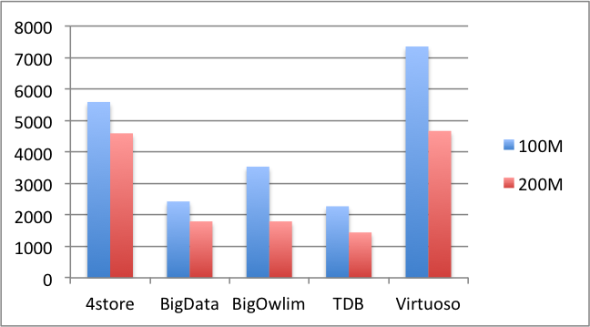
Performance
Much work on benchmarking of triple stores
There are several standard benchmark sets
Two key things are measured include
  Time to load and index triples
  Time to answer various kinds of SPARQL queries
The Berlin SPARQL Benchmarks evaluated 4store, BigData, BigOwlim, Jena TDB and Virtuoso in 2011 with 100M
and 200M datasets.
The numbers are “query
mixes per hour”, so bigger
is better

Slide 14
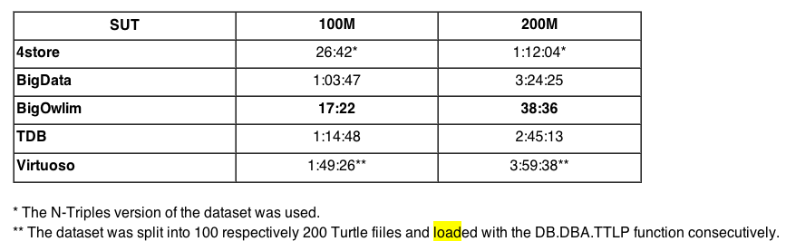
Load Time

Slide 15
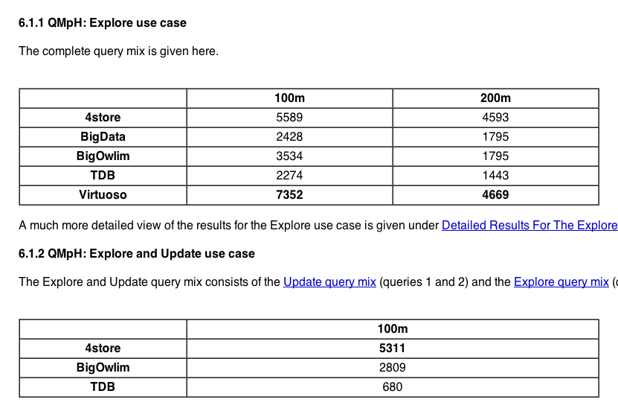
Queries per hour

Slide 16
Summary
A triple store is an essential component of any system using RDF
There are a number of good ones available, both open sourced and commercial
Developing triple stores for large-scale parallel systems is still a research topic

