Slide 1
OWL 2
Web Ontology Language
Some material adapted from presentations by Ian Horrocks and by Feroz Farazi

Slide 2
Introduction
OWL 2 extends OWL 1.1 and is backward compatible with it
The new features of OWL 2 based on real applications, use cases and user experience
Adopted as a W3C recommendation in December 2012
All new features were justified by use cases and examples
Most OWL software supports OWL 2

Slide 3
Features and Rationale
Syntactic sugar
New constructs for properties
Extended datatypes
Punning
Extended annotations
Some innovations
Minor features

Slide 4
Syntactic Sugar
OWL 2 adds features that
Don’t change expressiveness, semantics, complexity
Makes some patterns easier to write
Allowing more efficient processing in reasoners
New features include:
DisjointClasses
DisjointUnion
NegativeObjectPropertyAssertion
NegativeDataPropertyAssertion

Slide 5
Syntactic sugar: disJointClasses
It’s common to want to assert that a set of classes are pairwise disjoint
No individual can be an instance of two of the classes in set
Faculty, staff and students are all disjoint
[a owl:allDisjointClasses;
owlmembers (:faculty :staff :students)]
In OWL 1.1 we’d have to make three assertions
:faculty owl:disjointWith :staff
:faculty owl:disjointWith :student
:staff owl:disjointWith :staff
Which gets cumbersome for large sets

Slide 6
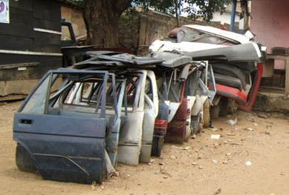
Syntactic sugar: disJointUnion
Need for disjointUnion construct
A :CarDoor is exclusively either
a :FrontDoor, a :RearDoor or a :TrunkDoor
and not more than one of them
In OWL 2 :CarDoor a owl:disjointUnionOf (:FrontDoor :RearDoor :TrunkDoor).
In OWL 1.1
:CarDoor owl:unionOf (:FrontDoor :RearDoor :TrunkDoor).
:FrontDoor owl:disjointWith :ReadDoor .
:FrontDoor owl:disjointWith :TrunkDoor .
:RearDoor owl:disjointWith :TrunkDoor .

Slide 7
Syntactic sugar: disJointUnion
It’s common for a concept to have more than one decomposition into disjoint union sets
E.g.: every person is either male or female (but not both), either a minor or adult (but not both) and either living or dead (but not both)
foaf:Person
owl:disjointUnionOf (:Male :Female);
owl:disjointUnionOf (:Minor :Adult);
owl:disjointUnionOf (:Living :Dead);

Slide 8
Syntactic sugar: negative assertions
Asserts that a property doesn’t hold between two instances or between an instance and a literal
NegativeObjectPropertyAssertion
Barack Obama was not born in Kenya
NegativeDataPropertyAssertion
Barack Obama is not 60 years old
Encoded using a “reification style”

Slide 9
Syntactic sugar: negative assertions
@prefix dbr: <http://dbpedia.org/resource/> .
@prefix dbo: <http://dbpedia.org/ontology/> .
[a owl:NegativeObjectPropertyAssertion;
owl:sourceIndividual dbr:Barack_Obama ;
owl:assertionProperty dbo:bithPlace ;
owl:targetIndividual dbr:Kenya] .
[a owl:NegativeDataPropertyAssertion;
owl:sourceIndividual dbo:Barack_Obama ;
owl:assertionProperty dbo:age ;
owl:targetIndividual "60" ] .

Slide 10
Syntactic sugar: negative assertions
Note that the negative assertions are about two individuals
Suppose we want to say that :john has no spouse?
Or to define the concept of an unmarried person?
Can we use a negative assertion to do it?

Slide 11
Syntactic sugar: negative assertions
Suppose we want to say that :john has no spouse?
[a owl:NegativeObjectPropertyAssertion;
owl:sourceIndividual :john ;
owl:assertionProperty dbpo:spouse ;
owl:targetIndividual ????????] .
We can’t do this with a negative assertion ☹
It requires a variable, e.g., there is no ?X such that (:john, dbpo:spouse, ?X) is true
Notes:
There is no individual we can put here.

Slide 12
Syntactic sugar: negative assertions
The negative assertion feature is limited
Can we define a concept :unmarriedPerson and assert that :john is an instance of this?
We can do it this way in OWL:
An unmarried person is a kind of person
and a kind of thing with exactly 0 spouses
Notes:
There is no individual we can put here.

Slide 13
John is not married
:john a :unmarriedPerson .
:unmarriedPerson a Person;
a [a owl:Restriction;
onProperty dbpo:spouse;
owl:cardinality “0”] .

Slide 14
New property Features
Self restriction
Qualified cardinality restriction
Object properties
Disjoint properties
Property chain
Keys

Slide 15
Self restriction
Classes of objects that are related to themselves by a given property
E.g., the class of processes that regulate themselves
It is also called local reflexivity
E.g., Auto-regulating processes regulate themselves
Narcissists are things who love themselves
:Narcissist owl:equivalentClass
[a owl:Restriction;
owl:onProperty :loves;
owl:hasSelf "true"^^xsd:boolean] .

Slide 16
Qualified cardinality restrictions
Qualifies the instances to be counted
Six varieties: {Data|Object}{Min|Exact|Max} Type
Examples
People with exactly 3 children who are girls
People with at least 3 names
Each individual has at most 1 SSN
E.g., pizzas with exactly four toppings all of which are cheeses

Slide 17
Qualified cardinality restrictions
Done via new properties with domain owl:Re-striction, namely {min|max|} QualifiedCardinality and onClass
E.g.: people with exactly 3 children who are girls
[a owl:restriction;
owl:onProperty :hasChild;
owl:onClass [owl:subClassOf :Female; owl:subClassOf :Minor].
QualifiedCardinality “3” .
Or: hasChild exactly 3 Female and Minor

Slide 18
Object properties
ReflexiveObjectProperty
Globally reflexive
Everything is part of itself
IrreflexiveObjectProperty
Nothing can be a proper part of itself
AsymmetricObjectProperty
If x is proper part of y, then the opposite does not hold

Slide 19
Disjoint properties
E.g., you can’t be both the parent of and child of the same person
DisjointObjectProperties (for object properties)
E.g., :hasParent owl:propertyDisjointWith :hasChild
DisjointDataProperties (for data properties)
E.g., :startTime owl:disjointWith :endTime
AllDisjointProperties for pairwise disjointness
[a owl:AlldisjointProperties ;
owl:members (:hasSon :hasDaughter :hasParent) ] .

Slide 20
A Dissertation Committee
Here is a relevant real-world example.
A dissertation committee has a candidate who must be a student and five members all of whom must be faculty. One member must be the advisor, another can be a co-advisor and two must be readers. The readers can not serve as advisor or co-advisor.
How can we model it in OWL?

Slide 21
A Dissertation Committee
A dissertation committee has a candidate who must be a student and five members all of whom must be faculty. One member must be the advisor, another can be a co-advisor and two must be readers. The readers can not serve as advisor or co-advisor.
Define a DissertationCommittee class
Define properties it can have along with appropriate constraints

Slide 22
A Dissertation Committee
:DC a owl:class; [a owl:Restriction; owl:onProperty :co-advisor; owl:maxCardinality “1”] .
:candidate a owl:FunctionalProperty; rdfs:domain :DC; rdfs:range :Student.
:advisor a owl:FunctionalProperty; rdfs:domain :DC; rdfs:range :Faculty.
:co-advisor owl:ObjectProperty; rdfs:domain :DC; rdfs:range :Faculty, owl:propertyDisjointWith :advisor .
…

Slide 23
Property Chains
A common pattern in a graph representation is a chain of properties, e.g. parent·parent
Properties can be defined as a composition of other properties
The brother of your parent is your uncle
:uncle owl:propertyChainAxiom (:parent :brother).
Your parent’s sister’s spouse is your uncle
:uncle owl:propertyChainAxiom (:parent :sister :spouse). .

Slide 24
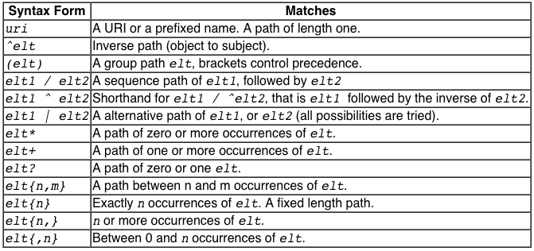
Property chains: OWL vs. SPARQL
SPARQL also supports property chains (aka paths) and adds expressivity with a regex-like grammar
Operators include ? (0 or 1), + (one or more), * (any number), ^ (inverse), # constraints, …

Slide 25
Property chains: OWL vs. SPARQL
Common usecase: find all of an entities types
SELECT DISTINCT ?class WHERE {
dbr:Barack_Obama rdf:type/owl:subclassOf* ?class }
Another: find all birth places using isPartOf SELECT DISTINCT ?place WHERE {
dbr:Barack_Obama dbo:birthplace/dbo:isPartOf* ?place}
Another: find all ancestors
SELECT DISTINCT ?person WHERE {
dbr:Barack_Obama ^dbo:child+ ?person}

Slide 26
Keys
Individuals can be identified uniquely
Identification can be done using
A data or object property (equivalent to inverse functional)
A set of properties
Examples
foaf:Person
owl:hasKey (foaf:mbox),
(:homePhone :foaf:name).

Slide 27
Extended datatypes
Extra datatypes
Examples: owl:real, owl:rational, xsd:pattern
Datatype restrictions
Range of datatypes
For example, a teenager has age between 13 and 18

Slide 28
Extended datatypes
Data range combinations
Intersection of
DataIntersectionOf( xsd:nonNegativeInteger xsd:nonPositiveInteger )
Union of
DataUnionOf( xsd:string xsd:integer )
Complement of data range
DataComplementOf( xsd:positiveInteger )

Slide 29
An Example: Teenager
:Teenager a [owl:Restriction ; owl:onProperty :hasAge ; owl:someValuesFrom _:y .]
_:y a rdfs:Datatype ; owl:onDatatype xsd:integer ; owl:withRestrictions ( _:z1 _:z2 ) .
_:z1 xsd:minInclusive "13"^^xsd:integer .
_:z2 xsd:maxInclusive "19"^^xsd:integer .

Slide 30
An Example: Teenager (2)
:Teenager a [owl:Restriction ; owl:onProperty :hasAge ; owl:someValuesFrom
[a rdfs:Datatype ; owl:onDatatype xsd:integer ; owl:withRestrictions
( [xsd:minInclusive "13"^^xsd:integer]
[xsd:maxInclusive "19"^^xsd:integer ])]] .

Slide 31
An Example: Teenager (3)
:has Age some [owl:Restriction ; owl:onProperty :hasAge ; owl:someValuesFrom
[a rdfs:Datatype ; owl:onDatatype xsd:integer ; owl:withRestrictions
( [xsd:minInclusive "13"^^xsd:integer]
[xsd:maxInclusive "19"^^xsd:integer ])]] .

Slide 32
Punning
OWL 1 DL things can’t be both a class and instance
E.g., :SnowLeopard can’t be both a subclass of :Feline and an instance of :EndangeredSpecies
OWL 2 DL offers better support for meta-modeling via punning
A URI denoting an owl thing can have two distinct views, e.g., as a class and as an instance
The one intended is determined by its use
A pun is often defined as a joke that exploits the fact that a word has two different senses or meanings

Slide 33
Punning Restrictions
Some puns are not allowed ☹
Classes and object properties also can have the same name
For example, :mother can be both a property and a class of people
But classes and datatype properties can not have the same name
Also datatype properties and object properties can not have the same name

Slide 34
Punning Example
@prefix foaf: <http://xmlns.com/foaf/0.1/> .
@prefix owl: <http://www.w3.org/2002/07/owl#> .
@prefix rdfs: <http://www.w3.org/2000/01/rdf-schema#>.
foaf:Person a owl:Class.
:Woman a owl:Class.
:Parent a owl:Class.
:mother a owl:ObjectProperty;
rdfs:domain foaf:Person;
rdfs:range foaf:Person .
:mother a owl:Class;
owl:intersectionOf (:Woman :Parent).
validate via http://owl.cs.manchester.ac.uk/validator/

Slide 35
Annotations
In OWL annotations comprise information that carries no official meaning
Some properties in OWL 1 are annotation properties, e.g., owl:comment, rdf:label and rdf:seeAlso
OWL 1 allowed RDF reification as a way to say things about triples, again w/o official meaning
[a rdf:Statement; rdf:subject :Barack_Obama; rdf:predicate dbpo:born_in; rdf:object :Kenya; :certainty “0.01” ].

Slide 36
Annotations
OWL 2 has native support for annotations, including
Annotations on owl axioms (i.e., triples)
Annotations on entities (e.g., a Class)
Annotations on annotations
The mechanism is again reification

Slide 37
Annotations
:Man rdfs:subClassOf :Person .
_:x rdf:type owl:Axiom ;
owl:subject :Man ;
owl:predicate rdfs:subClassOf ;
owl:object :Person ;
:probability “0.99"^^xsd:integer;
rdfs:label ”Every man is a person.” .

Slide 38
Inverse object properties
Some object property can be the inverse of another property
For example, partOf and hasPart
ObjectInverseOf( :partOf ) expression represents the inverse property of :partOf
Makes writing ontologies easier by avoiding the need to explicitly name an inverse

Slide 39
OWL Sub-languages
OWL 1 had sub-languages: OWL FULL, OWL DL and OWL Lite
OWL FULL is undecidable
OWL DL is worst case highly intractable
Even OWL Lite turned out to be not very tractable (EXPTIME-complete)
OWL 2 introduced three sub-languages (profiles) designed for different use cases

Slide 40
OWL 2 Profiles
EL: polynomial time reasoning for schema & data
Useful for ontologies with large conceptual part
QL: fast (logspace) query answering using RDBMs via SQL
Useful for large datasets already stored in RDBs
RL: fast (polynomial) query answering using rule-extended DBs
Useful for large datasets stored as RDF triples

Slide 41
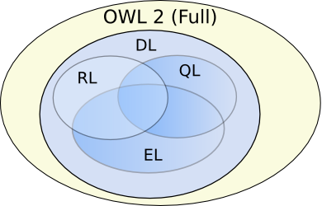
OWL Profiles
Profiles considered
Useful computational properties, e.g., reasoning complexity
Implementation possibilities, e.g., using RDBs
There are three profiles
OWL 2 EL
OWL 2 QL
OWL 2 RL

Slide 42
OWL 2 EL
A (near maximal) fragment of OWL 2 such that
Satisfiability checking is in PTime (PTime-Complete)
Data complexity of query answering is PTime-Complete
Based on EL family of description logics
Existential (someValuesFrom) + conjunction
Does not allow disjunction or universal restrictions
Saturation is an efficient reasoning technique
It can capture the expressive power used by many large-scale ontologies, e.g., SNOMED CT

Slide 43
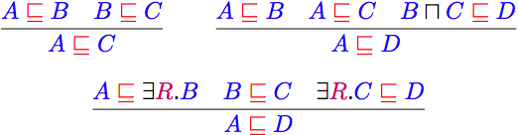
Basic Saturation-based Technique
Normalise ontology axioms to standard form:
Saturate using inference rules:
Extension to Horn fragment requires (many) more rules
Saturation is a general reasoning technique in which you first compute the deductive closure of a given set of rules and add the results to the KB. Then run your prover.

Slide 44
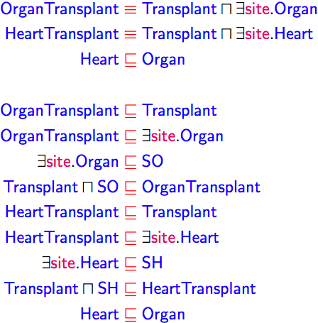
Saturation-based Technique (basics)
Example: infer that a heart transplant is a kind of organ transplant

Slide 45
Saturation-based Technique (basics)
Example:

Slide 46
Saturation-based Technique (basics)
Example:

Slide 47
Saturation-based Technique (basics)
Example:

Slide 48
Saturation-based Technique (basics)
Example:

Slide 49
Saturation-based Technique (basics)
Example:

Slide 50
Saturation-based Technique (basics)
Example:

Slide 51
Saturation-based Technique (basics)
Example:

Slide 52
Saturation-based Technique (basics)
Example:

Slide 53

Saturation-based Technique (basics)
Example:

Slide 54
Saturation-based Technique (basics)
Example:

Slide 55
Saturation-based Technique (basics)
Example:

Slide 56
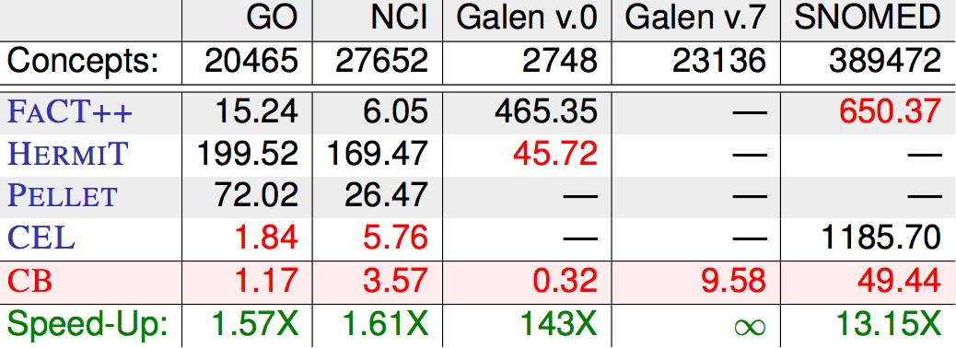
Saturation-based Technique
Performance with large bio-medical ontologies
Galen and Snomed are large ontologies of medical terms; both have OWL versions. NCI is a vocabulary of cancer-related terms. GO is the gene ontology.

Slide 57
OWL 2 QL
The QL acronym reflects its relation to the standard relational Query Language
It does not allow existential and universal restrictions to a class expression or a data range
enable a tight integration with RDBMSs
reasoners can be implemented on top of standard relational databases
Can answer complex queries (in particular, unions of conjunctive queries) over the instance level (ABox) of a DL knowledge base

Slide 58
OWL 2 QL
We can exploit query rewriting based reasoning technique
Computationally optimal
Data storage and query evaluation can be delegated to standard RDBMS
Can be extended to more expressive languages (beyond AC⁰) by delegating query answering to a Datalog engine

Slide 59
What is Datalog?
Truly declarative logic programming language that’s a subset of Prolog
Just rules and facts
No data structures, cut
Rule ordering unimportant
Used as a query language for deductive databases
Queries on finite sets sets guaranteed to terminate
parent(bill,mary).
parent(mary,john).
ancestor(X,Y) :- parent(X,Y).
ancestor(X,Y) :- parent(X,Z),ancestor(Z,Y).

Slide 60
Query Rewriting Technique (basics)
Given ontology O and query Q, use O to rewrite Q as Q⁰ such that, for any set of ground facts A:
ans(Q, O, A) = ans(Q⁰, ;, A)
Resolution based query rewriting
Clausify ontology axioms
Saturate (clausified) ontology and query using resolution
Prune redundant query clauses

Slide 61
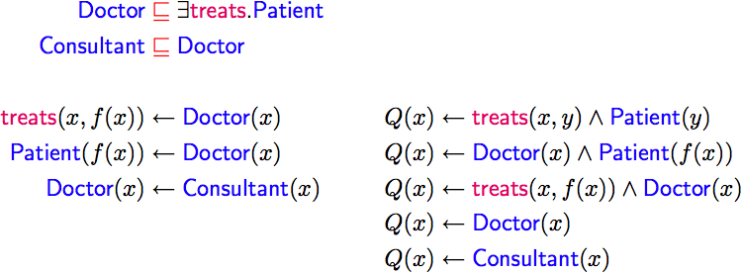
Query Rewriting Technique (basics)
Example:
Q(x) is our query: Who treats people who are patients?

Slide 62
Query Rewriting Technique (basics)
Example:
Translate the DL expressions into rules
f(x) is a Skolem individual
If you are a doctor then you treat someone and that someone is a patient

Slide 63
Query Rewriting Technique (basics)
Example:
For each rule in the rules version of the KB we want to enhance the query, so that we need not use the rule in the KB.

Slide 64
Query Rewriting Technique (basics)
Example:
Doctor(X) implies treats(x, f(x)) so we can replace it
Must unify f(x) with y, so end up with the second way of satisfying our query Q(x)

Slide 65
Query Rewriting Technique (basics)
Example:

Slide 66
Query Rewriting Technique (basics)
Example:
Applying the KB second rule to the 1st query rule gives us another way to solve the Q(x)

Slide 67
Query Rewriting Technique (basics)
Example:

Slide 68
Query Rewriting Technique (basics)
Example:
Since Doctor(x) implies treats(x, f(x)) we can derive Q(X) if Doctor(x) and Doctor(x), which reduces to the third query rule.

Slide 69
Query Rewriting Technique (basics)
Example:

Slide 70
Query Rewriting Technique (basics)
Example:

Slide 71
Query Rewriting Technique (basics)
Example:

Slide 72
Query Rewriting Technique (basics)
Example:
Remove useless redundant query rules

Slide 73
Query Rewriting Technique (basics)
Example:
For DL-Lite, result is a union of conjunctive queries (UCQ)

Slide 74

Query Rewriting Technique (basics)
Data can be stored/left in RDBMS
Relationship between ontology and DB defined by mappings, e.g.:
UCQ translated into SQL query:

Slide 75
OWL 2 RL
RL acronym reflects relation to Rule Languages
OWL 2 RL designed to accommodate
OWL 2 applications that trade full expressivity for efficiency
RDF(S) applications needing added expressivity from OWL 2
Not allowed: existential quantification to a class, union and disjoint union to class expressions
It can be implemented using rule-based technologies such Datalog, Jess, Prolog, etc.

Slide 76
Profile Selection…
Depends on
Expressiveness required by the application
Priority given to reasoning on classes or data
Size of the datasets

Slide 77
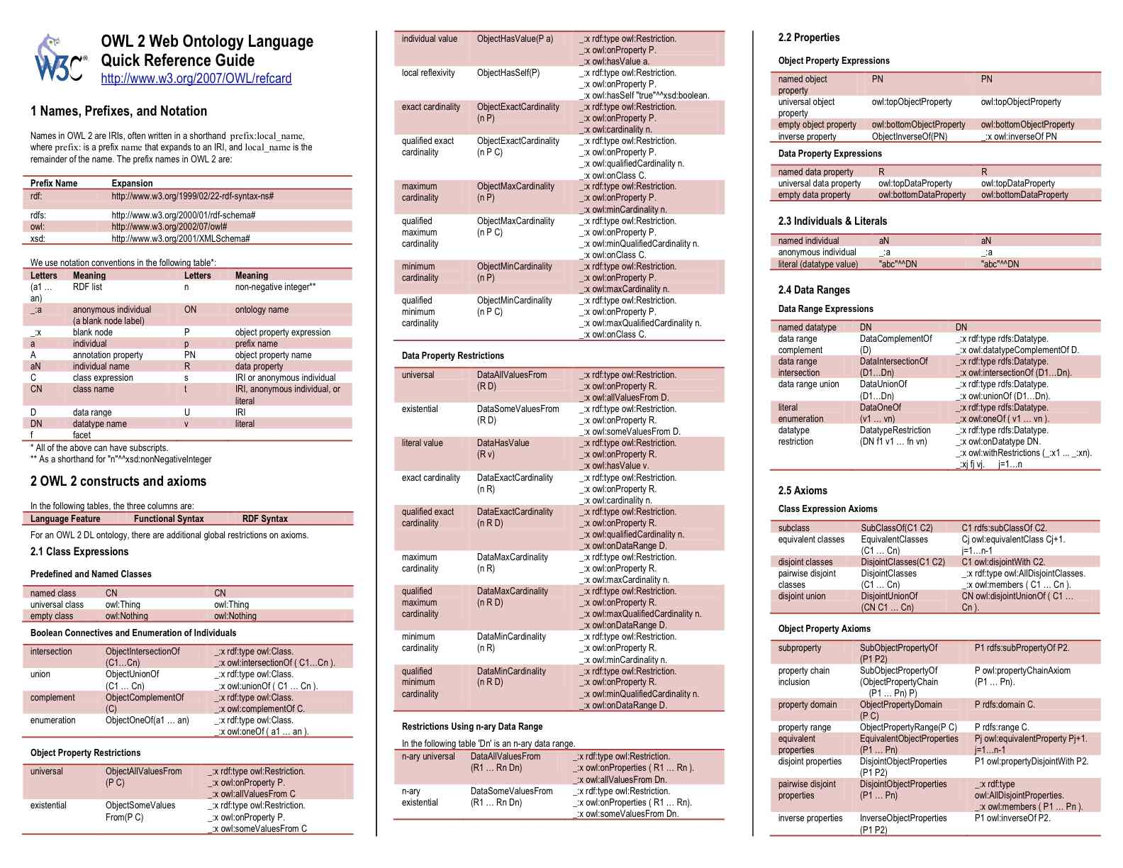

Slide 78
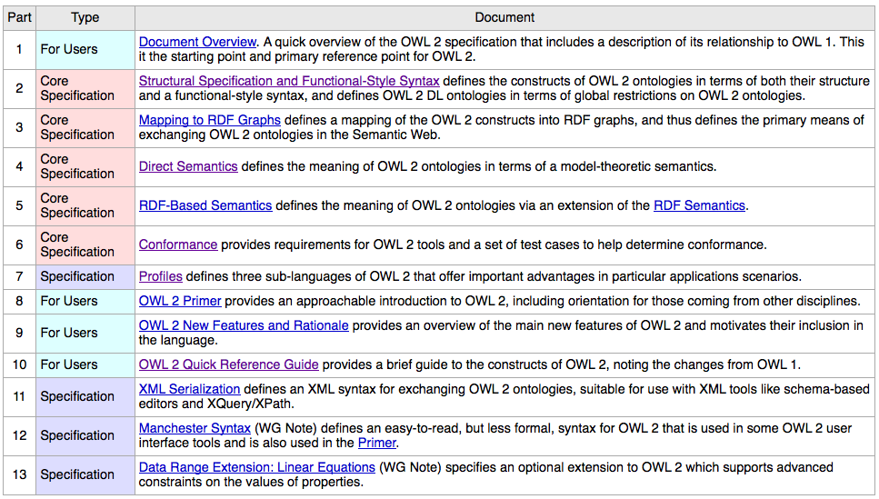
Key OWL 2 Documents
http://w3.org/TR/2009/WD-owl2-overview-20090421/

Slide 79
Conclusion
Most of the new features of OWL 2 in comparing with the initial version of OWL have been discussed
Rationale behind the inclusion of the new features have also been discussed
Three profiles – EL, QL and RL – are provided that fit different use cases and implementation strategies

