Slide 1
Resolution in Propositional and First-Order Logic

Slide 2
Inference rules
Logical inference creates new sentences that logically follow from a set of sentences (KB)
An inference rule is sound if every sentence X it produces when operating on a KB logically follows from the KB
i.e., inference rule creates no contradictions
An inference rule is complete if it can produce every expression that logically follows from (is entailed by) the KB.
Note analogy to complete search algorithms

Slide 3
Sound rules of inference
Here are some examples of sound rules of inference
Each can be shown to be sound using a truth table
RULE PREMISE CONCLUSION
Modus Ponens A, A → B B
And Introduction A, B A ∧ B
And Elimination A ∧ B A
Double Negation ¬¬A A
Unit Resolution A ∨ B, ¬B A
Resolution A ∨ B, ¬B ∨ C A ∨ C

Slide 4
Soundness of modus ponens
A | B | A → B | OK?
True | True | True | √
True | False | False | √
False | True | True | √
False | False | True | √

Slide 5
Resolution
Resolution is a valid inference rule producing a new clause implied by two clauses containing complementary literals
A literal is an atomic symbol or its negation, i.e., P, ~P
Amazingly, this is the only interference rule you need to build a sound and complete theorem prover
Based on proof by contradiction and usually called resolution refutation
The resolution rule was discovered by Alan Robinson (CS, U. of Syracuse) in the mid 60s

Slide 6
Resolution
A KB is actually a set of sentences all of which are true, i.e., a conjunction of sentences.
To use resolution, put KB into conjunctive normal form (CNF), where each sentence written as a disjunc- tion of (one or more) literals
Example
KB: [P→Q , Q→R∧S]
KB in CNF: [~P∨Q , ~Q∨R , ~Q∨S]
Resolve KB(1) and KB(2) producing: ~P∨R (i.e., P→R)
Resolve KB(1) and KB(3) producing: ~P∨S (i.e., P→S)
New KB: [~P∨Q , ~Q∨~R∨~S , ~P∨R , ~P∨S]
Tautologies
(A→B)↔(~A∨B)
(A∨(B∧C)) ↔(A∨B)∧(A∨C)

Slide 7
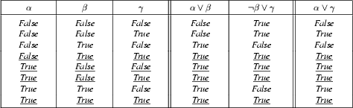
Soundness of the resolution inference rule
From the rightmost three columns of this truth table, we can see that
(α ∨ β) ∧ (β ∨ γ) ↔ (α ∨ γ)
is valid (i.e., always true regardless of the truth values assigned to α, β and γ

Slide 8
Resolution
Resolution is a sound and complete inference procedure for unrestricted FOL
Reminder: Resolution rule for propositional logic:
P₁ ∨ P₂ ∨ ... ∨ P_{n}
¬P₁ ∨ Q₂ ∨ ... ∨ Q_{m}
Resolvent: P₂ ∨ ... ∨ P_{n} ∨ Q₂ ∨ ... ∨ Q_{m}
We’ll need to extend this to handle quantifiers and variables

Slide 9
Resolution covers many cases
Modes Ponens
from P and P → Q derive Q
from P and ¬ P ∨ Q derive Q
Chaining
from P → Q and Q → R derive P → R
from (¬ P ∨ Q) and (¬ Q ∨ R) derive ¬ P ∨ R
Contradiction detection
from P and ¬ P derive false
from P and ¬ P derive the empty clause (=false)

Slide 10
Resolution in first-order logic
Given sentences in conjunctive normal form:
P₁ ∨ ... ∨ P_{n} and Q₁ ∨ ... ∨ Q_{m}
P_{i} and Q_{i} are literals, i.e., positive or negated predicate symbol with its terms
if P_{j} and ¬Q_{k} unify with substitution list θ, then derive the resolvent sentence:
subst(θ, P₁∨…∨P_{j-1}∨P_{j+1}…P_{n}∨ Q₁∨…Q_{k-1}∨Q_{k+1}∨…∨Q_{m})
Example
from clause P(x, f(a)) ∨ P(x, f(y)) ∨ Q(y)
and clause ¬P(z, f(a)) ∨ ¬Q(z)
derive resolvent P(z, f(y)) ∨ Q(y) ∨ ¬Q(z)
Using θ = {x/z}

Slide 11
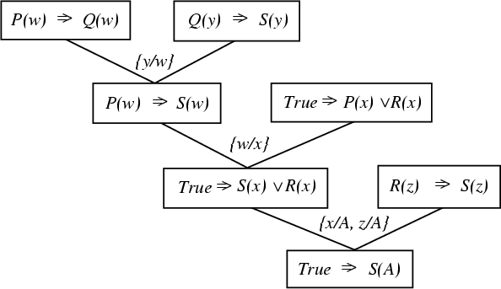
A resolution proof tree

Slide 12
A resolution proof tree
~P(w) v Q(w)
~Q(y) v S(y)
~True v P(x) v R(x)
P(x) v R(x)
~P(w) v S(w)
~R(w) v S(w)
S(x) v R(x)
S(A)

Slide 13
Resolution refutation
Given a consistent set of axioms KB and goal sentence Q, show that KB |= Q
Proof by contradiction: Add ¬Q to KB and try to prove false, i.e.:
(KB |- Q) ↔ (KB ∧ ¬Q |- False)
Resolution is refutation complete: it can establish that a given sentence Q is entailed by KB, but can’t (in general) generate all logical consequences of a set of sentences
Also, it cannot be used to prove that Q is not entailed by KB
Resolution won’t always give an answer since entailment is only semi-decidable
And you can’t just run two proofs in parallel, one trying to prove Q and the other trying to prove ¬Q, since KB might not entail either one

Slide 14
Resolution example
KB:
allergies(X) → sneeze(X)
cat(Y) ∧ allergicToCats(X) → allergies(X)
cat(felix)
allergicToCats(mary)
Goal:
sneeze(mary)

Slide 15
Refutation resolution proof tree
¬allergies(w) v sneeze(w)
¬cat(y) v ¬allergicToCats(z) ∨ allergies(z)
w/z
¬cat(y) v sneeze(z) ∨ ¬allergicToCats(z)
cat(felix)
y/felix
sneeze(z) v ¬allergicToCats(z)
allergicToCats(mary)
z/mary
sneeze(mary)
¬sneeze(mary)
Notation
old/new
false
negated query

