Slide 1
RDF and RDB 2 D2RQ

Slide 2
D2RQ showed the way
Early system to expose relational data as RDF
See http://d2rq.org/
Open source: https://github.com/d2rq/d2rq
Still widely used
Lets you
Query a non-RDF database using SPARQL
Access database content as linked data over Web
Dump database content in RDF formats
Access non-RDF database using Apache Jena API

Slide 3
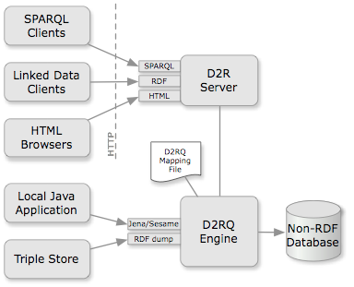
D2RQ
D2RQ mapping language file describes relation between ontology & RDB
D2R server gives HTML & linked data views & SPARQL endpoint
D2RQ engine uses map-pings to rewrite Jena & Sesame API calls to SQL queries & generates RDF dumps in various formats

Slide 4
D2RQ Features
Browsing database contents: Web interface for navigation through the RDF contents for people
Resolvable URIs: D2R Server assigns a resolvable URI to each entity in the database
Content negotiation: HTML & RDF versions share URIs; HTTP content negotiation fixes version
SPARQL: Both an endpoint and explorer provided
BLOBs and CLOBs: Support for serving up values as files (e.g., PDFs, images)
Not surprisingly, no inferencing

Slide 5
D2RQ Mapping Language
The mapping is defined in RDF
D2RQ default map uses a standard heuristic:
Each DB table has information about one type of thing
Each table row represents one object
First column is key => defines the object
Other columns represent properties
Edit default mapping or create your own

Slide 6
Let’s do it
Need: relational DBMS, Java, Web server
Clone or download D2RQ git repo
Compile with: ant jar
Install java and ant as needed
Create default mapping from a database
Start D2RQ server on a port
Send it SPARQL queries
Access it via html

Slide 7
A simple database
Load lab.sql into mysql
lab.sql is an sql dump file
mysql –u demo –p demo
...
mysql> show databases;
+--------------------+
| Database |
+--------------------+
| information_schema |
| mysql |
| performance_schema |
| sys |
+--------------------+
4 rows in set (0.00 sec)
mysql> source lab.sql
...
DROP SCHEMA IF EXISTS lab;
CREATE SCHEMA lab;
USE lab;
Drop TABLE IF EXISTS people;
CREATE TABLE people (
`Name` varchar(50),
`Age` INT default NULL,
`Mobile` varchar(50) default NULL,
PRIMARY KEY (`Name`)
);
INSERT INTO people (`Name`, `Age`, `Mobile`) VALUES
('Al Turing', 32, '443-253-3863'),
('Don Knuth', 25, '410-228-6282'),
('Chuck Babbage', 38, '410-499-1282');

Slide 8
A simple database
mysql> use lab; show tables;
+---------------+
| Tables_in_lab |
+---------------+
| people |
+---------------+
mysql> desc people;
+--------+-------------+------+-----+---------+-------+
| Field | Type | Null | Key | Default | Extra |
+--------+-------------+------+-----+---------+-------+
| Name | varchar(50) | NO | PRI | | |
| Age | int(11) | YES | | NULL | |
| Mobile | varchar(50) | YES | | NULL | |
+--------+-------------+------+-----+---------+-------+
mysql> select * from people;
+---------------+------+--------------+
| Name | Age | Mobile |
+---------------+------+--------------+
| Al Turing | 32 | 443-253-3863 |
| Don Knuth | 25 | 410-228-6282 |
| Chuck Babbage | 38 | 410-499-1282 |
+---------------+------+--------------+

Slide 9
D2RQ’s default model for this table
people table has info about things of type people <http://localhost:8081/resource/people>
Each table row has information about one instance of a people
First column is the key and is used both as
Identifier for a people instance <http://localhost:8081/people/Al_Turing>
rdf:label for the people instance “Al Turing”
Properties of a person are: name, age & mobile <http://localhost:8081/resource/people#Age>

Slide 10
Generating RDF mappings
D2RQ generates default mapping from database
% d2rq/generate-mapping –u demo –w3c \ -o lab_map.ttl “jdbc:mysql://127.0.0.1/lab”
-u arg: user for database access
-o arg: file to write mapping to
-w3c flag: use W3C compatible mapping format
Last arg: string JDBC uses to access database table
Resulting mapping can be edited as desired
ground URIs in a namespace like http://ebiq.org/o/lab/
Change the encodings of cell values (e.g., space => _)

Slide 11
Default D2RQ mapping
@prefix ...
Map:database a d2rq:Database;
d2rq:jdbcDriver "com.mysql.jdbc.Driver";
d2rq:jdbcDSN "jdbc:mysql://127.0.0.1/lab";
d2rq:username "demo”;
jdbc:autoReconnect "true";
jdbc:zeroDateTimeBehavior "convertToNull”; .
map:people a d2rq:ClassMap;
d2rq:dataStorage map:database;
d2rq:uriPattern "people/@@people.Name|urlify@@";
d2rq:class vocab:people;
d2rq:classDefinitionLabel "people”; .
map:people__label a d2rq:PropertyBridge;
d2rq:belongsToClassMap map:people;
d2rq:property rdfs:label;
d2rq:pattern "people #@@people.Name@@”;.
map:people_Name a d2rq:PropertyBridge;
d2rq:belongsToClassMap map:people;
d2rq:property vocab:people_Name;
d2rq:propertyDefinitionLabel "people Name";
d2rq:column "people.Name"; .
map:people_Age a d2rq:PropertyBridge;
d2rq:belongsToClassMap map:people;
d2rq:property vocab:people_Age;
d2rq:propertyDefinitionLabel "people Age";
d2rq:column "people.Age";
d2rq:datatype xsd:int; .
map:people_Mobile a d2rq:PropertyBridge;
d2rq:belongsToClassMap map:people;
d2rq:property vocab:people_Mobile;
d2rq:propertyDefinitionLabel "people Mobile";
d2rq:column "people.Mobile"; .

Slide 12
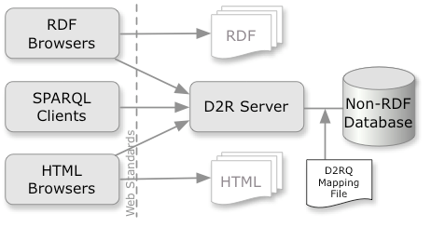
D2R Server
The d2r-server provides real-time access to rdf data via several protocols
d2r-server -port 8081 lab_map.ttl

Slide 13
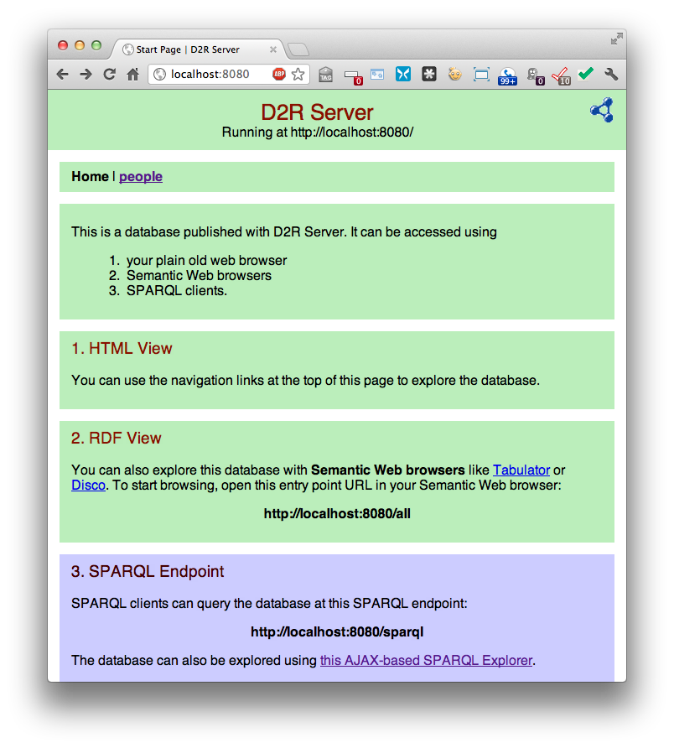
Access via D2R server
Explore via HTML
Via SPARQL endpoint

Slide 14
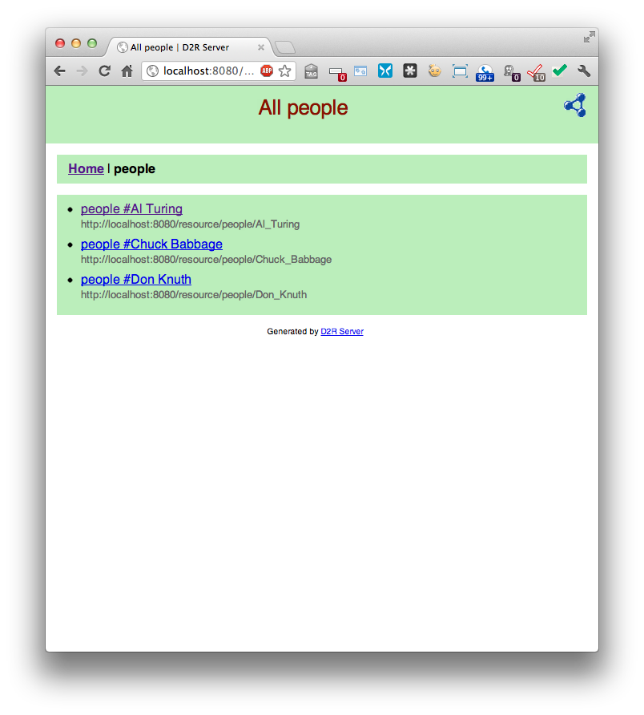
Access via D2R server
Explore via HTML
Via SPARQL endpoint

Slide 15
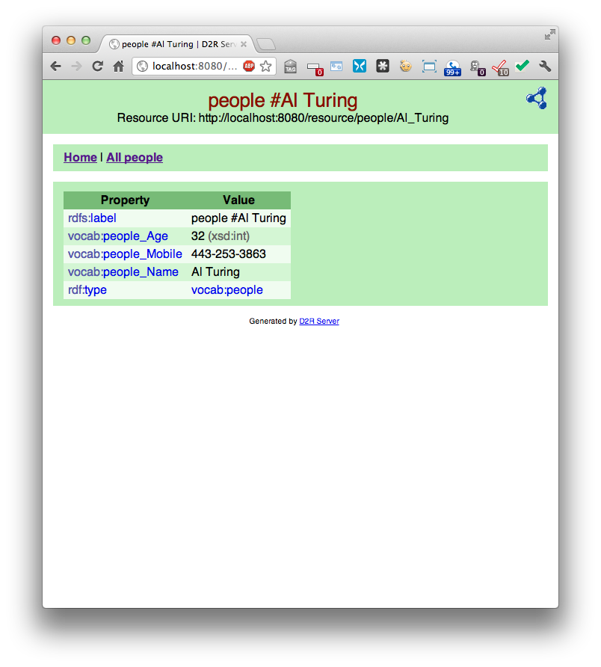
Access via D2R server
Explore via HTML
Via SPARQL endpoint

Slide 16
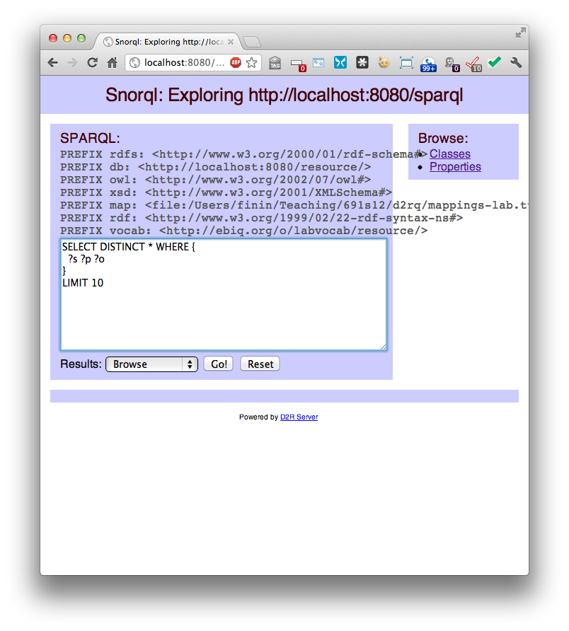
Access via D2R server
Via SPARQL endpoint

Slide 17
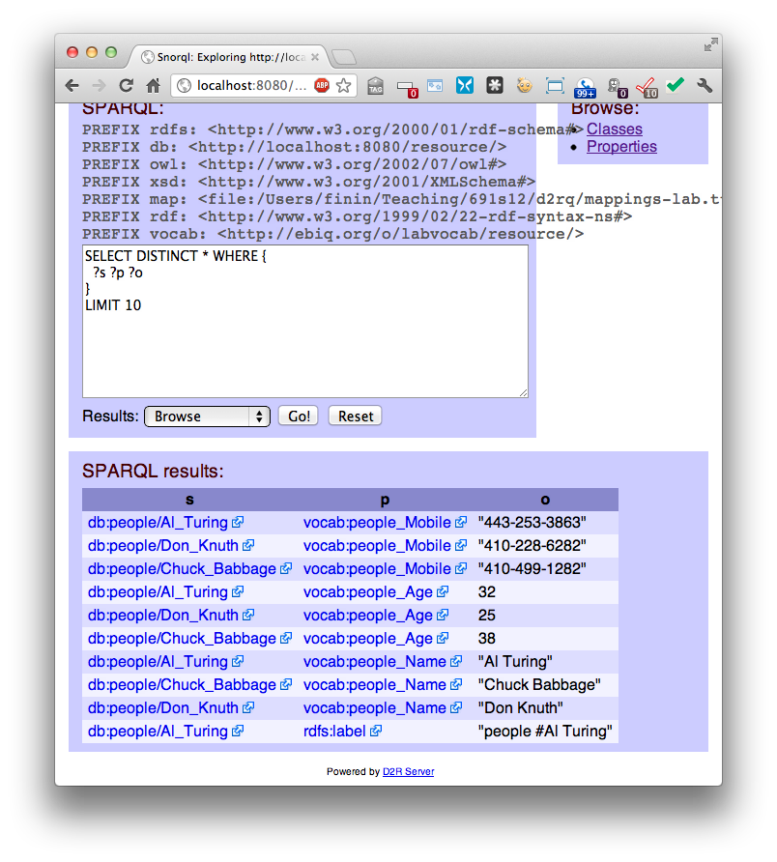
Access via D2R server
Via SPARQL endpoint

Slide 18
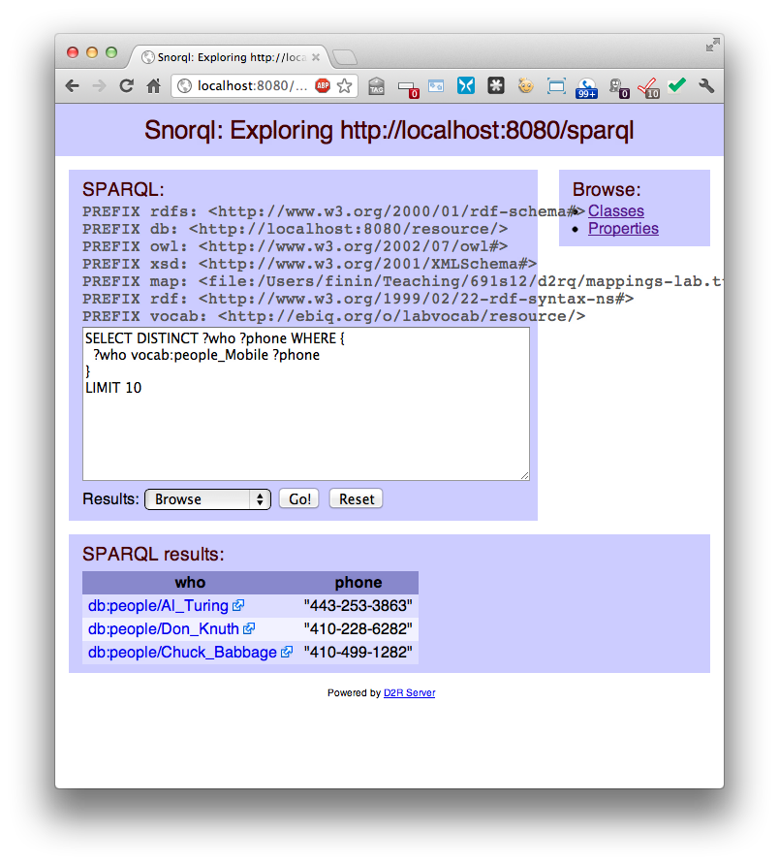
Access via D2R server
Via SPARQL endpoint

Slide 19
SPARLQ updates pushed to the DB
We can add, delete or modify triples with SPARQL and the changes will be made to the underlying database tables
PREFIX …
DELETE
{db:Al_Turing db:people#Mobile ?o . }
INSERT
{db:Al_Turing db:people#Mobile "443-561-1234" .
db:Grace_Hopper a db:people;
db:people#Mobile "410-455-8612” .}

Slide 20
Generating RDF dumps
Once mapping is defined, use dump-rdf for RDF dumps in various formats, e.g.:
% dump-rdf --w3c -o ../lab.ttl \ -f TURTLE ../lab_map.ttl

Slide 21
Generating RDF dumps
@prefix rdf: <http://www.w3.org/1999/02/22-rdf-syntax-ns#> .
…
@prefix vocab: <file:///Users/finin/Sites/691f16/examples/d2rq/vocab/> .
@prefix map: <file:///Users/finin/Sites/691f16/examples/d2rq/lab.ttl#> .
@prefix db: <file:///Users/finin/Sites/691f16/examples/d2rq/lab.ttl> .
vocab:people_Name a rdf:Property ;
rdfs:label "people Name" .
db:l#people/Al_Turing> a vocab:people ;
rdfs:label "people #Al Turing" ;
vocab:people_Age 32 ;
vocab:people_Mobile "443-253-3863" ;
vocab:people_Name "Al Turing" .
…

Slide 22
Content Negotiation
D2RQ automatically recognizes URIs for
Entities (e.g., an RDF object like a class or instance) http://localhost:8080/resource/people/Al_Turing
RDF representations http://localhost:8080/data/people/Al_Turing
HTML representations http://localhost:8080/page/people/Al_Turing
The HTTP protocol supports content negotiation
A get request can specify what kind of content it wants, e.g., HTML or RDF

Slide 23
Resources and 303 redirects
Asking for raw resource make no sense – it’s just an identifier
Client specifies in HTTP header the kind of content desired, e.g. HTML or RDF
Server responds with an 303 redirect indicating where to go
When client gets the 303 response, it asks for new URL

Slide 24
Resources and 303 redirects
% curl -H "Accept: text/html" http://localhost:8081/resource/people/Al_Turing
303 See Other: For a description of this item, see http://localhost:8081/page/people/Al_Turing
% curl -H "Accept: application/rdf+xml” http://localhost:8081/resource/people/Al_Turing
303 See Other: For a description of this item, see http://localhost:8081/data/people/Al_Turing

Slide 25
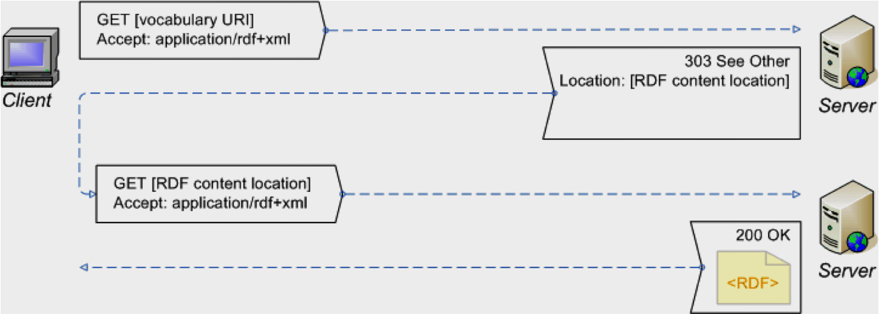
URIs should be de-referenceable
Linked Data best practice says that URIs should be dereferenceable;
Doing a GET on one should always yield useful information

Slide 26
Asking for RDF data
% curl http://localhost:8081/data/people/Al_Turing
@prefix rdfs: <http://www.w3.org/2000/01/rdf-schema#> . …
@prefix vocab: <http://ebiq.org/o/labvocab/resource/> .
<http://localhost:8080/data/people/Al_Turing>
rdfs:label "RDF Description of people #Al Turing" ;
foaf:primaryTopic <http://localhost:8080/resource/people/Al_Turing> .
vocab:people
rdfs:seeAlso <http://localhost:8080/sparql?query=DESCRIBE+%3Chttp%3A%2F%2Febiq.org%2Fo%2Flabvocab%2Fresource%2Fpeople%3E> .
<http://localhost:8080/resource/people/Al_Turing>
a vocab:people ;
rdfs:label "people #Al Turing" ;
vocab:people_Age "32"^^xsd:int ;
vocab:people_Mobile "443-253-3863" ;
vocab:people_Name "Al Turing" .

Slide 27
Asking for HTML
% curl http://localhost:8081/page/people/Al_Turing
<?xml version="1.0" encoding="utf-8"?>
<!DOCTYPE html PUBLIC "-//W3C//DTD XHTML 1.0 Strict//EN" "http://www.w3.org/TR/xhtml1/DTD/xhtml1-strict.dtd">
<html xmlns="http://www.w3.org/1999/xhtml" xml:lang="en" lang="en">
<head>
<title> people #Al Turing | D2R Server </title>
<link rel="stylesheet" type="text/css" href="http://localhost:8080/snorql/style.css" />
<link rel="alternate" type="application/rdf+xml" href="http://localhost:8080/data/people/Al_Turing?output=rdfxml" title="This page in RDF (XML)" />
<link rel="alternate" type="text/rdf+n3" href="http://localhost:8080/data/people/Al_Turing?output=n3" title="This page in RDF (N3)" />
</head>
…

Slide 28
ISWC database example
D2RQ comes with an example database and mapping for information about the first ISWC conference
To run:
d2r-server -port 8082 ../iswc_map.ttl
Visit http://localhost:8082/

Slide 29
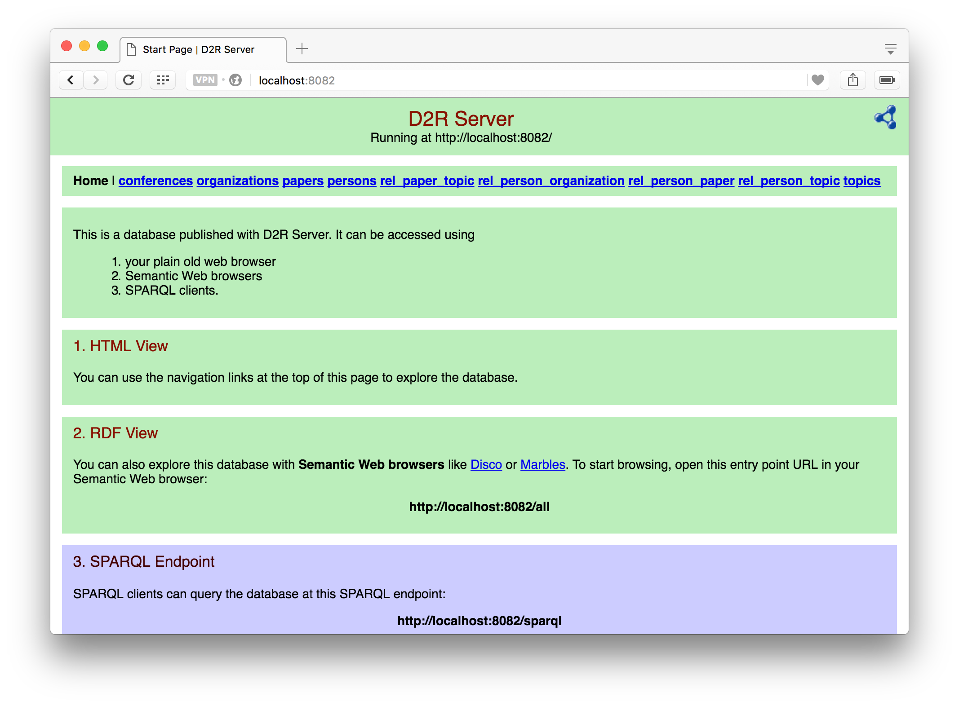

Slide 30
ISWC Database
Information about several conferences
Its richer schema goes beyond simple auto generated mapping
This tutorial shows how to install and some sample queries
This one shows how to update the data via SPARQL
mysql> use iswc; show tables;
+-------------------------+
| Tables_in_iswc |
+-------------------------+
| conferences |
| organizations |
| papers |
| persons |
| rel_paper_topic |
| rel_person_organization |
| rel_person_paper |
| rel_person_topic |
| topics |
+-------------------------+
9 rows in set (0.00 sec)

Slide 31
R2RML
D2RQ was a practical system first developed in 2004 that is widely used
W3C formed a RDB2RDF working group in 2009 to develop a standard
R2RML: RDB to RDF Mapping Language is a W3C recommendation since 2012-09-27
Several implementations are available

