Slide 1
RDF123: Spreadsheets to RDF
In 2007 we developed the RDF123 Java app to translate spreadsheets into RDF graphs
Translation is driven by a map that permits
a rich schema to apply to each row, rather than just creating a single instance of a RDF/OWL class.
Conditionals allow different rows to use different schemata
See http://rdf123.umbc.edu/ for more info
See CSV on the Web: A Primer for the W3C’s work on developing a standard

Slide 2
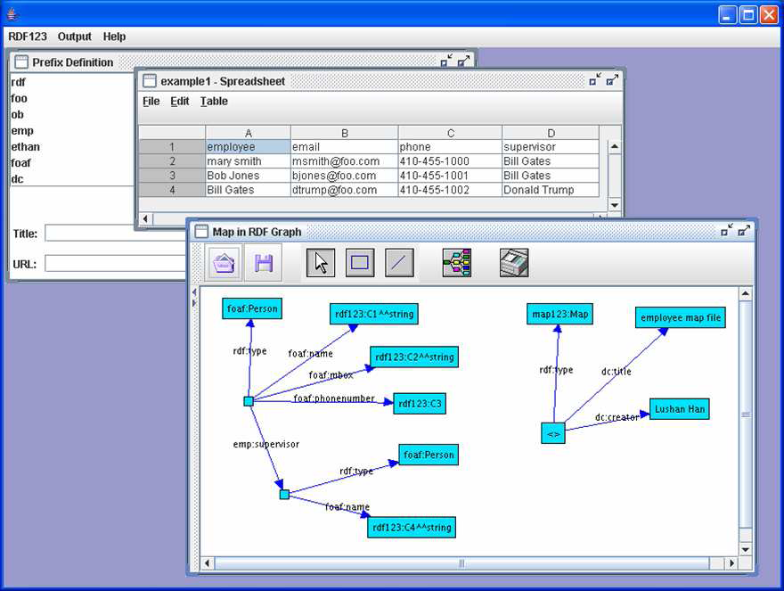
RDF123 Java Application

Slide 3
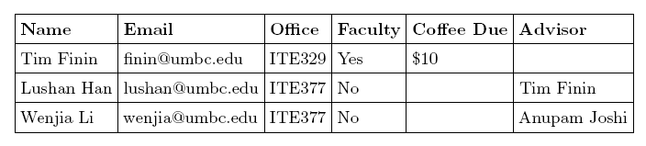
RDF123 Example

Slide 4
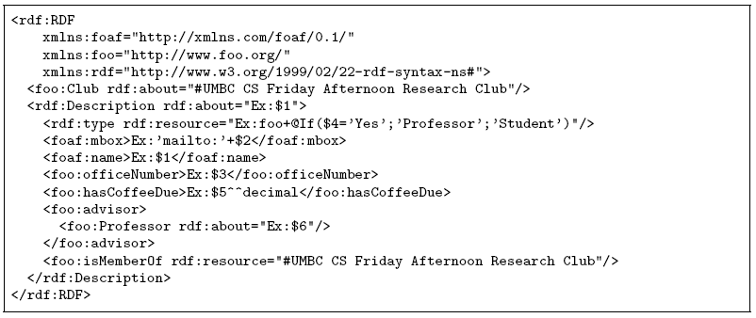
RDF123 graph serialized as RDF/XML

