Slide 1
Generating Linked Data by Inferring the Semantics of Tables Varish Mulwad, Ph.D. 2015
http://ebiq.org/j/96

Slide 2
Goal: Table => LOD*
dbprop:team
http://dbpedia.org/class/yago/NationalBasketballAssociationTeams
Name | Team | Position | Height
Michael Jordan | Chicago | Shooting guard | 1.98
Allen Iverson | Philadelphia | Point guard | 1.83
Yao Ming | Houston | Center | 2.29
Tim Duncan | San Antonio | Power forward | 2.11
http://dbpedia.org/resource/Allen_Iverson
Player height in meters
* DBpedia

Slide 3
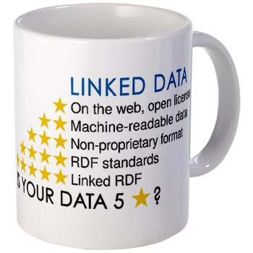
Goal: Table => LOD*
Name | Team | Position | Height
Michael Jordan | Chicago | Shooting guard | 1.98
Allen Iverson | Philadelphia | Point guard | 1.83
Yao Ming | Houston | Center | 2.29
Tim Duncan | San Antonio | Power forward | 2.11
@prefix dbpedia: <http://dbpedia.org/resource/> .
@prefix dbo: <http://dbpedia.org/ontology/> .
@prefix yago: <http://dbpedia.org/class/yago/> .
"Name"@en is rdfs:label of dbo:BasketballPlayer .
"Team"@en is rdfs:label of yago:NationalBasketballAssociationTeams .
"Michael Jordan"@en is rdfs:label of dbpedia:Michael Jordan .
dbpedia:Michael Jordan a dbo:BasketballPlayer .
"Chicago Bulls"@en is rdfs:label of dbpedia:Chicago Bulls .
dbpedia:Chicago Bulls a yago:NationalBasketballAssociationTeams .
RDF Linked Data
All this in a completely automated way
* DBpedia

Slide 4




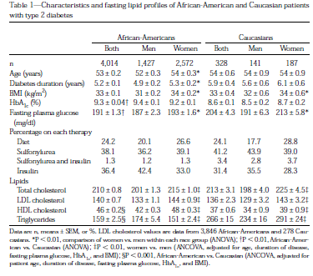


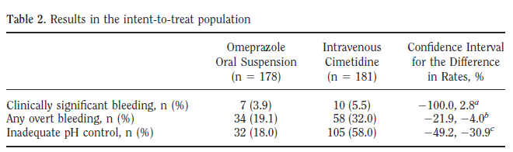
Tables are everywhere !! … yet …
The web – 154 million high quality relational tables
Notes:
Why do we want to interpret tables

Slide 5
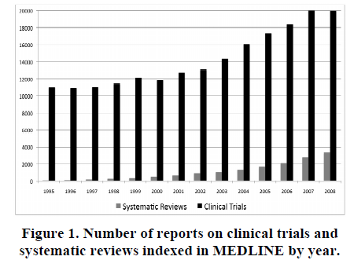
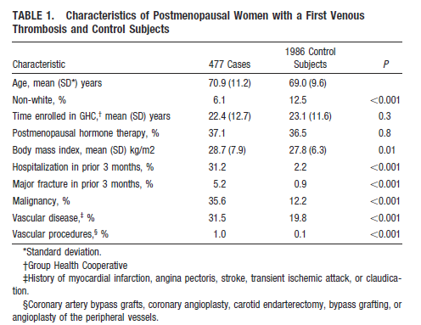
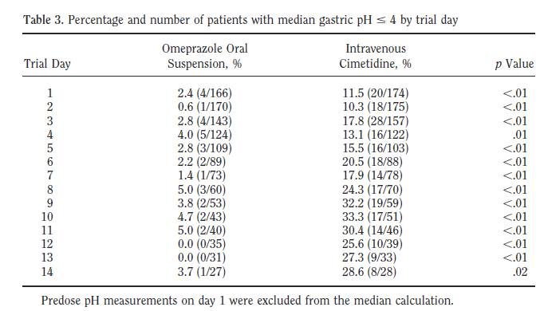
Evidence–based medicine
Evidence-based medicine judges the efficacy of treatments or tests by meta-analyses of clinical trials. Key information is often found in tables in articles
# of Clinical trials published in 2008
# of meta analysis published in 2008
However, the rate at which meta-analyses are published remains very low … hampers effective health care treatment …
Figure: Evidence-Based Medicine - the Essential Role of Systematic Reviews, and the Need for Automated Text Mining Tools, IHI 2010

Slide 6




~ 400,000 datasets ~ < 1 % in RDF

Slide 7
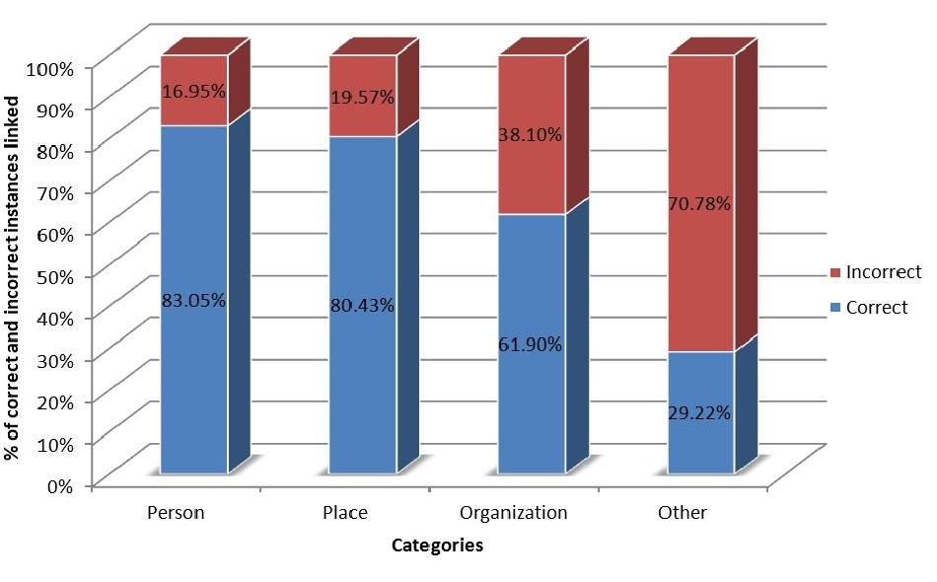


2010 Preliminary System
T2LD Framework
Predict Class for Columns
Linking the table cells
Identify and Discover relations
Class prediction for column: 77%
Entity Linking for table cells: 66%
Examples of class label prediction results: Column – Nationality Prediction – MilitaryConflict
Column – Birth Place Prediction – PopulatedPlace

Slide 8

Sources of Errors
The sequential approach let errors perco-late from one phase to the next
The system was biased toward predicting overly general classes over more appropriate specific ones
Heuristics largely drive the system
Although we consider multiple sources of evidence, we did not joint assignment

Slide 9
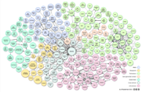

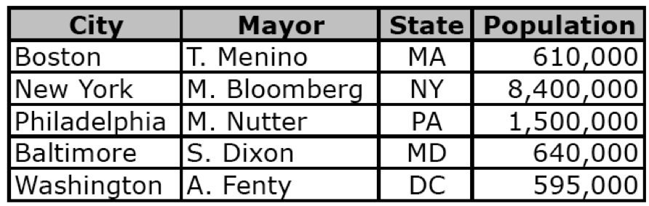
A Domain Independent Framework
Pre-processing modules
Sampling
Acronym detection
Query and generate initial mappings
Joint Inference/Assignment
2
1
Generate Linked RDF
Verify (optional)
Store in a knowledge base & publish as LOD

Slide 10


Query Mechanism
Team
Michael Jordan | Chicago Bulls | Shooting Guard | 1.98
{dbo:Place,dbo:City,yago:WomenArtist,yago:LivingPeople,yago:NationalBasketballAssociationTeams…}
Chicago Bulls, Chicago, Judy Chicago …
………
possible types
possible entities

Slide 11
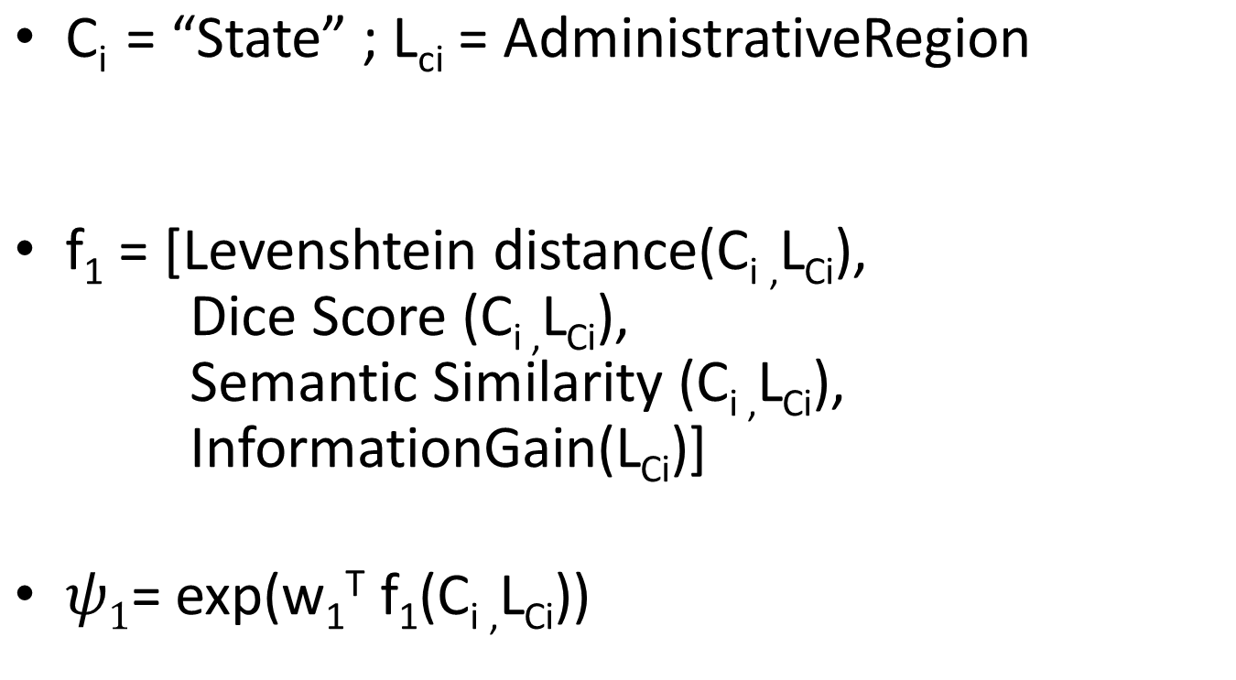
Ranking the candidates
String in column header
Class from an ontology
String similarity metrics

Slide 12
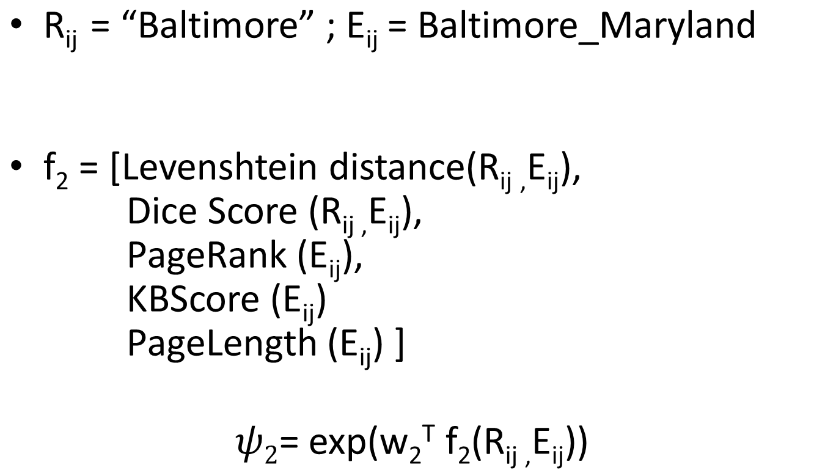
Ranking the candidates
String in table cell
Entity from the knowledge base (KB)
String similarity metrics
Popularity metrics

Slide 13

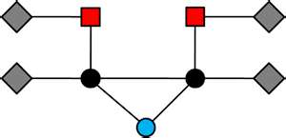
Joint Inference over evidence in a table
Probabilistic Graphical Models

Slide 14
A graphical model for tables Joint inference over evidence in a table
Class
C1
C2
C3
Team
Chicago
Philadelphia
Houston
San Antonio
R11
R21
R31
R12
R22
R32
R13
R23
R33
Instance

Slide 15






Parameterized graphical model
Captures interaction between row values
$$ψ4$$
$$ψ4$$
$$ψ4$$
R11
R12
R13
R21
R22
R23
R31
R32
R33
$$ψ3$$
$$ψ3$$
$$ψ3$$
Row value
C1
C2
Factor Node
C3
Function that captures the affinity between the column headers and row values
Variable Node: Column header
$$ψ5$$
Captures interaction between column headers

Slide 16
Challenge: Interpreting Literals
Many columns have literals, e.g., numbers
Population
690,000
345,000
510,020
120,000
Age
75
65
50
25
Age in years?
Percent?
Population?
Profit in $K ?
Predict properties based on cell values
Cyc had hand coded rules: humans don’t live past 120
We extract value distributions from LOD resources
Differ for subclasses: age of people vs. political leaders vs. athletes
Represent as measurements: value + units
Metric: possibility/probability of values given distribution

Slide 17

Other Challenges
Using table captions and other text is associated documents to provide context
Size of some data.gov tables (> 400K rows!) makes using full graphical model impractical
Sample table and run model on the subset
Achieving acceptable accuracy may require human input
100% accuracy unattainable automatically
How best to let humans offer advice and/or correct interpretations?

