Slide 1

JSON-LD
JSON for Linked Data: a standard for serializing RDF using JSON

Slide 2
JSON as an XML Alternative
Light-weight XML alternative for data-interchange
JSON = JavaScript Object Notation
It’s really language independent
Most programming languages can easily read it and instantiate objects
Defined in RFC 4627
Started gaining traction ~2006, now widely used
http://json.org/ has more information

Slide 3
Example
{"firstName": "John",
"lastName" : "Smith",
"age" : 25,
"address" :
{"streetAdr” : "21 2nd Street",
"city" : "New York",
"state" : "NY",
”zip" : "10021"},
"phoneNumber":
[{"type" : "home",
"number": "212 555-1234"},
{"type" : "fax",
"number” : "646 555-4567"}]
}
This is a JSON object with five key-value pairs
Objects are wrapped by curly braces
There are no object IDs
Keys are strings
Values are numbers, strings, objects or arrays
Arrays are wrapped by square brackets

Slide 4
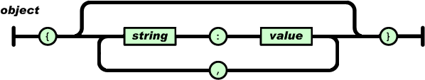
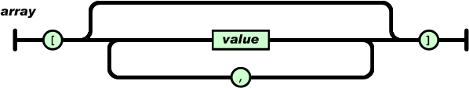
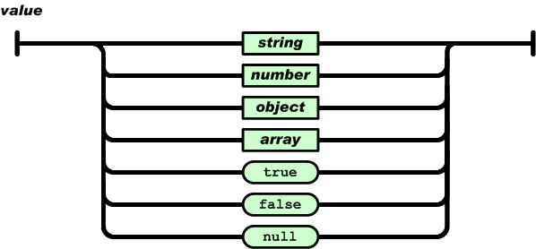
The BNF is simple

Slide 5
Evaluation
JSON is simpler than XML and more compact
No closing tags, but after compressing XML and JSON the difference is not so great
XML parsing is hard because of its complexity
JSON has a better fit for OO systems than XML, but not as extensible
Preferred for simple data exchange by many
MongoDB: ‘NoSQL’ database for JSON objects
ElasticSearch: Lucene-based IR system using JSON to represent documents

Slide 6
Dict to Graph (1)
JSON objects: like key-value stores where the values can be atomic, lists or JSON objects
These map to Python simple types, lists and dictionaries
>>> j_string = """{"firstName":"John", "lastName":"Smith" ... }"""
>>> j_obj = json.loads(j_string)
>>> j_obj
{'firstName':'John','lastName':'Smith','age':25,'address':{'streetAdr':'21 2ndStreet','city':’NewYork','state':'NY','zip':'10021’},'phoneNumber':[{'type':'home','number':'212-555-1234'},{'type':'fax','number':'646-555-4567'}]}
>>> j_obj['phoneNumber'][0]['number']
'212-555-1234'

Slide 7
Dict to Graph (2)
Using JSON for knowledge graphs requires us to develop conventions to:
Represent a general graph structure with this tree-oriented data structure
Encode aspects for a RDF knowledge graph, like namespaces, prefixes, distinguishing URI representing objects from those representing web pages

Slide 8
JSON-LD Status
JSON-LD: 2014 W3C recommendation for representing RDF data as JSON objects
See JSON-LD 1.1 for a draft of a new version
Google, Bing and Yandex look for embedded JSON-LD data in web pages
and use the information they understand, e.g., statements using schema.org terms
Google now recommends using JSON-LD for structured data whenever possible

Slide 9
JSON-LD
@prefix foaf: <http://xmlns.com/foaf/0.1/> . @prefix xsd: <http://www.w3.org/2001/XMLSchema#> .
<http://me.markus-lanthaler.com> a foaf:Person ;
foaf:name "Markus Lanthaler"^^xsd:string ;
foaf:workplaceHomepage <http://www.tugraz.at/> .
JSON-LD: 2014 W3C recommendation for representing RDF data as JSON objects
{"@context": {
"name": "http://xmlns.com/foaf/0.1/name",
"homepage": {
"@id": "http://xmlns.com/foaf/0.1/workplaceHomepage",
"@type": "@id"
},
"Person": "http://xmlns.com/foaf/0.1/Person"
},
"@id": "http://me.markus-lanthaler.com",
"@type": "Person",
"name": "Markus Lanthaler",
"homepage": "http://www.tugraz.at/"
}

Slide 10
In the beginning
{
"name": "Manu Sporny",
"homepage": "http://manu.sporny.org/",
"image": "http://manu.sporny.org/images/manu.png"
}

Slide 11
A bit better
{
"http://schema.org/name": "Manu Sporny",
"http://schema.org/url": { "@id": "http://manu.sporny.org/" }
"http://schema.org/image": { "@id": "http://manu.sporny.org/images/manu.png" }
}
The '@id' keyword means 'This value is an identifier that is an IRI’
i.e., it’s not just a reference to a web page

Slide 12
Define a context
A context lets you define things that apply to the entire JSON object, such as full versions of some terms and (we will see) namespace prefixes and other properties
{ "@context":
{
"name": "http://schema.org/name", % [1]
"image": {
"@id": "http://schema.org/image", % [2]
"@type": "@id" % [3]
},
"homepage": {
"@id": "http://schema.org/url", % [4]
"@type": "@id" % [5]
} } }
[1] means 'name' is short for 'http://schema.org/name'
[2] means 'image' is short for 'http://schema.org/image'
[3] means a string value associated with 'image' should be interpreted as an identifier that is an IRI
[4] means 'homepage' short for 'http://schema.org/url'
[5] means string value associated with 'homepage’ to be interpreted as an identifier that is an IRI

Slide 13
Reference an external context
A context can be specified by a URL that points to a JSON object
{
"@context": "http://json-ld.org/contexts/person.jsonld",
"name": "Manu Sporny",
"homepage": "http://manu.sporny.org/",
"image": "http://manu.sporny.org/images/manu.png"
}

Slide 14
More typically: add context inline
{"@context":
{
"name": "http://schema.org/name",
"image": {
"@id": "http://schema.org/image",
"@type": "@id"
},
"homepage": {
"@id": "http://schema.org/url",
"@type": "@id"
}
},
"name": "Manu Sporny",
"homepage": "http://manu.sporny.org/",
"image": "http://manu.sporny.org/images/manu.png"
}

Slide 15
External Context?
Fetch http://json-ld.org/contexts/person.jsonld
curl http://json-ld.org/contexts/person.jsonld
Returns a JSON object defining the context
Fetch http://schema.org/
curl –L http://schema.org/
Returns HTML page, since its default application/type is HTML
Fetch
curl --header "Accept: application/ld+json" -L http://schema.org/
Notes:
-L says to follow redirects

Slide 16
Making assertions about things
The "@id" JSON property means value is (1) a reference to an RDF object, not a literal, and (2) the subject of all other property/values pairs in this object. @type is rdf:type
{"@context": {
...
"Restaurant": "http://schema.org/Restaurant",
"Brewery": "http://schema.org/Brewery"
}
"@id": "http://example.org/places#BrewEats",
"@type": [ "Restaurant", "Brewery" ],
...}

Slide 17
Adding a default vocabulary
The "@vocab" JSON property means any unqualified properties (e.g., “name”) or objects (e.g., “Restaurant”) come from its value’s vocabulary
{"@context": {
"@vocab": "http://schema.org/"
}
"@id": "http://example.org/places#BrewEats",
"@type": "Restaurant",
"name": "Brew Eats"
...}

Slide 18
Mixing vocabularies
{"@context":
{ "xsd": "http://www.w3.org/2001/XMLSchema#",
"foaf": "http://xmlns.com/foaf/0.1/",
"foaf:homepage": { "@type": "@id" },
"picture": { "@id": "foaf:depiction", "@type": "@id" }
},
"@id": "http://me.markus-lanthaler.com/",
"@type": "foaf:Person",
"foaf:name": "Markus Lanthaler",
"foaf:homepage": "http://www.markus-lanthaler.com/",
"picture": "http://twitter.com/account/profile_image/mlanthaler"
}

Slide 19
Mixing vocabularies
@prefix foaf: <http://xmlns.com/foaf/0.1/> .
@prefix xsd: <http://www.w3.org/2001/XMLSchema#> .
<http://me.markus-lanthaler.com/> a foaf:Person ;
foaf:depiction <http://twitter.com/account/profile_image/mlanthaler> ;
foaf:homepage <http://www.markus-lanthaler.com/> ;
foaf:name "Markus Lanthaler"^^xsd:string .
{"@context":
{ "xsd": "http://www.w3.org/2001/XMLSchema#",
"foaf": "http://xmlns.com/foaf/0.1/",
"foaf:homepage": { "@type": "@id" },
"picture": { "@id": "foaf:depiction", "@type": "@id" }
},
"@id": "http://me.markus-lanthaler.com/",
"@type": "foaf:Person",
"foaf:name": "Markus Lanthaler",
"foaf:homepage": "http://www.markus-lanthaler.com/",
"picture": http://twitter.com/account/profile_image/mlanthaler }

Slide 20
Embedding other objects
{
...
"name": "Manu Sporny",
"foaf:knows":
{
"@type": "Person",
"name": "Gregg Kellogg",
}
...
}
Produces a blank node

Slide 21
Search Engines looks for JSON-LD
Google, Bing and Yandex all looks for and use JSON-LD markup
Only schema.org vocabulary is “understood”
Put a JSON-LD object in head or body of web page wrapped with script tags:
<script type="application/ld+json">
{...}
</script>

Slide 22
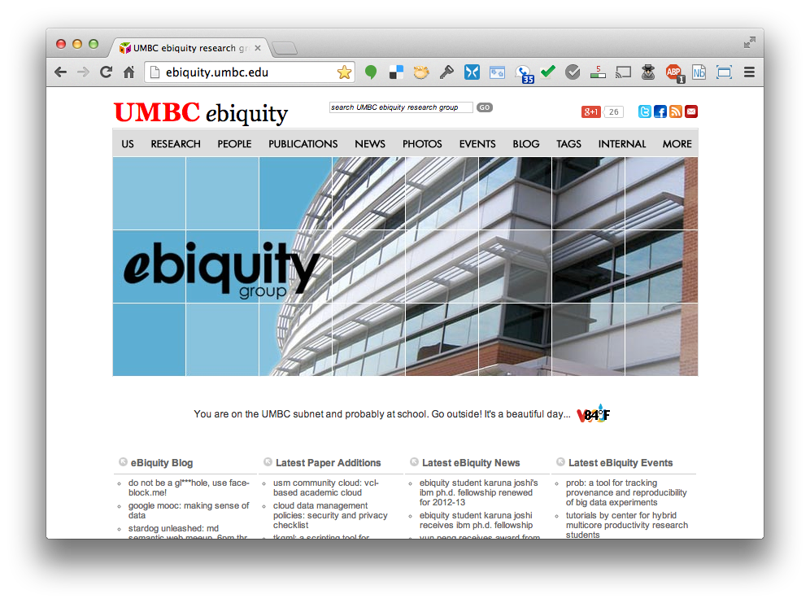

Slide 23
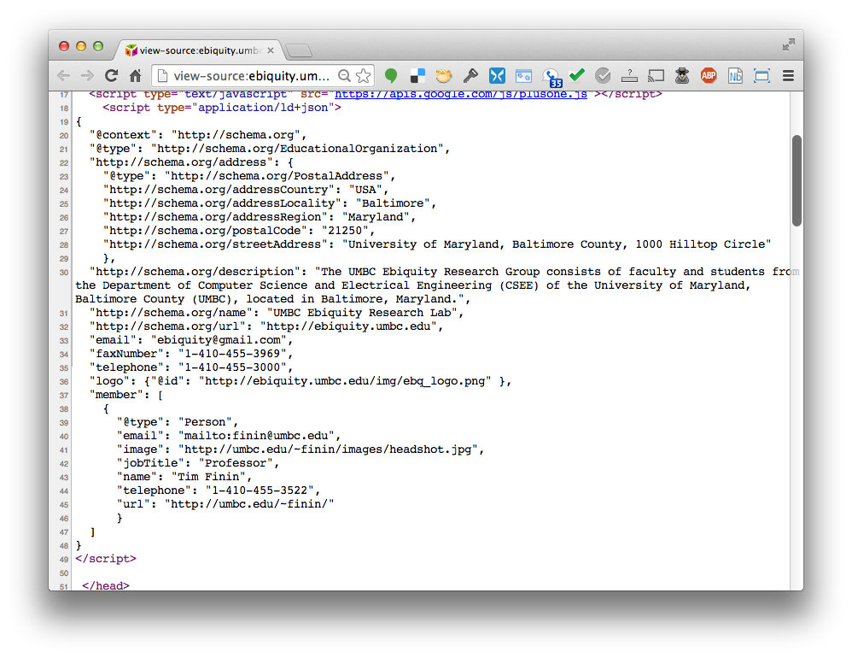

Slide 24
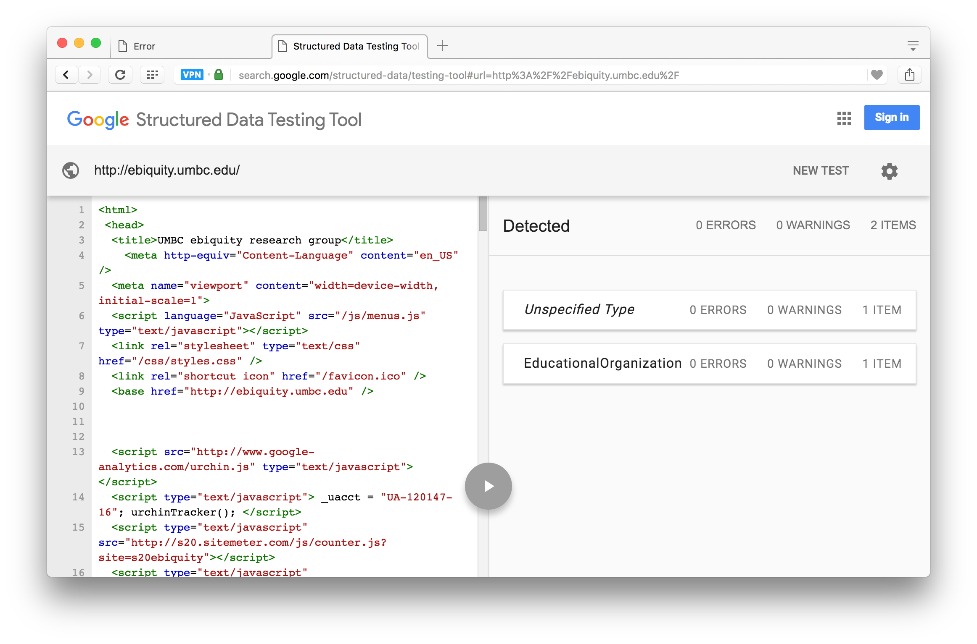
https://search.google.com/structured-data/testing-tool

Slide 25
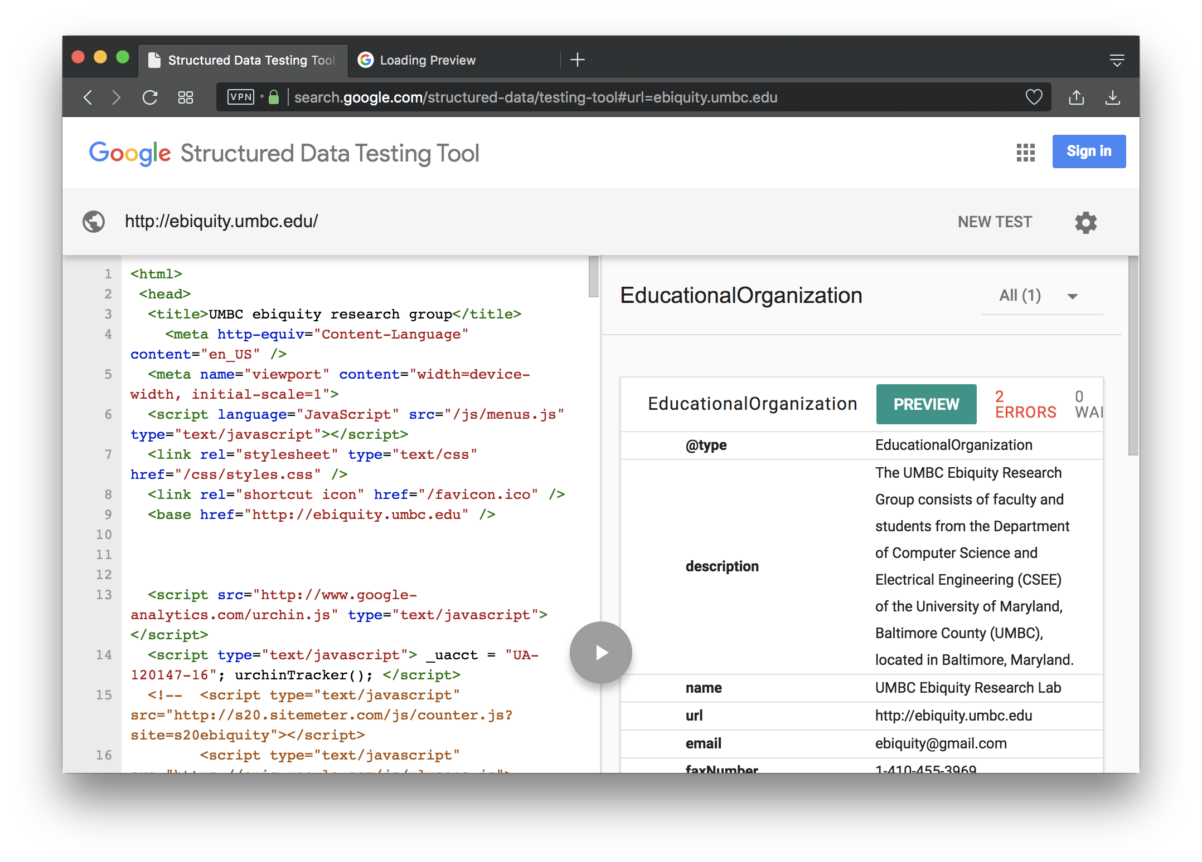

Slide 26
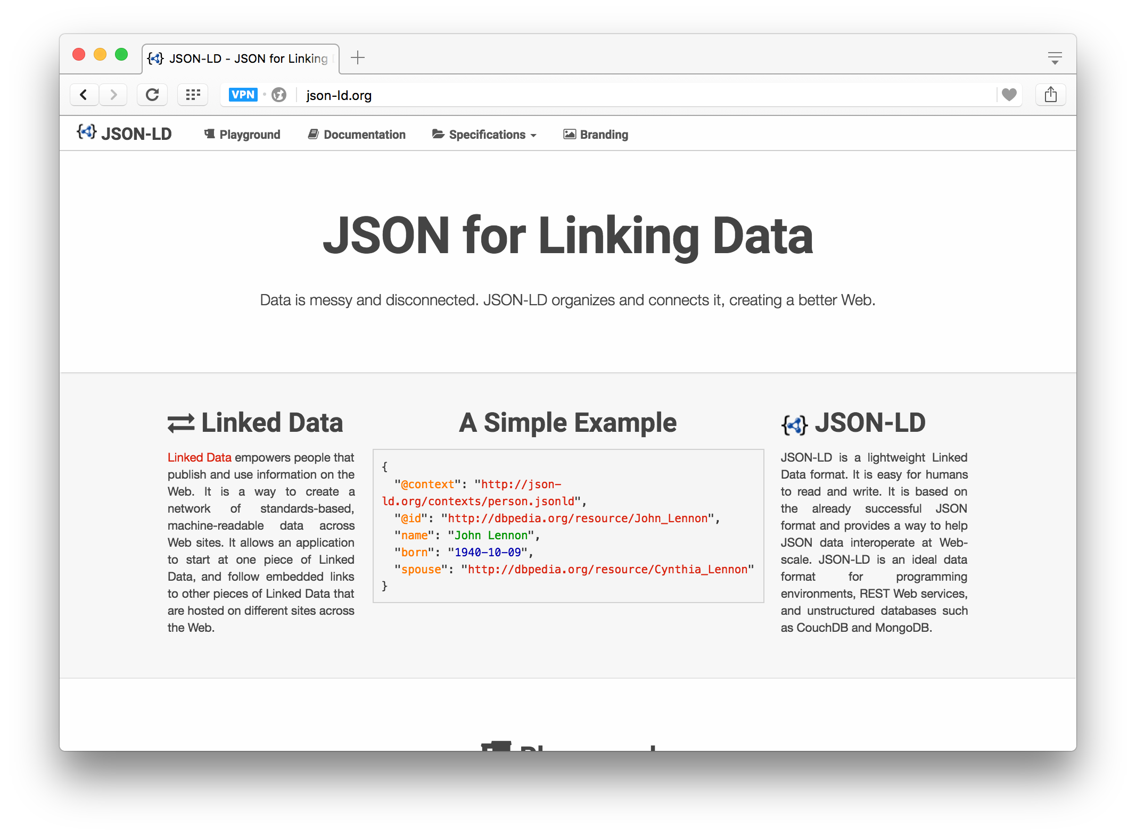

http://json-ld.org/

Slide 27
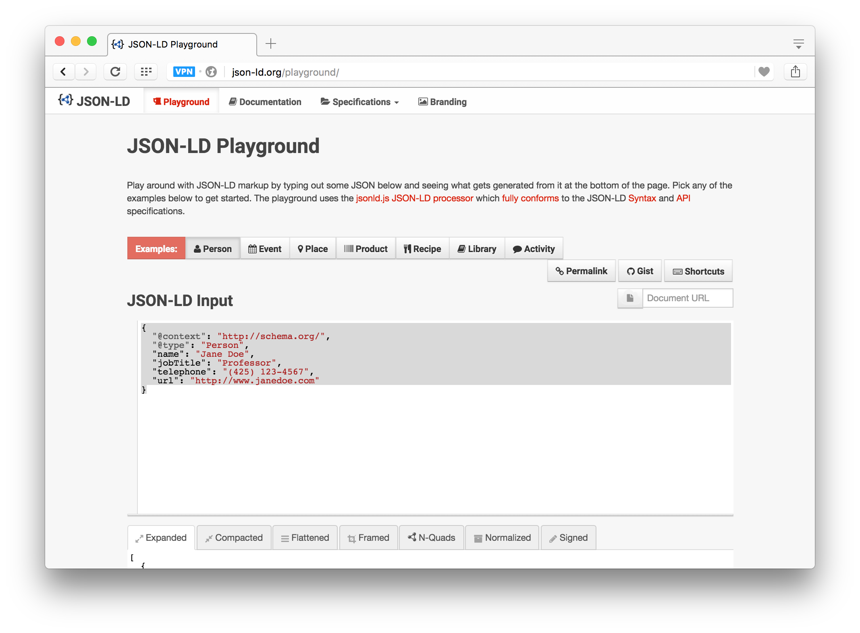
JSON-LD Playground

Slide 28
Conclusion
JSON-LD is a good solution to putting blocks of semantic data on web pages
Aimed at publishing linked data, not ontologies, i.e., ABOX not TBOX
Tools available for extracting RDF triples
Search engines look for and use JSON-LD that use vocabularies they understand (i.e., schema.org)

