Slide 1
Microdata and schema.org

Slide 2
Basics
Microdata is a simple semantic markup scheme that’s an alternative to RDFa
Developed by WHATWG* and supported by major search companies (Google, Microsoft, Yahoo, Yandex)
Like RDFa, it uses HTML tag attributes to host metadata
It can also be expressed as JSON-LD
Vocabularies are controlled and hosted at schema.org
* Web Hypertext Application Technology Working Group

Slide 3
What is WHATWG?
Web Hypertext Application Technology Working Group
Community interested in evolving the Web with focus on HTML and Web API development
Ian Hickson is a key person, now at Google
Founded in 2004 by individuals from Apple, Mozilla and Opera after a W3C workshop
Concern about W3C's embrace of XHTML
Worked on HTML5, developed Microdata spec

Slide 4

HTML5
Started by WHATWG as an alternative to XHTML, then joined by W3C
HTML5 recommendation, October 2014
HTML5.2 recommendation, Dec. 2017
WHATWG will evolve it as a “living standard”
HTML5 ≈ HTML + CSS + js
Native support for graphics, video, audio, speech, semantic markup, …
Current support in major browsers

Slide 5
Microdata
The microdata effort has two parts:
A markup scheme
A set of vocabularies/ontologies
The markup is similar to RDFa in providing ways to identify subjects, types, properties & objects
Also a standard way to encode Microdata as RDFa
Sanctioned vocabularies at schema.org and include a small number of very useful ones: people, movies, events, recipes, etc.

Slide 6
An example
<div>
<h1>Avatar</h1>
<span>Director: James Cameron (born 1954) </span>
<span>Science fiction</span>
<a href=”avatar-trailer.html">Trailer</a>
</div>

Slide 7
An example: itemscope
An itemscope attribute identifies a content subtree that is the subject about which we want to say something
<div itemscope >
<h1>Avatar</h1>
<span>Director: James Cameron (born 1954) </span>
<span>Science fiction</span>
<a href=”avatar-trailer.html">Trailer</a>
</div>

Slide 8
An example: itemtype
An itemscope attribute identifies a content subtree that is the subject about which we want to say something
The itemtype attribute specifies the subject’s type
<div itemscope itemtype="http://schema.org/Movie">
<h1>Avatar</h1>
<span>Director: James Cameron (born 1954) </span>
<span>Science fiction</span>
<a href=”avatar-trailer.html">Trailer</a>
</div>

Slide 9
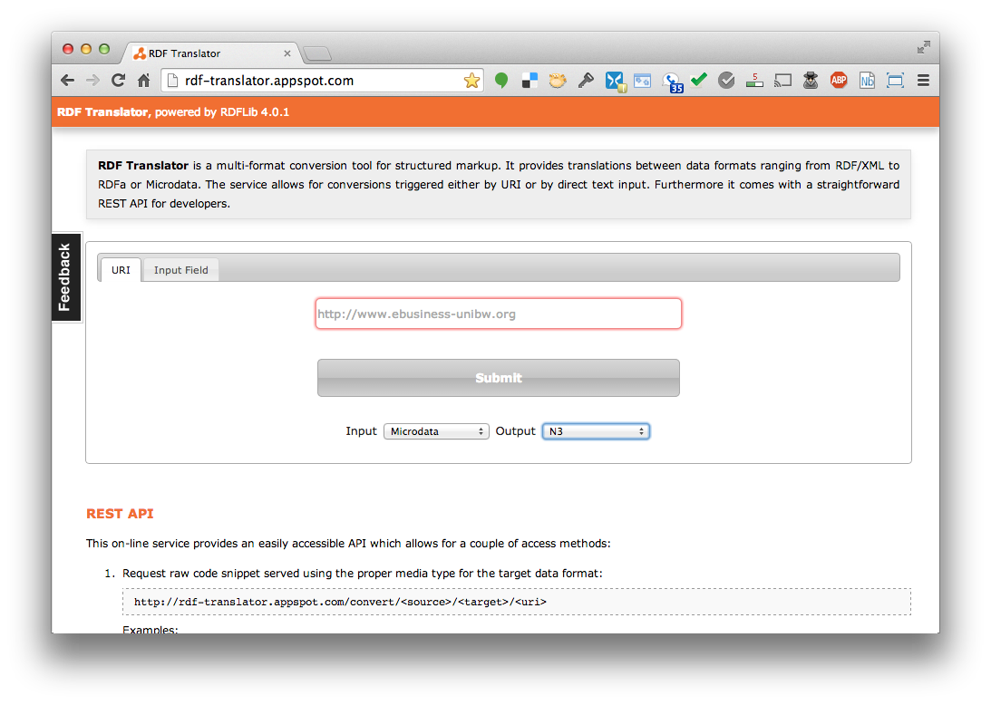
Microdata <-> RDF
http://rdf-translator.appspot.com/

Slide 10
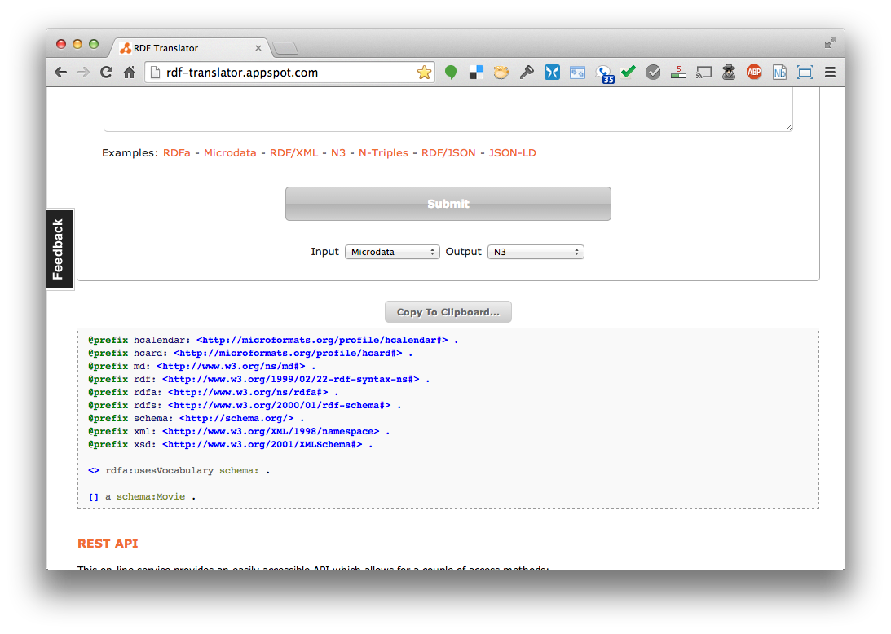
Microdata <-> RDF
http://rdf-translator.appspot.com/

Slide 11
An example: itemtype
An itemscope attribute identifies content subtree that is the subject about which we want to say something
The itemtype attribute specifies the subject’s type
<div itemscope itemtype="http://schema.org/Movie">
<h1>Avatar</h1>
<span>Director: James Cameron (born 1954) </span>
<span>Science fiction</span>
<a href=”avatar-trailer.html">Trailer</a>
</div>
[ ] a schema:Movie .

Slide 12
An example: itemprop
An itemscope attribute identifies a content subtree that is the subject about which we want to say something
The itemtype attribute specifies the subject’s type
An itemprop attribute gives a property of that type
<div itemscope itemtype="http://schema.org/Movie">
<h1 itemprop="name">Avatar</h1>
<span>Director: James Cameron (born 1954) </span>
<span itemprop="genre">Science fiction</span>
<a href=”avatar-trailer.html” itemprop="trailer">Trailer</a>
</div>

Slide 13
An example: itemprop
An itemscope attribute identifies a content subtree that is the subject about which we want to say something
The itemtype attribute specifies the subject’s type
An itemprop attribute gives a property of that type
<div itemscope itemtype="http://schema.org/Movie">
<h1 itemprop="name">Avatar</h1>
<span>Director: James Cameron (born 1954) </span>
<span itemprop="genre">Science fiction</span>
<a href=”avatar-trailer.html” itemprop="trailer">Trailer</a>
</div>
[ ] a schema:Movie ;
schema:genre "Science fiction" ;
schema:name "Avatar" ;
schema:trailer <avatar-trailer.html> .

Slide 14
An example: embedded items
An itemprop immediately followed by another itemscope makes the value an object
<div itemscope itemtype="http://schema.org/Movie">
<h1 itemprop="name">Avatar</h1>
<div itemprop="director" itemscope itemtype="http://schema.org/Person">
Director: <span itemprop="name">James Cameron</span> (born <span itemprop="birthDate">1954</span>)
</div>
<span itemprop="genre">Science fiction</span>
<a href="avatar-trailer.html" itemprop="trailer">Trailer</a>
</div>

Slide 15
An example: embedded items
[ ] a schema:Movie ;
schema:director [ a schema:Person ;
schema:birthDate "1954" ;
schema:name "James Cameron" ] ;
schema:genre "Science fiction" ;
schema:name "Avatar" ;
schema:trailer <avatar-trailer.html> .
An itemprop immediately followed by another itemcope makes the value an object
<div itemscope itemtype="http://schema.org/Movie">
<h1 itemprop="name">Avatar</h1>
<div itemprop="director" itemscope itemtype="http://schema.org/Person">
Director: <span itemprop="name">James Cameron</span> (born <span itemprop="birthDate">1954</span>)
</div>
<span itemprop="genre">Science fiction</span>
<a href="avatar-trailer.html" itemprop="trailer">Trailer</a>
</div>

Slide 16
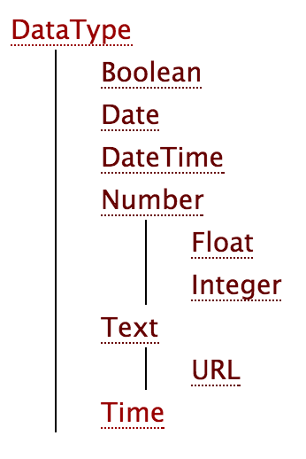
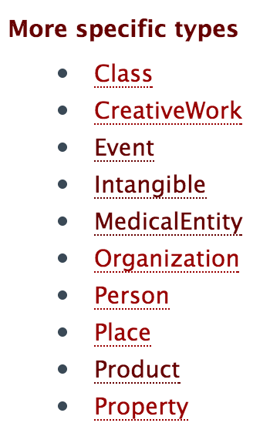
schema.org vocabulary
Full type hierarchy in one file
605 classes, 911 properties (Nov ‘18)
Data types: Boolean, Date, DateTime, Number, Text, Time
Objects: Rooted at Thing with two ‘metaclasses’ (Class and Property) and eight subclasses
See github repo for examples and code

Slide 17
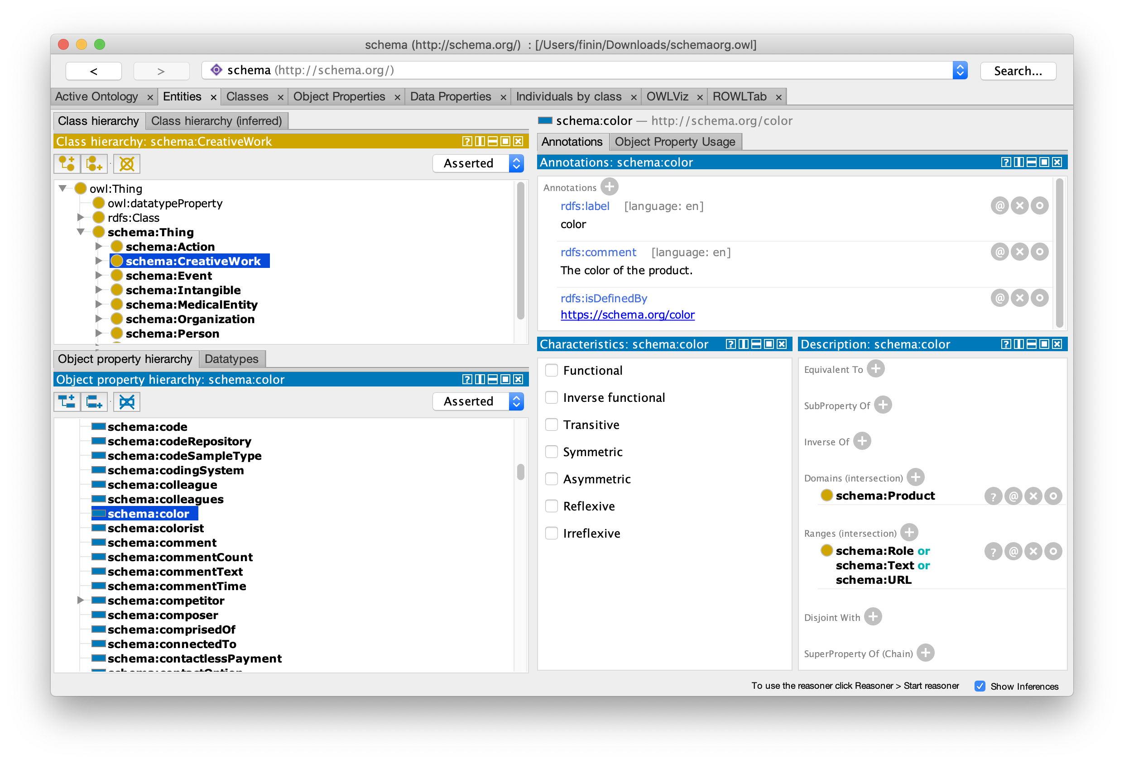
Schemas as rdfs and owl?
See the schema.org developer page

Slide 18
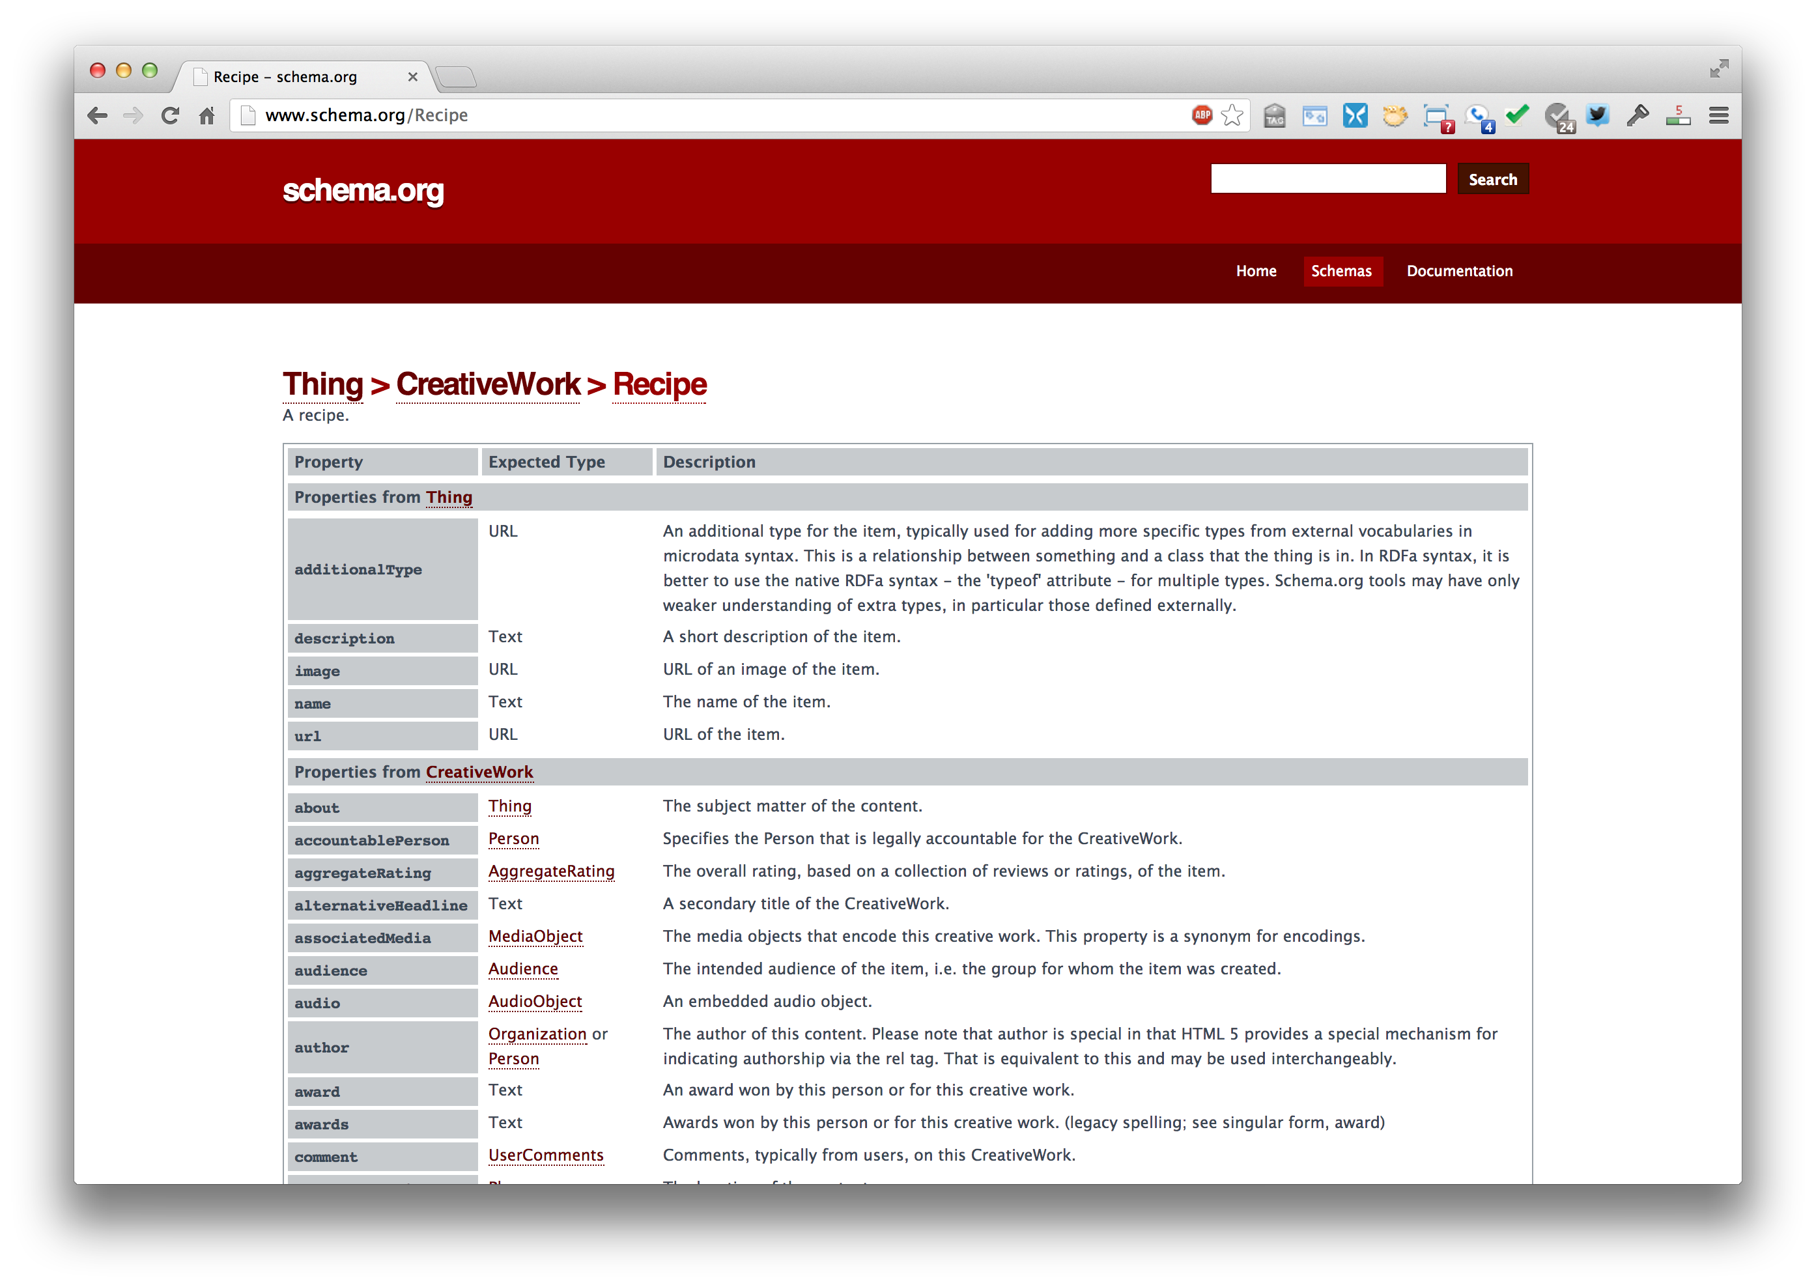
http://www.schema.org/Recipe

Slide 19
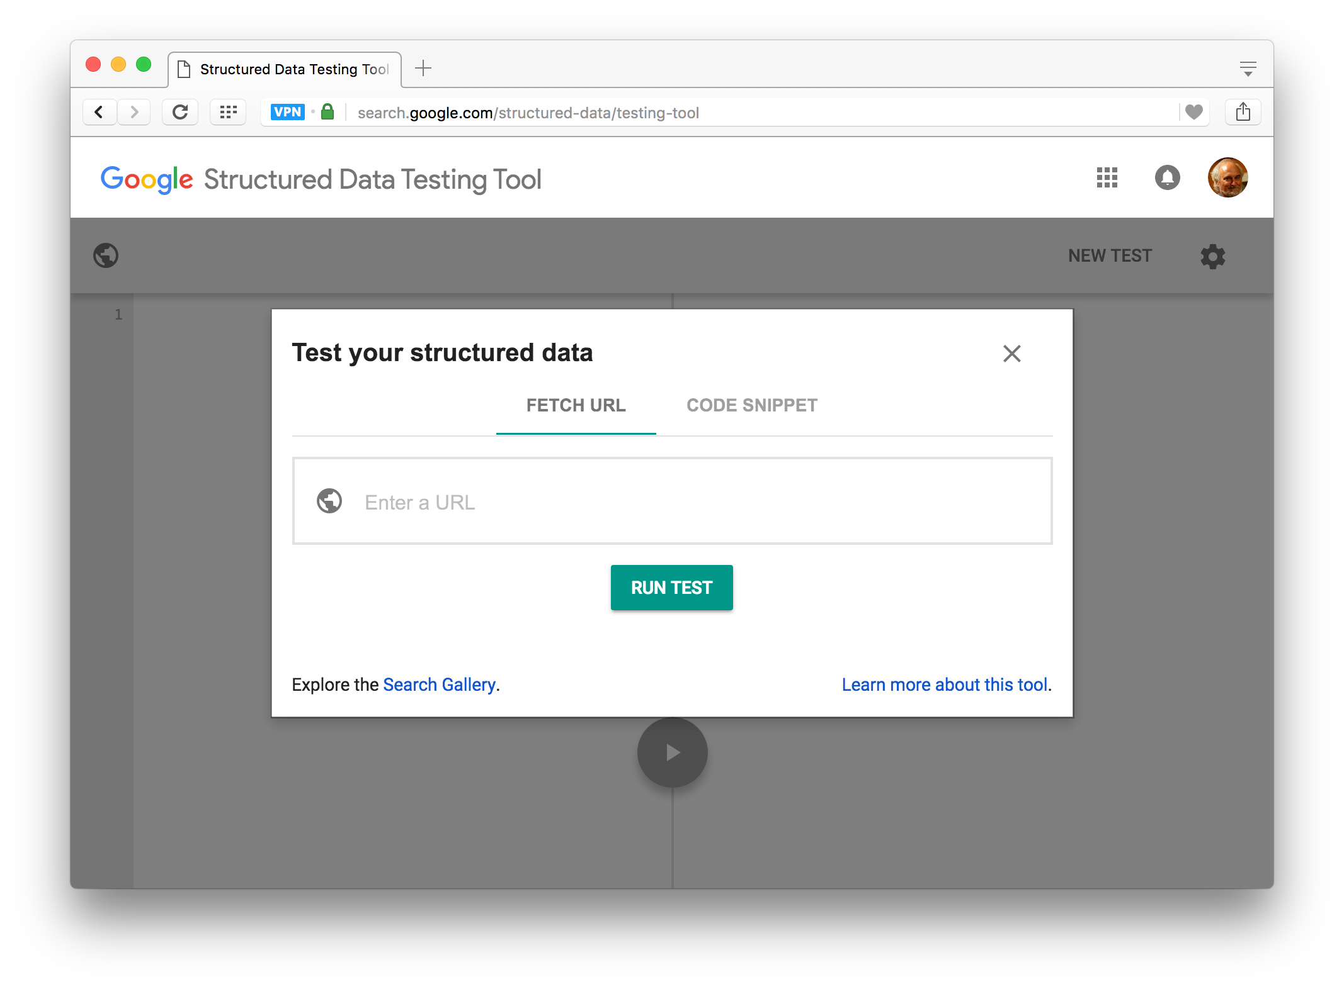

Testing Structured Data in HTML

Slide 20
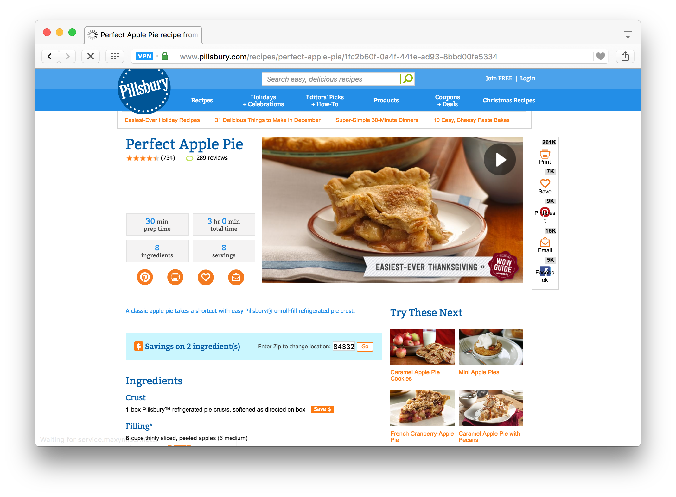
Testing Structured Data in HTML
https://www.pillsbury.com/recipes/perfect-apple-pie/1fc2b60f-0a4f-441e-ad93-8bbd00fe5334

Slide 21
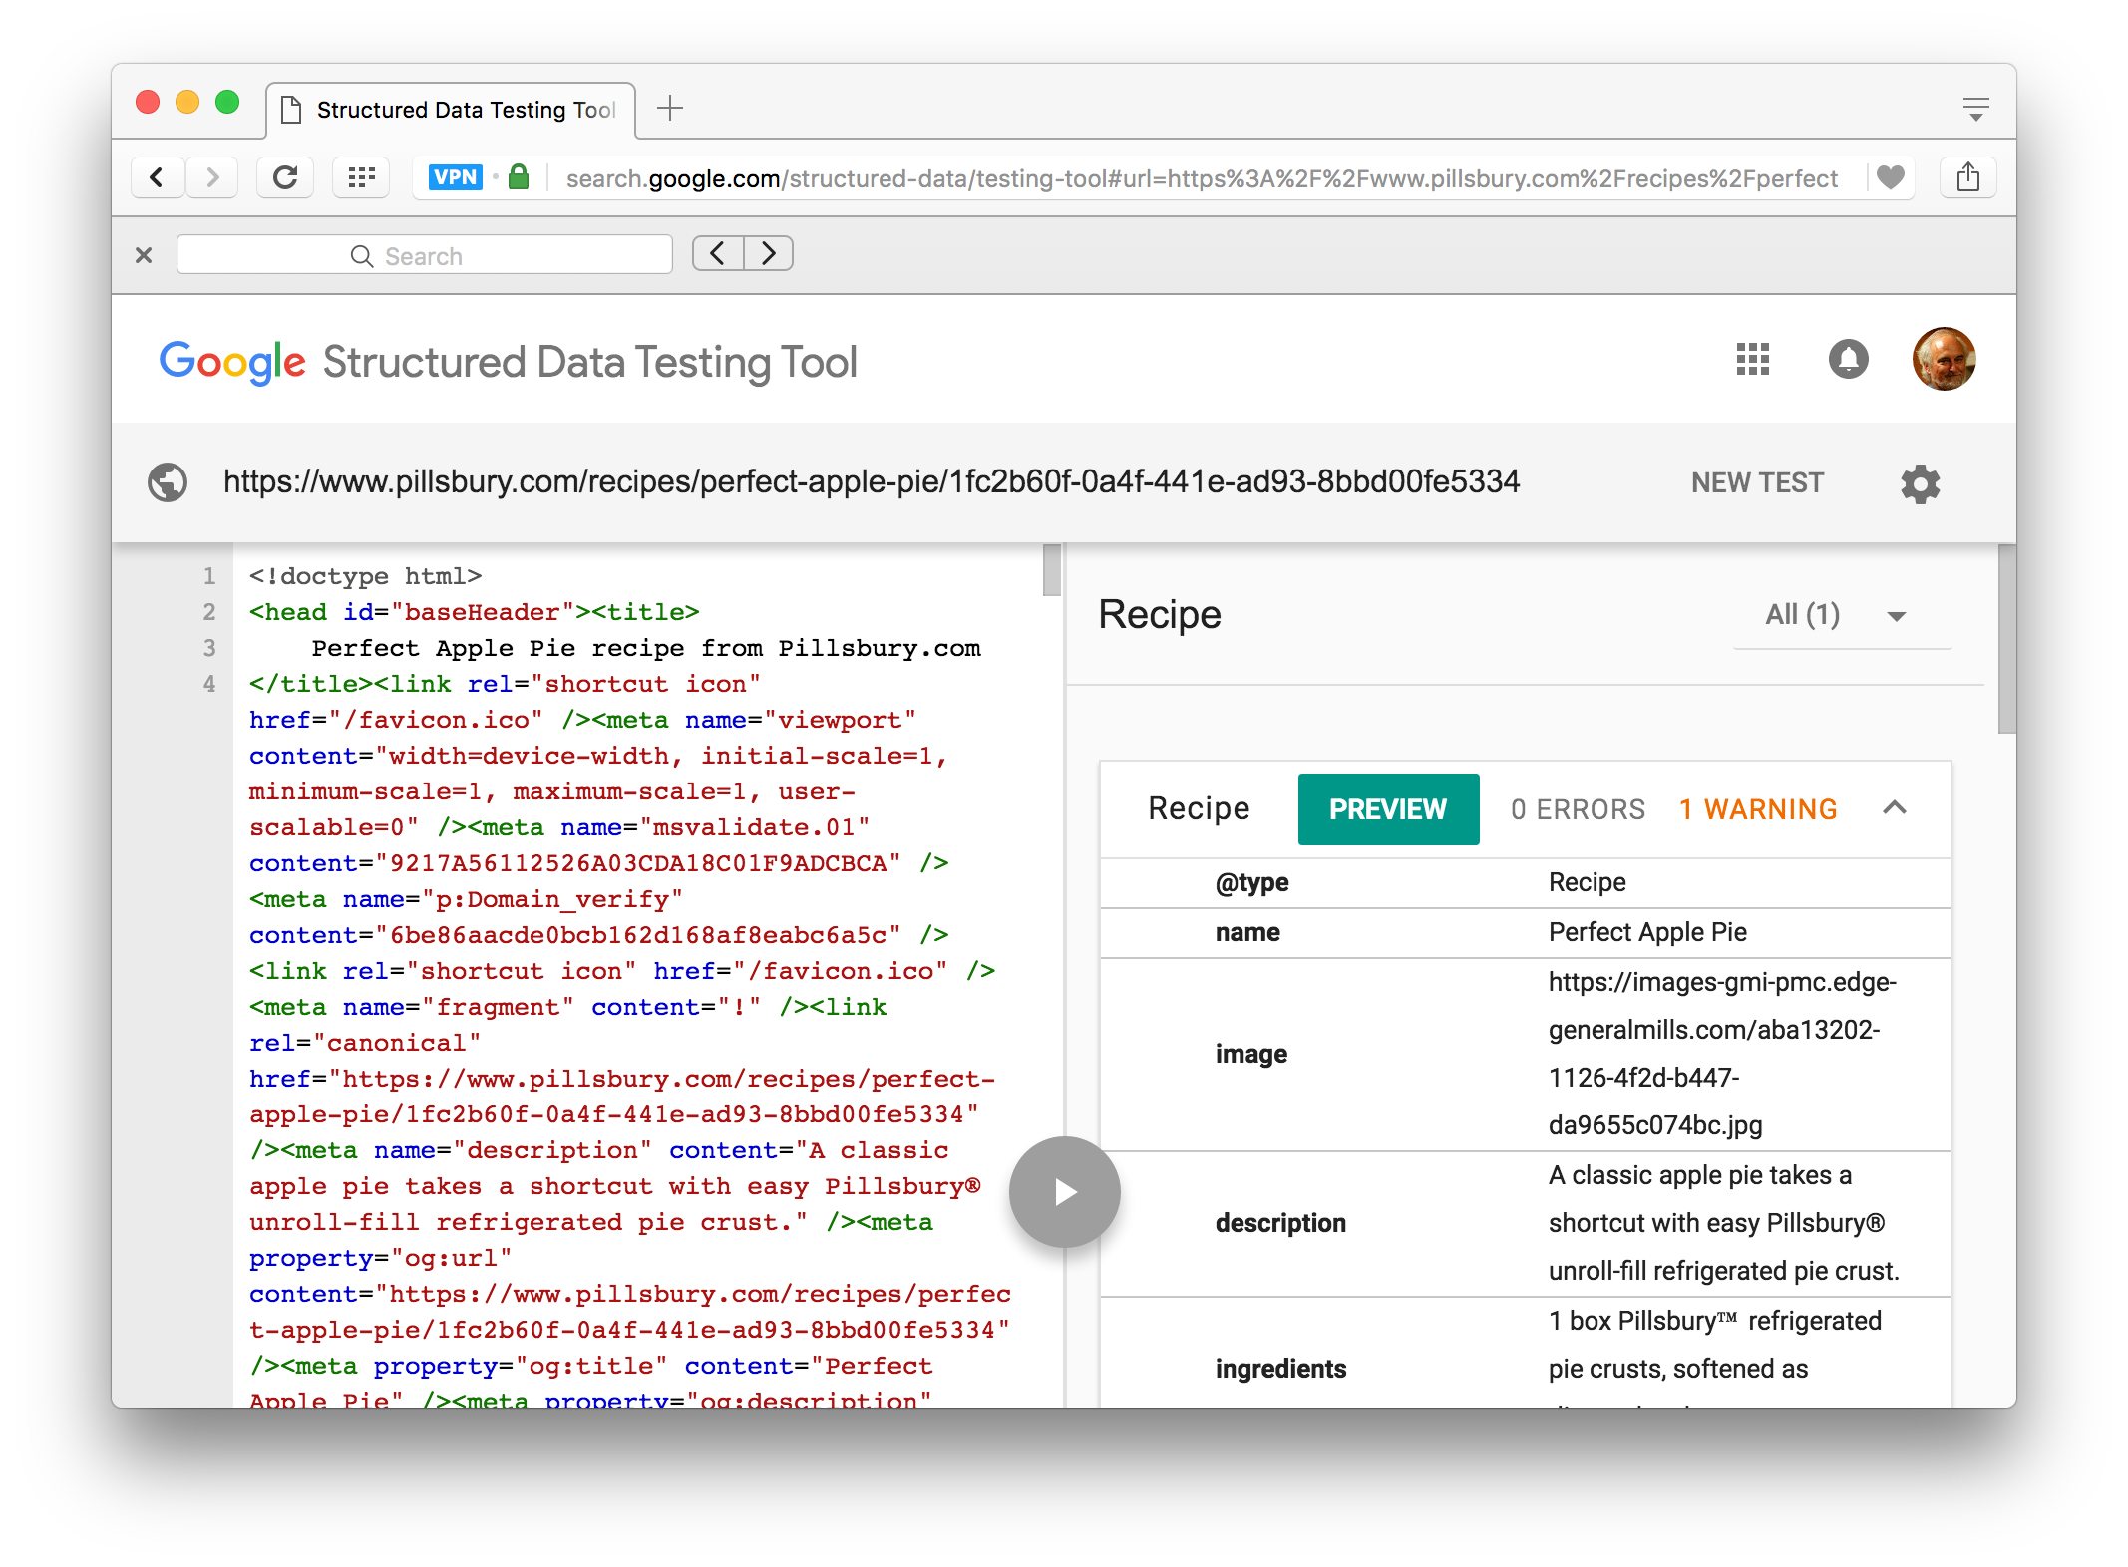
Testing Structured Data in HTML

Slide 22
Microdata as a KR language
More than RDF, less than RDFS
Properties have an expected type (range)
Can be a list of types, any of which are OK
Might be a string for many properties (“some data better than none”)
Properties attached ≥ 1 types (domain)
Classes can have multiple parents and inherit (properties) from all of them
No axioms (e.g., disjointness, cardinality, etc.)
No relation like subPropertyOf

Slide 23
Mixing vocabularies
Microdata is intended to work with just one vocabulary: the one at schema.org
Advantages: simple and controlled
Simple, organized, well designed
Controlled by the schema.org people
Disadvantages: too simple, too controlled
Too simple, narrow, mono-lingual
Controlled by the schema.org people

Slide 24
Extending schema.org ontology
Extensions: hosted vs. external
Hosted: managed & published by schema.org project
You can subclass existing classes
Person/Engineer
Person/Engineer/ElectricalEngineer
Subclass existing properties
musicGroupMember/leadVocalist
musicGroupMember/leadGuitar1
musicGroupMember/leadGuitar2
Hosted Extensions 11/18
auto.schema.org
bib.schema.org
health-lifesci.schema.org
iot.schema.org
meta.schema.org
pending.schema.org

Slide 25
Extension Problems
Hard to establish agreed upon meaning
Through axioms supported by the language (e.g., equivalence, disjointness, etc.)
No place for documentation (annotations, labels, comments)
With no namespace mechanism, your Person/Engineer and mine can be confused and might mean different things
Is a Computer Scientist an engineer?

Slide 26
Serialization
Schema.org has a data model and serializations
Microdata is the original, native serialization
RDFa is more expressive and works with the RDF stack
Everyone agrees that RDFa Lite is a good encoding: as simple as Microdata but more expressive
JSON-LD is an increasingly popular accepted encoding
Search engines look for Microdata, RDFa and JSON-LD
Schema.org considers RDFa to be the “canonical machine representation of schema.org”
Bur Google recommends using JSON-LD

Slide 27
Conclusions
Microdata is an effort by search companies to use a simple, controlled semantic language
Its semantics is pragmatic
e.g., expected types: a string is accepted where a thing is expected – “some data is better than none”
The real value is in
Supported vocabularies and
their use by Search companies
=> Immediate motivation for using semantic markup

