Slide 1
From Strings to Things: KELVIN in TAC KBP and EDL
Tim Finin¹, Dawn Lawrie², James Mayfield,
Paul McNamee and Craig Harman
Human Language Technology Center of Excellence
Johns Hopkins University
¹University of Maryland, Baltimore County
²Loyola University Maryland
December 2017

Slide 2
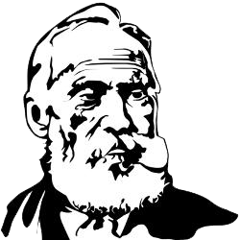
Kelvin
KELVIN: Knowledge Extraction, Linking, Validation and Inference
Developed at the Human Language Technology Center of Excellence at JHU and used in TAC KBP (2010-17), EDL (2015-17) and other projects
Takes English, Chinese & Spanish documents and produce a knowledge graph in several formats
We’ll review its monolingual processing, look at the multi-lingual use case

Slide 3
NIST TAC

Slide 4

NIST Text Analysis Conference
Annual evaluation workshops since 2008 on natural language processing & related applications with large test collections and common evaluation procedures
Knowledge Base Population (KBP) tracks focus on building KBs from information extracted from text
Cold Start KBP: construct a KB from text
Entity discovery & linking: cluster and link entity mentions
Slot filling
Slot filler validation
Sentiment
Events: discover and cluster events in text
http://nist.gov/tac

Slide 5
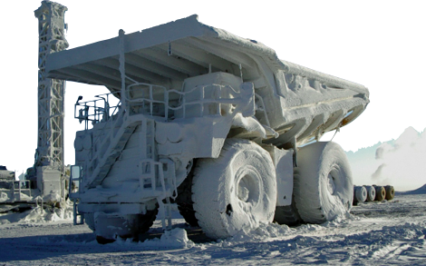
NIST TAC Cold Start
When Lisa's mother Marge Simpson went to a weekend getaway at Rancho Relaxo, the movie The Happy Little Elves Meet Fuzzy Snuggleduck was one of the R-rated european adult movies available on their cable channels.
After two years in the academic quagmire of Springfield Elementary, Lisa finally has a teacher that she connects with. But she soon learns that the problem with being middle-class is that

Slide 6
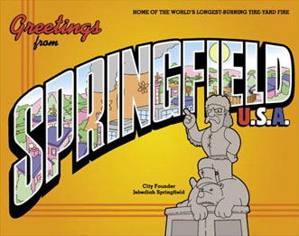





After two years in the academic quagmire of Springfield Elementary, Lisa finally has a teacher that she connects with. But she soon learns that the problem with being middle-class is that
When Lisa's mother Marge Simpson went to a weekend getaway at Rancho Relaxo, the movie The Happy Little Elves Meet Fuzzy Snuggleduck was one of the R-rated european adult movies available on their cable channels.
Springfield
Marge Simpson
Homer Simpson
Springfield Elementary
Lisa Simpson
Bart Simpson

Slide 7
After two years in the academic quagmire of Springfield Elementary, Lisa finally has a teacher that she connects with. But she soon learns that the problem with being middle-class is that
When Lisa's mother Marge Simpson went to a weekend getaway at Rancho Relaxo, the movie The Happy Little Elves Meet Fuzzy Snuggleduck was one of the R-rated european adult movies available on their cable channels.
Springfield
Bottomless Pete, Nature’s
Cruelest Mistake
per:cities_of_residence
per:alternate_names
Marge Simpson
Homer Simpson
Springfield Elementary
per:children
per:children
per:spouse
per:schools_attended
Lisa Simpson
Bart Simpson

Slide 8
Entity-Valued Relations
Relation | Inverse(s)
per:children | per:parents
per:other_family | per:other_family
per:parents | per:children
per:siblings | per:siblings
per:spouse | per:spouse
per:employee_of | {org,gpe}:employees*
per:member_of | org:membership*
per:schools_attended | org:students*
per:city_of_birth | gpe:births_in_city*
per:stateorprovince_of_birth | gpe:births_in_stateorprovince*
per:country_of_birth | gpe:births_in_country*
per:cities_of_residence | gpe:residents_of_city*
per:statesorprovinces_of_residence | gpe:residents_of_stateorprovince
per:countries_of_residence | gpe:residents_of_country*
per:city_of_death | gpe:deaths_in_city*
per:stateorprovince_of_death | gpe:deaths_in_stateorprovince*
per:country_of_death | gpe:deaths_in_country*
org:shareholders | {per,org,gpe}:holds_shares_in*
org:founded_by | {per,org,gpe}:organizations_founded*
org:top_members_employees | per:top_member_employee_of*
{org,gpe}:member_of | org:members
org:members | {org,gpe}:member_of
org:parents | {org,gpe}:subsidiaries
org:subsidiaries | org:parents
org:city_of_headquarters | gpe:headquarters_in_city*
org:stateorprovince_of_headquarters | gpe:headquarters_in_stateorprovince*
org:country_of_headquarters | gpe:headquarters_in_country*

Slide 9
String-Filled Relations
per:alternate_names | org:alternate_names
per:date_of_birth | org:political_religious_affiliation
per:age | org:number_of_employees_members
per:origin | org:date_founded
per:date_of_death | org:date_dissolved
per:cause_of_death | org:website
per:title
per:religion
per:charges

Slide 10


Cold Start
Schema
per:children
per:other_family
per:parents
per:siblings
per:spouse
per:employee_of
per:member_of
per:schools_attended
per:city_of_birth
per:stateorprovince_of_birth
per:country_of_birth
per:cities_of_residence
per:statesorprovinces_of_residence
per:countries_of_residence
per:city_of_death
per:stateorprovince_of_death
per:country_of_death
org:shareholders
org:founded_by

Slide 11
The Task
You are given:
Schema
per:children
per:other_family
per:parents
per:siblings
per:spouse
per:employee_of
per:member_of
per:schools_attended
per:city_of_birth
per:stateorprovince_of_birth
per:country_of_birth
per:cities_of_residence
per:statesorprovinces_of_residence
per:countries_of_residence
per:city_of_death
per:stateorprovince_of_death
per:country_of_death
org:shareholders
org:founded_by
When Lisa's mother Marge Simpson went to a weekend getaway at Rancho Relaxo, the movie The Happy Little Elves Meet Fuzzy Snuggleduck was one of the R-rated european adult movies available on their cable channels.
When Lisa's mother Marge Simpson went to a weekend getaway at Rancho Relaxo, the movie The Happy Little Elves Meet Fuzzy Snuggleduck was one of the R-rated european adult movies available on their cable channels.
When Lisa's mother Marge Simpson went to a weekend getaway at Rancho Relaxo, the movie The Happy Little Elves Meet Fuzzy Snuggleduck was one of the R-rated european adult movies available on their cable channels.
When Lisa's mother Marge Simpson went to a weekend getaway at Rancho Relaxo, the movie The Happy Little Elves Meet Fuzzy Snuggleduck was one of the R-rated european adult movies available on their cable channels.
When Lisa's mother Marge Simpson went to a weekend getaway at Rancho Relaxo, the movie The Happy Little Elves Meet Fuzzy Snuggleduck was one of the R-rated european adult movies available on their cable channels.
When Lisa's mother Marge Simpson went to a weekend getaway at Rancho Relaxo, the movie The Happy Little Elves Meet Fuzzy Snuggleduck was one of the R-rated european adult movies available on their cable channels.
When Lisa's mother Marge Simpson went to a weekend getaway at Rancho Relaxo, the movie The Happy Little Elves Meet Fuzzy Snuggleduck was one of the R-rated european adult movies available on their cable channels.
When Lisa's mother Marge Simpson went to a weekend getaway at Rancho Relaxo, the movie The Happy Little Elves Meet Fuzzy Snuggleduck was one of the R-rated european adult movies available on their cable channels.
When Lisa's mother Marge Simpson went to a weekend getaway at Rancho Relaxo, the movie The Happy Little Elves Meet Fuzzy Snuggleduck was one of the R-rated european adult movies available on their cable channels.

Slide 12
When Lisa's mother Marge Simpson went to a weekend getaway at Rancho Relaxo, the movie The Happy Little Elves Meet Fuzzy Snuggleduck was one of the R-rated european adult movies available on their cable channels.
Schema
per:children
per:other_family
per:parents
per:siblings
per:spouse
per:employee_of
per:member_of
per:schools_attended
per:city_of_birth
per:stateorprovince_of_birth
per:country_of_birth
per:cities_of_residence
per:statesorprovinces_of_residence
per:countries_of_residence
per:city_of_death
per:stateorprovince_of_death
per:country_of_death
org:shareholders
org:founded_by
When Lisa's mother Marge Simpson went to a weekend getaway at Rancho Relaxo, the movie The Happy Little Elves Meet Fuzzy Snuggleduck was one of the R-rated european adult movies available on their cable channels.
When Lisa's mother Marge Simpson went to a weekend getaway at Rancho Relaxo, the movie The Happy Little Elves Meet Fuzzy Snuggleduck was one of the R-rated european adult movies available on their cable channels.
When Lisa's mother Marge Simpson went to a weekend getaway at Rancho Relaxo, the movie The Happy Little Elves Meet Fuzzy Snuggleduck was one of the R-rated european adult movies available on their cable channels.
When Lisa's mother Marge Simpson went to a weekend getaway at Rancho Relaxo, the movie The Happy Little Elves Meet Fuzzy Snuggleduck was one of the R-rated european adult movies available on their cable channels.
When Lisa's mother Marge Simpson went to a weekend getaway at Rancho Relaxo, the movie The Happy Little Elves Meet Fuzzy Snuggleduck was one of the R-rated european adult movies available on their cable channels.
When Lisa's mother Marge Simpson went to a weekend getaway at Rancho Relaxo, the movie The Happy Little Elves Meet Fuzzy Snuggleduck was one of the R-rated european adult movies available on their cable channels.
You Must Produce:
When Lisa's mother Marge Simpson went to a weekend getaway at Rancho Relaxo, the movie The Happy Little Elves Meet Fuzzy Snuggleduck was one of the R-rated european adult movies available on their cable channels.
When Lisa's mother Marge Simpson went to a weekend getaway at Rancho Relaxo, the movie The Happy Little Elves Meet Fuzzy Snuggleduck was one of the R-rated european adult movies available on their cable channels.
Springfield
Bottomless Pete, Nature’s
Cruelest Mistake
per:cities_of_residence
per:alternate_names
Marge Simpson
Homer Simpson
Springfield Elementary
per:children
per:children
per:spouse
per:schools_attended
Lisa Simpson
Bart Simpson

Slide 13
How do you know
that your KB is any good?
Springfield
Bottomless Pete, Nature’s
Cruelest Mistake
per:cities_of_residence
per:alternate_names
Marge Simpson
Homer Simpson
Springfield Elementary
per:children
per:children
per:spouse
per:schools_attended
Lisa Simpson
Bart Simpson

Slide 14
How do you know
that your KB is any good?
☞
Align it to a ground
truth KB
Springfield
Bottomless Pete, Nature’s
Cruelest Mistake
per:cities_of_residence
per:alternate_names
Marge Simpson
Homer Simpson
Springfield Elementary
per:children
per:children
per:spouse
per:schools_attended
Lisa Simpson
Bart Simpson

Slide 15

How do you know
that your KB is any good?
☞
Align it to a ground
truth KB
But how are you going to produce ground truth? And wouldn’t the alignment be intractable anyway if the KB were of any reasonable size?

Slide 16

Where did the children of
Marge Simpson go to school?
per:children
per:schools_attended
Springfield
Bottomless Pete, Nature’s
Cruelest Mistake
per:cities_of_residence
per:alternate_names
Marge Simpson
Homer Simpson
Springfield Elementary
per:children
per:children
per:spouse
per:schools_attended
Lisa Simpson
Bart Simpson

Slide 17
After two years in the academic quagmire of Springfield Elementary, Lisa finally has a teacher that she connects with. But she soon learns that the problem with being middle-class is that
When Lisa's mother Marge Simpson went to a weekend getaway at Rancho Relaxo, the movie The Happy Little Elves Meet Fuzzy Snuggleduck was one of the R-rated european adult movies available on their cable channels.
Springfield
Bottomless Pete, Nature’s
Cruelest Mistake
per:cities_of_residence
per:alternate_names
Marge Simpson
Homer Simpson
Springfield Elementary
per:children
per:children
per:spouse
per:schools_attended
Lisa Simpson
Bart Simpson

Slide 18
Sample Evaluation Queries
Query Entity | First Relation | Second Relation
Adriana Petryna | per:title
Blackstone Group | org:founded_by
William Shore | per:organizations_founded | org:date_founded
Wistar Institute | org:employees | per:title
Andrew W. Mellon | per:children | per:organizations_founded
Lycee Alliance Israelite Universelle | org:employees | per:schools_attended
Tsitsi Jaji | per:schools_attended | org:students

Slide 19
2016 TAC Cold Start KBP
Read 90K documents: newswire articles & social media posts in English, Chinese and Spanish
Find entity mentions, types and relations
Cluster entities within/across documents, link to reference KB when possible (which George Bush)
Remove errors (Obama born in Illinois), draw sound inferences (Malia and Sasha sisters)
Create knowledge graph with provenance data for entities, mentions and relations

Slide 20
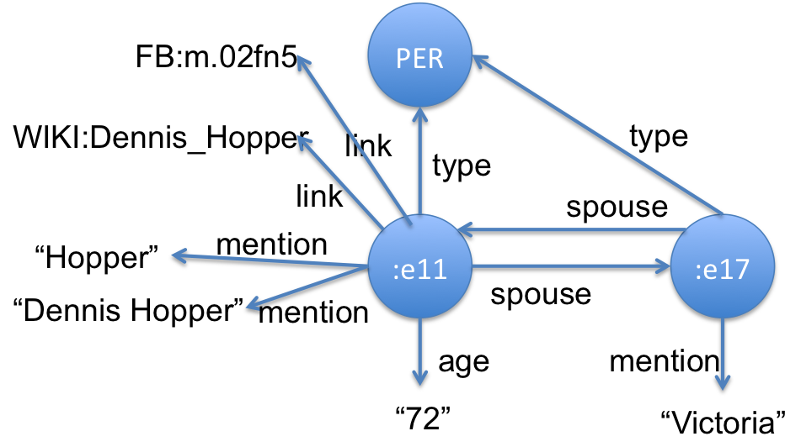
2016 TAC Cold Start KBP
Read 90K documents: newswire articles & social media posts in English, Chinese and Spanish
Find entity mentions, types and relations
Cluster entities within and across documents and link to a reference KB when appropriate
Remove errors (Obama born in Illinois), draw sound inferences (Malia and Sasha sisters)
Create knowledge graph with provenance data for entities, mentions and relations
<DOC id="APW_ENG_20100325.0021" type="story" >
<HEADLINE>
Divorce attorney says Dennis Hopper is dying
</HEADLINE>
<DATELINE>
LOS ANGELES 2010-03-25 00:15:51 UTC
</DATELINE>
<TEXT
<P>
Dennis Hopper's divorce attorney says in a court filing that the actor is dying and can't undergo chemotherapy as he battles prostate cancer.
</P>
<P>
Attorney Joseph Mannis described the "Easy Rider" star's grave condition in a declaration filed Wednesday in Los Angeles Superior Court.
</P>
<P>
Mannis and attorneys for Hopper's wife Victoria are fighting over when and whether to take the actor's deposition.
</P> …
…
:e00211 type PER
:e00211 link FB:m.02fn5
:e00211 link WIKI:Dennis_Hopper
:e00211 mention "Dennis Hopper" APW_021:185-197
:e00211 mention "Hopper" APW_021:507-512
:e00211 mention "Hopper" APW_021:618-623
:e00211 mention "丹尼斯·霍珀” CMN_011:930-936
:e00211 per:spouse :e00217 APW_021:521-528
:e00217 per:spouse :e00211 APW_021:521-528
:e00211 per:age "72" APW_021:521-528
…

Slide 21
2016 TAC Cold Start KBP
Read 90K documents: newswire articles & social media posts in English, Chinese and Spanish
Find entity mentions, types and relations
Cluster entities within and across documents and link to a reference KB when appropriate
Remove errors (Obama born in Illinois), draw sound inferences (Malia and Sasha sisters)
Create knowledge graph with provenance data for entities, mentions and relations
<DOC id="APW_NG_20100325.0021" type="story" >
<HEADLINE>
Divorce attorney says Dennis Hopper is dying
</HEADLINE>
<DATELINE>
LOS ANGELES 2010-03-25 00:15:51 UTC
</DATELINE>
<TEXT
<P>
Dennis Hopper's divorce attorney says in a court filing that the actor is dying and can't undergo chemotherapy as he battles prostate cancer.
</P>
<P>
Attorney Joseph Mannis described the "Easy Rider" star's grave condition in a declaration filed Wednesday in Los Angeles Superior Court.
</P>
<P>
Mannis and attorneys for Hopper's wife Victoria are fighting over when and whether to take the actor's deposition.
</P> …
:e00211 a kbp:per;
kbp:mention "Hopper", "Dennis Hopper";
kbp:spouse :e00217;
kbp:age "72";
kbp:link "m.02fn5"; ... .
[ ] a rdf:statement;
rdf:subject :e00211;
rdf:predicate "kbp:mention"
rdf:object "Hopper";
kbp:document "APW_021";
kbp:provenance "APW_021:507-512", "APW_021:618-623".
…
:e00211 type PER
:e00211 link FB:m.02fn5
:e00211 link WIKI:Dennis_Hopper
:e00211 mention "Dennis Hopper" APW_021:185-197
:e00211 mention "Hopper" APW_021:507-512
:e00211 mention "Hopper" APW_021:618-623
:e00211 mention "丹尼斯·霍珀” CMN_011:930-936
:e00211 per:spouse :e00217 APW_021:521-528
:e00217 per:spouse :e00211 APW_021:521-528
:e00211 per:age "72" APW_021:521-528
…

Slide 22

KB Evaluation Methodology
Evaluating KBs extracted from 90K documents is non-trivial
TAC’s approach is simplified by:
Fixing the ontology of entity types and relations
Specifying a serialization as triples + provenance
Sampling a KB using a set of queries grounded in an entity mention found in a document
Given a KB, we can evaluate its precision and recall for a set of queries
Notes:
Consider the graph isomorphis problem

Slide 23
KB Evaluation Methodology
A query: What are the names of schools attended by the children of the entity mentioned in document #45611 at characters 401-412
That mention is George Bush and the document context suggests it refers to the 41st U.S. president
Query given in structured form using TAC ontology
Assessors determine good answers in corpus and check submitted results using their provenance
Answers: entities for Yale, Harvard, Tulane, UT Austin, Univ. of Virginia, Boston College, ...

Slide 24

TAC Ontology
Five basic entity types
PER: people (John Lennon) or groups (Americans)
ORG: organizations like IBM, MIT or US Senate
GPE: geopolitical entity like Boston, Belgium or Europe
LOC: locations like Lake Michigan or the Rockies
FAC: facilities like BWI or the Empire State Building
Entity Mentions
Strings referencing entities by name (Barack Obama), description (the President) or pronoun (his)
~65 relations
Relations hold between two entities: parent_of, spouse, employer, founded_by, city_of_birth, …
Or between an entity & string: age, website, title, cause_of_death, ...

Slide 25
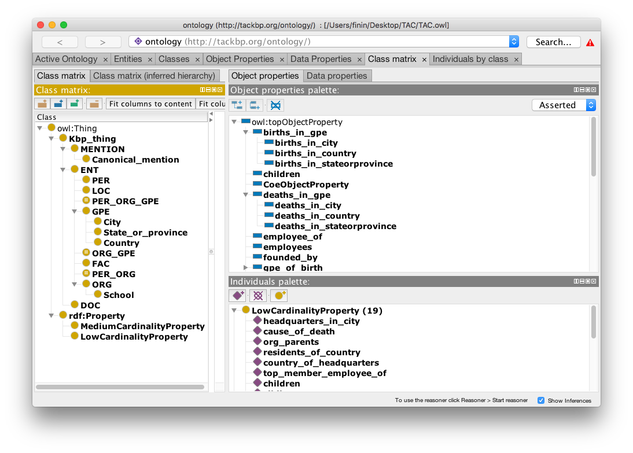
TAC and COE Ontologies
Our ontology has official TAC types/relations and many more we capture from tools and infer from the data

Slide 26
Monlingual Kelvin

Slide 27
Kelvin
KELVIN: Knowledge Extraction, Linking, Validation and Inference
Developed at the Human Language Technology Center of Excellence at JHU and used in TAC KBP (2010-17), EDL (2015-17) and other projects
Takes English, Chinese & Spanish documents and produce a knowledge graph in several formats
We’ll review its monolingual processing, look at the multi-lingual use case

Slide 28

1 Information Extraction
1
documents
1
IE
Process documents in parallel on a grid, applying information extraction tools to find mentions, entities, relations and events
Produce an Apache Thrift object for each document with text and relevant data produced by tools using a common Concrete schema for NLP data
2
TAC
3
CR
4
KB
5
MAT
KBs

Slide 29
2 Integrating NLP data
2
documents
IE
Process Concrete objects in parallel to:
Integrate data from tools (e.g., Stanford, Serif)
Fix problems, e.g., trim mentions, find missed mentions, deconflict tangled mention chains, …
Extract relations from events (life.born => date and place of birth)
Map relations found by open IE systems to TAC ontology (“is engineer at” => per:employee_of)
Map schema to extended TAC ontology
30K ENG: 430K entities; 1.8M relations
1
2
TAC
3
CR
4
KB
5
MAT
KBs

Slide 30
3 Kripke: Cross-Doc Coref
3
documents
Cross-document co-reference creates initial KB from a set of single-document KBs
Identify that Barack Obama entity in DOC32 is same individual as Obama in DOC342, etc.
Language agnostic; works well for ENG, CMN, SPA document collections
Uses entity type and mention strings and context of co-mentioned entities
Untrained, agglomerative clustering
30K ENG: 210K entities; 1.2M relations
1
IE
2
TAC
3
CR
4
KB
5
MAT
KBs
Notes:
Superkripke == True => use nominal mentions

Slide 31
4 Inference and adjudication
4
documents
IE
Reasoning to
Delete relations violating ontology constraints
Person can’t be born in an organization
Person can’t be her own parent or spouse
Infer missing relations
Two people sharing a parent are siblings
X born in place P₁, P₁ part of P₂ => X born in P₂
Person probably citizen of their country of birth
A CFO is a per:top_level_employee
1
2
TAC
3
CR
4
KB
5
MAT
KBs
Notes:
Overview of pipeline step 3 – note that the number of facts is reduced still more.

Slide 32

Entity Linking
4
documents
1
IE
Try to links entities to reference KB, a subset of Freebase with
~4.5M entities and ~150M triples
Names and text in English, Spanish and Chinese
Don’t link if no matches, poor matches or ambiguous matches
2
TAC
3
CR
4
KB
5
MAT
KBs

Slide 33

KB-level merging rules
4
documents
Merge entities of same type linked to same KB entity
Merge cities in same region with same name
Highly discriminative relations give evidence of sameness
per:spouse is few to few
org:top_level_employee is few to few
Merge PERs with similar names who were
Both married to the same person, or
Both CEOs of the same company, or …
1
IE
2
TAC
3
CR
4
KB
5
MAT
KBs

Slide 34
Slot Value Consolidation
4
documents
Problem: too many values for some slots, especially for ‘popular’ entities, e.g.,
An entity with four different per:age values
Obama had ~100 per:employee_of values
Strategy: rank values and select best
Rank values by # of attesting docs and probability
Choose best N value depending on relation type
30K ENG: 183K entities; 2.1M relations
1
IE
2
TAC
3
CR
4
KB
5
MAT
KBs
Notes:
Understudied problem: oral surgeon vs. dentist; how many subsidiary orgs does the USG have?
-13% entities, +25+ relations

Slide 35
Materialize KB versions
5
documents
1
IE
Encode KB in your favorite database or graph store
We use the RDF/OWL Semantic Web technology stack
2
TAC
3
CR
4
KB
5
MAT
KBs
Notes:
Entities + 31% df (post authors)

Slide 36
Multi-lingual Kelvin

Slide 37
Multilingual KBP
Many examples where facts from different languages combine to answer queries or support inference
Q: Who lives in the same city as Bodo Elleke? A: Frank Ribery aka Franck Ribéry aka 里贝里
Why we know both live in Munich:
:e8 gpe:residents_of_city :e23 ENG_3:3217-3235 ...said the younger Bodo Elleke, who was born in Schodack in 1930 and is now a retired architect who lives in Munich.
:e8 gpe:residents_of_city :e25 CMN…0UTJ:292-361 拉霍伊在接受西班牙国家电台的采访时肯定，今年的三位金球奖热门候选人中，梅西“度过了一个出色的赛季”，而拜仁慕尼黑球员里贝里则“赢得了一切”
Kripke merged entities with mentions Frank Ribery, Franck Ribéry & 里贝里
BE
M
FR
Notes:
Kripke’s evidence for the merging was using translations & name similarity
This entity is in freebase, so tahat provides more evidence for merging

Slide 38
Monolingual to Multilingual Kelvin
IE
Zoom in on our cross-doc co-ref step
Concatenate document-level KBs to form a doc kb as input to Kripke
Kripke outputs a set of clusters defining an equivalence relation
Merger uses clusters to combine doc kb entities, yielding the initial KB
We use the doc kb and clusters from each language to create an initial multilingual KB
TAC
DOC KB
Kripke
Entity Clusters
Merge
KB

Slide 39
Trilingual KBP & EDL
CMN doc kb & clusters
ENG doc kb & clusters
SPA doc kb & clusters
KB
clusters
KB
clusters
KB
clusters
Kripke
clusters
Kripke computes clusters for combined multilingual doc kbs
Merge
4
KB
5
MAT
trilingual KBs

Slide 40
Trilingual KBP & EDL
CMN doc kb & clusters
ENG doc kb & clusters
SPA doc kb & clusters
KB
clusters
KB
clusters
KB
clusters
translate mentions?
Kripke
translate mentions?
clusters
Kripke computes clusters for combined monolingual doc kbs
Optionally translate non-English mentions
Merge
Translating non-English mentions to English, when possible enhances
clustering
4
KB
5
MAT
trilingual KBs

Slide 41
Trilingual KBP & EDL
CMN doc kb & clusters
ENG doc kb & clusters
SPA doc kb & clusters
KB
clusters
KB
clusters
KB
clusters
translate mentions?
Kripke
translate mentions?
clusters
Merge
Combine the four cluster equivalence relations to produce on global one
Kripke computes clusters for combined monolingual doc kbs
Optionally translate non-English mentions
Use all four clusters to merge entities in the three doc kbs
KB
4
KB
5
MAT
trilingual KBs

Slide 42
Results

Slide 43

2016 TAC KBP Results
For the 7 KB and 11 SF submissions, depending on metric (macro/micro avg), we placed
1st or 2nd of 5 on XLING and were the only team to do all three languages
2nd or 4th of 18 on ENG depending on metric
1st or 2nd of 4 on CMN depending on metric
We did poorly on SPA, finding few relations
See workshop paper for details
TAC EDL results are forthcoming

Slide 44
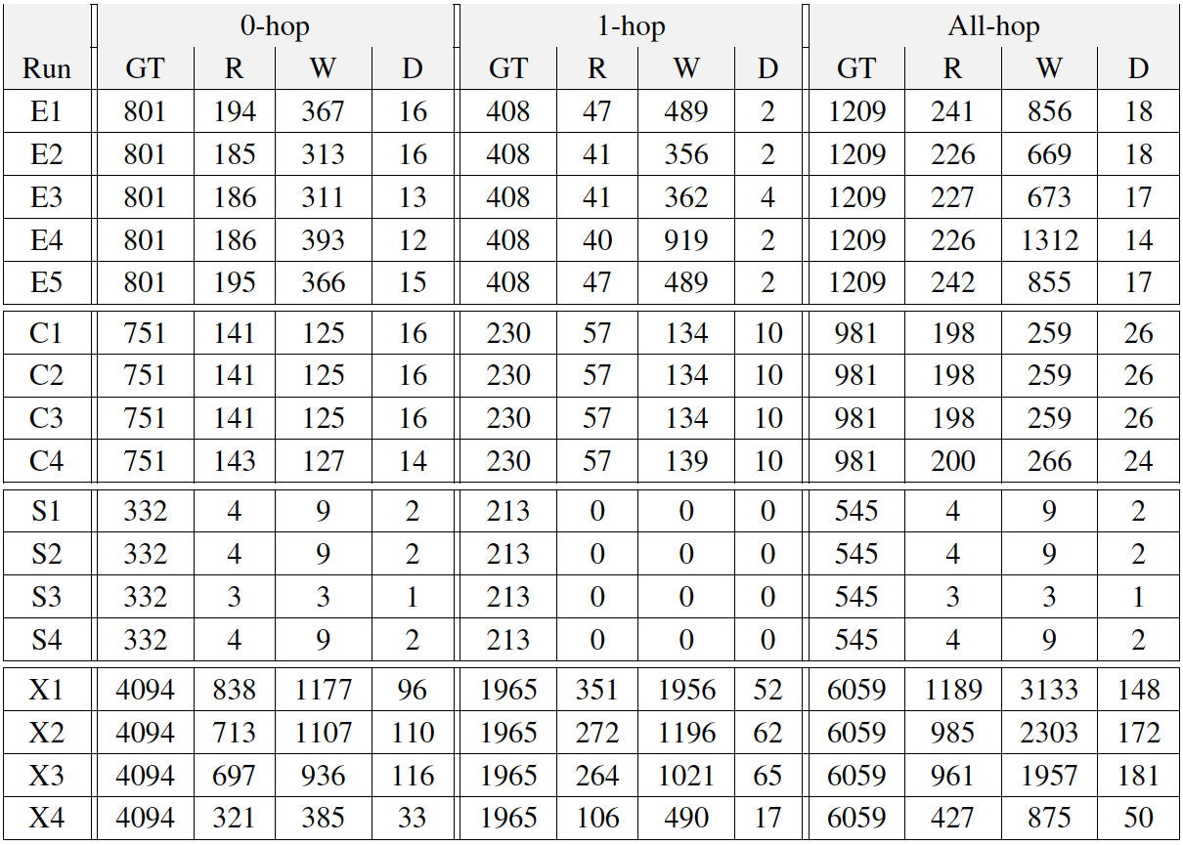
2016 TAC KBP Results
Ground-truth, right, wrong & duplicate answers for 2016 KBP KB runs

Slide 45
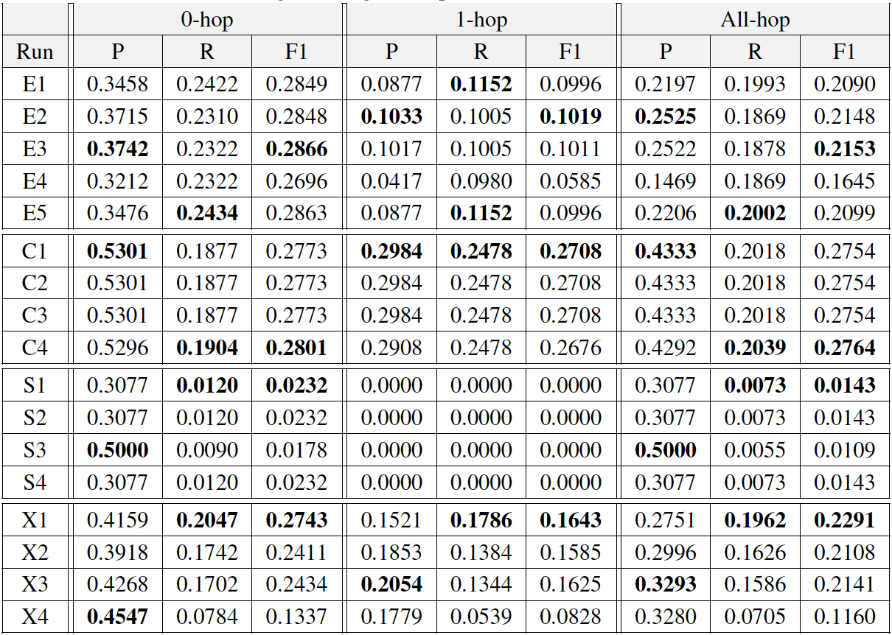
2016 TAC KBP Results
Micro precision, recall and F1 scores for 2016 KBP KB runs

Slide 46
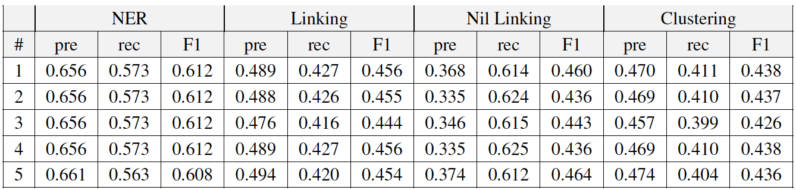
2016 EDL XLING Results
XLING run precision, recall and F1 measures for four key metrics: strong typed mention match (NER), strong all match (Linking), strong nil match (Nil), and mention ceaf plus (Clustering)

Slide 47
2016 Results Observations
Overall XLING1 was best
Variations for monolingual runs were similar
Using translated mentions for non-English helped
Using nominal mentions seemed to improve cross-doc co-ref slightly
EDL scores (and maybe KBP) lowered by bug in our nominal mention trimming code; the nominal strings correctly identified but offsets were wrong ☹

Slide 48

Kelvin Docker Container
Problem: Kelvin is a large and complex system that’s difficult to port to a new Unix environment, let alone a different OS
Solution: We use Docker to virtualize Kelvin as several containers that can be run on any system that supports Docker
e.g., most Unix systems, Mac OSX and Windows

Slide 49
Conclusion

Slide 50
Lessons Learned
We always have to mind precision & recall
Extracting information from text is inherently noisy; reading more text helps both
Using machine learning at every level is important
Making more use of probabilities will help
Extracting information about a events is hard
Recognizing the temporal extent of relations is important, but still a challenge

Slide 51

Conclusion
KBs help in extracting information from text
The information extracted can update the KBs
The KBs provide support for new tasks, such as question answering and speech interfaces
We’ll see this approach grow and evolve in the future
New machine learning frameworks will result in better accuracy

