Slide 1
Semantic Web outlook and trends
Dec 2018

Slide 2
The Past ~30 Odd Years
1984 Lenat’s Cyc vision
1989 TBL’s Web vision
1991 DARPA Knowledge Sharing Effort
1996 RDF
1998 XML
1999 RDFS
2000 DARPA Agent Markup Language, OIL
2001 W3C Semantic Web Activity
2003 OWL
2008 SPARQL
2009 OWL 2
~2009 Linked Data
2011 Schema.org
2012 Wikidata
2012 Microdata & schema.org
2013 Rule Inter. Format
2009- vocabularies: SKOS, PROV, RDB2RDF, …
2014 JSON-LD
2017 SHACL

Slide 3
The Next 30?
?

Slide 4

What’s Hot
Here are six areas that I think will be important in the next five years
Linked Data
Semantic Data
Big (Semantic) Data
Populating RDF KGs from text
Schema.org
Wikidata
Machine learning and structured data

Slide 5
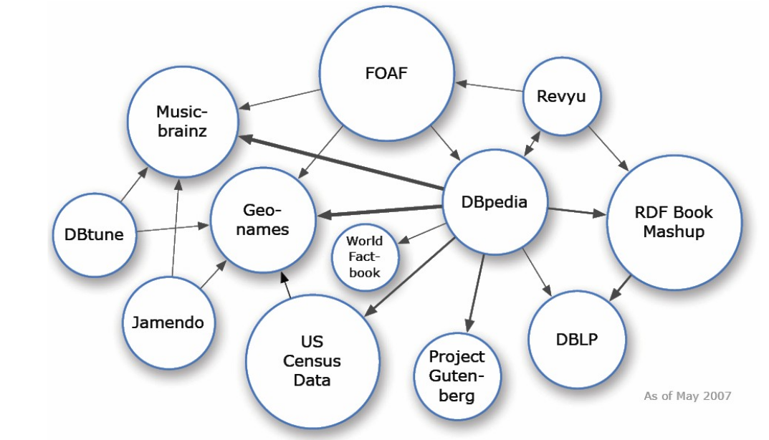
Linked Data
RDF is a good data language for many applications
Schema last applications, graph model is easy to map into others, Web oriented
OWL is a poor KR language in many ways
no certainties, contexts, default reasoning, procedural attachments, etc. Current OWL most rely on forward reasoning and don’t handle contradictions well.
Today’s immediate benefits mostly come from shallow reasoning and integrating and exploiting data rather than reasoning with deeper “ontological knowledge”

Slide 6

“Semantic” Data
The S word is very popular now
Semantic ≠ Semantic Web
Search companies are competing by better understanding (i) content on a web page and (ii) a user’s query
Facebook benefits from its social graph: you say you attended UMBC, not “UMBC”. FB knows it’s a university, which is a kind of educational institution
Hendler: “A little semantics goes a long way
It’s incremental: don’t try to do it all at once

Slide 7

Big (Semantic) Data
The big data theme and the growth of RDF data combine to create a need for better semantic tools that can work at Web scale
Problems include:
Parallel reasoning (Hard, see Webpie paper & letters)
Distributed SPARQL queries
Graph analytics on huge RDF graphs
Machine learning over RDF data
Extracting and using statistical knowledge from RDF

Slide 8

Knowledge Base Population
Information extraction involves extracting entities and relations from text
A common model: read lots of text documents and populate a knowledge Base with the entities, attributes and relations discovered
See DARPA Machine Reading Program, NIST TAC Knowledge Base Population track
RDF/OWL is increasingly chosen as the default target for such knowledge

Slide 9
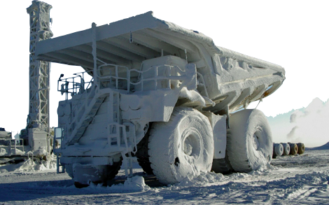
TAC 2012 Cold Start Knowledge Base Population

Slide 10
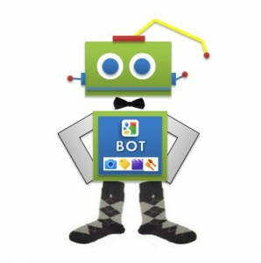
Microdata aka Schema.org
It’s significant that the big search companies have embraced an RDF compatible way to embed data in Web pages
They are beginning to detect and expliot the data to provide better services
It demonstrates that it’s not rocket surgery, is easy to add, and is useful
Their measured incremental approach is pragmatic and will open up possibilities for more

Slide 11

Wikidata
Wikipedia has been enormously successful and important, making all of us smarter
DBpedia shows its potential to make machines more intelligent
Wikidata aims to better integrate these two and has the potential of creating a knowledge resource with a permeable barrier between the unstructured and structured representations

Slide 12
New Application Areas
Some application areas will get a lot of attention because they important or new
Cybersecurity: Modeling cyber threat intelligence
Healthcare: Electronic healthcare records, personalized medicine
Mobile computing: Modeling and using context, integrating information from phone, web, email, calendar, GPS, sensors, etc.
Ecommerce: E.g., GoodRelations

Slide 13
Beyond PDF
Publication is important to all scholarly disciplines, especially STEM areas
Modernizing this is more than putting pdf versions of articles online
There is an interest in also publishing data, services and code and linking these to papers
Capturing provenance is an interesting aspect
Google Dataset Search
We need new author tools, indexing services, search engines, etc.

Slide 14
Conclusion
We are still exploring what can be done
and how to do it
and how to do it efficiently
and how to do it easily w/o a lot of training
and how to derive benefits from it (commercial or societal)
The technology and systems will change
It will be a fluid area for another decade or two
or maybe longer

