Slide 1
Description Logics

Slide 2
What is Description Logic?
A family of logic based KR formalisms
Descendants of semantic networks and KL-ONE
Describe domain in terms of concepts (classes), roles (relationships) and individuals
Distinguished by:
Formal semantics (typically model theoretic) based on a decidable fragments of FOL
Provision of inference services
Sound and complete decision procedures for key problems
Implemented systems (highly optimized)
Formal basis for OWL (DL profile)

Slide 3
Informally, What is Description Logic?
We define a concept using a simple noun phrase in a human language like English
A red car
A tall person who works for IBM
A tall person who works for a Bay-area Technology company
E.g., we don’t do this, using a set of rules
Natural languages have multiple ways of attaching modifiers to a simple concept
E.g. adjectives, propositional phrases, clausal modifiers, connectives (and, or, not)
Description logics, like OWL-DL, designed to define concepts in a similar way

Slide 4
Description Logics
Major focus of KR research in the 1980’s
Led by Ron Brachman (AT&T Labs)
Grew out of early network-based KR systems like semantic networks and frames
Major systems and languages
80s: KL-ONE, NIKL, KANDOR, BACK, CLASSIC, LOOM
90s: FACT, RACER, …
00s: DAML+OIL, OWL, Pellet, Jena, FACT++, …
10s: HermiT, ELK, …
Basis for semantic web language OWL

Slide 5
DL Paradigm
Description Logic characterized by a set of constructors that allow one to build complex descriptions or terms out of concepts and roles from atomic ones
Concepts: classes interpreted as sets of objects,
Roles: relations interpreted as binary relations on objects
Set of axioms for asserting facts about concepts, roles and individuals

Slide 6
Typical Architecture
father= man ∏ E has.child X human=mammal ∏ biped …
Knowledge Base
TBox
Definitions of Terminology
Assertions about individuals
ABox
Interface
john = human ∏ father john has.child mary
Inference System
Division into TBox and ABox has no logical significance, but is made for conceptual and implementation convenience

Slide 7
DL defines a family of languages
The expressiveness of a description logic is determined by the operators that it uses
Adding or removing operators (e.g., ¬, ∪) increases or decreases the kinds of statements expressible
Higher expressiveness usually means higher reasoning complexity
AL or Attributive Language is the base and includes just a few operators
Other DLs are described by the additional operators they include

Slide 8
AL: Attributive Language
Constructor Syntax Example
atomic concept C Human
atomic negation ~ C ~ Human
atomic role R hasChild
conjunction C ∧ D Human ∧ Male
value restriction R.C Human ∃ hasChild.Blond
existential rest. (lim) ∃ R Human ∃ hasChild
Top (univ. conc.) T T
bottom (null conc) ⊥ ⊥
for concepts C and D and role R

Slide 9
ALC
ALC is the smallest DL that is propositionally closed (i.e., includes full negation and disjunction) and include booleans (and, or, not) and restrictions on role values
constructor Syntax Example
atomic concept C Human
negation ~ C ~ (Human V Ape)
atomic role R hasChild
conjunction C ^ D Human ^ Male
disjunction C V D Nice V Rich
value restrict. ∃ R.C Human ∃ hasChild.Blond
existential restrict. ∃ R.C Human ∃ hasChild.Male
Top (univ. conc.) T T
bottom (null conc) ⊥ ⊥

Slide 10
Examples of ALC concepts
Person ∧ ∀hasChild.Male (everybody whose children are all male)
Person ∧ ∀hasChild.Male ∧∃hasChild.T (everybody who has a child and whose children are all male)
Living_being ∧ ¬Human_being (all living beings that are not human beings)
Student ∧ ¬∃interestedIn.Mathematics (all students not interested in mathematics)
Student ∧ ∀drinks.tea (all students who only drink tea)
∃hasChild.Male V ∀hasChild.⊥ (everybody who has a son or no child)

Slide 11
Other Constructors
The general DL model has additional constructors…
Constructor Syntax Example
Number restriction >= n R >= 7 hasChild
<= n R <= 1 hasmother
Inverse role R- haschild-
Transitive role R* hasChild*
Role composition R ◦ R hasParent ◦ hasBrother
Qualified # restric. >= n R.C >= 2 hasChild.Female
Singleton concepts {<name>} {Italy}

Slide 12
Special names and combinations
See http://en.wikipedia.org/wiki/Description_logic
S = ALC + transitive properties
H = role hierarchy, e.g., rdfs:subPropertyOf
O = nominals, e.g., values constrained by enumerated classes (e.g., days of week) , as in owl:oneOf and owl:hasValue
I = inverse properties
N = cardinality restrictions (owl:cardinality, maxCardonality)
^{(D)} = use of datatypes properties
R = complex role axioms (e.g. (ir)reflexivity, disjointedness)
Q = Qualified cardinality (e.g., at least two female children)
➔ OWL-DL is SHOIN^{(D)}
➔ OWL 2 is SROIQ^{(D)}
Note: R->H and Q->N

Slide 13
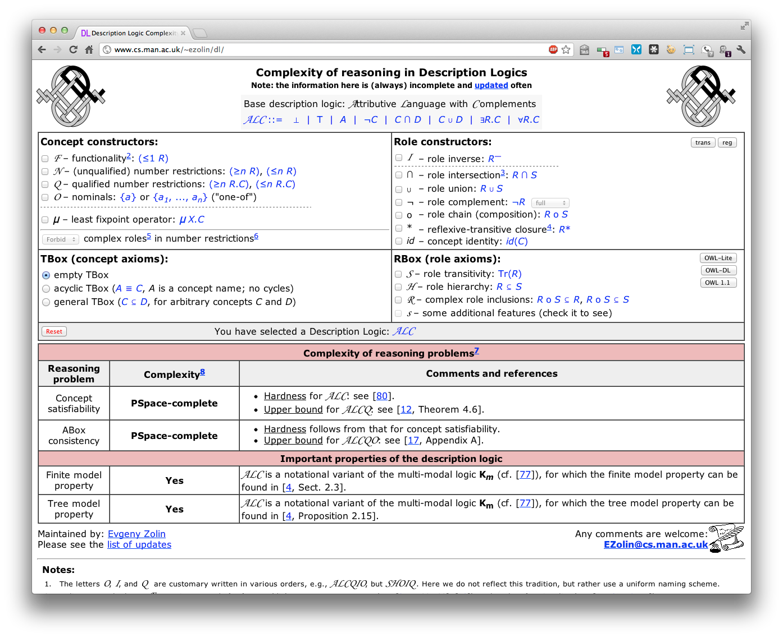
http://www.cs.man.ac.uk/~ezolin/dl/

Slide 14
OWL as a DL
OWL-DL is SHOIN^{(D)}
We can think of OWL as having three kinds of statements
Ways to specify classes
the intersection of humans and males
Ways to state axioms about those classes
Humans are a subclass of apes
Ways to talk about individuals
John is a human, a male, and has a child Mary

Slide 15
Subsumption: D ⊆ C ?
Concept C subsumes D iff on every interpretation I
I(D) ⊆ I(C)
This means the same as ∀(x)(D(x) → C(x)) for complex statements D & C
Determining whether one concept logically contains another is called the subsumption problem.
Subsumption is undecidable for reasonably expressive languages
e.g.; for FOL, subsumption means “does one FOL sentence imply another”
and non-polynomial for fairly restricted ones

Slide 16
Other reasoning problems
These problems can be reduced to subsumption (for languages with negation) and to the satisfiability problem
Concept satisfiability is C (necessarily) empty?
Instance Checking Father(john)?
Equivalence CreatureWithHeart ≡ CreatureWithKidney
Disjointness C ∏ D
Retrieval Father(X)? X = {john, robert}
Realization X(john)? X = {Father}

Slide 17
Definitions
A definition is a description of a concept or a relationship
It is used to assign a meaning to a term
In description logics, definitions use a specialized logical language
Description logics are able to do limited reasoning about concepts defined in their logic
One important inference is classification (computation of subsumption)

Slide 18
Necessary vs. Sufficient
Necessary properties of an object are common to all objects of that type
Being a man is a necessary condition for being a father
Sufficient properties allow one to identify an object as belonging to a type and need not be common to all members of the type
Speeding is a sufficient reason for being stopped by the police (but there are others!)
Definitions typically specify both necessary and sufficient properties

Slide 19
Subsumption
Meaning of Subsumption
A more general concept/description subsumes a more specific one. Members of a subsumed concept are necessarily members of a subsuming concept
Example: Animal subsumes Person; (aka IS-A, rdfs:subClassOf)
Two ways to formalize meaning of subsumption
Using logic: satisfying a subsumed concept implies that the subsuming concept is satisfied also
E.g., if john is a person, he is also an animal
Using set theory: instances of subsumed concept are necessarily a subset of subsuming concept’s instances
E.g., the set of all persons is a subset of all animals

Slide 20
How Does Classification Work?
animal
≡
mammal
sick animal
has
disease
“A sick animal has a disease”
dog
rabies
“A dog is a mammal”
“rabies is a disease”
A sick animal is defined as something that is both an animal and has at least one thing that is a kind of a disease

Slide 21
Defining a “rabid dog”
animal
mammal
sick animal
has
disease
dog
rabies
≡
has
rabid dog
The rabid dog cocept is defined as something that is both a dog and has rabies

Slide 22
Classification as a “sick animal”
animal
mammal
sick animal
has
disease
dog
rabies
has
rabid dog
We can easily prove that s rabid dog is a kind of sick animal

Slide 23
Defining “rabid animal”
animal
mammal
sick animal
has
disease
dog
≡
rabies
has
has
rabid dog
rabid animal
the rabid animal concept is defined as something that is both an animal and has rabies

Slide 24
DL reasoners places concepts in hierarchy
Note: we can remove the subclass link from rabid animal to animal because it is redundant. We don’t need to. But humans like to see the simplest structure and it may be informative for agents as well.
animal
mammal
sick animal
has
disease
rabid animal
has
dog
rabies
has
rabid dog
We can easily prove that s rabid dog is a kind of rabid animal

Slide 25
Primitive versus Structured (Defined)
Description logics reason with definitions
They prefer to have complete descriptions
A complete definition includes both necessary conditions and sufficient conditions
Often impractical or impossible, especially with natural kinds
A “primitive” definition is an incomplete one
Limits amount of classification that can be done automatically
Example:
Primitive: a Person
Defined: Parent = Person with at least one child

Slide 26
Classification is very useful
Classification is a powerful kind of reasoning that is very useful
Many expert systems can be usefully thought of as doing “heuristic classification”
Logical classification over structured descriptions and individuals is also quite useful
But… can classification ever deduce something about an individual other than what classes it belongs to?
And what does *that* tell us?

Slide 27
Example: Blood Pressure
Systolic
Blood Pressure
<= 160
•
pressure
≡
Non-Critical
Systolic BP
•
A Non-Critical Blood Pressure is “a Systolic B.P. between 85 and 160.”
pressure
>= 85

Slide 28
Example: Blood Pressure
Systolic
Blood Pressure
<= 160
•
pressure
Non-Critical
Systolic BP
≡
<= 140
•
pressure
•
pressure
Normal
Systolic BP
>= 85
•
pressure
>= 90
Normal Systolic B.P. is “a Systolic B.P. between 90 and 140.

Slide 29
If Joe’s BP is Normal is it also Non-Critical?
Systolic
Blood Pressure
<= 160
•
pressure
≡
Non-Critical
Systolic BP
≡
<= 140
•
pressure
•
pressure
Normal
Systolic BP
>= 85
?
•
pressure
Joe’s BP
>= 90

Slide 30
Concept Classification Infers Normal BP is Subsumed by Non-Critical BP
Systolic
Blood Pressure
<= 160
pressure
≡
•
Non-Critical
Systolic BP
<= 140
•
≡
pressure
•
pressure
Normal
Systolic BP
>= 85
•
pressure
>= 90

Slide 31
With Classified Concepts the Answer is Easy to Compute
Systolic
Blood Pressure
<= 160
≡
•
pressure
Non-Critical
Systolic BP
<= 140
•
≡
pressure
•
pressure
Normal
Systolic BP
>= 85
!
•
pressure
Joe’s BP
>= 90

Slide 32
Incidental properties
We can consider properties that are not part of any definition to be incidental
Classification based on non-incidental properties allow the inference of incidental properties
Examples:
E.g., red cars have been observed to have a high accident rate by insurance companies
Birds weighing more than 25kg can not fly
People with non-critical blood pressure require no medication

Slide 33
DL Conclusion
Description logic was the model for OWL reasoning
More expressive than rule-based systems without being undecidable or intractable
It can reason over general statements (e.g., a dog with rabies is a sick animal), unlike most rule-based systems
It still has limitations tho…

