Slide 1

The Fat-Free Alternative to XML

Slide 2
JSON as an XML Alternative
JSON is a light-weight alternative to XML for data-interchange
JSON = JavaScript Object Notation
It’s really language independent
Most programming languages can easily read it and instantiate objects or some other data structure
Defined in RFC 4627, IETF, July 2006
Current version is RFC 8259, December 2017
http://json.org/ has more information

Slide 3
JSON TL;DR
Lightweight data-interchange format
Easy for humans to read and write
Easy for machines to parse and generate
Not tied tied to JavaScript or Web

Slide 4
Example
{"firstName": "John",
"lastName" : "Smith",
"age" : 25,
"address" :
{"streetAdr” : "21 2nd Street",
"city" : "New York",
"state" : "NY",
”zip" : "10021"},
"phoneNumber":
[ {"type" : "home",
"number": "212-555-1234"},
{"type" : "fax",
"number” : "646-555-4567"} ]
}
This is a JSON object with five key-value pairs
Objects are wrapped by curly braces
There are no object IDs
Keys are strings
Values are numbers, strings, objects or arrays
Arrays/lists are wrapped by square brackets

Slide 5
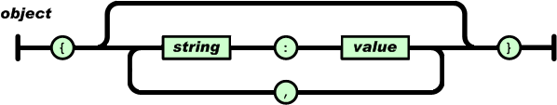
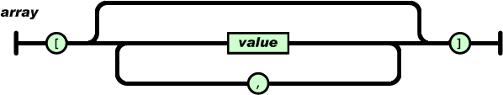
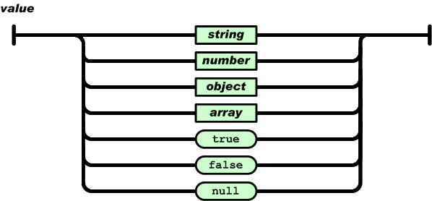
Simple BNF

Slide 6
Evaluation: JSON is …
Simpler and more compact than XML
No closing tags
XML parsing is hard because of its complexity
Compressed the two are similar in size
A better fit for OO systems than XML
Less extensible than XML
Widely preferred for simple data exchange

Slide 7
JSON is Simple
Less syntax, no semantics
Schemas? We don’t need no stinkin schemas!*
Transforms? Write your own

Slide 8
JSON Schema
{ "id": "http://ex.com/geo-location.schema.json",
"$schema": "http://json-schema.org/draft-07/schema#",
"title": "Longitude and Latitude Values",
"description": "A geographical coordinate.",
"required": [
"latitude",
"longitude” ],
"type": "object",
"properties": {
"latitude": {
"type": "number",
"minimum": -90,
"maximum": 90 },
"longitude": {
"type": "number",
"minimum": -180,
"maximum": 180 }
}
}
https://json-schema.org/
IETF draft, 3/2018
Provide annotations
Specifies
Possible properties
Required properties
Value types
Value constraints
References
{
"latitude": 48.858093,
"longitude": 2.294694
}

Slide 9
JSON-LD
JSON-LD is a W3C recommendation for representing RDF data as JSON objects
{"@context": {
"name": "http://xmlns.com/foaf/0.1/name",
"homepage": {
"@id": "http://xmlns.com/foaf/0.1/workplaceHomepage",
"@type": "@id"
},
"Person": "http://xmlns.com/foaf/0.1/Person"
},
"@id": "http://me.markus-lanthaler.com",
"@type": "Person",
"name": "Markus Lanthaler",
"homepage": "http://www.tugraz.at/"
}

Slide 10
Many popular systems use JSON
MongoDB is an open-source database for JSON objects
Very popular NoSQL database
A NoSQL DB is one that uses a model not based on relational tables
Elastic Search is a popular, scalable information retrieval engine that uses JSON as its native representation

Slide 11
Example: JSON in Python
>>> import json
>>> x = json.load(open('example.json'))
>>> x
{u'lastName': u'Smith', u'age': 25, u'phoneNumber': [{u'type': u'home', u'number': u'212-555-1234'}, {u'type': u'fax', u'number': u'646-555-4567'}], u'firstName': u'John', u'address': {u'streetAdr': u'21 2nd Street', u'state': u'NY', u'zip': u'10021', u'city': u'New York'}}
>>> x['address']['state']
u'NY'
>>> print json.dumps(x, sort_keys=True, separators=(',',':'), indent=2)
{"address":{
"city":"New York",
"state":"NY",
"streetAdr":"21 2nd Street",
"zip":"10021”},
"age":25,
"firstName":"John",
"lastName":"Smith",
"phoneNumber":[
{ "number":"212-555-1234",
"type":"home”},
{"number":"646-555-4567",
"type":"fax” } ] }
>>>
Python’s JSON package reads & writes JSON from/to files & strings
Maps JSON objects to Python dictionaries
Maps JSON arrays to Python lists
Dump (write to file) and dumps (write to string) functions can do simple pretty printing

Slide 12
JSON vs. XML
JSON: The Fat-Free Alternative to XML
json.org page laying out the case for JSON over XML
Stop Comparing JSON and XML
Blog post arguing that they're very different things with their own areas of applicability
XML ⬄JSON
There are many web tools (e.g.: this one) and software packages (e.g. xml2dict) that can convert between simple XML and JSON representations

Slide 13

Jupyter Notebook Examples
Visit http://bit.ly/kg19class and get clone string
Clone this on your computer
cd class_material/examples/xml/
If needed:
pip3 install xmltodict
pip3 install jupyter
jupyter notebook &
In your web browser open xml2json.ipynb

Slide 14
Worse is Better?
JSON vs. XML as an example of “Worse is Better”
In 1989 Dick Gabriel headed a company with the best commercial version of Lisp
Lisp was considered by programming language experts to be much better than C
But C was 10x more popular than Lisp
Cf. today: Scheme vs. Python (w.r.t. mutable lists)
Gabriel explained it as worse is better
Software that's limited, but simple to learn/use, and flexible, can be more popular for most users

Slide 15
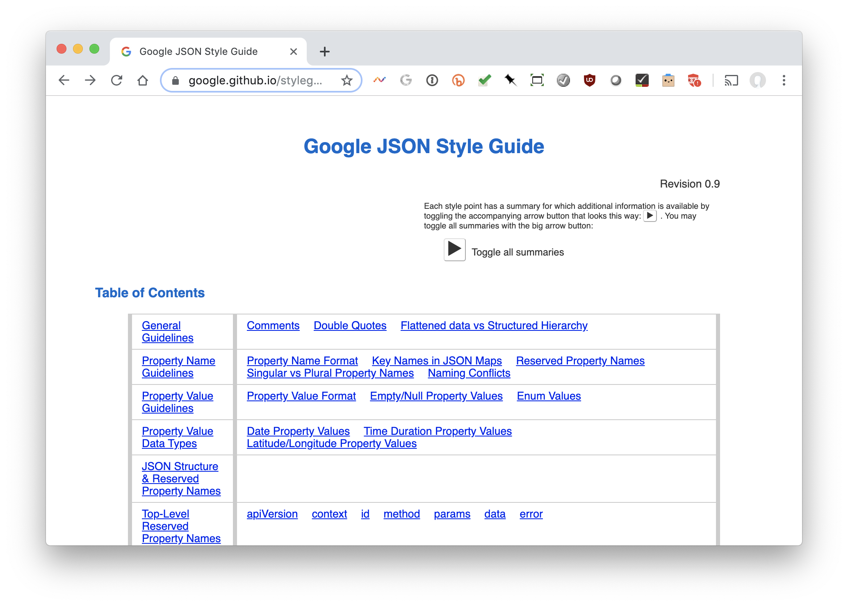
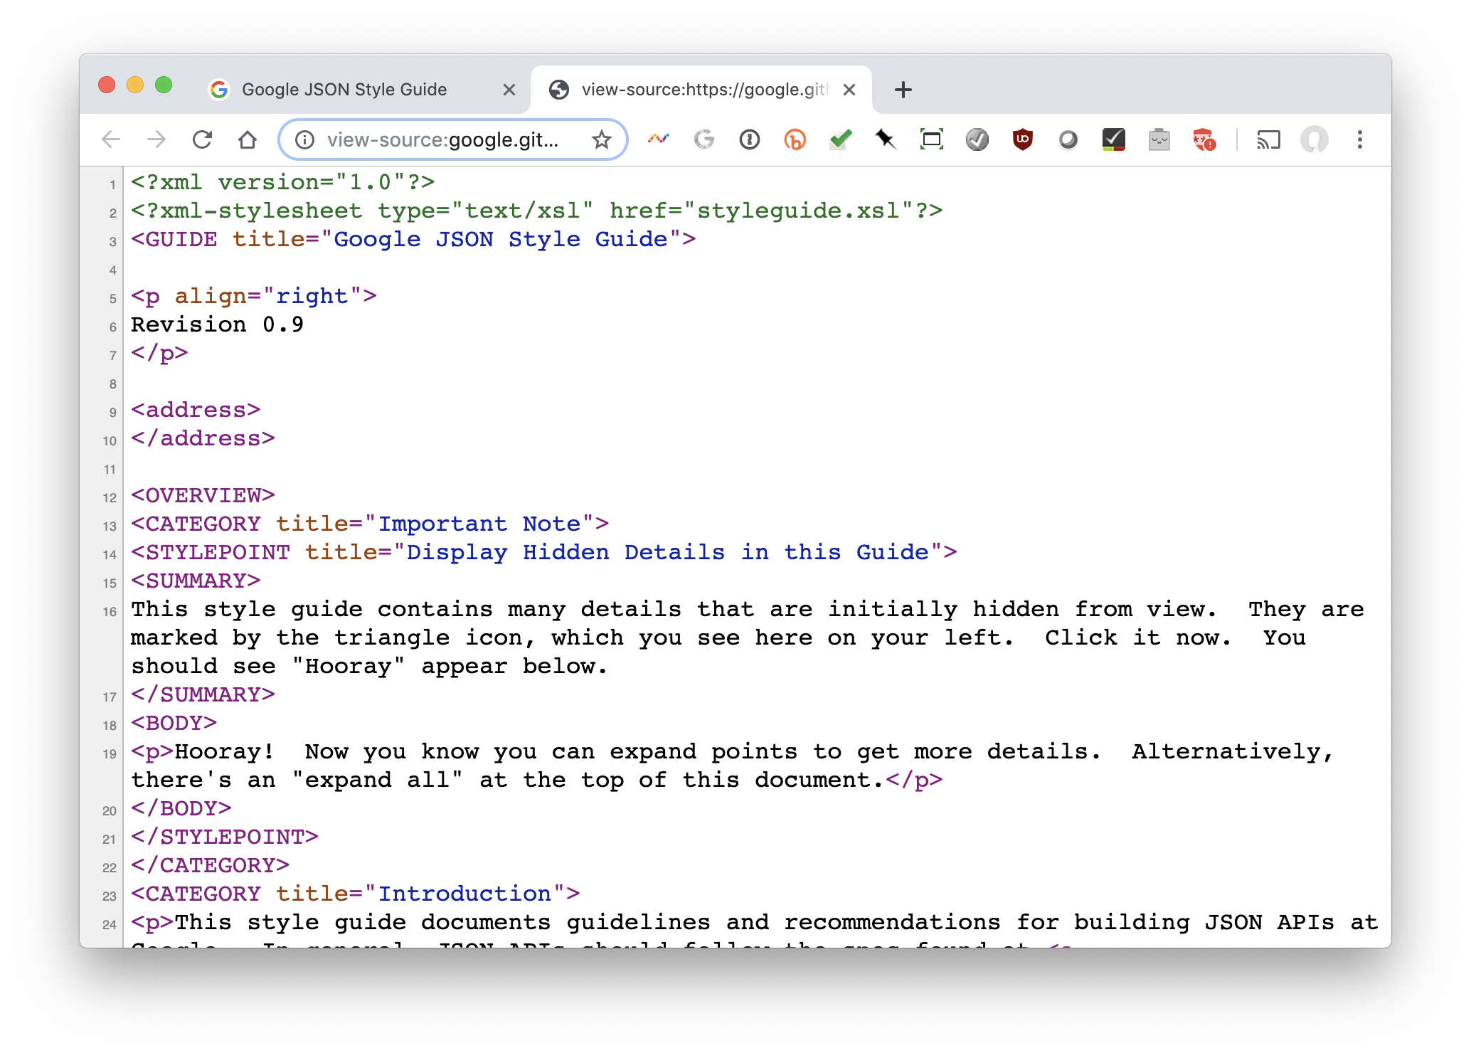
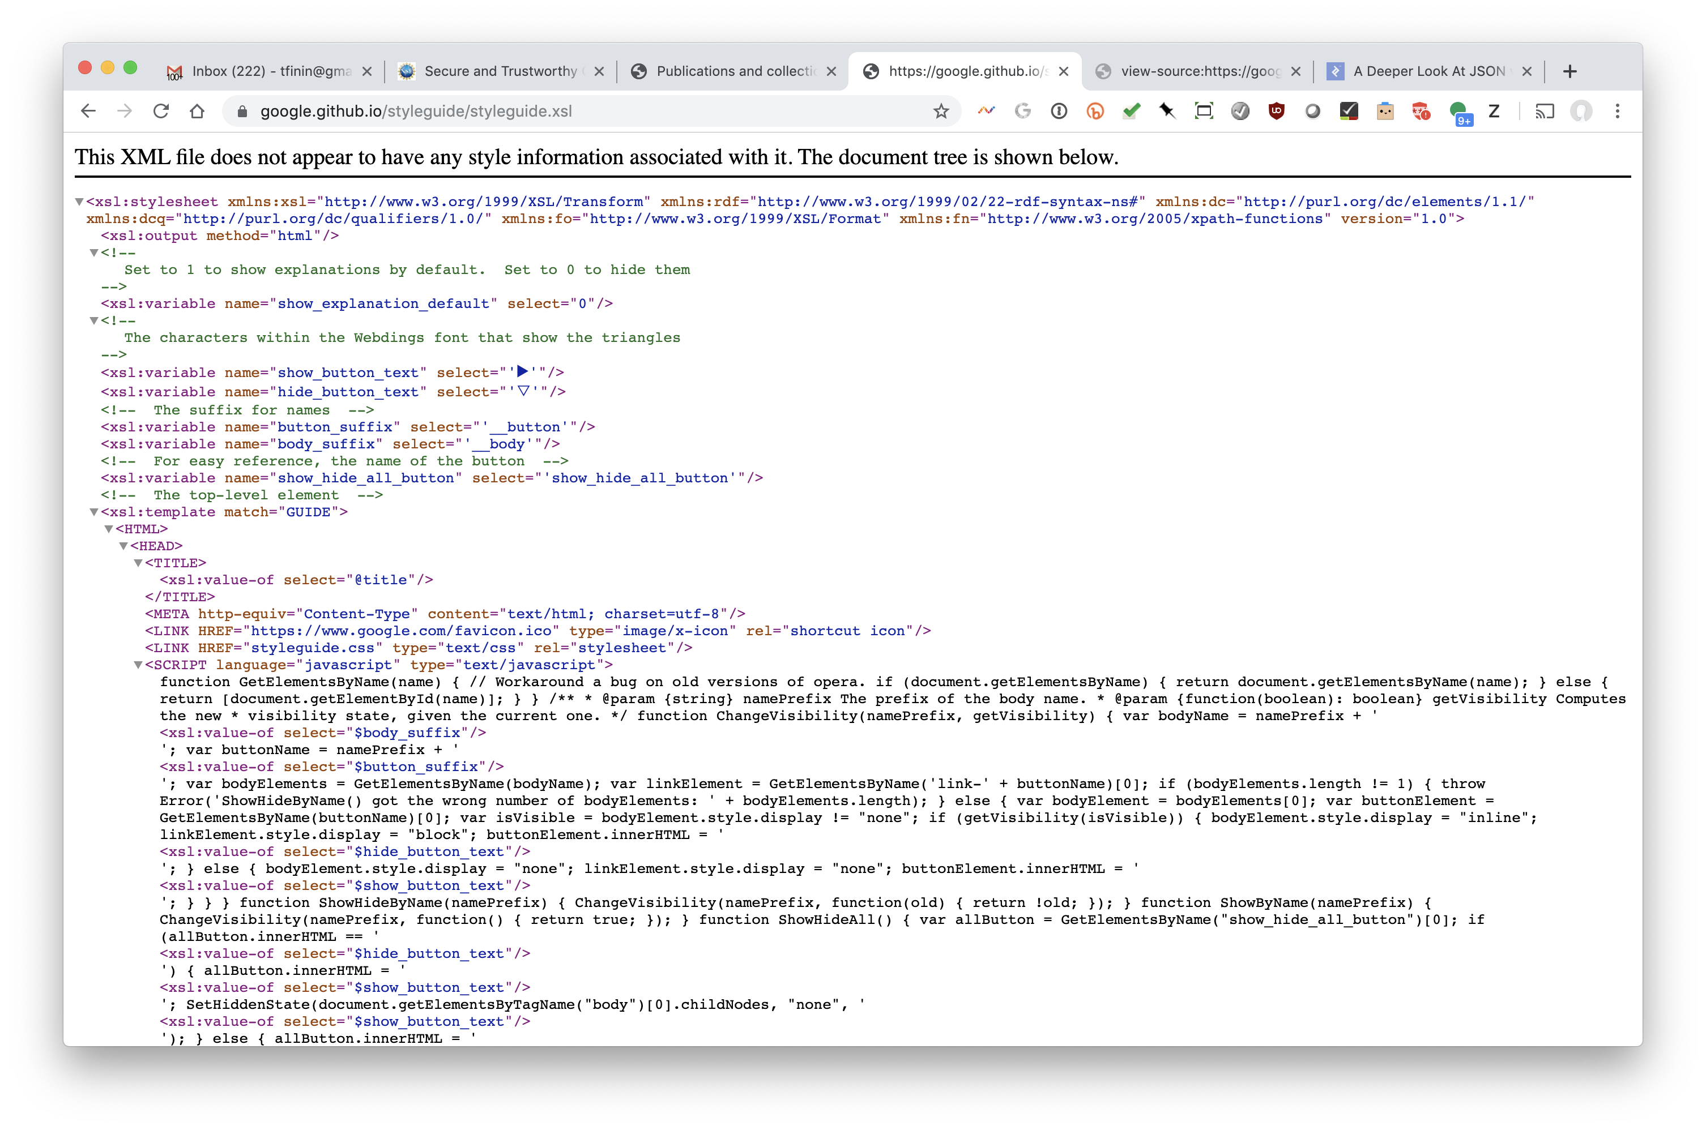
Google’s JSON Style Guide
Google has style guides for JSON and other languages
Note: its an XML document with an XSL stylesheet!
HTML
XML source
XSL stylesheet

Slide 16
Motivation for the style guide?
Google’s style guide addresses JSON’s shortcomings by specifying conventions, e.g.:
JSON doesn’t support objects having a unique ID which is needed to support graph structures
The style guide has data.id as a reserved property for this
{"data": {"id": "12345"}}
Later, we’ll study the W3C’s JSON-LD as a way to encode semantic web data using JSON
JSON-LD specifies conventions needed to represent RDF knowledge graphs in JSON
Today’s search engines recognize embedded JSON-LD in web pages and use the content

Slide 17
JSON Summary
JSON is preferred by most people for simple data encoding and exchange
Most XML documents can be converted to JSON
Shortcomings:
No standard schema mechanism
No stylesheets
Available datatypes are very simple
No semantics, e.g., no type system, cannot say spouse is a symmetric relation, grandparent = parent of parent
Good example of worse is better

