Slide 1
Freebase and the Google Knowledge Graph

Slide 2

Freebase
Started in 2005 by startup Metaweb
Goal: create an “open, shared database of the world's knowledge”
Online in 2007
Acquired by Google in 2010
Read-only in 2014
Basis for Google Knowledge Graph
Decommissioned in 2016
2014 dumps still available as RDF

Slide 3
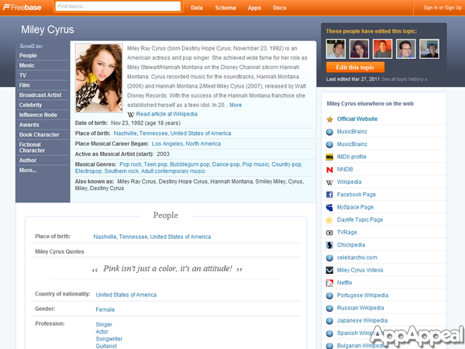
Screenshot

Slide 4
Approach
Initially populated with Wikipedia data
Crowdsourced updates/additions to schema & data, like Wikipedia
Tools to upload structured data, both schema & data
Focus on data, not text
Text mostly in the form of short descriptions
Graph based schema, but syntax and semantics different from RDF
Open source data that could be downloaded initially in a custom format, later in RDF
Business model: sell services using their custom query engine

Slide 5
Freebase Schema
Statistics
~10,000 types
~3,500 properties
~130M entities
~2B triples
Modeled many relations a CVTs= (compound value type) object to allow more roles, e.g.
:bho :spouseOf [a :Marriage with spouse :bho, :mo;
:start “1992”; :location :chi]
Larger, cleaner & more organized than DBpedia

Slide 6
The Last Picture Show
A final dump with 1.9B triples in RDF is available from Google
See also http://basekb.com/docs/
Used for DARPA Deft program, NIST TAC and other research efforts as a reference KB
FB relations still used for many evaluations
Data transferred to Wikidata and Google Knowledge graph

Slide 7
Google Knowledge Graph
Current types
Book
BookSeries
Educational Organization
Event
Government Organization
LocalBusiness
Movie
MovieSeries
MusicAlbum
MusicGroup
MusicRecording
Organization
Periodical
Person
Place
SportsTeam
TVEpisode
TVSeries
VideoGame
VideoGameSeries
WebSite
Freebase was initial version of Google knowledge Graph, aka Knowledge Vault
You can query it in a limited way
Inputs: query string, types, limit
Output: (JSON) ranked list of entities that match, along with types, short description, ID (= freebase ID)
See simple gkg.py example

Slide 8
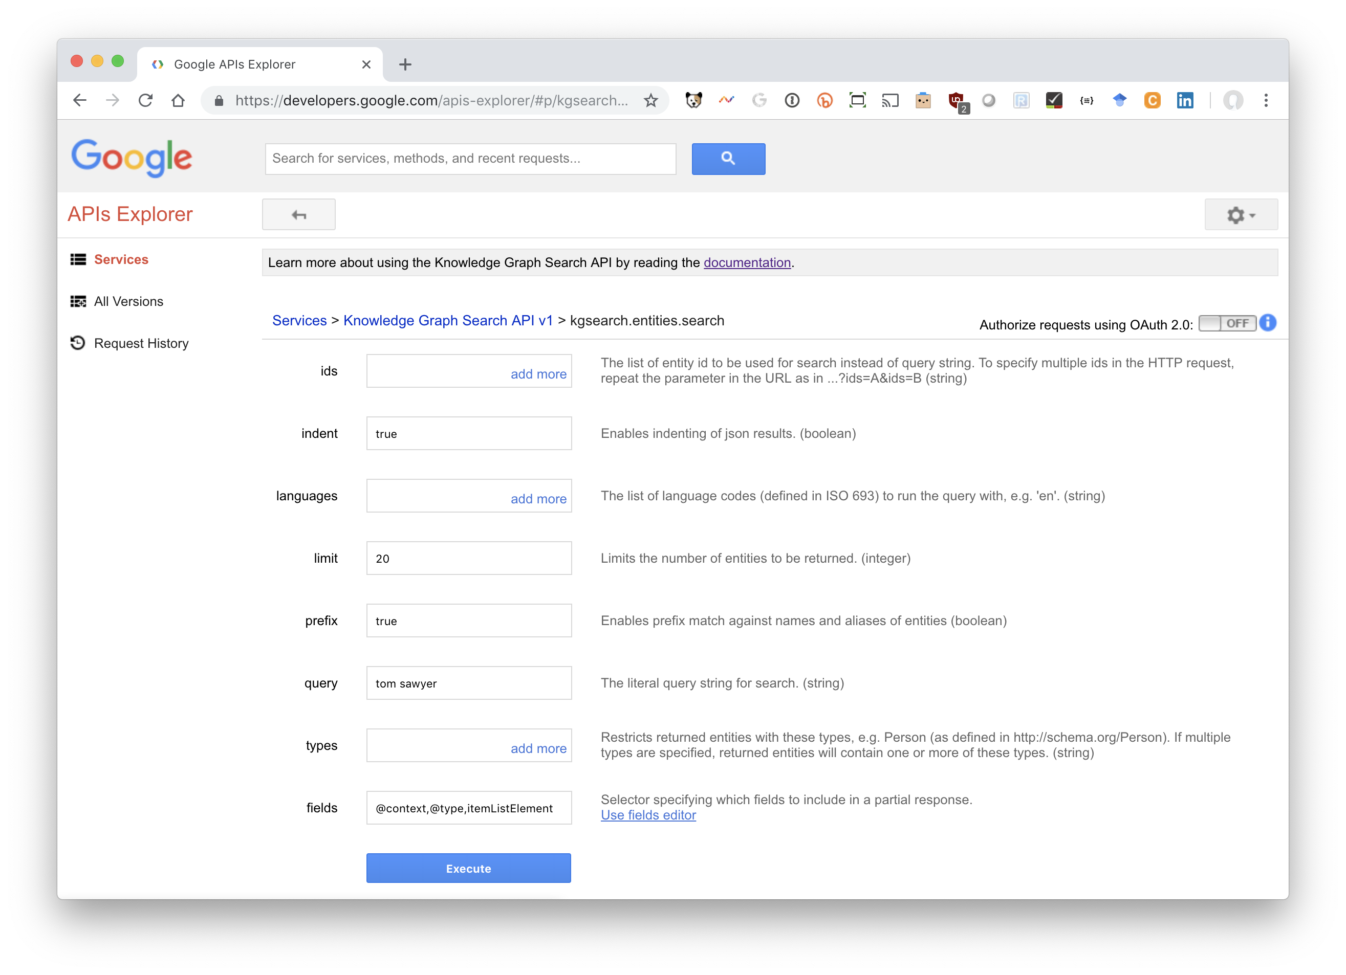
Experiment Online
Try: bit.ly/gkgClinton

Slide 9
Example
Query about Taylor Swift
https://kgsearch.googleapis.com/v1/entities:search?query=taylor+swift&key=API_KEY&limit=1&indent=True

Slide 10
{"@context": { "@vocab": "http://schema.org/",
"goog": "http://schema.googleapis.com/",
"resultScore": "goog:resultScore",
"detailedDescription": "goog:detailedDescription",
"EntitySearchResult": "goog:EntitySearchResult",
"kg": "http://g.co/kg"},
"@type": "ItemList",
"itemListElement": [
{ "@type": "EntitySearchResult",
"result": { "@id": "kg:/m/0dl567",
"name": "Taylor Swift",
"@type": ["Thing", "Person"],
"description": "Singer-songwriter",
"image": {"contentUrl": "https://t1.gstatic.com/images?q=tbn:ANd9GcQm…",
"url": "https://en.wikipedia.org/wiki/Taylor_Swift",
"license": "http://creativecommons.org/licenses/by-sa/2.0"},
"detailedDescription": {"articleBody": "Taylor Alison Swift is an American singer-songwriter …",
"url": "http://en.wikipedia.org/wiki/Taylor_Swift",
"license": "https://en.wikipedia.org/wiki/Wikipedia:Text_of_Creative_..."},
"url": "http://taylorswift.com/" },
"resultScore": 896.576599 } ] }

Slide 11
Tyrannosaurus (Q14332)
m/07hjh: Freebase ID of entity Tyrannosaurus
Try http://g.co/kg/m/07hjh
Wikidata property (P646) with label Freebase ID
/g/11r_php4q: Google Knowledge Graph ID
Wikidata has a property (P2671) with label Google Knowledge Graph ID
Try https://g.co/kg/g/11r_php4q
Only 101 Wikidata items have both

Slide 12
Is it the Google knowledge graph?
I don’t know…
Google says it’s now using Wikidata for the knowledge graph
We can only get some info. about some entities
Google may have many sources of data it uses to answer/enrich query results
My guess: Wikidata is the backbone of the knowledge graph, but Google links additional proprietary info. to many entities

