Slide 1
OWL, DL and rules
Based on slides from Grigoris Antoniou, Frank van Harmele and Vassilis Papataxiarhis

Slide 2
OWL and Rules
Rule based systems are an important and useful way to represent and reason with knowledge
Adding rules to OWL has proved to be fraught with problems
We’ll look at the underlying issues and several approaches
SWRL: failed standard that has become widely used
RIF: a successful standard that’s not yet widely used

Slide 3
Semantic Web and Logic
The Semantic Web is grounded in logic
But what logic?
OWL Full = Classical first order logic (FOL)
OWL-DL = Description logic
N3 rules ~= logic programming (LP) rules
SWRL ~= DL + LP
Other choices are possible, e.g., default logic, fuzzy logic, probabilistic logics, …
How do these fit together and what are the consequences

Slide 4
We need both structure and rules
OWL’s ontologies based on DL (and thus on FOL)
The Web is an open environment
Reusability / interoperability
An ontology is a model easy to understand
Many rule systems based on logic programming
To achieve decidability, ontology languages don’t offer the expressiveness we want. Rules do it well
Efficient reasoning support already exists
Rules are well-known and often more intuitive

Slide 5
Description Logics vs. Horn Logic
Neither is a subset of the other
Impossible in OWL DL: people who study and live in same city are local students
Easily done with a a rule
studiesAt(X,U), loc(U,L), lives(X,L) → localStud(X)
Impossible in horn rules: every person is either a man or a woman
Easily done in OWL DL:
:Person owl:disjointUnionOf (:Man :Woman).

Slide 6
What’s Horn clause logic
Prolog and most ‘logic’-oriented rule languages use horn clause logic
Defined by UCLA mathematician Alfred Horn
Horn clauses: subset of FOL where every sentence is a disjunction of atoms where at most one is positive
~P V ~Q V R
~P V ~Q
R
Atoms: propositional variables (isMarried) or predicates (e.g., person(alice), mother(alice, ?x)) that can have variables

Slide 7
Alternate formulation as implications
Horn clauses can be re-written using the implication operator
~P V ~Q V R ⇔ P ∧ Q ➔R (R true of both P and Q true)
~P V ~Q ⇔ P ∧ Q ➔⊥ (contradiction if both P and Q true))
R ⇔ ➔ R (R is true)
What we end up with is ~ “pure prolog”
Single positive atom as the rule conclusion
Conjunction of positive atoms as the rule antecedents (conditions)
No not operator
Atoms can be predicates (e.g., person(X), mother(X,Y), between(City, newYork, baltimore)

Slide 8
Prolog’s synax
Prolog syntax is a bit different, putting the rule’s conclusion first
hasMother(?x, ?m) :- hasParent(?x, ?m), female(?m) .
A fact is a rule w/o a body (i.e., no conditions)
hasParent(john, tom).
hasParent(john, mary).
female(mary).
Prolog ‘proves’ queries by matching a fact, or a rule’s conclusion and then proving each condition in the rule’s body
head = conclusion
body = conjunction of conditions

Slide 9
We can relax this a bit
Head can contain a conjunction of atoms
P ∧Q ← R is equivalent to P←R and Q←R
Body can have disjunctions
P←R∨Q is equivalent to P←R and P←Q
But somethings are just not allowed:
No disjunction in head, e.g.,
man(?x) ; woman(?x) :- person(x)
No logical negation operator, i.e. NOT
man(?x) :- person(x), not(woman(x))

Slide 10
Where are the quantifiers?
Quantifiers (forall, exists) are implicit
Variables in rule head are universally quantified
Variables only in rule body existentially quantified
Example:
IsParent(?x) :- hasChild(?x, ?y).
isParent(X) ← hasChild(X,Y)
forAll X: isParent(X) if Exisits Y: hasChild(X,Y) ∀X isParent(X) → ∃Y hasChild(X,Y)

Slide 11
Facts & rule conclusions are definite
Definite means not a disjunction
Facts are rule with the trivial true condition
Consider these true facts:
P ∨ Q # either P or Q (or both) are true
P ➔ R # if P is true, then R is true
Q ➔ R # if Q is true, then R is true
What can you conclude?
Can this be expressed in horn logic?
Notes:
R follows since either P or Q is true and both imply that R is true

Slide 12
Facts & rule conclusions are definite
Consider these true facts where not is classical negation rather than “negation as failure”
not(P) ➔ Q, not(Q) ➔P # i.e. P∨Q
P ➔ R, Q ➔ R
Horn clause reasoners can’t prove that either P or Q is necessarily true or false so can’t show that R must be true
Notes:
This seems to get did of the disjunction, but if we treat not as prolog’s negation as failure, it does not help

Slide 13
The Programming in Prolog
Prolog = PROgramming in LOGic
Prolog’s procedural elements make it very useful, when used in moderation
One element is it’s unprovable operator, \+
\+ P succeeds if and only P cannot be proven
Often called “negation as failure”
Example: assume a person is unmarried if we don’t know they are married
Unmarried(?x) :- person(?x), \+ married(?x) .

Slide 14
Non-ground entailment (1)
The LP-semantics defined in terms of minimal Herbrand model, i.e., sets of ground facts
Because of this, LP horn clause reasoners can not derive rules, so that can not do general subsumption reasoning
i.e., It can only reason about atomic facts to infer new facts
It can’t reason about rules and complex facts to create new rules

Slide 15
Non-ground entailment (2)
A horn-clause reasoner can’t do the following
Given
animal(?X) ∧ disease(?D) ∧ has(?X,?D) → sickAnimal(?x)
dog(?X) → animal(?X)
disease(rabies)
Derive a new rule dog(?X), has(?X, rabies) → sickAnimal(?X)
Even though it follows from the underlying logic

Slide 16
Decidability
The largest obstacle!
Tradeoff between expressiveness and decidability
Facing decidability issues from
In LP: Finiteness of the domain
In classical logic (and thus in DL ): combination of constructs
Problem:
Combination of “simple” DLs and Horn Logic are undecidable. (Levy & Rousset, 1998)

Slide 17
SWRL: Semantic Web Rule Language
SWRL is the union of DL and horn logic + many built-in functions (e.g., for math)
Submitted to W3C in 2004, but failed to become a recommendation (led to RIF)
Problem: full SWRL specification leads to undecidability in reasoning
SWRL is well specified and subsets are widely supported (e.g., in Pellet, HermiT)
• Based on OWL: rules use terms for OWL concepts (classes, properties, individuals, literals…)

Slide 18
SWRL
OWL classes are unary predicates, properties are binary ones
sibling(?p,?s) ^ Man(?s) → brother(?p,?s)
As in Prolog, bulitins can be booleans or do a computation and unify the result to a variable
swrlb:greaterThan(?age2, ?age1) # age2>age1
swrlb:subtract(?n1,?n2,?diff) # diff=n1-n2
SWRL predicates for OWL axioms and data tests
differentFrom(?x, ?y), sameAs(?x, ?y), xsd:int(?x), [3, 4, 5](?x), …

Slide 19
SWRL Built-Ins
SWRL defines a set of built-in predicate that allow for comparisons, math evaluation, string operations and more
See here for the complete list
Examples
Person(?p), hasAge(?p, ?age), swrlb:greaterThan(?age, 18) -> Adult(?p)
Person(?p), bornOnDate(?p, ?date), xsd:date(?date), swrlb:date(?date, ?year, ?month, ?day, ?timezone) -> bornInYear(?p, ?year)
Some reasoners (e.g., Pellet) allow you to define new built-ins in Java

Slide 20
Drawbacks of full SWRL
Main source of complexity:
arbitrary OWL expressions (e.g. restrictions) can appear in the head or body of a rule
Adds significant expressive power to OWL, but causes undecidability
there is no inference engine that draws exactly the same conclusions as the SWRL semantics

Slide 21
SWRL Sublanguages
Challenge: identify sublanguages of SWRL with right balance between expressivity and computational viability
A candidate OWL DL + DL-safe rules
every variable must appear in a non-description logic atom in the rule body

Slide 22
DL-safe rules
Standard reasoners support only DL-safe rules
Rule variables bind only to known individuals (i.e., owl2 owl:NamedIndividual)
Example
:Vehicle(?v) ^ :Motor(?m) ^ :hasMotor(?v,?m) -> :MotorVehicle(?v)
Where
:Car = :Vehicle and some :hasMotor Motor
:x a :Car
Reasoner won’t bind ?m to a motor since it is not a known individual
Thus the rule cannot conclude MotorVehicle(:x)

Slide 23
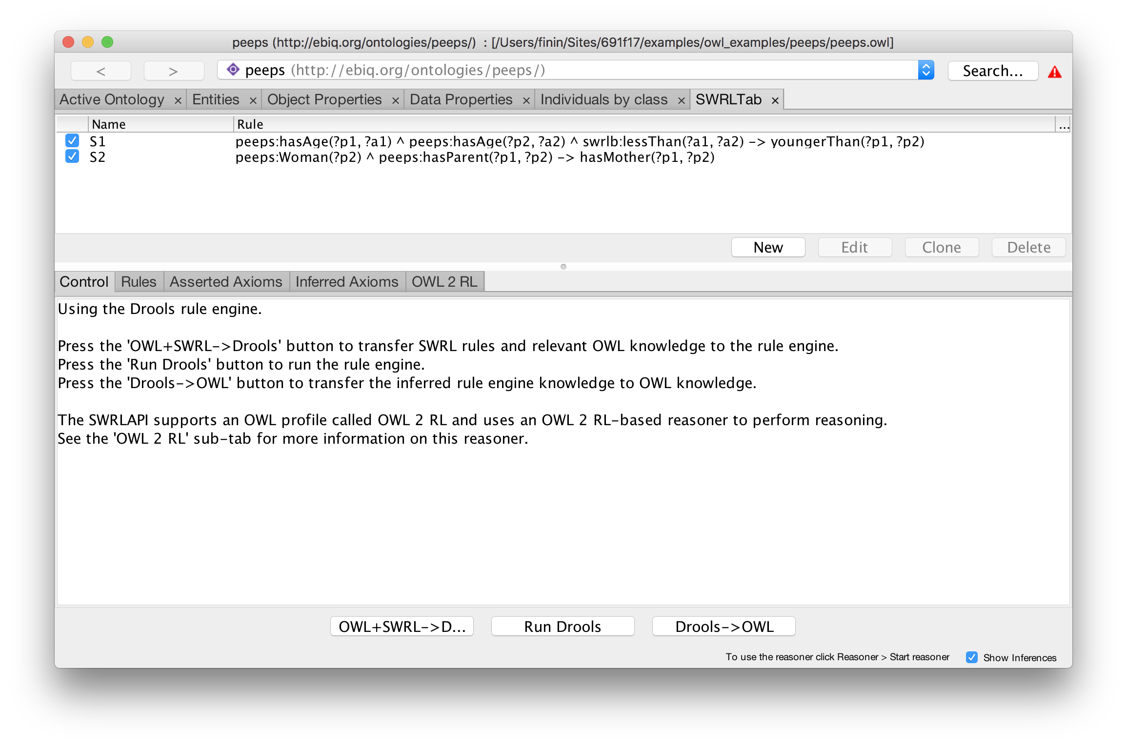
Protégé 5 had SWRLTab
Add/edit rules and optionally run a separate rules engine

Slide 24
SWRL limitations
SWRL rules do not support many useful features of of some rule-based systems
Default reasoning
Rule priorities
Negation as failure (e.g., for closed-world semantics)
Data structures
…
Limitations led to RIF, Rule Interchange Format

Slide 25
Summary
Horn logic is a subset of predicate logic that allows efficient reasoning, orthogonal to description logics
Horn logic is the basis of monotonic rules
DLP and SWRL are two important ways of combining OWL with Horn rules.
DLP is essentially the intersection of OWL and Horn logic
SWRL is a much richer language

Slide 26
Summary (2)
Nonmonotonic rules are useful in situations where the available information is incomplete
They are rules that may be overridden by contrary evidence
Priorities are sometimes used to resolve some conflicts between rules

