Slide 1
Piece of Eden rentals
Rachel Cohen, Eric forte, Nick keckeisen Stephen masterson, Matthew walker

Slide 2
Our web Application
A rental service for beachfront vacation properties
Main Functions:
Create a user profile
Upload a property
Search for and view a property
Renting a property
View a property on the Google Maps interface

Slide 3
Design technologies
AWS for easy and reliable website hosting
Django Web Framework using Python for a clean design
Python REST API to communicate with the database to retrieve information to display in the UI
MongoDB for data storage and retrieval

Slide 4
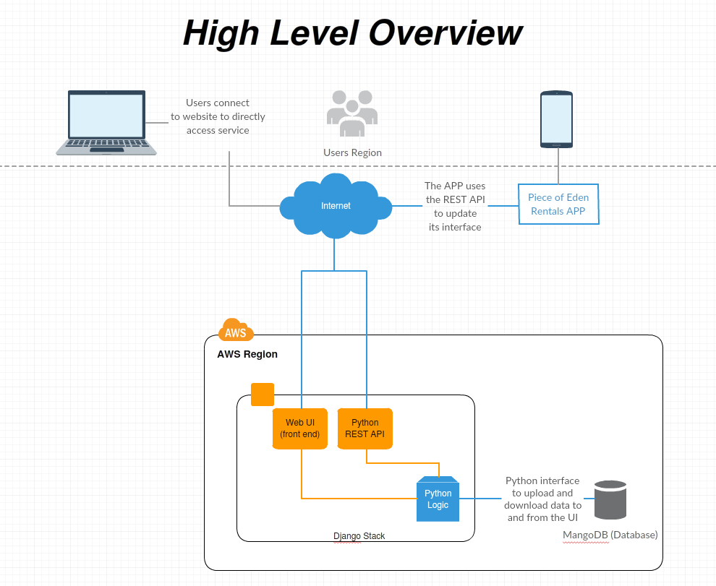

Slide 5

Let’s Demo!

