Slide 1
Piece of Eden rentals
Rachel Cohen, Eric forte, Nick keckeisen Stephen masterson, Matthew walker

Slide 2
What is it?
A platform to display beachfront properties on six continents
To rent properties for vacations
To rent personal properties for added income
Includes user profiles to allow for landlord & property ratings by customers
Safe and secure transactions from anywhere on the globe
Search for properties by
Google Maps interface
by city, state, country.

Slide 3
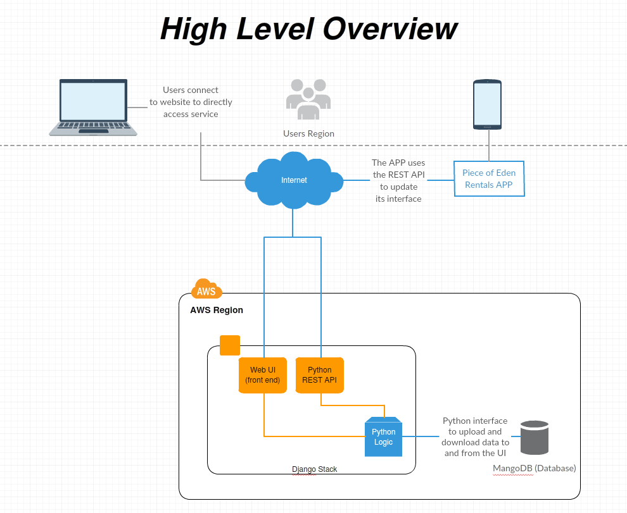

Slide 4
Design technologies
Amazon Web services for easy and reliable website hosting
Django web framework using Python for a clean & pragmatic design
Python REST API
MangoDB for data storage & retrieval

Slide 5
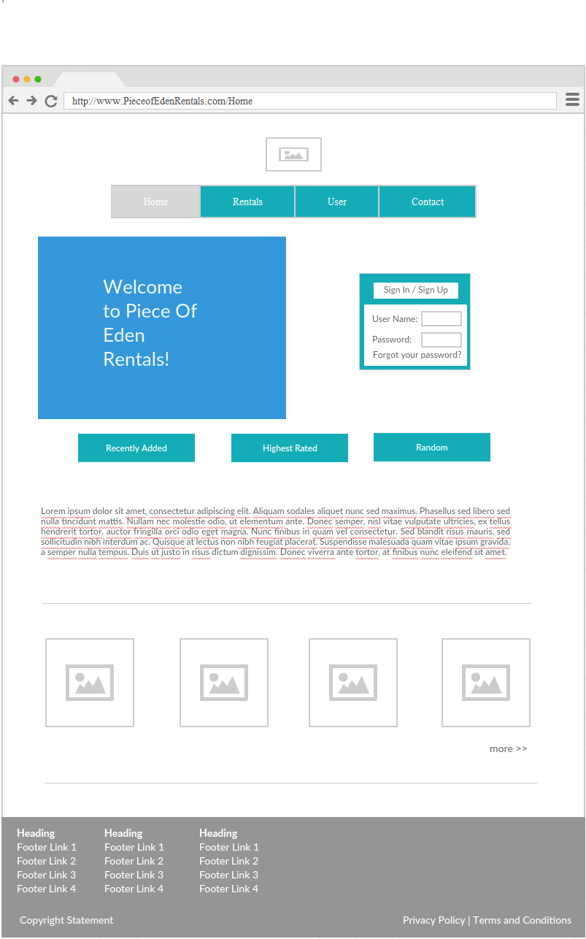
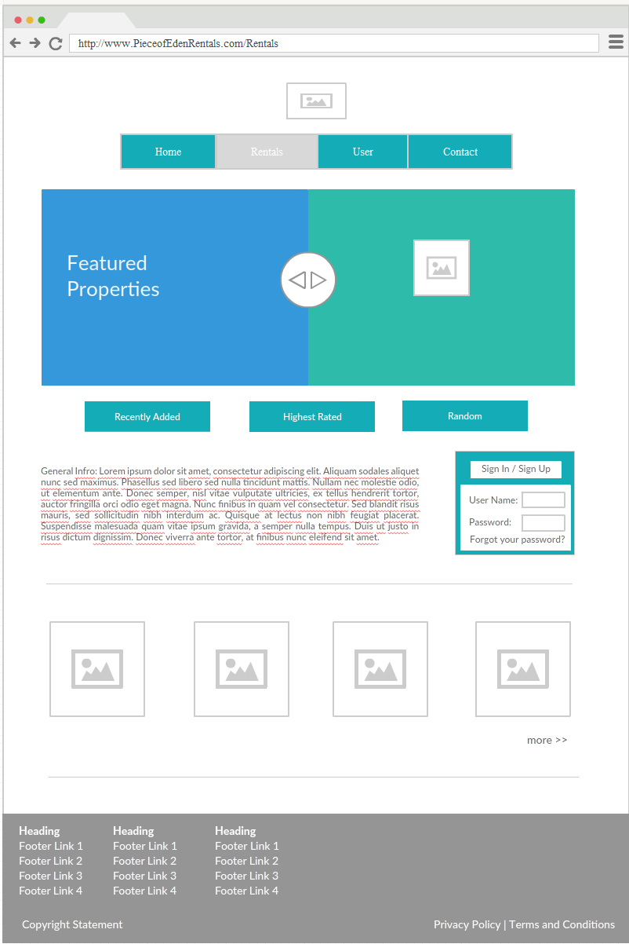
Home & Rental pages

Slide 6
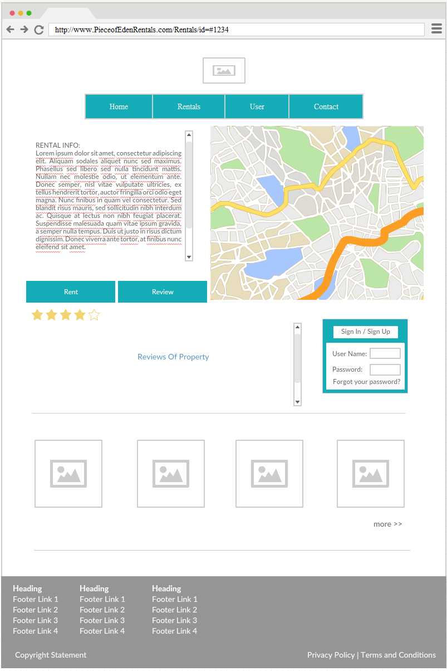
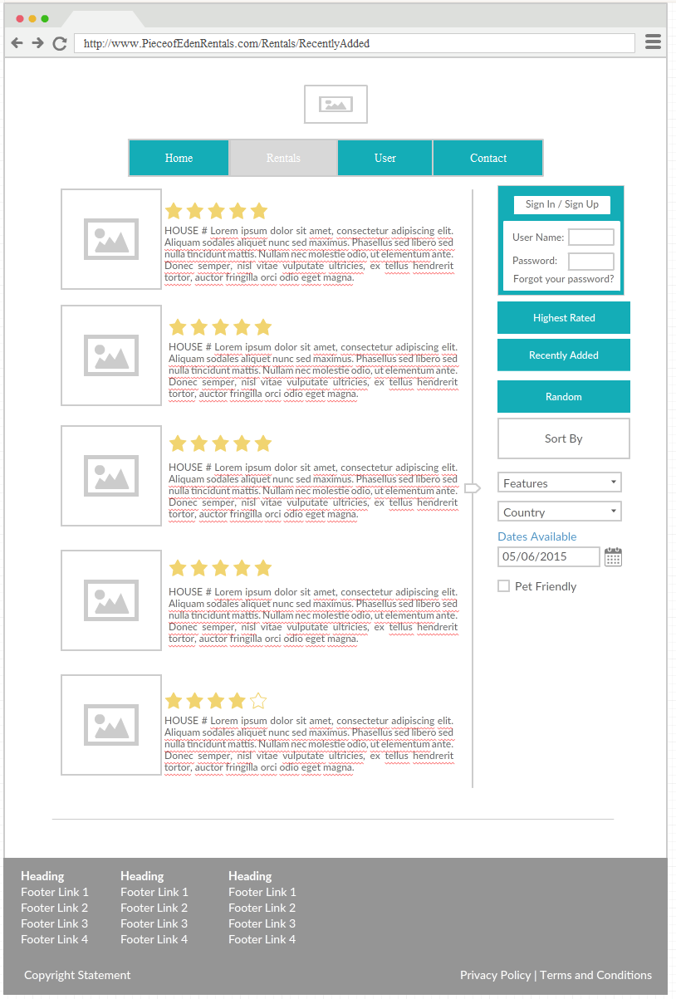
Search & Maps pages

Slide 7
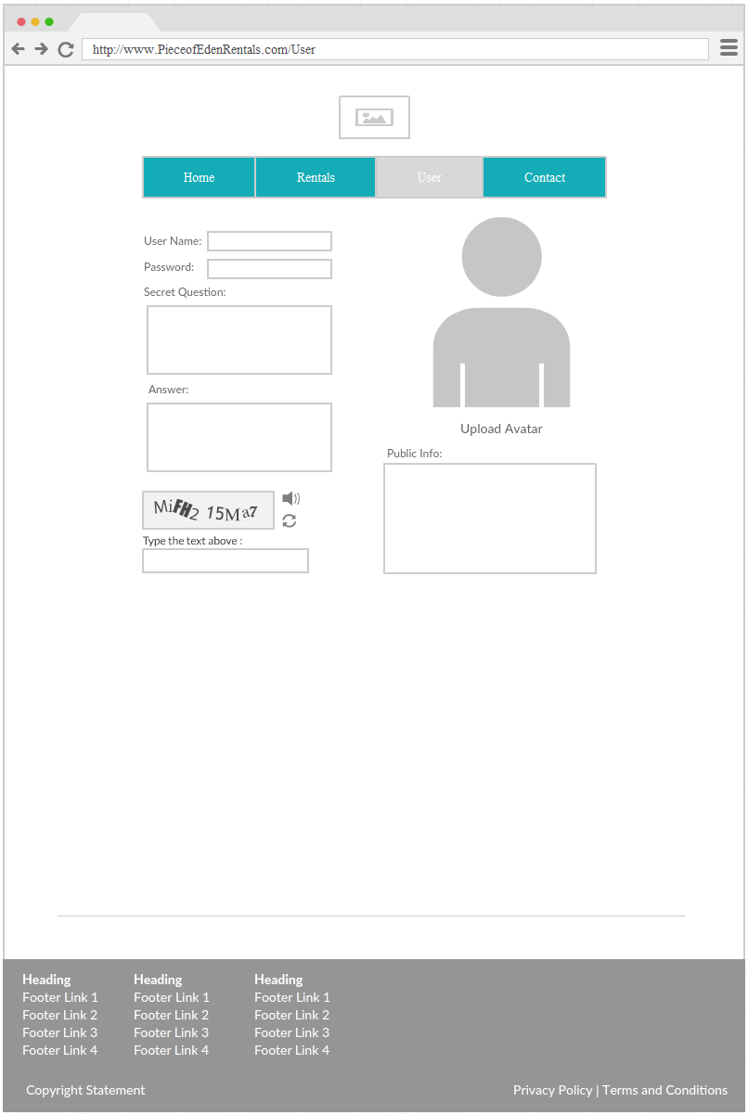
User Page

