Slide 1

UMBC Cyber Defense Team
Networking Basics & Wireshark
2017-2018

Slide 2
AGENDA
Basics
Physical Devices, Networks, IP Addresses, Protocols, OSI Model, Ports, Packets, IEEE 802
Applications
ifconfig, tcpdump, netstat, netcat, ping, tshark, cURL, wget, nmap, scapy
Wireshark
Demo, filters, tcp stream, fields,
Bro, SNORT, BUrp suite
Security
Encryption / Firewalls
IPS/IDS
Deep packet inspection
CCDC
Lab

Slide 3
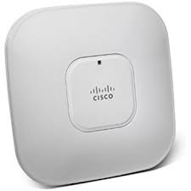
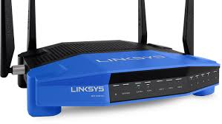
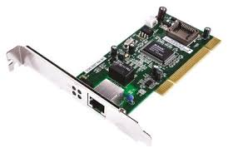
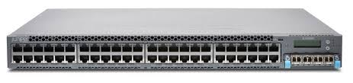
PHYSICAL DEVICES
Routers, Access Points, Switches
Network interface cards
Access Point (AP)
Router
Network Interface Card
Switch

Slide 4
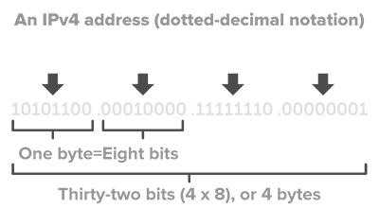
IP ADDRESSES (IPV4)
32-bit number unique to every computer
Private / Public
Private are used within homes/businesses and are not routable to the internet (192. , 172., 10.)
Public are used to communicate across the internet
Subnet Masks / Classes
How the computer tells the network part of the address, from the specific device on that network
i.e. 192.168.1.5 with 255.255.255.0 what does that mean?
Hosts formula: 2n - 2 = number of hosts (n = # of 0’s in binary IP address)
Subnets formula: 2^n = number of subnets (n = # of 1’s in binary IP address)
Typically, when giving an IP (ifconfig eth0 192.168.1.10/24 or /32)

Slide 5
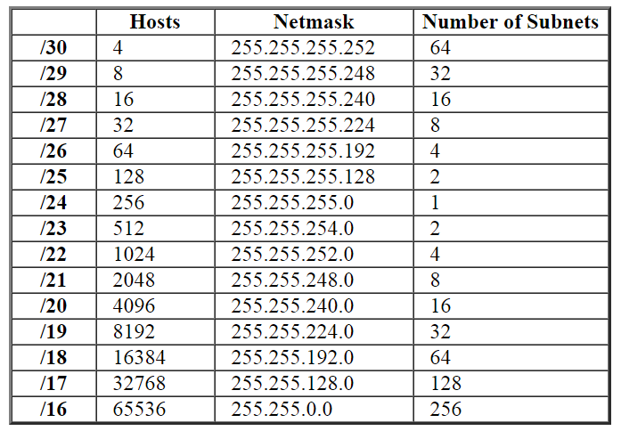

Slide 6
MAC ADDRESSES
Media Access Control (MAC) Address
Unique identifier assigned to network interfaces for communications at the data link layer of a network segment
Often stored in the hardware itself in read only memory
Example
00:00:00:a1:2b:cc

Slide 7
NETWORKS
Every network includes:
At least two computers Server or Client workstation.
Networking Interface Card's (NIC)
A connection medium, usually a wire or cable, although wireless communication between networked computers and peripherals is also possible.
Network Operating system software

Slide 8
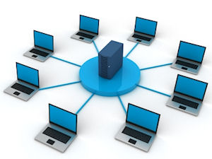
NETWORKS
Types of Networks:
Local Area Networks (LANs)
usually confined to a geographic area such as the same building
Virtual Private Networks (VPNs)
Extends a private network across a public network
Enables users to send and receive data across shared or public networks as if they were directly connected to the private network
Internet
Wide Area Networks (WANs)
Combines multiple LANs that are geographically separated
Intranet
Private network utilizing internet-type tools
Metropolitan Area Networks (MANs)
Network of computers within a city

Slide 9
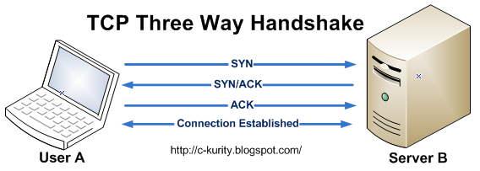
PROTOCOLS
TCP - Transmission Control Protocol
Connection-oriented protocol
Guaranteed message is received but the transfer is slower
UDP - User Datagram Protocol
Connectionless protocol
Transfer is faster but not as reliable
TCP 3-WAY HANDSHAKE
SYNchronize
SYNchronize-ACKnowledge
ACKnowledge

Slide 10
OTHER PROTOCOLS
FTP: File Transfer Protocol – Transfers files between a client and a server.
SSH: Secure Shell – Unix based command system interface.
SMTP: Simple Mail Transfer Protocol – delivers email
DNS: Domain Name Servers – The way computers resolve host names
DHCP: Dynamic Host Configuration Protocol – automatic IP provision
HTTP: Hypertext Transfer Protocol – Connects you to the web
HTTPS: HTTP over SSL /TLS (Secure Socket Layer/Transport Layer Security)

Slide 11
PORTS
A port is the means with which a computer ‘listens’ for different kinds of network traffic.
Each port is literally only a two way tunnel
Ports are identified by Port numbers, ranging from 0 to 65535
Why that number? Headers in a packet!
Ports 0-1023: Well-known or System Ports. Lots of important ports here.
Ports 1024-49151: Registered Ports. Registered services use these. (Openfire!)
Ports 49152-65535: Ephemeral Ports. Experimental or private services.

Slide 12
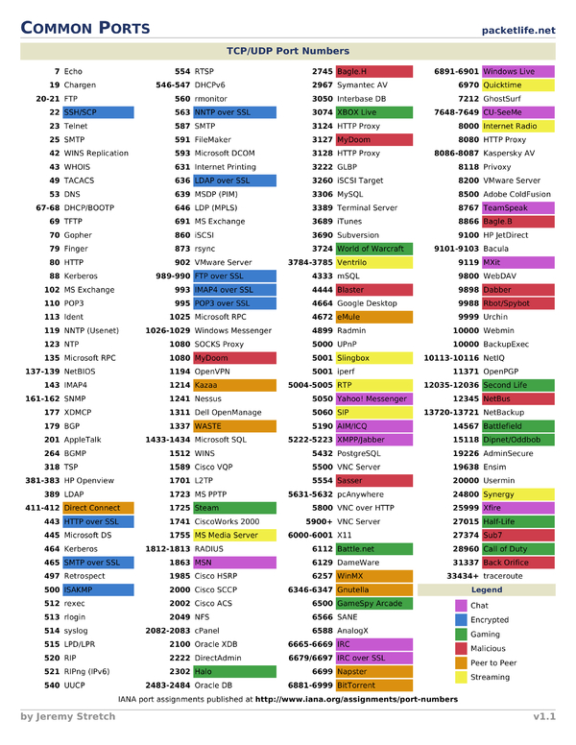

Slide 13
PACKETS
How information is carried
Framing:
Addresses - needs source and destination
Error detection / correction
may contain a checksum, parity bits, or cyclic redundancy checks
Hop counts
relates to time-to-live (TTL) field
Length
Priority
Payload
Captures

Slide 14
OSI MODEL
Open Systems Interconnection (OSI) Model
Conceptual model that characterizes the communication functions of a telecommunication or computing system
Layers serve the layer above
Physical (Bits) - Transmission and reception of raw bit streams
Data Link (Frame) - Reliable transmission of data frames between two nodes connected by a physical layer
Network (Packet) - Structuring a multi-node network (addressing, routing, traffic control
Transport (Segment (tcp) / Datagram (UDP)) - Reliable transmission of data segments
Session (Data) - Managing communication sessions (continuous exchange of information)
Presentation (Data) - Translation of data between a networking service and an application
Application (Data) - High-level APIs

Slide 15
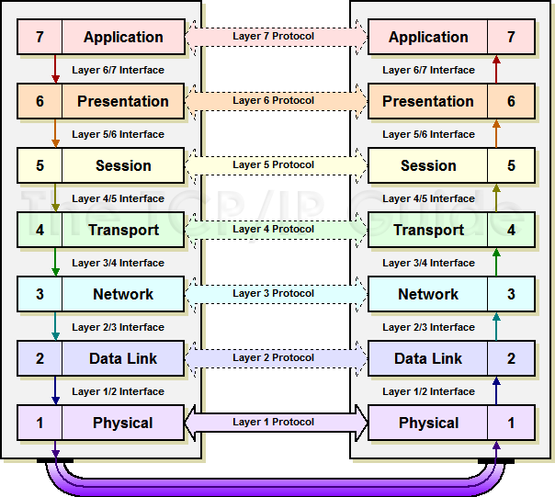

Slide 16
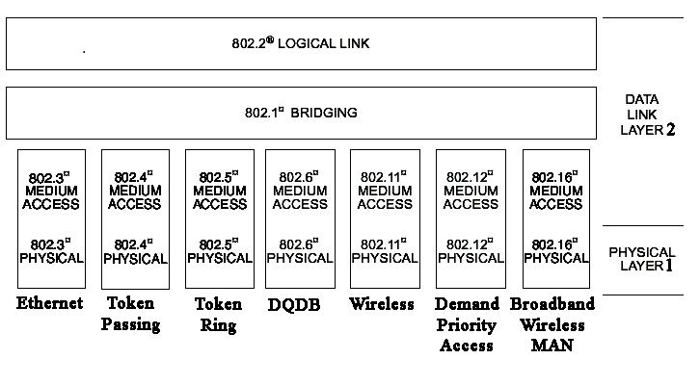
IEEE 802
A family of IEEE standards dealing with local area networks and metropolitan area networks
Protocols must adhere to these

Slide 17
BEST WAY TO LEARN NETWORKING?

Slide 18
APPLICATIONS
Best way to learn networking is through hands on experience
Ping
send ICMP ECHO_REQUEST to network hosts
ifconfig / ip
show / manipulate routing, devices, policy routing and tunnels
route
show / manipulate the IP routing table
tcpdump
dump traffic on a network

Slide 19
NETSTAT
Print network connections, routing tables, interfere statistics, masquerade connections, and multicast memberships
netstat -tulpn
Great for checking what ports processes/services are listening on
Windows explorer is listening on port 666/1337? What?

Slide 20
NETCAT
Arbitrary TCP and UDP connections and listens
‘Swiss Army Knife for TCP/IP’
Listen on a port
nc -lp <port>
Connect to that port
nc <ip> <port>

Slide 21
TSHARK
Dump and analyze network traffic
Just like tcpdump...but better
Can filter pcaps based upon whatever field you want
use -T to specify field extraction
use -e to specify which fields
Examples DNS analysis
tshark -i <interface> -f “src port 53” -n -T fields -e dns.qry.name -e dns.resp.addr
CTFs

Slide 22
cURL
Transfer a URL
Loads of useful tricks:
proxy support
user authentication
FTP upload
HTTP post
SSL connections
Cookies
curl <URL>
curl -I <URL> -- gets Headers

Slide 23
WGET
Retrieves content from a web server
Can be used to download things from the web
wget http://example.com/file.txt
Essentially is a spider that scapes web pages
can be blocked with robots.txt
can be unblocked by doing ‘--execute robots=off’

Slide 24
NMAP
Short for Network Mapper
Tool used for network scanning
Will send packets throughout the network to probe for hosts
Scripts will use the results from these probes to identify what host OS is there and what services it is running
Great for checking what services are open/running on your system, and who is on your network

Slide 25
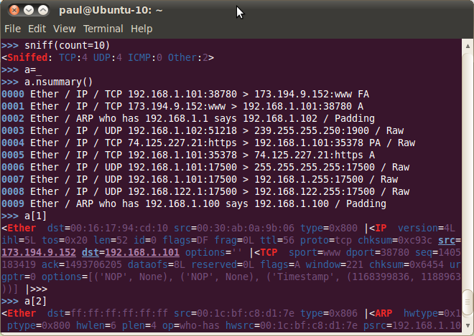
SCAPY
Based on python
Very powerful and interactive packet manipulation program
Can forge or decode packets, send them, match replies, and more

Slide 26
WIRESHARK
Demo

Slide 27
OTHERS
Bro (IDS)
Network analysis framework
BURP Suite
Web app penetration testing toolkit
SNORT (IDS/IPS)
‘Free’ and open source network intrusion detection and prevention system
Real-time traffic analysis and packet logging
Can detect probes and attacks
Sniffer, packet logger, and network intrusion detection

Slide 28
SECURITY
Encryption
Firewalls
Intrusion Detection Systems (IDS)
Intrusion Prevention Systems (IPS)

Slide 29

SOURCES
Linux MAN Pages, always RTFM first
Sangay Yeshi “BasicNetworking101.pdf”
http://www.steves-internet-guide.com/networking/
https://www.lantronix.com/resources/networking-tutorials/ethernet-tutorial-networking-basics/
https://commotionwireless.net/docs/cck/networking/learn-networking-basics/
https://en.wikipedia.org/wiki/IEEE_802
http://www.techrepublic.com/article/build-your-skills-a-crash-course-in-tcp-ip/
http://wintelguy.com/subnetcalc.pl

