Slide 1
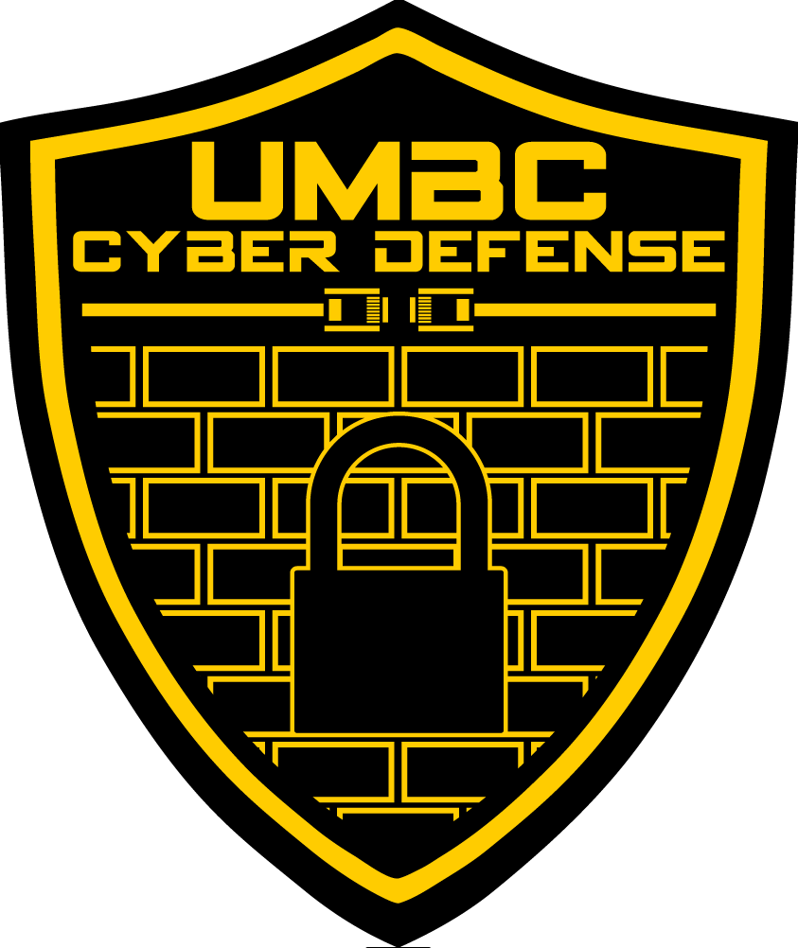
UMBC Cyber Defense Team
FIRST MEETING/CLASS PRESENTATION
2019-2020
Notes:
Kevin

Slide 2
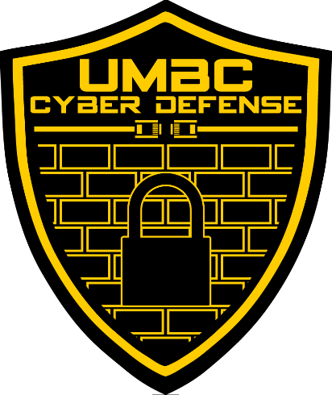

Welcome to the UMBC Cyber Defense Club!
Also called the UMBC CyberDawgs! Also known as DawgSec sometimes
A student run organization since 2009.
We’re a group of students that share a passion for and recognize the importance of computer security
such hack
much cyber

Slide 3
Some Introductions
President: Anna Staats
Comp Sci, Spring 2020
Bit Flipper
Vice President: Seamus Burke
Comp Sci and Math, Spring 2020
Cyber Arms Dealer
Secretary: Jackie Schultz
Information Systems, Spring 2020
Security, Probably
Treasurer: Amina Mahmood
Comp Sci, Spring 2021
Windows, Malware Analysis
Historian: RJ Joyce
Never Graduating
Malware Analysis, Data Science
Technical Advisor: Cyrus Bonyadi
Doctorate CS, Spring 2021
Blockchain Enthusiast
Notes:
Also introduce CCDC team:
Drew, Ben, Seamus, Anna, RJ, Cyrus
Also shoutout Joe and Grant for being Joe and Grant

Slide 4
Some More Introductions
Bedazzler: Grant Spencer
Comp Sci, Hebrew minor, Spring 2020
Warranty Voider
Assistant: Joe Aurelio
Comp Sci Masters, Spring 2021
Computer Security or something
Traitor: Ben Ireland
Navy
Nuclear Submarines

Slide 5
So…what is computer security?
The protecting of computers, networks, programs and data from unintended or unauthorized access, change or destruction
Basically keeping the bad guys out, while keeping everything up and running
Several different types of computer security
Application Security
Network Security
Information Security
Offensive Security
And much, much more!!
Notes:
Kevin

Slide 6
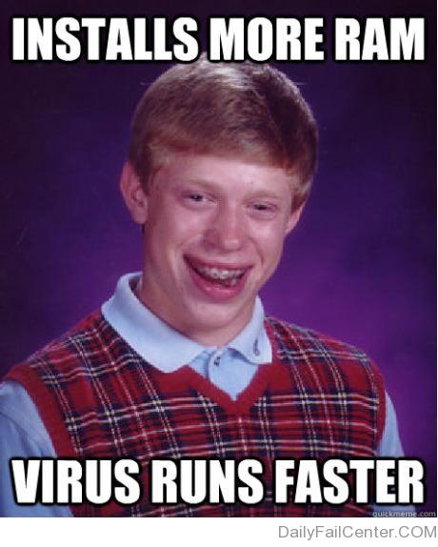
Why Computer Security?
Highly sensitive data is accessed, stolen, and/or used every day
Over 480 million records leaked in 2015 alone
Many of these hacks could have been mitigated with proper training and good practices
The need for computer security is crucial, from enterprise to mom & pop shops!
Job market is always looking for cybersecurity SMEs
Oh, AND it’s suuuuuper fun to learn about.
Notes:
Kevin

Slide 7
How Do the Cyber Dawgs Approach This?
There are lots of ways to learn about computer security…
…but we believe in approaching it through multiple tracks.
We have three main tracks that we follow throughout the year:
Education + Hands-on
Competition Participation
Industry Exposure
Notes:
Kevin

Slide 8
Track #1: Education and Hands-on
Our regular club meetings: every Wednesday; 7-9 in PUP105
We go over lots of relevant and important topics pertaining to cyber security
We have a schedule for this semester!
Check it out on our website: http://umbccd.umbc.edu/
Some stuff we’ll be covering this semester:
Web exploitation
Networking basics
Offensive security
Notes:
Kevin

Slide 9

This all sounds super cool…but do I need to have experience coming in?
No experience required!
Schedule is tailored for beginners and veterans alike.
Having trouble/can’t find a solution? Ask us!
Bored/already know it? ASK US!!!
This is a club, not a lecture hall, so even if you already know the topic, please come by and hang out, and help people if you are inclined.
This semester, we also have CMSC491/791!
Most of our resources are available on our GitHub as well: https://github.com/UMBCCyberDawgs
Notes:
Kevin

Slide 10
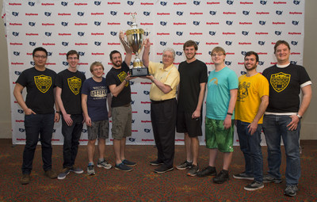
Track #2: Competition Participation
We encourage EVERYONE to do at least one competition while they’re part of the Cyber Dawgs
Formal requirement for the 491/791 class
We’ve done pretty well in the past… join us!
NCCDC Champions 2017
ISTS Champions 2019
CSAW North American Trivia Division Champions 2017/2018
Notes:
Zack
What the club was founded on
We do both CTFs and defense competitions, covering offense and defense

Slide 11
Some Upcoming Competitions
PicoCTF is always running, it’s an introductory CTF
New version comes out: 9/27/19 - 10/11/19 https://picoctf.com/
CSAW CTF (Cyber Security Awareness Week): Qualifiers begin September 13th!
We’ll be playing as a group. This is one of the harder collegiate-level CTFs, but feel free to join anyway!
CyberSkyline Metropolis CTF (hosted at UMD College Park)
Teams of 4, we’ll be organizing in the coming weeks
Others: Kaizen, NCL, Parsons CTF, Cyberforce, ISTS CCDC (of course!)
Notes:
If money is an issue, let us know offline

Slide 12
Oh…and WE are hosting our own Competitions!
October 19th: Cyber Defense Exercise!
Virtually required to make the CCDC team -- show off your knowledge and drive (or learn if you don’t have knowledge yet)
April 11th: DawgCTF!
Great events for beginners and veterans alike
There will be prizes for top performers!!!
There will also be some companies to network with!
Notes:
Mini ccdc like competition

Slide 13


Track #3: Industry Exposure
The field of computer security is ever changing
It’s important to know what industry is using today!
We’ll have some industry folks come in and give talks, demos, labs, and host competitions!
Our current sponsors:
Parsons
Tensley Consulting
More Coming Soon!
Notes:
Kevin

Slide 14
Some Upcoming Conferences
BSides DC
Like $20, October 25th - 27th, 2018
Tickets are unfortunately all sold for this year, but we recommend it for next year
ShmooCon DC
January 31th - February 2nd, 2019
Probably the best security conference on the East Coast, but it’s like $150 and tickets are hard to get so...
Shmooze-a-Student!
BSides Charm
Spring 2019 - Like $20
Notes:
Zack
If money is an issue, let us know offline

Slide 15
YEEHAW!!! I’M TOTALLY HOOKED!
Remember: our regular club meetings are Wednesdays from 7pm-9pm in PUP105.
Get on our slack channel! https://umbccd.slack.com
This is really the best way to communicate with us, so get on this ASAP!
Check out our website to see our schedule, resources page, and link up with the group at http://umbccd.umbc.edu/
Subscribe to our mailing list: send an email to umbccd-group+subscribe@umbc.edu to join (umbc email only)
Notes:
Slack

Slide 16
Okay but I wanna learn _now_
https://overthewire.org/wargames/
For general Linux (start with Bandit)
https://wargames.ret2.systems/edu/
For reverse engineering/exploitation
https://pwnable.kr/
For exploitation/war games
Notes:
Slack

Slide 17
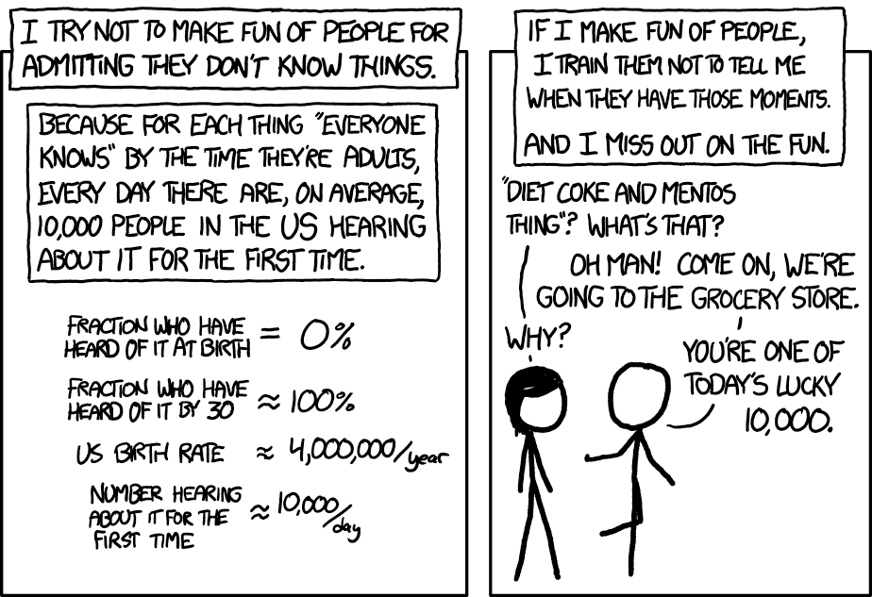
Now, a few more things to note (courtesy of our club alumni)
Learning cyber security is hard, but we’re here to help!
Meetings are a starting point
Requires dedication and time
Don’t hesitate to ask questions - we are here to help!
XKCD 1053, Randall Munroe
Notes:
Zack

Slide 18
OH…AND THIS IS IMPORTANT
While we are a cyber defense team, the tools and techniques we will be going over are used to break into a system/network
So unless it is YOUR server, computer, virtual machine, or service, or unless you have EXPLICIT and COMPLETE permission to do so…
DO NOT USE ANY OF THESE TOOLS OR TECHNIQUES ON A SYSTEM THAT YOU DON’T HAVE COMPLETE AUTHORIZATION TO DO SO
If you don’t adhere to this, some of the legal ramifications include - but are not limited to-the following:
Expulsion from UMBC
Being charged for either a misdemeanor or a felony, depending on the severity
Fines up to $100,000 for misdemeanors, up to $250,000 for felonies
Jail time up to 1 year for misdemeanors, up to 10 years for felonies
AND THIS IS JUST THE FEDERAL LEVEL.
Notes:
KEVIN!!!!

Slide 19

What questions do you have???
ALRIGHT, NOW IT’S TIME FOR SOME AWESOMENESS COURTESY OF OUR HISTORIAN, RJ!!
Notes:
Kevin

