Slide 1

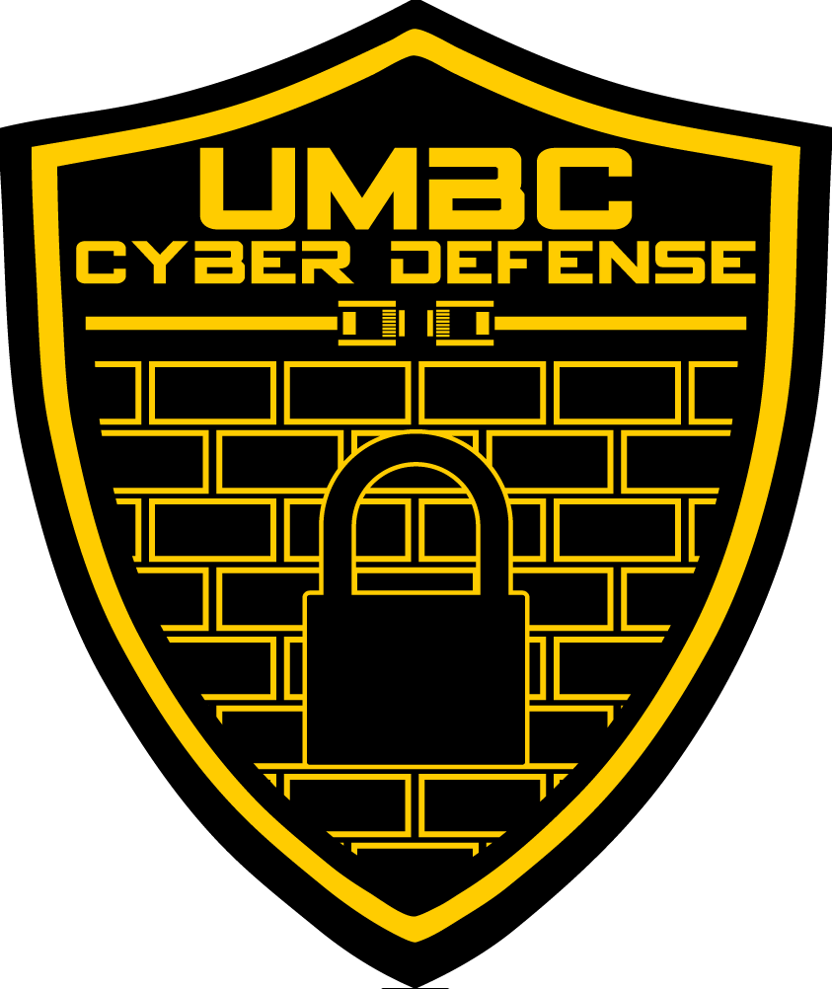
UMBC Cyber Defense Team
First meeting presentation
2017-2018

Slide 2
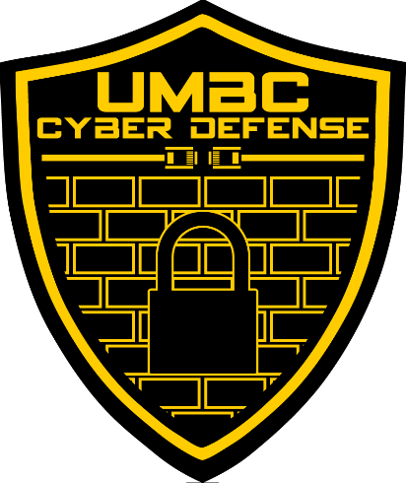
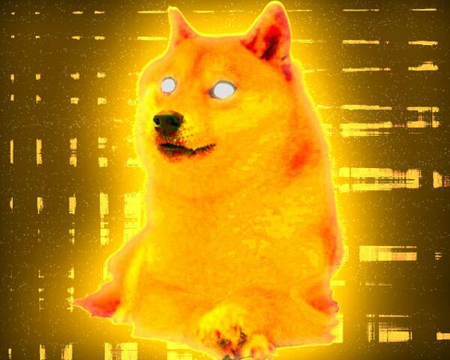
Welcome to the UMBC Cyber Defense Club!
Also called the UMBC Cyber Dawgs!
A student run organization since 2009.
We’re a group of students that share a passion for-and recognize the importance of-computer and network security
such hack
much cyber

Slide 3
Some Introductions
President: Bryan Vanek
Comp Sci & Math, Spring 2018
Firewalls, Secure Programming
Vice President: Chris Gardner
Comp Sci & Math, Spring 2018
Offensive Security, RE
Secretary: Kevin Bilzer
Computer Science, Spring 2020
Web Exploitation, Recon
Treasurer: Christian Beam
Computer Science, Spring 2019
Computer Networking, SDN
Historian: Alexander Spizler
Comp Sci Grad Student
History, Awesome Hype Man
Technical Advisor: Zack Orndorff
Computer Science, Spring 2019
Linux Administration

Slide 4
So…what is cyber security?
The protecting of computers, networks, programs and data from unintended or unauthorized access, change or destruction
Basically keeping the bad guys out, while keeping everything up and running
Several different types of cyber security
Application Security
Network Security
Information Security
Recovery/backup security
Offensive Security
And much, much more!!

Slide 5
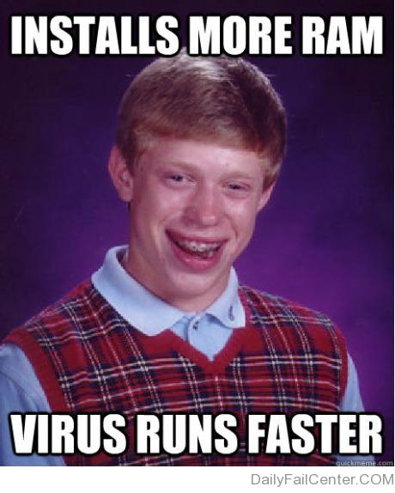
Why is Cyber Security Important?
Highly sensitive data is accessed, stolen, and/or used every day
Over 480 million records leaked in 2015-and those are just the big, well-known hacks
A lot of these hacks could have been mitigated with proper training and good practices
In other words, people’s lives get ruined because of this, and most (if not all) of it is preventable

Slide 6
Who Should Use Cyber Security?
EVERYONE!!!! Not just limited to IT professionals
Hospitals
Large and small commerce + financial institutions
ALL government agencies
The need for cyber security is crucial-from enterprise to mom & pop shops!
Job market is always looking for cyber security experts
Oh, AND it’s suuuuuper fun to learn about.

Slide 7
How Do the Cyber Dawgs Approach This?
There are lots of ways to learn about cyber security…
…but we believe in approaching it through multiple tracks.
We have three main tracks that we follow throughout the year:
Education + Hands-on
Competition Participation
Industry Exposure

Slide 8
Track #1: Education and Hands-on
Our regular club meetings: every Wednesday; 7-9 in PUP206
We go over lots of relevant and important topics pertaining to cyber security
We have a schedule for this semester!
Check it out on our website: http://umbccd.umbc.edu/
Some stuff we’ll be covering this semester:
Website Exploitation
Networking + Network Forensics
Firewall Security
CTF101

Slide 9
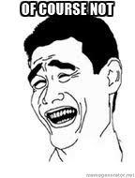
This all sounds super cool…but do I need to have experience coming in?
No experience required!
Schedule is tailored for beginners and veterans alike.
Having trouble/can’t find a solution? Ask us!
Want to learn about something else? ASK US!
Bored/already know it? ASK US!!!
This semester, we also have CMSC491/791!
We also have lab meetings now! Tuesdays from 7pm-9pm in ITE227.
All of our resources are available on our github as well: https://github.com/UMBCCyberDawgs

Slide 10
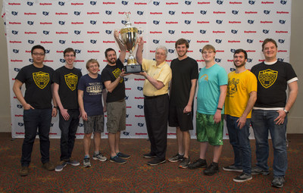
Track #2: Competition Participation
What the club was founded on
We encourage EVERYONE to do at least one competition while they’re part of the cyber dawgs
Lots of different types of competitions available!
Last year, we did pretty well…

Slide 11
Some Upcoming Competitions
NSA Codebreakers: September 15th at 9pm!
Registration available at https://codebreaker.ltsnet.net/ (use your UMBC email)
CSAW CTF (Cyber Security Awareness Week): Qualifiers begin September 15th!
We’ll have our own teams-speak with us if you’re interested!
NCL (National Cyber League): Registration up until September 29th!
https://www.nationalcyberleague.org/regular-seaso-fall
Others: CyberPatriot, Kaizen, MITRE, PICO, CCDC (will post as details become available)

Slide 12





Oh…and WE are hosting our own CTFs!
October 28th: Mini-CCDC!
Middle of March: Cyber Dawgs CTF!
Great events for beginners and veterans alike
There will be prizes for top performers!!!
There will also be some companies to network with!

Slide 13
Track #3: Industry Exposure
The fields of IT, CS, IS, and cyber security is ever changing
It’s important to know what industry is using today!
We’ll have some industry folks come in and give talks, demos, and labs!
Dates + Times will be released as they become available!

Slide 14
YEEHAW!!! I’M TOTALLY HOOKED!
Remember: our regular club meetings are Wednesdays from 7pm-9pm in PUP206.
Check out our website to see our schedule, resources page, and link up with the group at http://umbccd.umbc.edu/
Subscribe to our mailing list: send an email to umbccd-group+subscribe@umbc.edu to join (umbc email only)
Get on our slack channel! https://umbccd.slack.com
This is really the best way to communicate with us, so get on this ASAP!

Slide 15
Now, a few more things to note (courtesy of our previous president, Julio Valcarcel)
Learning cyber security is hard, but we’re here to help!
Meetings are a starting point
Requires dedication and time
Don’t hesitate to ask questions-we are here to help!
If you have suggestions for talks, let us know!
When replying to mailing list make sure it has the person’s email not the mailing list email address
Don’t reply to umbccd-group@umbc.edu unless it is for the whole list

Slide 16
OH…AND THIS IS IMPORTANT
While we are a cyber defense team, the tools and techniques we will be going over are used to break into a system/network
So unless it is YOUR server, computer, virtual machine, or service, or unless you have EXPLICIT and COMPLETE permission to do so…
DO NOT USE ANY OF THESE TOOLS OR TECHNIQUES ON A SYSTEM THAT YOU DON’T HAVE COMPLETE AUTHORIZATION TO DO SO
If you don’t adhere to this, some of the legal ramifications include-but are not limited to-the following:
Expulsion from UMBC
Being charged for either a misdemeanor or a felony, depending on the severity
Fines up to $100,000 for misdemeanors, up to $250,000 for felonies
Jail time up to 1 year for misdemeanors, up to 10 years for felonies
AND THIS IS JUST THE FEDERAL LEVEL.

Slide 17

ANY QUESTIONS?
ALRIGHT, NOW IT’S TIME FOR SOME AWESOMENESS COURTESY OF OUR HISTORIAN, ALEXANDER SPIZLER!!

Slide 18


Alright, enough chit chat LET’S SHOW YOU GUYS SOME COOL STUFF YOU CAN DO WITH WHAT YOU LEARN HERE!

