Slide 1
Networking Fundamentals

Slide 2
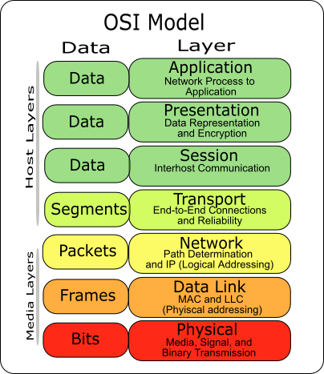
OSI Model
Application is Layer 7
Presentation is Layer 6
Session is Layer 5
Transport is Layer 4
Network is Layer 3
Data Link is Layer 2
Physical is Layer 1

Slide 3
TCP/IP and OSI
TCP/IP | OSI
Application | Application
 | Presentation
 | Session
Transport | Transport
Internet | Network
Network Access | Data Link
 | Physical

Slide 4
Physical Layer
Medium which data travels across
Fiber Optic
Coaxial
Cat 5/6

Slide 5
Data Link Layer
How data is sent over physical layer

Slide 6
Network Layer
Internet Protocol Suite
IPv4/IPv6
ICMP

Slide 7
Transport Layer
TCP
UDP

Slide 8
Layers 5,6,7
Session Layer
Administers and Maintains Connections
Presentation Layer
Format Data
Arrange Objects
Application Layer
Data Output
End-User Interaction

Slide 9
Layer 6&7
Presentation & Application Layer

Slide 10
Common Applications
Email
SMTP
POP
IMAP
Remote Management
SSH
FTP
Web
HTTP
Other
DNS

Slide 11
SMTP (Simple Mail Transfer Protocol)
SMTP
Port 25
Port 587
Sending Mail
SSMTP
SMTP over SSL/TLS
Primarily Port 587
May have Port 465

Slide 12
POP (Post Office Protocol)
POP3
Listening Port 110
Mail Retrieval
Like a PO box
Holds email until user retrieves, then no longer has a copy
POP3S
Port 995

Slide 13
IMAP (Internet Message Access Protocol)
IMAP
Port 143
Unlike POP, IMAP keeps mail on the server
IMAPS
Port 993

Slide 14
SSH (Secure Shell)
Used for shell access on remote servers
Encrypted by design
Port 22
Linux command is “ssh”

Slide 15
Telnet
Used for shell access and command execution
Telnet is from 1969 (RFC 15)
DON’T USE TELNET
Unencrypted by design
SSH is the replacement for Telnet
Linux command is “telnet”

Slide 16
FTP (File Transfer Protocol)
FTP
Port 20 (Transfer)
Port 21 (Command)
SFTP
FTP over SSH
FTPS
TLS extension for FTP
Port 989 (Transfer)
Port 990 (Command)

Slide 17
HTTP
Common Commands
GET | Retrieve data
POST | Send data to server
PUT | Send data to server
DELETE | Remove data from server
HTTP
Port 80
HTTPS
Port 443
HTTP over TLS/SSL

Slide 18
HTTP Commands
HTTP can be interpreted by your browser, on the command line you can use the following
curl (Installed by default on most systems)
wget
Both commands send a GET request by default but can perform other actions

Slide 19
DNS Operations
Port 53
Maps between arbitrary domain name and IP address
Load Balancing
1 Name, Multiple IP addresses
Stores information in records

Slide 20
Commonly Used DNS Records
Record | Use
A | Maps domain name to IPv4 address
AAAA | Maps domain name to IPv6 address
CNAME | Maps one domain name to another domain name
MX | Maps domain name to message transfer agents (Email)
TXT | Store human readable text strings

Slide 21
DNS Linux Commands
nslookup
dig

Slide 22
Other Protocols and Ports
http://web.mit.edu/rhel-doc/4/RH-DOCS/rhel-sg-en-4/ch-ports.html

Slide 23
Layer 5
Session Layer

Slide 24
Sockets
Sockets map ports to applications
A socket is half of a connection
Typically designated by IP address and port
192.168.1.1:80

Slide 25
Layer 4
Transport Layer

Slide 26
TCP vs UDP
TCP
Connection Oriented
Single data stream
Definable urgency
“Air-traffic Control”
UDP
Connectionless
Low Overhead
Multi-stream
“Fire and Forget”

Slide 27
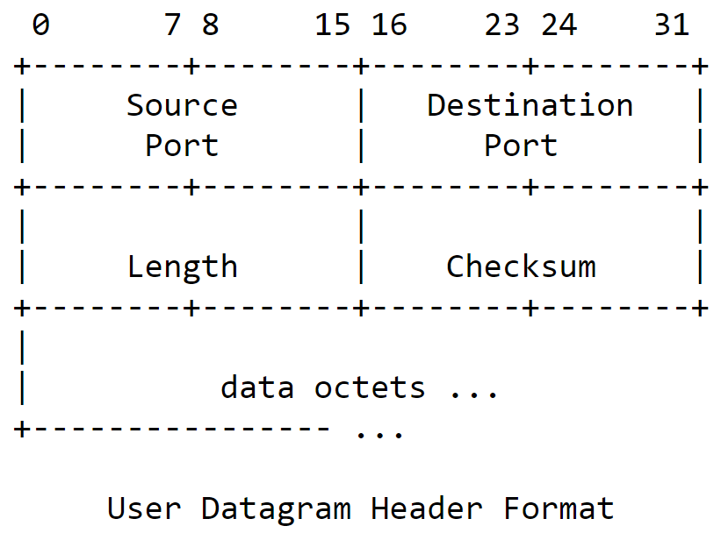
UDP Header
Source Port
Destination Port
Length of Message
16-bit Checksum
16-bit due to technology at the time of draft

Slide 28
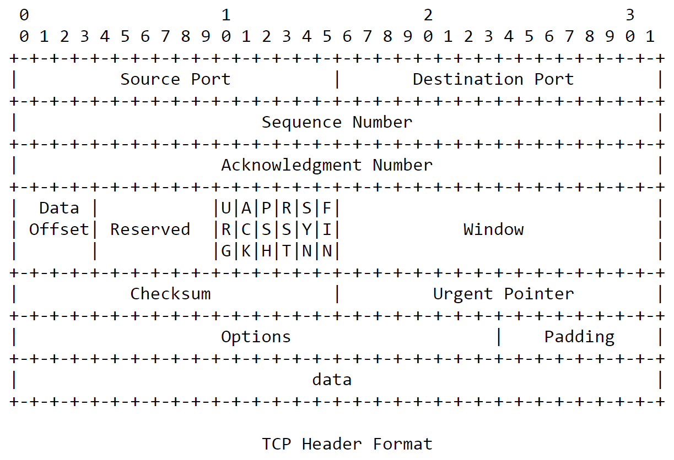
TCP Header
Addressed by Port
Ordered Data
Flags for Categorization
Sliding Window Size
Checksum
Urgency
Options

Slide 29
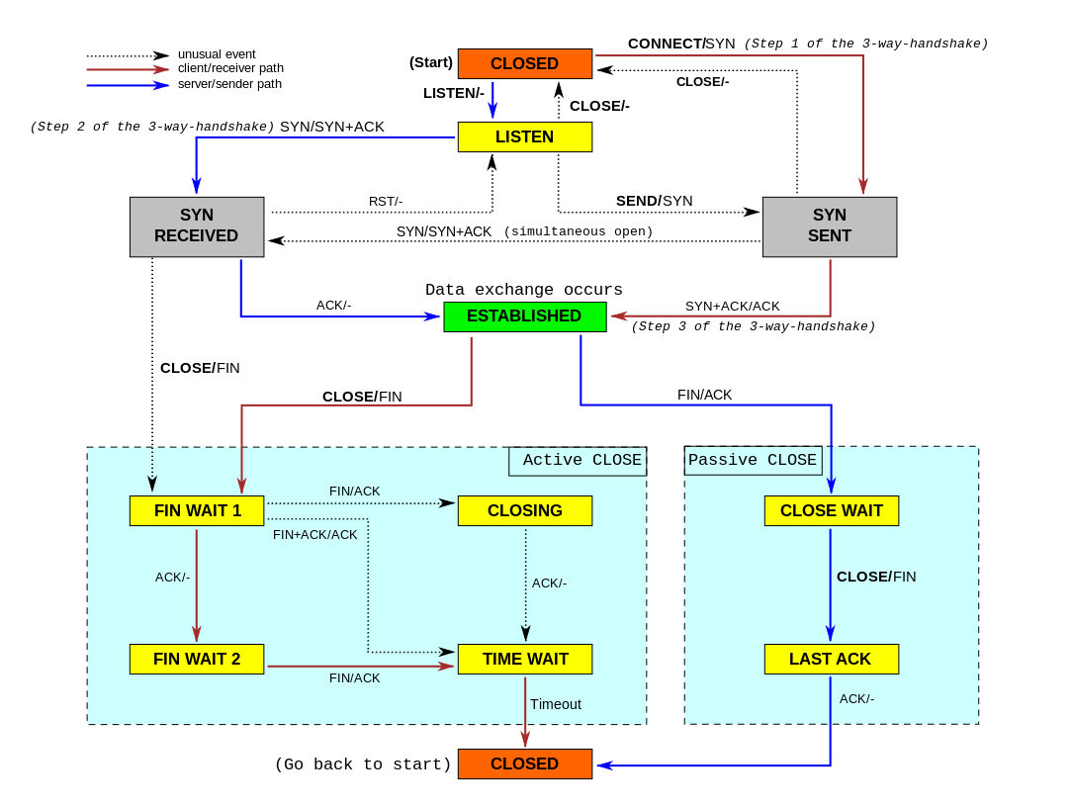
TCP Operations
Open Connection
SYN
SYN+ACK
ACK
Close Connection
FIN
FIN/ACK
ACK

Slide 30
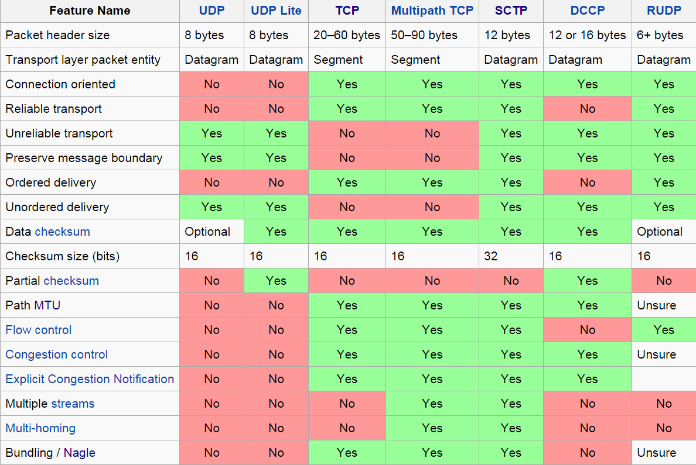
Other Layer 4 Protocols

Slide 31
Layer 3
Network Layer

Slide 32
End vs Hop
End-to-End
Does not require direct connection
Network Layer
Hop-by-Hop
Requires direct connection
Link Layer

Slide 33
The Internet Protocol Suite
End-to End communications
Connectionless
Maximum of 65535 bytes
Included protocols
ICMP
IP
IPsec

Slide 34
IPv4
32 bit address space
255.255.255.255
192.168.1.1

Slide 35
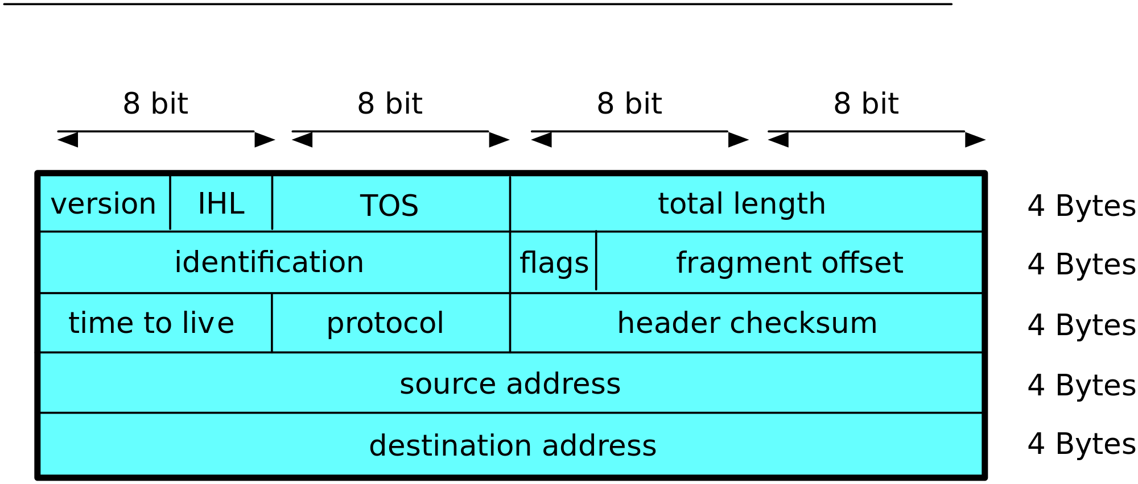
IPv4

Slide 36
IPv6
Lack of IPv4 addresses
128 bit address space
FFFF:FFFF:FFFF:FFFF:FFFF:FFFF:FFFF:FFFF
212F::6551:DA01:47::A6

Slide 37
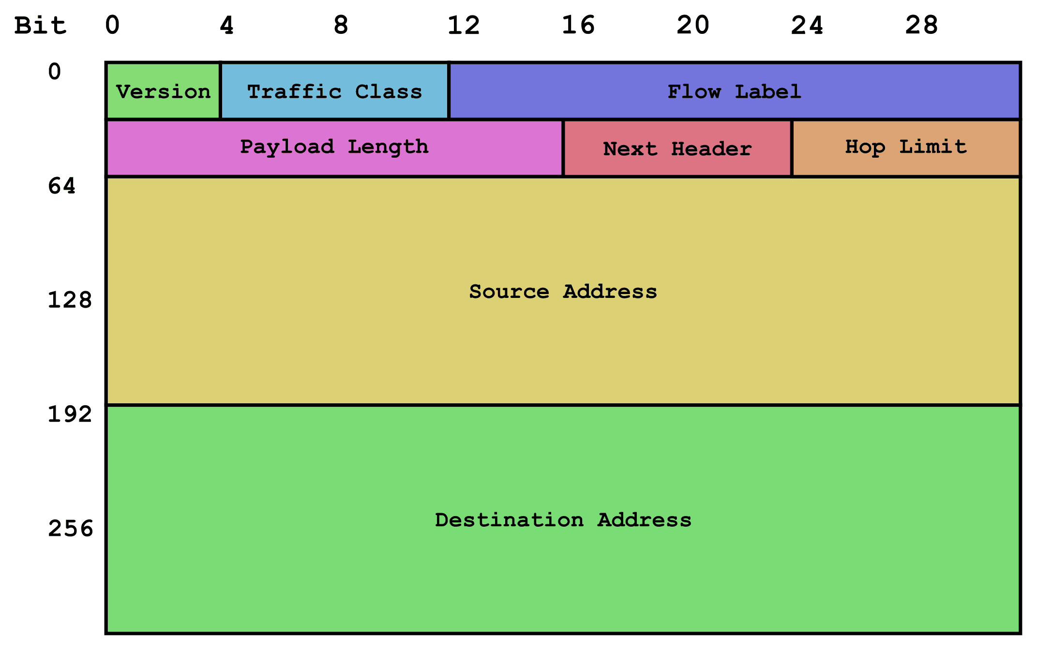
IPv6 Header

Slide 38
Layer 2
Link Layer

Slide 39
Ethernet
LAN Standard
MAC Address
FF:FF:FF:FF:FF:FF
Address assigned to the NIC (Network Interface Card)
Hop by Hop
Notes:
()Ethernet~
()L2 MTU sizes fix the max size of frames~
()payload chunkation/fragmentation~
()ethertype field used to identify what kind of data is included in the payload~
()optional field for VLAN tagging~

Slide 40
ARP (Address Resolution Protocol)
Maps IP address to MAC address
If you computer is trying to find an IP address on its LAN, it will use ARP to find out the MAC address of that computer
Notes:
()ARP~
()uses L3 to get L2~
()cross compare: MAC not change, but L3 can; duplicate IP~
()Inverse ARP, InARP IS NOT Reverse ARP. InARP used to find L3 address of L2 address~
()DHCP, replaces RARP function; Assigns L3 addresses as configured for L2 address~
()ARP spoofing~
()malicious ARP proxy~
()reroutes traffic to specific points, common escalation to MitM and DDoS attacks

Slide 41
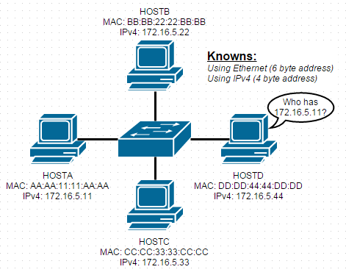
ARP Request
Notes:
()ARP~
()note how traffic is propagated to all nodes in the network~
()compare to a larger network, the amount of traffic propagation and data usage~

Slide 42
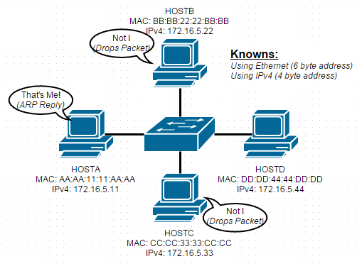
ARP Response

Slide 43
NDP
Functions similar to ARP but for IPv6 (Part of ICMPv6)
Notes:
()NDP~
()uses L3 to get L2~
()cross compare: MAC not change, but L3 can; duplicate IP~
()IPv6 version of ARP~
()Part of ICMPv6~
()Multicast for address resolution, Unicast for determination of reachability~
()Multicast operation helps to determine if there is a duplicate IP
()Multicast also reduces the total amount of traffic~
()note that ff02::2:ff:: is for routers~

