Slide 1
2016.11.30 UMBC Cyber Dawgs CTF
Miscellaneous Challenge
Answers

Slide 2
2. What is the flag contained in the image of misc2.jpg?
Trying to open it directly, doesn't work – complains about the header if you try to open it in Gimp.
Let's compare the header of that to a known-good .jpg we have – see the differences?
hexdump -C misc2.jpg
  00000000 ee ee ee e0 00 10 4a 46 49 46 00 01 01 01 00 48 |......JFIF.....H|
hexdump -C known_good.jpg
  00000000 ff d8 ff e0 00 10 4a 46 49 46 00 01 01 00 00 01 |......JFIF......|

Slide 3
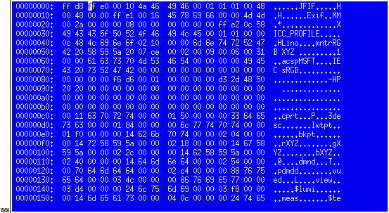
2. What is the flag contained in the image of misc2.jpg?
It looks to me like misc2.jpg just has a slightly corrupted header, that we could quickly fix with a hexeditor
Hexer = awesome hexeditor (like vi) - https://gitlab.com/hexer/hexer
I just replaced the
first 3 bytes with:
ff d8 ff via hexer

Slide 4

2. What is the flag contained in the image of misc2.jpg?
And then opened it and viola!

Slide 5
3. What is the flag contained in the image of misc3.png?
Since you can see the image fine, it's not raw in the image..maybe it's steganography!
Googling around brings you to a site that does steg in .pngs - http://manytools.org/hacker-tools/steganography-encode-text-into-image/

Slide 6
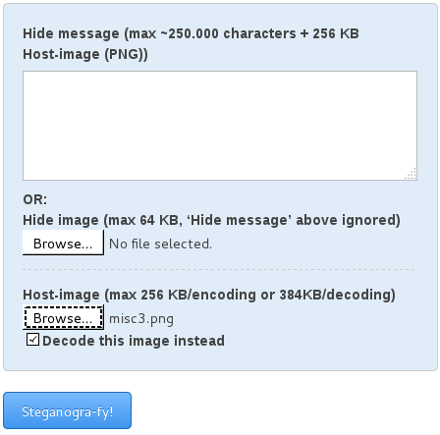
3. What is the flag contained in the image of misc3.png?
Load the PNG in the site and click “Decode this image instead”

Slide 7
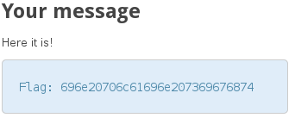
3. What is the flag contained in the image of misc3.png?
Viola!

Slide 8
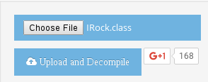
4. What are the correct parameters to pass Irock.class to get it to output “you win”?
Well, since it's a compiled Java file, the easiest thing to do is to decompile it.
Googling for “java decompiler” sends me to a link that will do it online for you! - http://www.javadecompilers.com/
Put it in, click “Upload and Decompile”

Slide 9
4. What are the correct parameters to pass Irock.class to get it to output “you win”?
And viola, it outputs this:
/*
* Decompiled with CFR 0_114.
*/
import java.io.PrintStream;
public class IRock {
public static void main(String[] arrstring) {
String string = arrstring[0];
if (string.length() == 11 && string.substring(1, 3).equals("zK") && string.charAt(0) == 'v' && string.substring(3, 10).equals("t,taASm") && Integer.parseInt("" + string.charAt(10) + "") == 5) {
System.out.println("you win");
}
}
}
Since this isn't obsfugated, we can tell it has to be 11 characters, start with v, then zK, then t,taASm, then end with a 5. So the answer is vzKt,taASm5

Slide 10
5. What is the output of code.c, given the correct parameters? (use the lowest number for a parameter if more than one number works)
Okay, lets look at the program in parts:
if (argc != 5) {
return 1;
}
This means we need exactly 5 arguments to the program (as the first argument is the name of the program + 4 arguments = 5)

Slide 11
5. What is the output of code.c, given the correct parameters? (use the lowest number for a parameter if more than one number works)
int second = atoi(argv[3]);
if (second != 0x181) {
  return 2;
}
Okay, in C, 0x<BLAH> means that's a hexadecimal representation of an integer.
So what is the decimal equivalent of 181? (385)

Slide 12
5. What is the output of code.c, given the correct parameters? (use the lowest number for a parameter if more than one number works)
int first = atoi(argv[4]);
if (floor(((((first * 99)/3)+6)/7)-2345) != 2374) {
  return 3;
}
Okay, this one requires simple algebra to reverse the operations
  ceiling((((2374+2345)*7)-6)*3)/99
(that equals 1001!)

Slide 13
5. What is the output of code.c, given the correct parameters? (use the lowest number for a parameter if more than one number works)
char* fourth = argv[2];
if (fourth[2] != '5' || fourth[1] != (char)0160 || fourth[5] != (char)0x44 || fourth[3] != '!' || fourth[4] != 'a' || strlen(fourth) != 6 || fourth[0] != (char)46) {
return 4;
}
This one requires some octal, hex, and decimal conversion of ascii values. Luckily http://www.ascii-code.com/ has hex, octal, and decimal values for ASCII characters
Map everything and you end up with .p4!aD

Slide 14
5. What is the output of code.c, given the correct parameters? (use the lowest number for a parameter if more than one number works)
int third = atoi(argv[1]);
if ((third|61) != 957) {
  return 5;
}
And finally we have a simple bit-wise or operation. You can either break things down into binary to check, or do the lazy man and just run numbers until you find a match.
  #include <stdio.h>
  int main(int argc, char* argv) {
  for (int i=0;i<9999;i++) {
  if ((i|61) == 957) {
  printf("%d\n",i);
  return 1;
  }
  }
  }
This yields 896

Slide 15
5. What is the output of code.c, given the correct parameters? (use the lowest number for a parameter if more than one number works)
Okay, now to compile code.c
(note, due to the libraries contained (or google some of the errors and you'd get told), you have to compile it like this:
  gcc -lssl -lcrypto -lm code.c
Then you can run: ./a.out 896 '.p5!aD' 385 1001
Yielding: abfd08271174042ab537bbbc7919826f

Slide 16
6. What is the flag contained in the image of misc1.pgm (hint the hidden image is a jpg)?
The size of the binary image that has been hidden in the pgm question file was written as an unsigned int at the beginning of the file
the program to encrypt the hidden image was compiled with gcc therefore the unsigned int has a size of 32 bits.
The high order bytes were written first to make it easier to extract.
PGM files don't use their low order bit. So it is possile to insert exactly one bit of data per byte in the cover file. (The flower pic)
Therefore the size of the hidden image can be recovered by looping over the first 32 bytes of the cover file and extracting the lo bit.

Slide 17
6. What is the flag contained in the image of misc1.pgm (hint the hidden image is a jpg)?
Code to do this may look something like the following...
This example is pseudo code where:
byte is type defed as an unsigned char.
i, j, k and last_index are unsigned ints initialized to 0.
getGray is a function that gets a byte of the cover file at the paramter it's passed.
getlsbs takes 8 bytes of the cover file and returns 1 byte of the size.
// Extract the file size which is the first 32 bytes of the cover file
unsigned size = 0;
for (i = 0; i < 4; i++)
{
// Fill the buffer
byte buffer[8];
for (j = 0, k = last_index; j < 8; j++, k++)
{
buffer[j] = getGray(k);
}
last_index = k;
size = size << 8;
byte data = getlsbs(buffer);
size |= data;
}

Slide 18
6. What is the flag contained in the image of misc1.pgm (hint the hidden image is a jpg)?
The type of the hidden file was jpg, which was given information (maybe...) this could also have been obtained by reassembling the image and looking at the magic bytes.
After finding the size the image, extraction becomes a trivial execise in bit operartions.
Sample pseudo code:
the set byte function sets the next byte of the jpg image in this example.
// Extract the entire image
for (i = 0; i < size; i++)
{
byte buffer[8];
for (j = 0, k = last_index; j < 8; j++, k++)
{
buffer[j] = getGray(k);
}
last_index = k;
byte data = getlsbs(buffer);
setByte(i, data);
}
// write the data buffer to a file

Slide 19
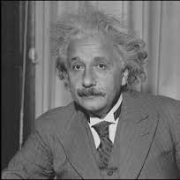
6. What is the flag contained in the image of misc1.pgm (hint the hidden image is a jpg)?
When finished, you should have a .jpg output, that when opens, looks like this:

