Slide 1
2016.11.30 UMBC Cyber Dawgs CTF
Network Forensics Challenge
Answers

Slide 2
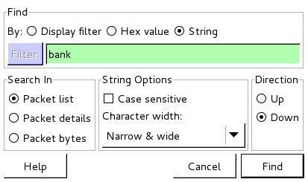
1. What is the banking website visited in this pcap?
Open up the pcap in wireshark, and go to “Edit”, then “Find String”, and search for the string “bank” in the corresponding dialog

Slide 3
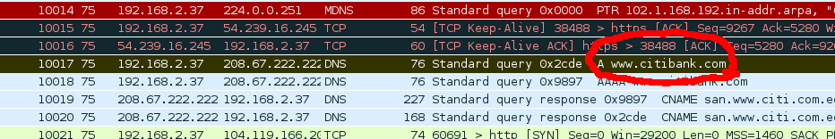
1. What is the banking website visited in this pcap?
It found a hit! Easy!

Slide 4
2. What band did this person search for via a search engine?
I tried a couple things that didn't work first (like searching for the string “search” via wireshark, until there were too many hits to go through), and then realized that for it to be in the pcap, it'd likely have to be a request to a web server (IE a destination port of 80 and a type “GET”), so filtered on that by clicking “Expression” and then adding that, ending up with:
tcp.dstport == 80 and http.request.method == “GET”

Slide 5
2. What band did this person search for via a search engine?
This brought the number of results down to a manageable amount, so I literally scanned them manually, and lucked out!

Slide 6
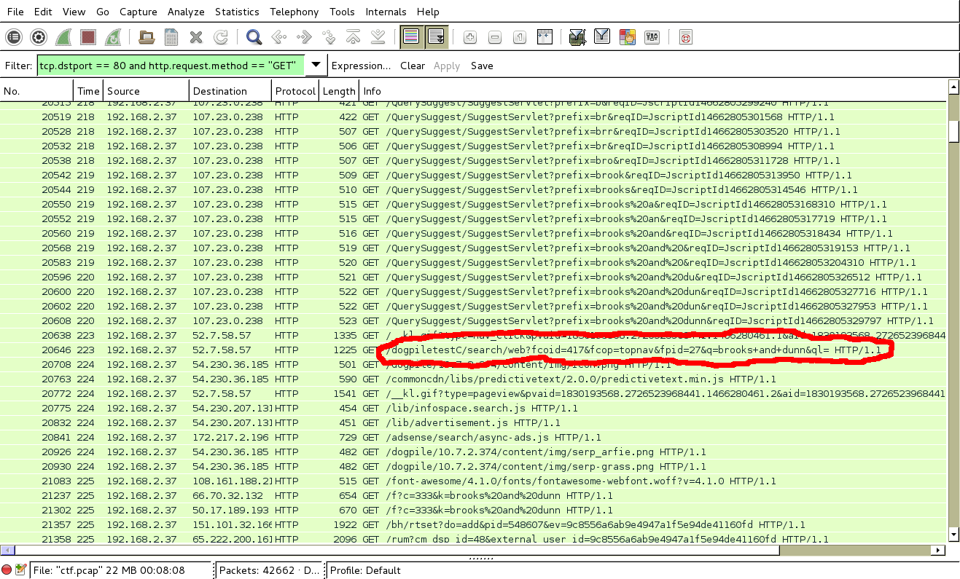
2. What band did this person search for via a search engine?

Slide 7
3. How many total DNS requests were catured in this pcap?
This is where tcpdump, that you can pipe into other commands, comes into play.
tcpdump -r ctf.pcap -nn -tttt “dst port 53” | wc -l
  1111

Slide 8
4. How many unique domains were requested in this pcap?
This is where tcpdump, that you can pipe into other commands, comes into play.
tcpdump -r ctf.pcap -nn -tttt “dst port 53” | head -10 lets me see the format
  2016-06-18 16:05:12.199148 IP 192.168.2.37.46688 > 208.67.222.222.53: 19833+ PTR? 102.1.168.192.in-addr.arpa. (44)
  2016-06-18 16:05:17.218688 IP 192.168.2.37.48733 > 208.67.222.222.53: 14785+ PTR? 101.1.168.192.in-addr.arpa. (44)
  2016-06-18 16:05:22.001394 IP 192.168.2.37.59853 > 208.67.222.222.53: 47293+ A? tiles.services.mozilla.com. (44)
  2016-06-18 16:05:22.001421 IP 192.168.2.37.59853 > 208.67.222.222.53: 25762+ AAAA? tiles.services.mozilla.com. (44)
  2016-06-18 16:05:22.236136 IP 192.168.2.37.38937 > 208.67.222.222.53: 32142+ PTR? 102.1.168.192.in-addr.arpa. (44)
  2016-06-18 16:05:22.475080 IP 192.168.2.37.54021 > 208.67.222.222.53: 64583+ A? ocsp.digicert.com. (35)
  2016-06-18 16:05:22.475093 IP 192.168.2.37.54021 > 208.67.222.222.53: 51209+ AAAA? ocsp.digicert.com. (35)
  2016-06-18 16:05:22.878382 IP 192.168.2.37.51129 > 208.67.222.222.53: 34582+ A? tiles-cloudfront.cdn.mozilla.net. (50)
  2016-06-18 16:05:22.878405 IP 192.168.2.37.51129 > 208.67.222.222.53: 7745+ AAAA? tiles-cloudfront.cdn.mozilla.net. (50)
  2016-06-18 16:05:23.645502 IP 192.168.2.37.43683 > 208.67.222.222.53: 19615+ A? secure.informaction.com. (41)

Slide 9
4. How many unique domains were requested in this pcap?
Now that we know the domain is always in the 9th column, we can grab just the 9th column, pass them to a command that only uniquifies them, and then count them.
tcpdump -r ctf.pcap -nnn "dst port 53" | awk '{print $9}' | sort -u | wc -l
  353

Slide 10
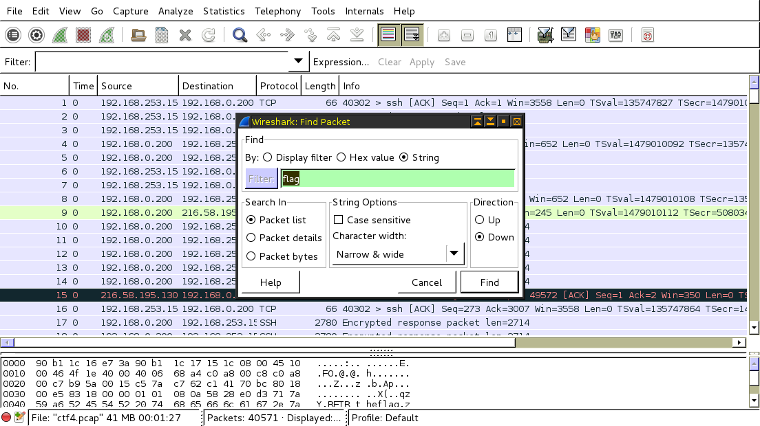
5. Find the flag in this pcap
First, I opened the pcap in wireshark. The I searched for the string “flag”, just to see if I would get lucky.

Slide 11
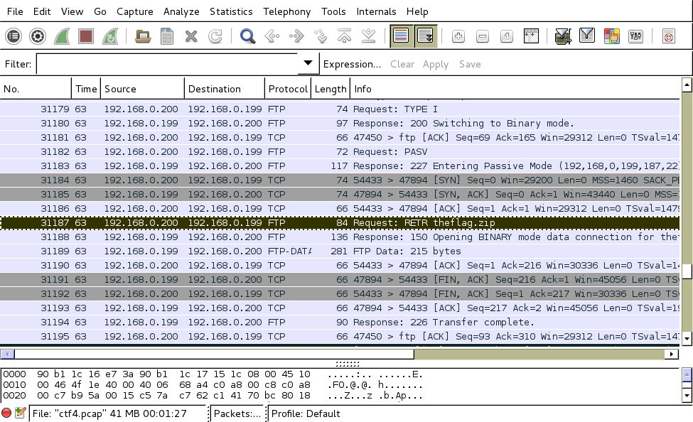
5. Find the flag in this pcap
I did! There appears to be an FTP session that downloaded a file called “theflag.zip”

Slide 12
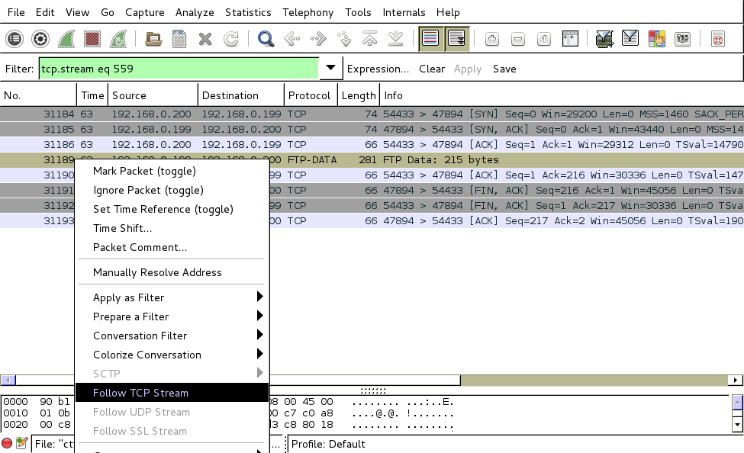
5. Find the flag in this pcap
Okay, now to pull that file out of traffic. We want to follow the TCP Stream of the transfer from ther server to us (FTP-DATA in Wireshark).

Slide 13
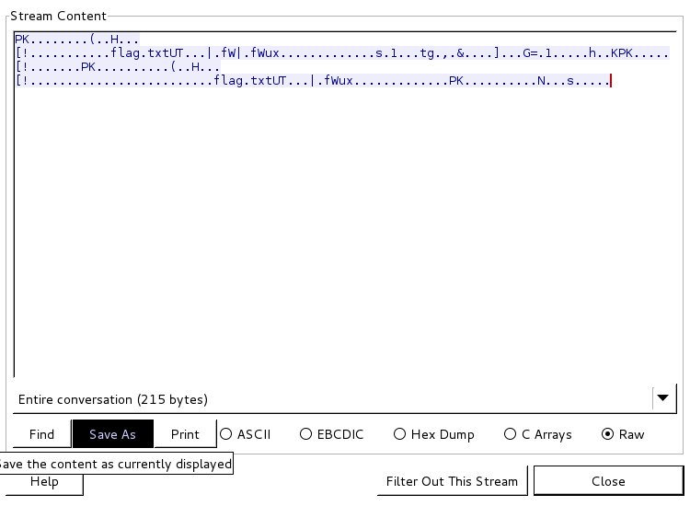
5. Find the flag in this pcap
When the stream comes up, we want to “Save As” the raw stream to disk (as theflag.zip)

Slide 14
5. Find the flag in this pcap
Okay, now we have the zip file! Let's extract it –
unzip theflag.zip
Archive: theflag.zip
[theflag.zip] flag.txt password:
Oh no, where are we going to find the password?

Slide 15
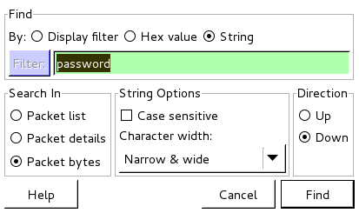
5. Find the flag in this pcap
Okay, let's try a “Find Packet”, and search for the string “password”, but this type make sure we select more than just “Packet List”, but also “Packet bytes” (so we search the ENTIRE packet)

Slide 16
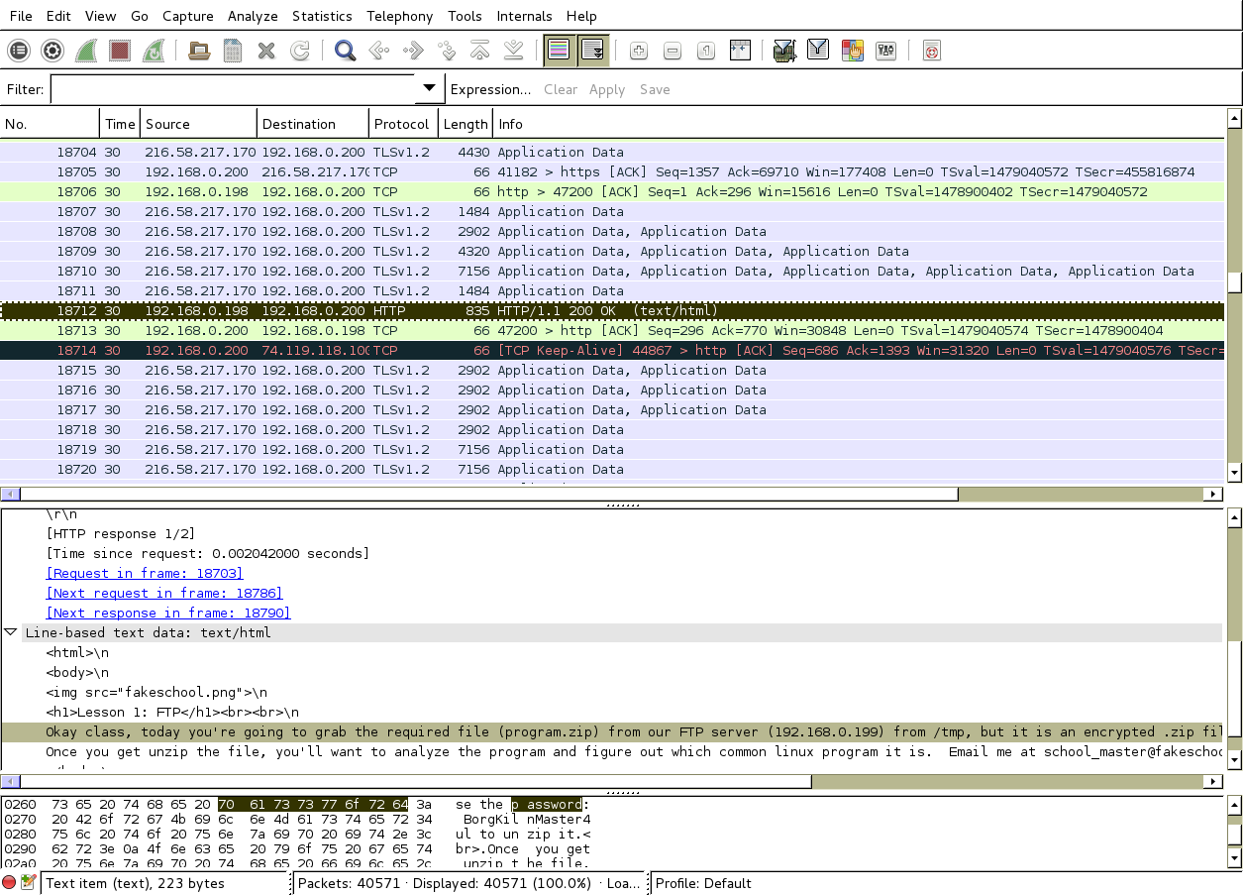
5. Find the flag in this pcap
We get a hit!

Slide 17
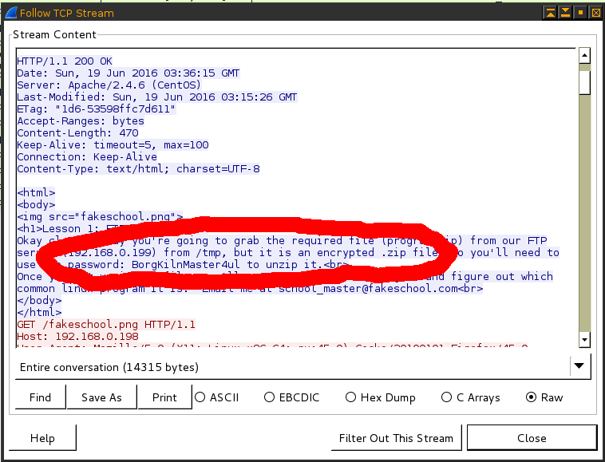
5. Find the flag in this pcap
Since it's hard to read, we right click and “Follow TCP Stream” to view it more cleanly.

Slide 18
5. Find the flag in this pcap
Now we unzip theflag.zip, using the password: BorgKilnMaster4ul, and a flag.txt pops out
cat flag.txt
  BlatheringBlatherskites

Slide 19
6. Covert Channel in PCAP
Long running SSH tunnel
Hint 1: Not all data is transferred in the data payload of TCP or UDP
Hint 2: Check out the IO graph of the transmissions

Slide 20
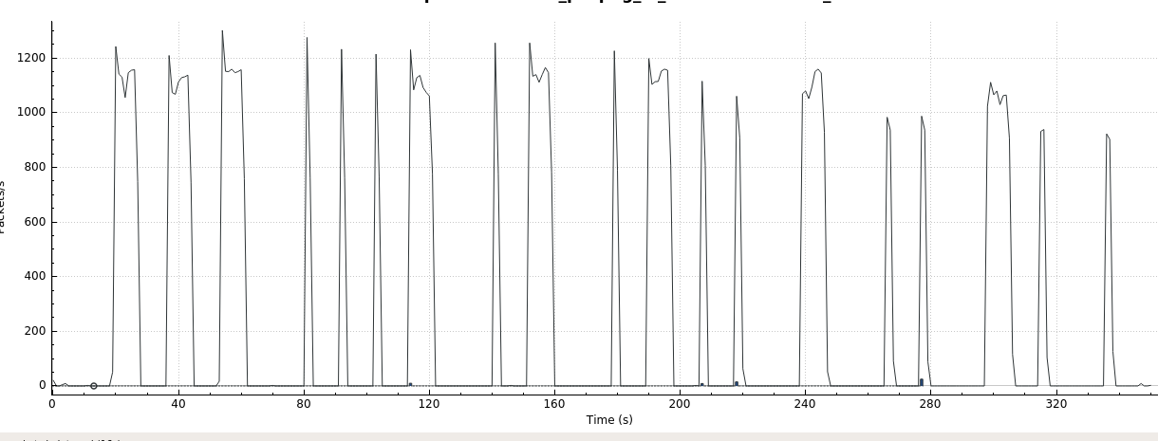
6. Covert Channel in PCAP
Hey, those look like 1’s and 0’s
Try hex – nope. Try binary - nope

Slide 21
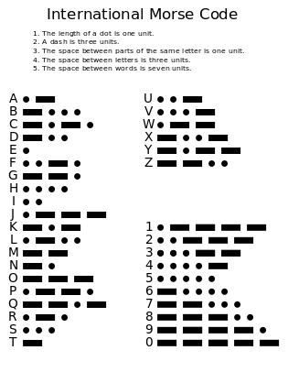
6. Covert Channel in PCAP
Hey, those look like dots and dashes
  Try Morse code. :)

Slide 22
6. Covert Channel in PCAP
‘O’ ‘V' ‘A’ ‘L’ ‘T’ ‘I’ ‘N’ ‘E’

