Slide 1
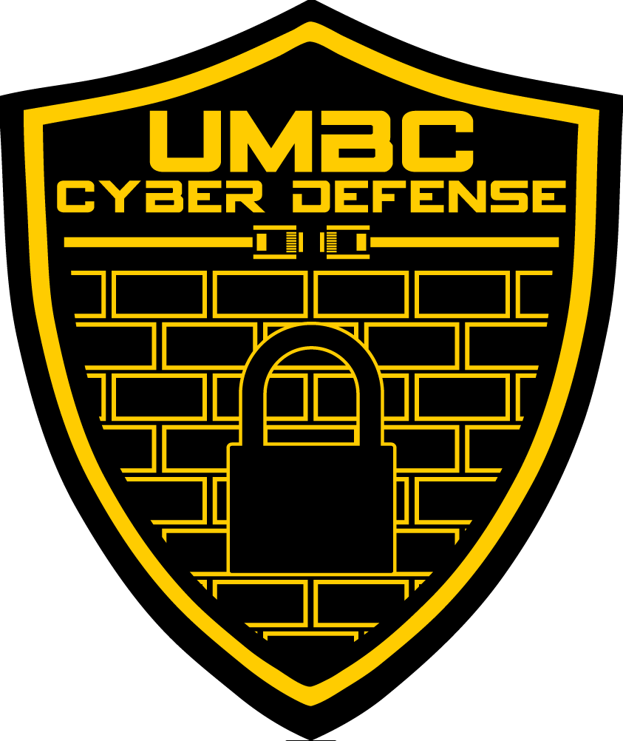
UMBC Cyber Defense Team
First meeting presentation
2016-2017

Slide 2
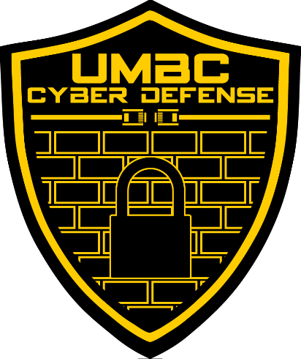

Welcome to the UMBC Cyber Defense Club!
Also called the UMBC Cyber Dawgs!
A student run organization since 2009.
We’re a group of students that share a passion for-and recognize the importance of-computer and network security
such hack
much cyber

Slide 3
Some Introductions
President: Bryan Vanek
Comp Sci & Math, Spring 2018
Firewalls, Secure Programming
Vice President: Anh Ho
Computer Science, Spring 2017
Windows Administration
Secretary: Zack Orndorff
Computer Science, Spring 2019
Linux Administration
Treasurer: Christian Beam
Computer Science, Spring 2019
Computer Networking, SDN
Historian: Jacob Rust
Computer Science, Spring 2017
History, Awesome Hype Man
Technical Advisor: Chris Gardner
Comp Sci & Math, Spring 2018
Offensive Security, Forensics

Slide 4
So…what is cyber security?
The protecting of computers, networks, programs and data from unintended or unauthorized access, change or destruction
Basically keeping the bad guys out, while keeping everything up and running
Several different types of cyber security
Application Security
Network Security
Information Security
Recovery/backup security
Offensive Security
And much, much more!!

Slide 5
Why is Cyber Security Important?
Highly sensitive data is accessed, stolen, and/or used every day
Over 480 million records leaked in 2015-and those are just the big, well-known hacks
A lot of these hacks could have been mitigated with proper training and good practices
In other words, people’s lives get ruined because of this, and most (if not all) of it is preventable

Slide 6

Who Should Use Cyber Security?
EVERYONE!!!! Not just limited to IT professionals
Hospitals
Large and small commerce + financial institutions
ALL government agencies
The need for cyber security is crucial-from enterprise to mom & pop shops!
Job market is always looking for cyber security experts
Oh, AND it’s suuuuuper fun to learn about.

Slide 7
How Do the Cyber Dawgs Approach This?
There are lots of ways to learn about cyber security…
…but we believe in approaching it through multiple tracks.
We have three main tracks that we follow throughout the year:
Education + Hands-on
Competition Participation
Industry Exposure

Slide 8
Track #1: Education and Hands-on
Our regular club meetings: every Wednesday from 7-9 in ITE233
We go over lots of relevant and important topics pertaining to cyber security
We have a schedule for this semester!
Check it out on our website: http://umbccd.umbc.edu/
Some stuff we’ll be covering this semester:
Hashing and cracking tools
Website Exploitation
Networking + Network Forensics
Firewall Security

Slide 9

This all sounds super cool…but do I need to have experience coming in?
No experience required!
Schedule is tailored for beginners and veterans alike.
Having trouble/can’t find a solution? Ask us!
Want to learn about something else? ASK US!
Bored/already know it? ASK US!!!
Office hours: ITE366 at free hour (from 12-1)
We’re building a resources page for everyone too!
Also, we’re working on a curriculum for a potential spring course (for credit), and we’re looking for feedback through the semester! SO DO THAT!!

Slide 10
Track #2: Competition Participation
What the club was founded on
We encourage EVERYONE to do at least one competition while they’re part of the cyber dawgs
Lots of different types of competitions available!
Defensive Competitions
Offensive Competitions
Mixed Style Competitions

Slide 11
Some Upcoming Competitions
NSA Codebreakers: Starts September 9th!
Registration available at https://codebreaker.Ltsnet.net (use your UMBC email)
CSAW CTF (Cyber Security Awareness Week): Qualifiers begin September 16th!
We’ll have our own teams-speak with us if you’re interested!
NCL (National Cyber League): Registration up until October 3rd!
http://www.nationalcyberleague.org/
Others: Kaizen, MITRE, PICO, CCDC (will post as details become available)
We also have a coach for this year’s CCDC competition!

Slide 12
Oh…and WE are hosting our own CTF!
The DawgCTF; tentatively scheduled for 3/4/17
Jeopardy style CTF open to the entire UMBC campus!
A great event for first timers!
Topics will include (but are not limited to)
Network Forensics
Reverse Engineering
Cryptography
There will be prizes for top performers!!!
There will also be some companies to network with!
Parsons
Splunk
More to come!

Slide 13
Track #3: Industry Exposure
The fields of IT, CS, IS, and cyber security is ever changing
It’s important to know what industry is using today!
We’ll have some industry folks come in and give talks, demos, and labs!
NSA Codebreakers: Details + Tips & Tricks with Dan Guernsey
Parsons: The Farm Initiative with Brett Hite
Splunk: More than a SIEM (Security Information and Enterprise Management) + Security Enterprise with Sabrina Lea
Dates + Times will be released as they become available!

Slide 14
YEEHAW!!! I’M TOTALLY HOOKED!
Remember: our regular club meetings are Wednesdays from 7pm-9pm in ITE233.
Check out our website to see our schedule, resources page, and link up with the group at http://umbccd.umbc.edu/
Subscribe to our mailing list: send an email to umbccd-subscribe@lists.umbc.edu to join
Get on our slack channel! https://umbccd.slack.com
This is really the best way to communicate with us, so get on this ASAP!

Slide 15
Now, a few more things to note (courtesy of our previous president, Julio Valcarcel)
Learning cyber security is hard
Meetings are a starting point
Requires dedication and time
Don’t hesitate to ask questions-we are here to help!
If you have suggestions for talks, let us know!
When replying to mailing list make sure it has the person’s email not the mailing list email address
Don’t reply to umbccd@lists.umbc.edu unless it is for the whole list

Slide 16
OH…AND THIS IS IMPORTANT
While we are a cyber defense team, the tools and techniques we will be going over are used to break into a system/network
So unless it is YOUR server, computer, virtual machine, or service, or unless you have EXPLICIT and COMPLETE permission to do so…
DO NOT USE ANY OF THESE TOOLS OR TECHNIQUES ON A SYSTEM THAT YOU DON’T HAVE COMPLETE AUTHORIZATION TO DO SO
If you don’t adhere to this, some of the legal ramifications include-but are not limited to-the following:
Expulsion from UMBC
Being charged for either a misdemeanor or a felony, depending on the severity
Fines up to $100,000 for misdemeanors, up to $250,000 for felonies
Jail time up to 1 year for misdemeanors, up to 10 years for felonies
AND THIS IS JUST THE FEDERAL LEVEL.

Slide 17

ANY QUESTIONS?
ALRIGHT, NOW IT’S TIME FOR SOME AWESOMENESS COURTESY OF OUR HISTORIAN, JACOB RUST!!

Slide 18
So…let’s talk about some recently reported hacks…

Slide 19
The DNC Hack
Discovered by Crowdstrike on June 14^{tt,} corroborated by Fidelis Cybersecurity and Mandiant
Two separate Russian intelligence-affiliated adversaries present in the DNC network
One group had access for more than a year
Methods of attack included gaining root access through malware (originated from Russian military intelligence-identical SSL certs)
Results? Resignations (Debbie Schultz), disclosure of countless communications/emails, PII
A complicated, planned attack…but this isn’t always the case

Slide 20
Social Engineering
Successful infiltration/hacking mainly comes from something called Social Engineering
Psychological manipulation to get access to confidential information
People who were recently ‘engineered’
Mark Zuckerberg (Facebook CEO): Twitter & Pinterest hacked (password was ‘dadada’)
Sundar Pichai (Google CEO): Quora + Twitter
Leslie Jones (Actress): iCloud revealed passport, driver’s license, phone number

Slide 21
The reason I’m telling you this?
Hacking and infiltration take on many different forms
Whether you’re a public figure or the most private individual ever, if someone is motivated enough and has enough time, they WILL get your information
Truly, in today’s society, it’s not a matter of ‘if,’ but a matter of ‘when’
You are only as secure as your weakest point of entry
One weak password or one missing piece of software can lead to a cascade of infiltrations and breaches
So as you learn with us this semester, always keep this in mind: WE ARE NOT JUST HERE TO LEARN-WE ARE HERE TO EDUCATE

Slide 22


Alright, enough chit chat LET’S SHOW YOU GUYS SOME COOL STUFF YOU CAN DO WITH WHAT YOU LEARN HERE!

