Slide 1

UMBC Cyber Defense Team
Spring 2017 First Meeting
+ Advanced Firewall Utilities

Slide 2


Welcome to the UMBC Cyber Defense Club!
Also called the UMBC Cyber Dawgs!
A student run organization since 2009.
We’re a group of students that share a passion for-and recognize the importance of-computer and network security
such hack
much cyber

Slide 3
Some Introductions
President: Bryan Vanek
Comp Sci & Math, Spring 2018
Firewalls, Secure Programming
Vice President: Anh Ho
Computer Science, Spring 2017
Windows Administration
Secretary: Zack Orndorff
Computer Science, Spring 2019
Linux Administration
Treasurer: Christian Beam
Computer Science, Spring 2019
Computer Networking, SDN
Historian: Jacob Rust
Comp Sci + Math, Spring 2017
History, Awesome Hype Man
Technical Advisor: Chris Gardner
Comp Sci & Math, Spring 2018
Offensive Security, Forensics

Slide 4

A few reminders for everyone…
No experience required!
Schedule is tailored for beginners and veterans alike.
Having trouble/can’t find a solution? Ask us!
Want to learn about something else? ASK US!
Bored/already know it? ASK US!!!

Slide 5
Track #2: Competition Participation
What the club was founded on
We encourage EVERYONE to do at least one competition while they’re part of the cyber dawgs
Lots of different types of competitions available!
Defensive Competitions
Offensive Competitions
Mixed Style Competitions

Slide 6
Some Upcoming Competitions
CCDC (Collegiate Cyber Defense Challenge)
We got approved for a second team this year!
Still looking for some people to fill those slots-come talk to us if you’re interested!
Metropolis: Cyber Skyline (February 18th from 9am-4pm)
Register here: https://www.cyberskyline.com/events/metropolis
Another great event for beginners
Prizes were pretty snazzy last year too!

Slide 7
Oh…and WE are hosting our own CTF!
The UMBC Cyber Defense Team CTF is official! Scheduled for March 11th
Jeopardy style CTF open to the entire UMBC campus!
A great event for first timers!
Topics will include (but are not limited to)
Network Forensics
Reverse Engineering
Cryptography
There will be prizes for top performers!!!
There will also be some companies to network with!
Parsons
Tensley Consulting
NSA (maybe…still working on that)

Slide 8
A few reminders
Remember: our regular club meetings are Wednesdays from 7pm-9pm in ITE231.
Check out our website to see our schedule, resources page, and link up with the group at http://umbccd.umbc.edu/
Subscribe to our mailing list: send an email to umbccd-subscribe@lists.umbc.edu to join
Get on our slack channel! https://umbccd.slack.com
This is really the best way to communicate with us, so get on this ASAP!

Slide 9
Now, a few more things to note (courtesy of our previous president, Julio Valcarcel)
Learning cyber security is hard
Meetings are a starting point
Requires dedication and time
Don’t hesitate to ask questions-we are here to help!
If you have suggestions for talks, let us know!
When replying to mailing list make sure it has the person’s email not the mailing list email address
Don’t reply to umbccd@lists.umbc.edu unless it is for the whole list

Slide 10
OH…AND THIS IS IMPORTANT
While we are a cyber defense team, the tools and techniques we will be going over are used to break into a system/network
So unless it is YOUR server, computer, virtual machine, or service, or unless you have EXPLICIT and COMPLETE permission to do so…
DO NOT USE ANY OF THESE TOOLS OR TECHNIQUES ON A SYSTEM THAT YOU DON’T HAVE COMPLETE AUTHORIZATION TO DO SO
If you don’t adhere to this, some of the legal ramifications include-but are not limited to-the following:
Expulsion from UMBC
Being charged for either a misdemeanor or a felony, depending on the severity
Fines up to $100,000 for misdemeanors, up to $250,000 for felonies
Jail time up to 1 year for misdemeanors, up to 10 years for felonies
AND THIS IS JUST THE FEDERAL LEVEL.

Slide 11

A Quick Review…
Firewall: a system designed to prevent unauthorized to or from a private network.
Firewalls can be implemented via hardware OR software
Hardware: security appliances, physically turning ports on/off.
Examples: firewalls built into routers, Cisco/Juniper PoE services
Much better for larger scale configurations
Software: Installed on a computer and takes care of port forwarding/network trafficking.
Examples: Windows Firewall, firewalld, iptables
Better for smaller organizations or individuals (ESPECIALLY for people who move around)
Today, we will be covering a firewall that can serve as both a hardware and a software firewall.

Slide 12
A Quick Review…
Packet Filtering: examining each incoming packet and decide whether or not to allow it in.
Each packet has a header that identifies what kind of packet it is. Written rules will then determine what we do with that piece of data.
PFSense can do this.
Web Application Firewall: Ways that browsers handle HTTP (averts attackes that SSL would catch)
PFSense can also do this!
Using a Proxy Server: Hiding a network address and connect through another means.
Circuit Gateway: Once a connection is made, no need to check those packets. Relies on the three-way handshake (TCP) or connectionless (UDP).

Slide 13
Now then, let’s define what a ‘port’ is.
A port is the means with which a computer ‘listens’ for different kinds of network traffic.
Each port is literally only a two way tunnel
Ports are identified by Port numbers, ranging from 0 to 65535
Why that number? Headers in a packet!
Ports 0-1023: Well-known or System Ports. Lots of important ports here.
Ports 1024-49151: Registered Ports. Registered services use these.
Ports 49152-65535: Ephemeral Ports. Experimental or private services.
When configuring firewalls, it’s usually a good idea to know these numbers!

Slide 14
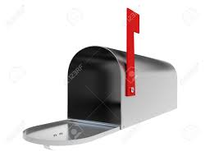



To formulate and analogy, I like to think about it being like a mailbox…
…and each one has four states…
Two-way opening
Only receive
Only give
Completely blocked

Slide 15
ImPORTant Ports
FTP: File Transfer Protocol – Transfers files between a client and a server.
Port number 20. Used in a lot of older systems. Also used by Filezilla.
VERY INSECURE. Doesn’t do encryption; sends files over plain text.
SFTP: FTP over SSH (port 22). More secure.
SSH: Secure Shell – Unix based command system interface.
Port number 22. Helpful with server control. You use this to get into GL!
A good option for remote login; commands, files, and passwords are encrypted. Also does authentication.
Not perfect; vulnerabilities have been found!
Telnet – Like SSH, but has NO security implementations. (Port 23)
IF SOMEONE EVER USES THIS, MAKE THEM USE SSH.

Slide 16
Important Ports (Cont.)
SMTP: Simple Mail Transfer Protocol – delivers email
Port 25. Used by a lot of common email clients (Outlook Express!)
Needed for email servers; used in tandem with other protocols
POP3 (Port 110) and IMAP (Port 143) handle delivery.
DNS: Domain Name Servers – The way computers resolve host names
Port 53. Can be thought of as a phone book!
Critical to keep up for web servers
HAS VULNERABILITIES. Namely cache poisoning (uses fake address to divert)
DHCP: Dynamic Host Configuration Protocol – automatic IP provision
Port 67. Crucial for IP management/web servers.

Slide 17

Important Ports (Cont.)
HTTP: Hypertext Transfer Protocol – Connects you to the web
Port 80. Transfers files and pages over the web. HTML then formats
If you block this, you can’t connect to certain web pages!!
However, HTTP by itself is insecure! Man-in-the-middle attacks can see stuff!
HTTPS: HTTP over SSL /TLS (Secure Socket Layer/Transport Layer Security)
Port 443. Requires authentication; encrypts and decrypts pages
Not perfect (HEARTBLEED), but still very secure! Locked down as of now
Web Caching: sometimes called HTTP Proxy
Port 8080. Allows you to store web pages!
Necessary to have on if you ever want to utilize proxies

Slide 18
Need to talk about one more thing…
TCP vs UDP: Transmission Control Protocol vs User Datagram Protocol
Reliability vs Speed; Connection oriented vs connectionless. Both used by IP.
What kinds of protocols do you think belong in one of these? Applications?
ICMP: Internet Control Message Protocol
Used by network devices for reporting errors.
Tools: ping, traceroute, echo
Unless you’re the admin, DISABLE THESE. Ping = bad people knowing when you’re server is up (or down).
Wanna learn more about port numbers?
http://packetlife.net/media/library/23/common_ports.pdf

Slide 19
PFSense: an overview
PFSense: An open source firewall-specifically, a network firewall
Different from IPTables in a couple senses:
It has one configuration file that takes in your packets
Provides Dynamic Modification (modifying tables, lists, anchors on the fly)
VERY fast
This is used primarily as a perimeter firewall-usually installed on its own system or own vm.
Can also serve as an AP, DHCP Server, DNS Server, and even a VPN endpoint!
Also comes with a bunch of super useful plugins and capabilities
Can work with IDS/IPS (Snort, Bro, etc.)
PFBlocker: international IP download management (SUPER USEFUL)

Slide 20
Some more background…
In the spirit of being a networking firewall, PFSense is considered to be more of a package/platform
A ‘complete’ router-software platform.
Different from a normal router in that you can fully utilize computer/system resources
Can do other things too (DNS forwarding, caching HTTP objects w/ Squid, block domains (ads?))
Based off of FreeBSD. SUPER useful, as it comes with a powerful networking stack to power it.
PFSense is many things at the same time: router, firewall, AP, gateway, etc.
This further solidifies the fact that PFSense in itself is an OS, NOT just simply a piece of software.
There are paid versions of PFSense, but for our purposes, we will be focusing on the open-source, free versions.

Slide 21
Hardware Requirements
To implement at the enterprise level, you will need some bare metal. Let’s break this down…
CPU: Unless you’re using 10 Gbps, regular multi-threading processors are totally fine.
** More processing power != more speed here, but for enterprise, always consider power consumption!! **
Memory: speed isn’t really important, but capacity is very important.
PFSense uses store-and-forward switching, where it takes in the entire packet, checks the dest ip, src ip, checksum, and forwards it if there aren’t any errors.
256 MB is what’s required, but 1 GB should be used for most installs.
** If you want to install PFBlockerng or Squid, consider bumping it up to 2 or 4 GB.

Slide 22
The NICs: The most important part
At the very minimum, a conventional setup requires 2 NICs
You will need to set up one WAN and one LAN.
Each additional subnet or WAN will then require an additional NIC.
This can be useful if you want to set up a guest network (subnet)
To clarify, NICs in this context refer to the number of ports you have available!
A quad NIC, for example, can run 2 WANs and 2 LANs no problem.

Slide 23
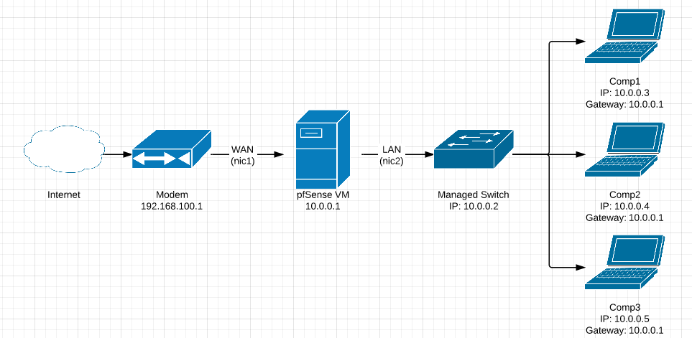
An example of a simple physical setup

Slide 24
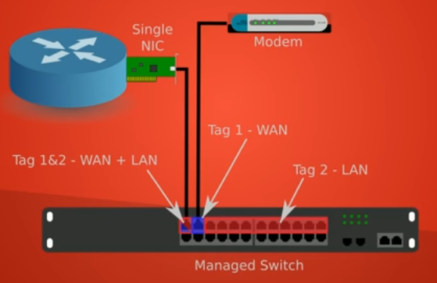
You can also use vlans
In general, if you need a bunch of subnets, use VLANs.
Useful if you need to use something that has a limited amount of interfaces (like a laptop)
** Be aware that bottlenecks can happened if you let one switch get overloaded. **

Slide 25
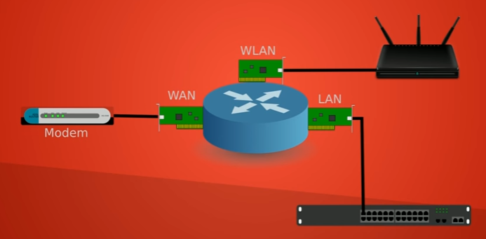
…or you can use a wireless setup
Using an external AP allows you to cover large areas
Your system also becomes a lot faster depending on the quality of your APs and the number of APs that you have.
Can be more costly depending on the area you need to cover…
But for today, we will be using a VM to introduce and explore PFSense.

Slide 26
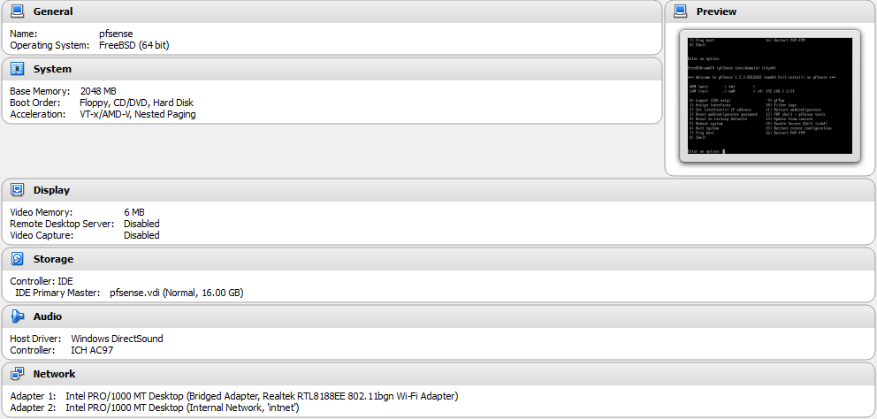
Exercise 1: installation on a vm https://www.pfsense.org/download/
BIG THING IS THE TWO NETWORK CARDS!!
Bridged = WAN
Internal = LAN

Slide 27
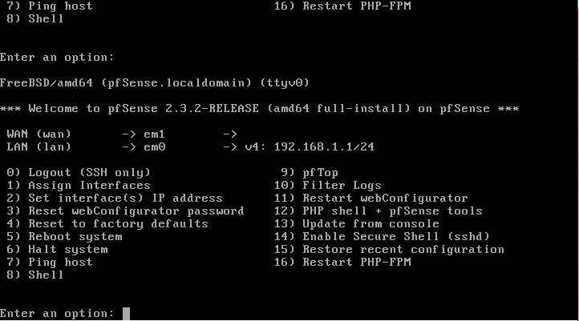
Exercise 1: Installation on a VM
Default installation will work just fine-just follow prompts, and then reset/reboot when prompted.
If all goes well, you will be at a screen that looks like this:

Slide 28
Exercise 1: Installation on a VM
Other tasks:
Install another VM that shares your internal network (Anything will work-the point is to access a web interface)
If you don’t have an assigned IP for your WAN, you will need to follow through option 1 and assign interfaces (basically just switch them)
There is a memory buffer issue that I’ve encountered a couple times with messing around with PFSense that you may run into. A good solution is here at around minute 19: https://www.youtube.com/watch?v=7nr9HNZ7OmY
If all goes well, you should be able to access the PFSense from your VM using the internal LAN IP!
Username: admin
Password: pfsense
Follow the installation wizard. Keep all the defaults for now.
Do NOT use a .net, .com, or .org ending if you want to change your domain name!

Slide 29
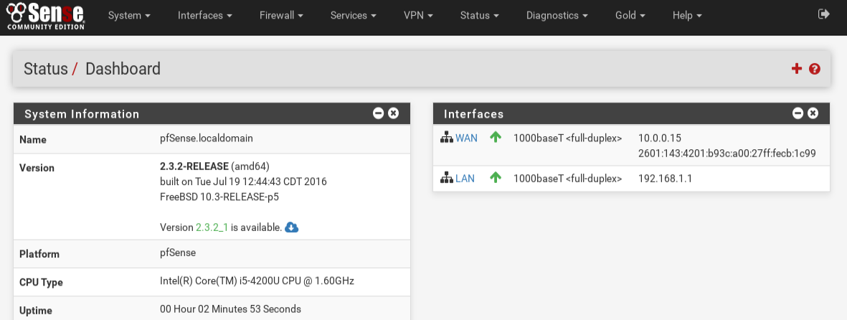
Initial Interface

Slide 30
So yes, this is a lovely little web interface!
Once installed, PFSense is very easy to work with and configure. There are also a bunch of help pages built in!
Some important things to do on a new install:
Update the system (can be done from the home dashboard; click the cloud)
If this were an enterprise solution and you had a certificate, you can enable https in System -> Advanced -> Admin Access
In System -> Advanced -> Miscellaneous, enable PowerD (for load balancing and monitoring system state) and change all settings to Adaptive
You should also disable IPv6 if you’re not going to use it. System -> Advanced -> Networking

Slide 31
Managing your Firewall + NAT settings
Four different optimization settings for the state table in PFSense:
Normal: the default optimization algorithm
High-Latency: useful for any kind of satellite/slow links (i.e. if you were in the middle of nowhere)
Aggressive: good for underpowered routers. Idle connections expire quicker, and CPU + memory are used more efficiently. Be warned: legitimate connections might get dropped!
Conservative: Opposite of aggressive; waits longer before a state is stale. More resource intensive, but improves a lot of things (VOIP, extended VPN)
** In general, go with Conservative. System -> Advanced -> Firewall & NAT **
PFSense also keeps track of unassigned IP addresses using Bogon Networks. This should be updated Weekly, not Monthly. System -> Advanced -> Firewall & NAT

Slide 32
Backups + restoration
PFSense backs up to a config.xml file (a text file) that contains everything that is your PFSense configuration. ALL YOU NEED IS THAT FILE, AND YOU SHOULD BACK UP TO IT REGULARLY.
Disasters can and will happen, but this .xml file makes things very easy.
It’s advised to perform and store this backup every time you make a configuration change, or at a minimum once a month.
There is also a package called AutoConfigBackup that schedules backups for you, but that costs money. You could always just use a cronjob though…

Slide 33
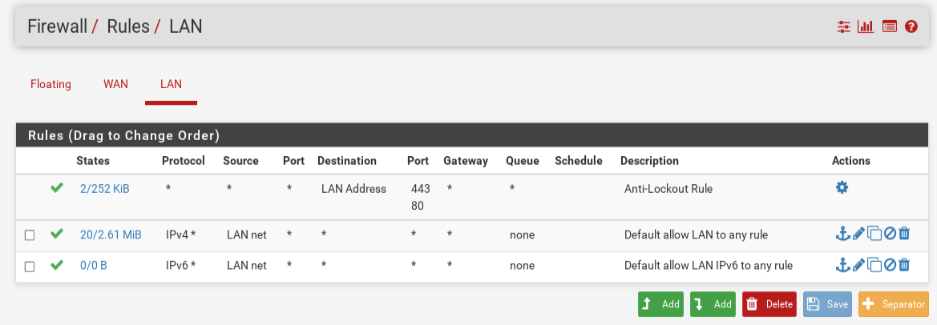
Now, on to The firewall material…
Very similar setup + application in comparison to IPTables
You can specify how your systems talk between each other (LAN) and how your system talks out to the Internet (WAN).
** By default, PFSense will block everything that isn’t whitelisted (but also note that your default LAN rule is a LAN allow-all)**
** Also by default, there is an HTTP/HTTPS Anti-lockout rule (in case you were to mess up while configuring) **

Slide 34
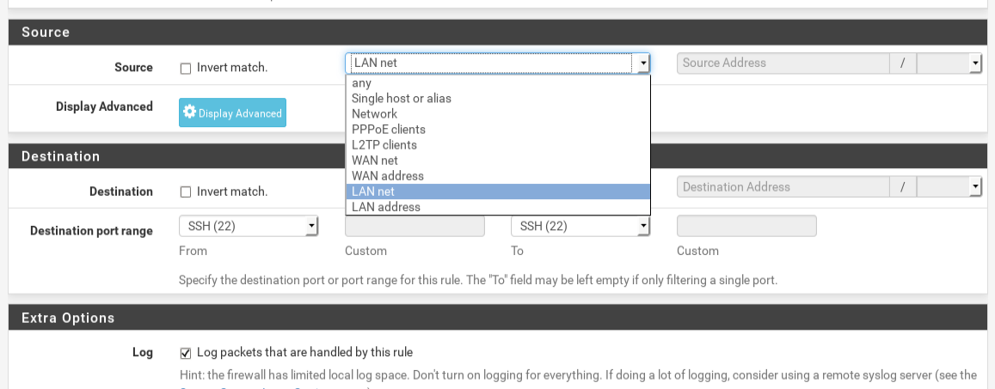
Adding rules: an easy, painless process
Again, similar to IPTables. Follow the GUI to set one up.
Things to note:
ACCEPT = ALLOW, DROP = BLOCK, REJECT = REJECT
You usually will want the rules to apply to the entire interface you’re working on. Be sure to select LAN net/WAN net when setting Destination/Source options.
ALWAYS BE SURE TO SAVE AND APPLY CHANGES WHEN DONE-DON’T CLOSE OUT!!!
This firewall automatically checks state-no need to manipulate this!
You can also easily copy rules and simply change the port numbers.

Slide 35
Floating Rules + Precedence
Rules are still evaluated in a top-down function-order appropriately (called first match), but there is also an order for group interface, individual interface, and floating rules (or rules that apply to everything)
When compared to iptables, floating rules are the equivalent of specifying a rule without the -i or -o flag (i.e. it applies to everything)
The order of these rules are as follows:
Rules defined on the floating tab are processed first
Rules defined on interface group tabs (Including OpenVPN) are processed second
Rules defined on interface tabs (WAN, LAN, OPTx, etc) are processed last

Slide 36
Some more firewall menu capabilities
Aliases: placeholders for real hosts, networks, or ports.
Example: WebServerPorts could be the alias for ports 443, 80, and 22, WebServers could contain the IPs of 5 web servers, and when making a rule, WebServers and WebServerPorts can be used to condense 15 firewall rules into one!
NAT: Binding addresses and Port Forwarding
Schedules: Having firewall rules active at particular times of the day
Traffic Shaper: utility that helps with controlling network traffic for performance optimization + lower latency
EXTREMELY important for enterprise/industry

Slide 37
A very useful pfsense Firewall package: pfblockerng
An IP Download manager; collects IPs from a multitude of sources
Can perform Country Blocking; blocks Ips based off of various geolocation databases.
Can run a Live Log from your main screen (basically a mini version of a SIEM like Splunk)
Duplication Removal, or filtering a list of IP addresses against one or more Classless Inter-Domain Routing (CIDR) specifications
Gets installed as just another option for your firewall tab!

Slide 38
Homework/Lab Stuff
Perform all of the same actions from the iptables lab in pfsense for the LAN interface. Include catch-alls, and observe the behavior of the firewall based off of the current precedence rules.
Set up an RRD interactive graph that shows and displays the quality of your WAN traffic.
Install and configure PFBlockerNG, then use it to try and generate statistics on the top 5 countries with unreliable/malicious IPs in the past 6 months. For the top 5, include the following:
The names of the countries
The ip ranges/specific ips, along with the total number of ips associated with them.
At least 5 of the protocols/connections that the blacklisted IPs of the number 1 country tries to take advantage of (SSH, SMTP, etc.)

