Slide 1
Shellcoding And You
With some RAT design for seasoning

Slide 2
Outline
What is shellcode?
Why do I care?
How do I write it?
How do I use it?
How do I design a Red Team (RT) toolkit around it?

Slide 3
What is Shellcode?
Shellcode refers to executable code that isn’t tied to a PE or binary
Position Independent Code refers to code that can be run from any address
Really any useful shellcode is going to be Position Independent
Who knows where we’re going to be running from an exploit, after injection, etc
Shellcode is commonly referenced in terms of exploits but is also a core piece of RT tools
Often need to start with shellcode first before we can use full modules

Slide 4
Why Do I Care?
Most Red Team (RT) tools use shellcode in some capacity
A tool can be anything, a RAT, a keylogger, a downloader, etc
Most shellcode tutorials detail writing shellcode in assembly
This isn’t most tutorials
We want most of our capabilities to be real executables written in C
Easier to develop, maintain, test, etc
Shellcode written in assembly should be the glue
Jump from arbitrary address -> real PEs

Slide 5
Why Do I Care?
Writing assembly is hard
-er than writing C code
Full Red Team tools need to do a lot of stuff
Keyloggers, screenshots, injection, etc
Shellcode gives us flexibility in how we can run
Run anywhere in memory
Run after an exploit
C code allows us to write sophisticated toolsets

Slide 6
A Note About Security
Antivirus and other security products are our bane
We already mentioned that we want to run in memory
As position independent code
Some products look for PE files in buffers to extract and scan
Will need obfuscate these
We also want our toolkit to be modular
No sense getting our keylogger caught when we just want screenshots

Slide 7
Let’s Review
Knowing all of this what does our ideal RAT look like?
Run totally in memory
To avoid AV
Architected as a sequence of modules
To avoid AV
Distributed as a shellcode package
So we can run it however we want
Sound easy?
☺

Slide 8
PE files in 5 minutes
Shellcode is the glue that will take us from run anywhere to run as a PE
Before we can do that we need to know what makes a PE a PE
If I want to write code in C can I just copy a DLL and run it in memory?
If not, how do I run a PE?
What happens when I double-click a .exe file?
Portable Executable (PE) files are the unit of execution on Windows
.dll files, .exe files, .sys files are the main ones
We’ll be focusing on DLLs

Slide 9
DLLs – the basics
Dynamic Link Libraries (DLLs) are PE files loaded and unloaded at the request of an EXE
DLLs can contain code, data, or both
Most RT tools will end up being DLLs
Easier to port, distribute, and execute in a variety of ways
DLLs have imports and (usually) exports
Imports: APIs used by the DLL’s code (CreateFile, CreateThread, etc)
Exports: Functions that the DLL exposes for other components to call

Slide 10
PE files in 5 minutes
PE files are primarily organized as sections and data directories
We’re skipping most of the minutiae for this talk
Sections are chunks of data in the file
Data directories describe things about how a PE should run
When you click to run an EXE the OS maps these sections into memory for you
The same process is done for DLLs via a call to LoadLibrary

Slide 11
PE files in 5 minutes
Sections are how the data in a PE is chunked
Sections have permissions (read, write, execute, etc)
Sections have virtual (in-memory) and raw (on-disk) sizes
Sections in a PE file have standard contents:
.text – code that executes
.data – global variables use in the code
.rsrc – resources (pictures, icons, etc)
.rdata – Imports, exports, other metadata about the PE
.pdata – exception information (x64 PEs)
.reloc - relocations
Section names and contents are compiler-specific

Slide 12
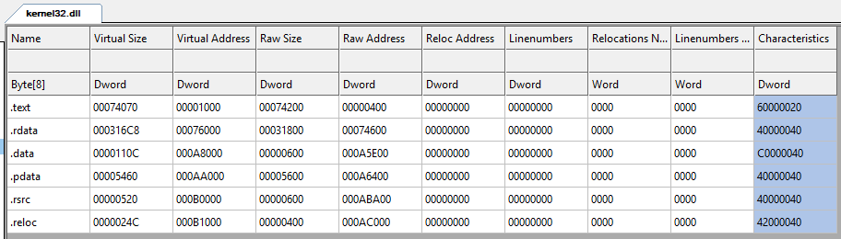
PE Files in 5 minutes

Slide 13
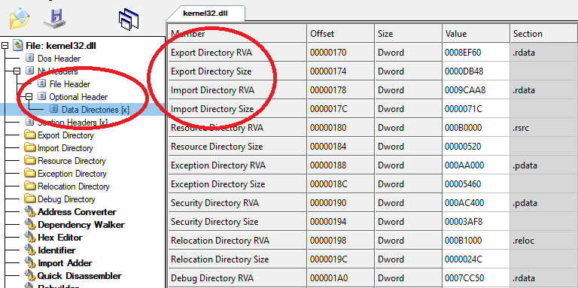
PE Files

Slide 14
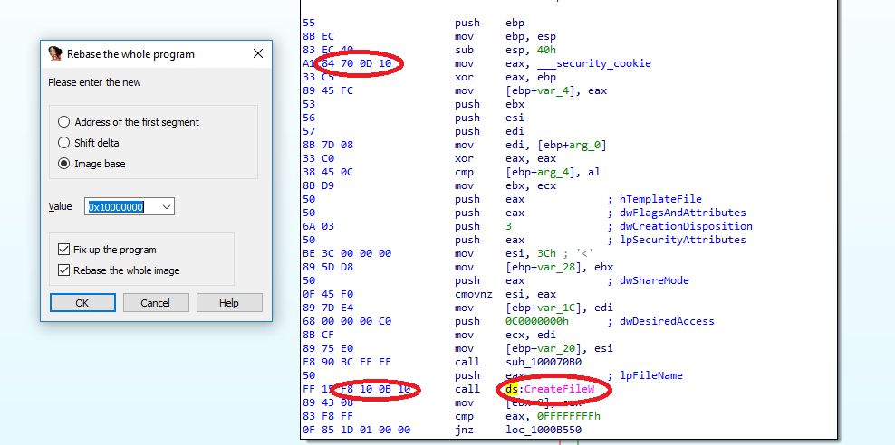
Why can’t I just run a DLL?
Notes:
“You might ask ‘what if I just read a .dll file off of disk, and try to jump right to a compiled function I wrote in C?’”
The red circles are all examples of things that the OS loader would normally take care of when mapping the DLL into memory
IDA loads the image at its preferred base address (covered in PE section below)
Explain that the circled parts of the opcodes are addresses relative to where the image would be loaded
Ask “What happens if the image is instead loaded at 0x400000” -> crash
Why do we care? Well if we get injected into another process who knows where we’ll be

Slide 15
Running PE files
PE files need to be loaded to run correctly
The loading process resolves:
Imports
How sections should be in memory (where, sizes, permissions)
Relocations
Internal OS lists (exceptions, blah blah)
Our shellcode will be responsible for doing this to itself and other modules
This is sometimes called Reflective Loading

Slide 16
Shellcoding
Your shellcode should be the transition from Assembly-land to C-land
Setting the stage
We want to do the setup so our main code can execute as if it were loaded normally
This mainly involves three steps:
Figuring out where we are in memory
Getting necessary function pointers
Finding our main payload and jumping to it
From there, our main payload can download additional modules, do the thing, etc.

Slide 17
Shellcoding – Finding Yourself
Position Independent Code (PIC) is meant to run from any address
Could be an exploit
Could be the result of VirtualAlloc
Could be based on somewhere you get loaded by LoadLibrary
The Intel instruction set does not allow you to modify/use EIP/RIP directly
Can’t do mov eax, eip or similar
So how do we know where we are?
Tricks!

Slide 18
Shellcoding – Finding Yourself
Possible to find the address that you’re executing from using floating point instructions
The FSTENV instruction stores the address of the last floating point instruction on the stack
Do any floating point opcode -> fstenv -> get address from stack -> gg
More trouble to maintain
A better solution is the jmp -> call -> pop sequence
Fewer changes and less math we need to do
Basic sequence:
jmp to the bottom of our shellcode
call back to the top of our shellcode
call instruction puts the return address on the stack
pop the return address
Our data (payload modules, etc) will be appended to our PIC
Notes:
Generally we’re appending our data to our shellcode/PIC
jmp -> call -> pop will always put us at our data
This means that we don’t need to care as much if we change our PIC stub

Slide 19
Shellcoding – Getting Function Pointers
In order to run a real payload we need to use a bunch of Windows APIs
Normally, the Windows Loader would find these for us
Since we’re writing shellcode, we’re on our own
Goal: Once we have LoadLibrary and GetProcAddress we can find any API we want
How do we find LoadLibrary and GetProcAddress before we have LoadLibrary and GetProcAddress?
Both of these functions are exported from kernel32 (PE header)
The PEB has a list of all modules that are loaded in the process

Slide 20
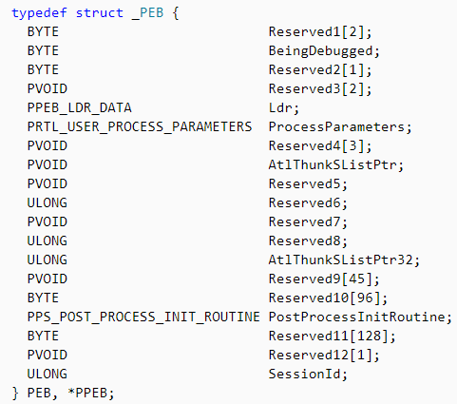
Getting Function Pointers – the PEB
The Process Environment Block (PEB) contains process metadata
The PEB can be retrieved using fs:[30h] on x86 and gs:[60h] on x64

Slide 21
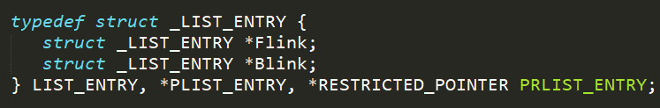
Getting Function Pointers – finding kernel32
Technically the PEB is either undocumented or subject to changes in future versions
Most internal lists on Windows use a LIST_ENTRY embedded in a parent structure
To find imports we want to go PEB -> Ldr -> InMemoryOrderModuleList (or any list)
Ldr is a PEB_LDR_DATA structure
Walking the list points to a LIST_ENTRY inside of LDR_DATA_TABLE_ENTRY structures
Flink and Blink point to the beginning of the LIST_ENTRY, not the beginning of the parent structure

Slide 22
Getting Function Pointers – finding kernel32
_PEB
…
BeingDebugged
…
Ldr
ProcessParameters
…
_PEB_LDR_DATA
…
InMemoryOrderModuleList
<other lists>
_LDR_DATA_TABLE_ENTRY
InLoadOrderLinks
InMemoryOrderModuleList
InInitOrderModuleList
DllBase
EntryPoint
SizeOfImage
FullDllName
…
Notes:
Only InMemoryOrderModuleList is documented
Call out that the InMemoryOrderModuleList LIST_ENTRY does not point to beginning of LDR_DATA_TABLE_ENTRY

Slide 23
Getting Function Pointers – Writing GetProcAddress
We can’t use GetProcAddress since we don’t know where it is
APIs exported by a DLL are in the Export directory
Once we write our own export parser we can resolve GetProcAddress manually
LoadLibrary + GetProcAddress = we can get any other API we need
Sandboxes may also hook LoadLibrary and GetProcAddress
Might make sense to just use our manual functions forever
Exports are accessed via the OptionalHeader.DataDirectory
IMAGE_DIRECTORY_ENTRY_EXPORT

Slide 24

Shellcoding – ASM SUX
Notes:
Usually you write assembly by hand when you’re worried about:
Size
Bad characters (e.g. from an exploit
Since we’re writing an implant we don’t have to worry about either of these since our normal work flow is just allocate->execute (more or less)

Slide 25
Shellcoding – Writing PIC in C
Remember:
We don’t want to write assembly unless we have to. Writing C is quicker and more flexible
We can’t just compiled function into memory normally and execute it successfully
The root cause of this is relocations
A relocation is an address that changes depending on where a PE is loaded
When a PE is compiled it is done so assuming it can load at its preferred address
Is the PE is loaded at a different address the memory addresses in the code are wrong
ASLR

Slide 26
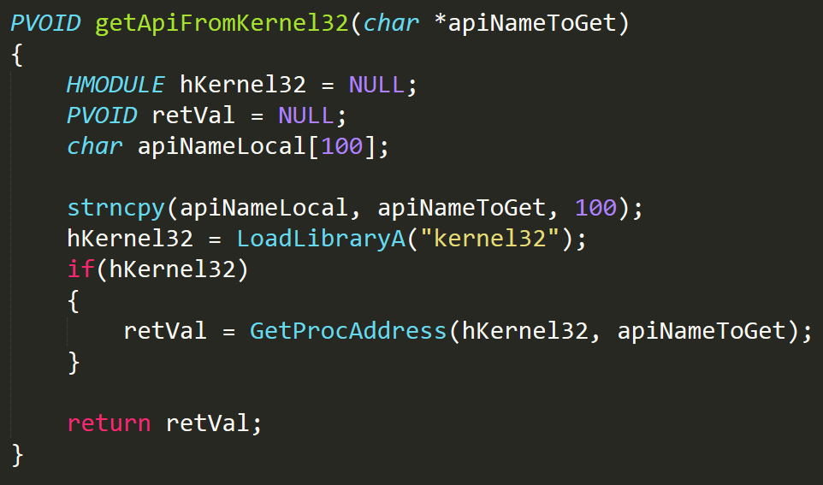
Writing PIC in C – What’s the Problem?
Why can’t we compile this function, copy it directly into memory, and run it?

Slide 27
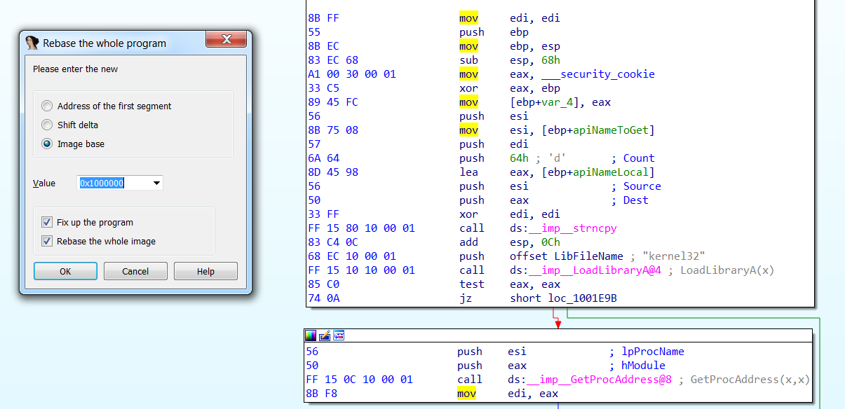
Writing PIC in C – What’s the Problem?
asdas
Notes:
“If we just copy this DLL/function to a random memory address the red circles will all cause crashes
If we want to write a function in C and run it as PIC we need to follow a few rules:
No stack cookies (or any other compiler features that insert structures into a function)
No imports, we need to use function pointers
Using strings like on the last slide will compile them into global variables, which we also can’t use
We’re using 32-bit code as an example here to really drive it home. Mention that PIC is easier to write in x64 since the instruction set automatically tends to use rip-relative addressing

Slide 28
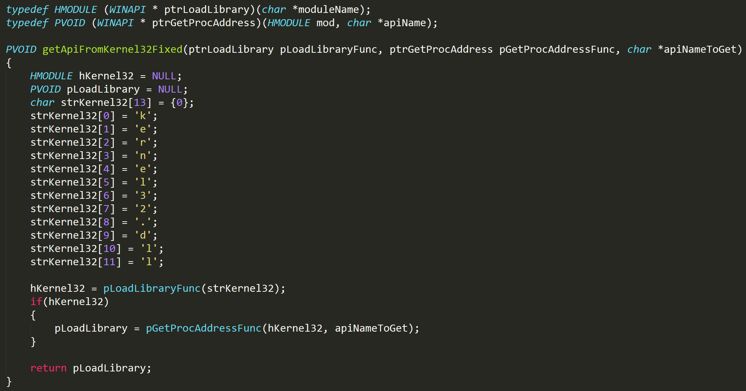
Writing PIC in C – How do I fix these?

Slide 29
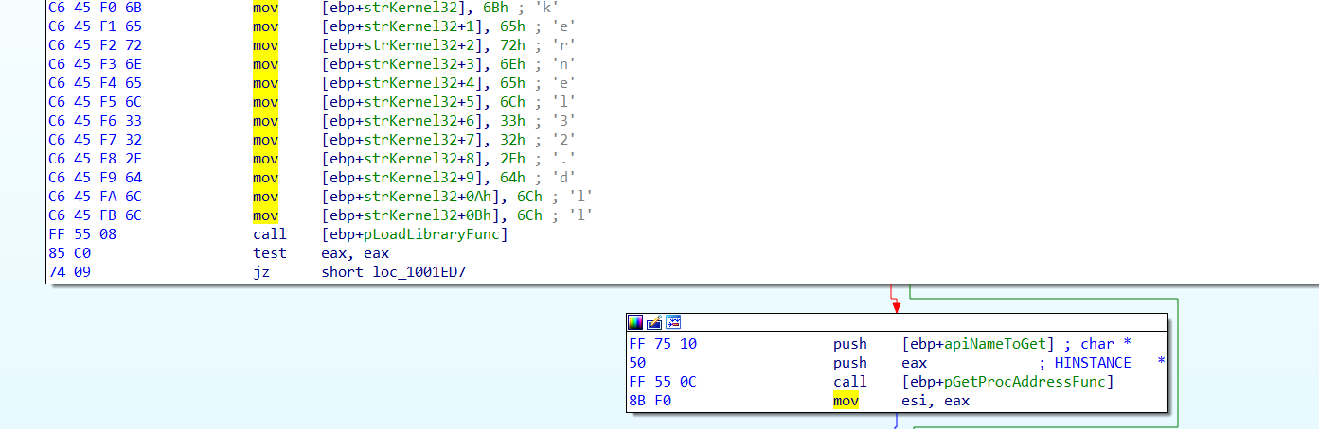
Writing PIC in C – How do I fix these?

Slide 30
Writing PIC in C – Tips and tricks
Disable stack cookies
Don’t import any APIs. Instead, use a structure of function pointers
You can get needed exports by walking the PE header
Don’t use global variables
Strings get compiled as global variable automagically. Use stack strings instead

Slide 31
Now What?
PEB parsing and PE loading are involved
Now that we can write our shellcode in C this is easier to manage
PE loading is a whole separate talk
Plenty of examples online
This is mostly just work
Since we’re focusing on shellcode the next question is how to we run it to avoid AV?

Slide 32
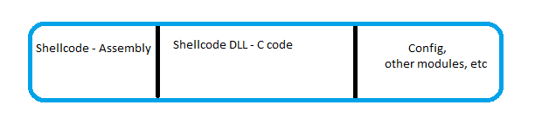
The Story So Far
With our PEB parsing and PE loading code we can make a shellcode buffer like:
Start execution at the beginning
Assembly jumps to where our PIC code in C is located
Shellcode DLL loads itself and other modules

Slide 33
The Story So Far
We can break the rest of our RAT up into different modules (DLLs)
Injection
Keylogging
Screenshots
VNC/RDP
Etc
We can use the same loading code to load additional payloads

Slide 34
AV and Me
We already had a few notes about avoiding AV
AV knows about how to do most malicious actions
CreateRemoteThread is baby’s first injection
Since we can’t hide what we’re doing we have two options:
Try to attack/disable the AV directly – hard to maintain
Try to blend in and look legitimate
AV’s need to worry about not flagging on false positives
We don’t, so we can abuse these decision-making processes

Slide 35
AV and Me
Distributing as a shellcode buffer gives us a lot of options
We can append more PEs to our shellcode blob
Minimal code changes
Worried about static scanning? Append an encoder
Need to be in a different process? Add an injection module
Append your config, etc
Gives you an easy way to build up a buffer per-system

