Slide 1

Advanced Linux stuff
By Chris & Zack

Slide 2
Agenda
CSAW Details
Linux Permissions review + advanced - I can’t let you do that Dave
Symlinks!
Pipes! (with cool examples!)
Ez linux debugging for fun and profit
Tying it all together: a demo. Wow! So Cool!
Wargamez: hacking the gibson one step at a time

Slide 3
CSAW STUFF HERE
CSAW is this weekend and we are competing! I hope to see you all there.
We will be competing in ITE 227 from 4pm - whenever on Friday, September 15th
Saturday times/room # TBA, probably starting around noon, room depends on attendance.
There will be pizza!
Only the top 10 qualify this year so we have our work cut out for us.
DM me (toomanybananas on Slack) if you get a flag! We can only send 4 people to finals so I need to know who our top performers are.

Slide 4
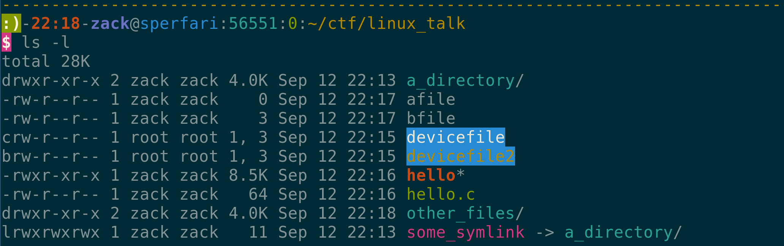
Linux Perms (review)
read = 4 write = 2 execute = 1
d = directory l = symlink b = block device c = character device
Notes:
Unix has 3 sets of permissions: user, group, other. Each file has an owning user and group.
Each can have read, write, execute.
Special files exist, per UNIX “everything is a file”. Examples: /dev/null, /dev/sda1, /dev/kvm
Major and minor number
Modification times are a farce! (sometimes)
Go thru all the columns and explain what they mean.
In case you forget, in order:
Permissions (file type, then rwx for each column)
Link count (directories have 2 to start because of ..)
Owner
Group owner
Size (for devices, it’s major/minor)
Date
Filename

Slide 5
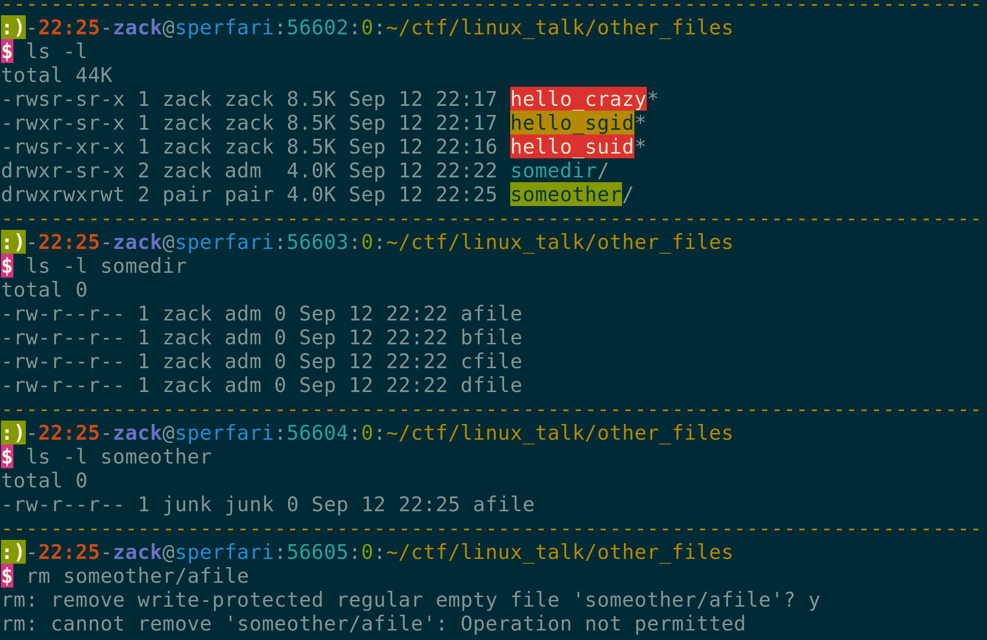
SUID/SGID
There are 3 more permission bits
setuid (4) setgid (2) Sticky bit (1)
Files:
setuid/setgid mean the file runs as owning user/group
Sticky bit is useless
Directories:
setuid is useless
setgid means that new files are owned by that group
Sticky bit means only owner can create files
So you can set a file suid with:
chmod 4755 /usr/local/bin/suidfile
Notes:
So I said that owner, group, other can have read, write, execute. That’s not entirely true… There’s another permission digit.
Three permissions:
Setuid (4)
Setgid (2)
Sticky bit (1)
Let’s talk about files first:
On files, setuid means the program will always run as the file owner, regardless of who runs it. This is how the passwd binary works. Root owns /usr/bin/passwd, and the setuid bit is set. We say it is “setuid root”. This means it can edit /etc/shadow.
Setgid is the same deal, only for groups.
Sticky bit is basically meaningless. It used to mean the file would “stick” in memory. I’ve never used it, or seen it used.
Now about directories:
Setuid means basically nothing
Setgid means that if you create a file in that directory, it’s owned by the directory’s owning group. This is useful for different people all working in a directory, and they need everyone else to be able to get to their files.
Sticky bit means that only a file’s owner or root can delete files in the directory. By default for file deletion, the directory’s permissions apply. So for /tmp, everyone that can write to the directory would be able to delete everyone else’s files.
You set this permission with chmod u+s or chmod 4755. (or whatever you want the other bits to be)
Now you understand why we laugh when people talk about “chmod -R 777 /usr”. This is implicitly “chmod -R 0777 /usr”

Slide 6
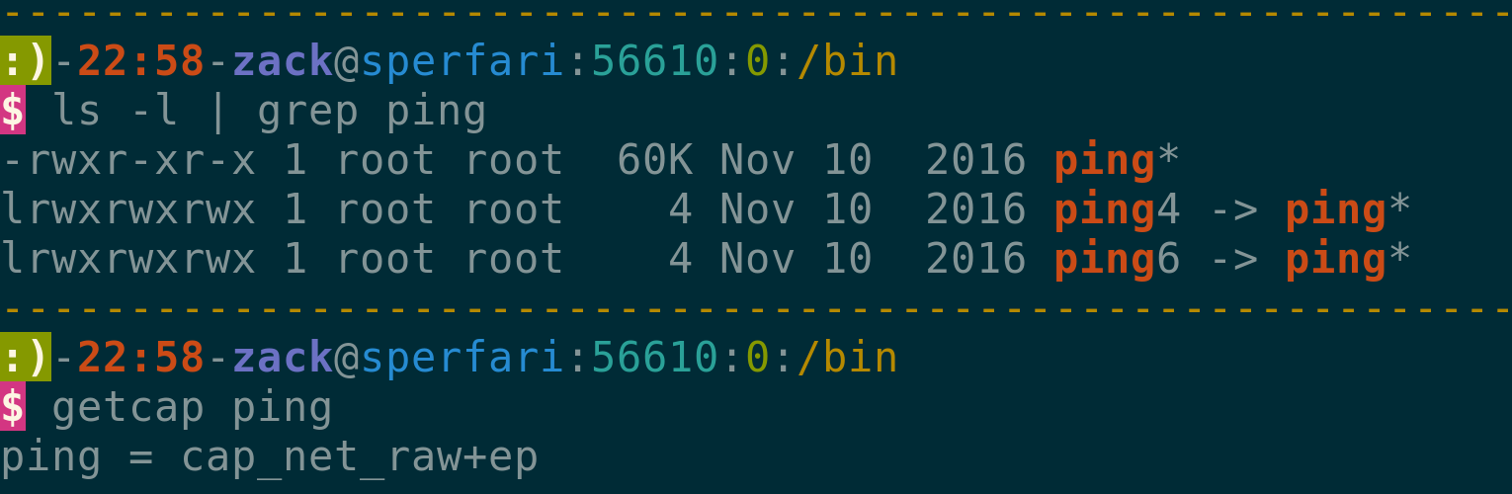
setcap
CAP_AUDIT_CONTROL CAP_AUDIT_READ CAP_AUDIT_WRITE CAP_BLOCK_SUSPEND CAP_CHOWN CAP_DAC_OVERRIDE CAP_IPC_LOCK CAP_IPC_OWNER CAP_KILL CAP_LEASE CAP_LINUX_IMMUTABLE CAP_MKNOD CAP_NET_ADMIN CAP_NET_BIND_SERVICE CAP_NET_RAW CAP_SETGID CAP_SETFCAP CAP_SETPCAP CAP_SETUID CAP_SYS_ADMIN … and more
The Linux kernel has a concept of “capabilities”. Idea is to split root up into pieces so a process can have just part of the privs.
Unfortunately, most of them are equivalent to full root
But they’re useful in a few cases, such as ping, which needs to send ICMP packets
Notes:
So UNIX file permissions/the filesystem isn’t actually as simple as we’ve made it sound.
No one talks about these, but there are “extended attributes” and POSIX ACLs.
POSIX ACLs are similar to Windows ACLs, we won’t talk much about them
“Extended attributes” store, well, extra stuff about a file
One thing they can store are “capabilities”
Root equivalency: http://forums.grsecurity.net/viewtopic.php?f=7&t=2522&sid=c6fbcf62fd5d3472562540a7e608ce4e#p10271

Slide 7
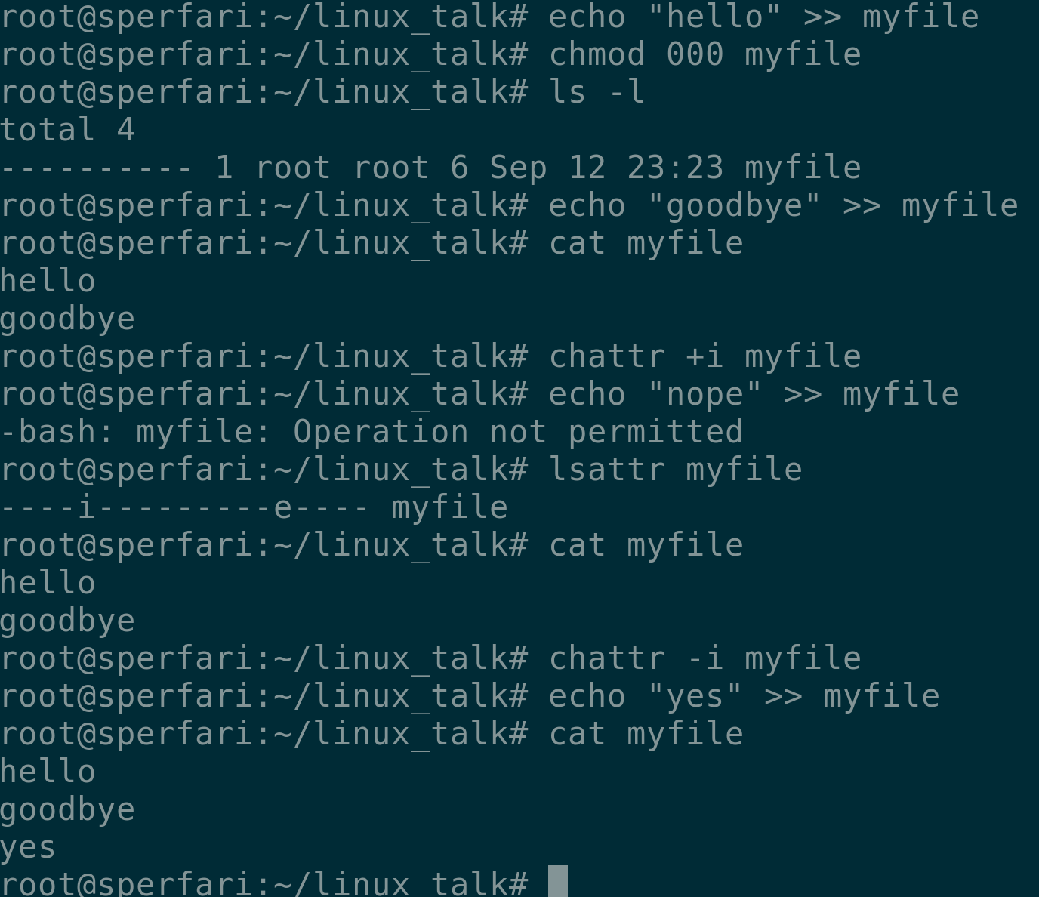
Linux attributes
These are Linux specific, not to be confused with POSIX extended attributes
Change them with chattr, see them with lsattr
Most are useless, the two important ones are immutable and appendonly
Immutable makes the file unchangable, even for root!
Appendonly makes it so you can only append stuff to the file, again, even for root!

Slide 8
Symbolic Links (Symlinks)
Symlinks are literally my favorite filesystem feature
Essentially a reference to another file. Inherits permission, content, etc from the file it points to.
Created with the ln command (ln -s symlink /path/to/file)
Since it has the same permissions as the file it points to but a different name, it can help you bypass a blacklist or whitelist in a SUID program. (hint for wargame)

Slide 9
Pipes! | | | | | | |
Pipes sends the output of one program to another program. Pipes can be chained together to form pipelines, which can do some pretty powerful stuff.
Common pipe recipients:
grep - search input for some pattern
cut - extract text from input based on some delimiters
tail/head - Get only the last few/first few lines of the input
sed - text processing tool, generally useful for substituting things
awk - another text processing tool, has a bit of a learning curve

Slide 10
Pipe demos
Find top 10 commands
cat .bash_history | grep -v "^#" | sed "s/sudo //" | sed -E "s/^\s+//" | cut -f 1 -d " " | sort | uniq -c | sort -nr | head -40
Defcon CTF Qualifiers 2017: crackme2000 solutions
objdump -M intel -d $1 | grep “cmp” | grep “rdi,0x” | cut -d”,” -f2 | xxd -r -p
objdump -M intel -d $1 | grep -1 “e.x,BYTE PTR \[rax” | grep cmp | grep -v “eax” | grep -v “al” | cut -d”,” -f2 | xxd -r -p
Fork bombs!
:(){ :|: & };:
Notes:
cat .bash_history | grep -v "^#" | sed "s/sudo //" | sed -E "s/^\s+//" | cut -f 1 -d " " | sort | uniq -c | sort -nr | head -40

Slide 11
Linux Debugging with Strace/Ltrace
Strace and ltrace are tools that make debugging certain programs on Linux really easy.
Strace intercepts all system calls and shows you the arguments and output
Ltrace intercepts all calls to dynamic libraries and shows you the arguments and output
Ltrace is a lot more useful than strace, but doesn’t work on every program!
Ltrace has no effect on statically linked binaries

Slide 12
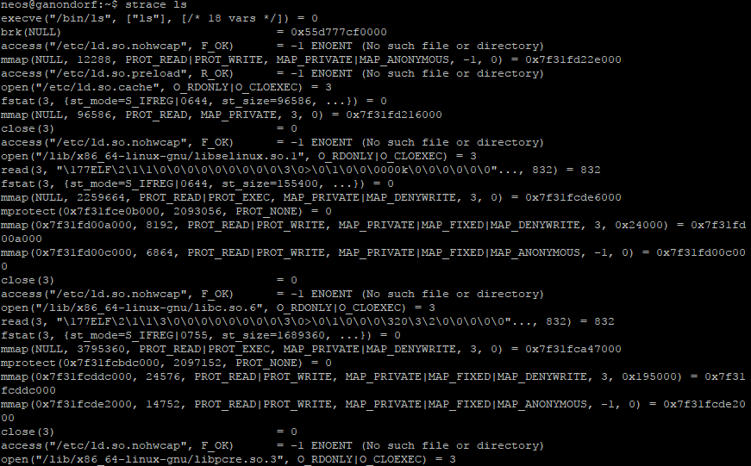
strace ls

Slide 13
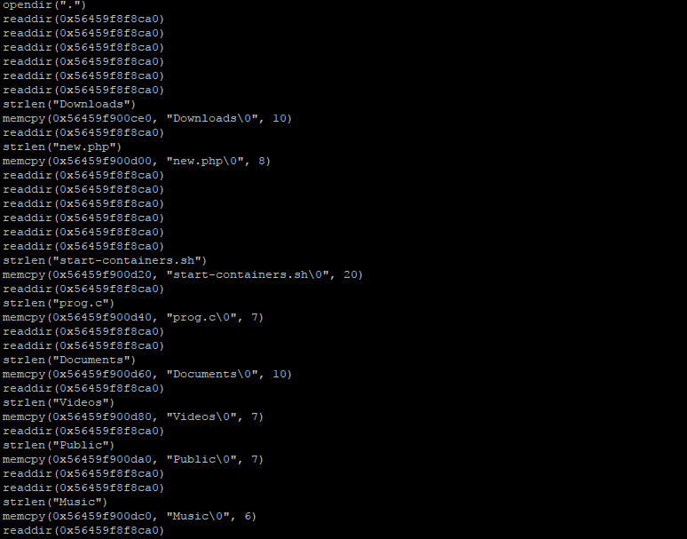
ltrace ls

Slide 14
Demo: Let’s make a keylogger!
Don’t use this for nefarious purposes
Also, don’t get caught.
Strace -s 1000 -f -qq -e write -e signal none -p $pid 2>&1 3>&1 | stdbuf -o0 -d”\”” -f2 | stdbuf -o0 tr -d ‘\n’

Slide 15
Wargamez
Now it’s time to apply what you’ve learned in this presentation!
There’s a wargame on Overthewire called Leviathan that ties in nicely with what we’ve taught you this lesson. All you need is a SSH client, such as PuTTY for Windows.
We will be walking around offering tipz n trickz, flag us down if you need help.
No such thing as a stupid question.
http://overthewire.org/wargames/leviathan/
You can also do Bandit (also on OTW) if you haven’t done it before.

