Slide 1
JDBC
<dependency> <groupId>org.postgresql</groupId> <artifactId>postgresql</artifactId> <version>42.6.0</version> </dependency>
Java Application
JDBC API
JDBC Driver Manager
JDBC Driver
JDBC Driver
JDBC Driver
Oracle
MS SQL
ODBC
Data
Source

Slide 2
JDBC (connection)
private static Connection connect() throws SQLException {
Properties props = new Properties();
props.put("user", "sysdba");
props.put("password", "masterkey");
String url = "jdbc:postgresql://localhost:5432/testDb";
return DriverManager.getConnection(url, props);
}
META-INF\services\java.sql.Driver

Slide 3
JDBC (select)
String query = "select COF_NAME, SUP_ID, PRICE, SALES, TOTAL from COFFEES";
try (Statement stmt = con.createStatement()) {
ResultSet rs = stmt.executeQuery(query);
while (rs.next()) {
String coffeeName = rs.getString("COF_NAME");
int supplierID = rs.getInt("SUP_ID"); //или индекс
float price = rs.getFloat("PRICE"); // rs.wasNull();
int sales = rs.getInt("SALES");
int total = rs.getInt("TOTAL");
System.out.println(coffeeName + ", " + supplierID + ", “
+ price + ", " + sales + ", " + total);
}
} //stmt.close();
try (PreparedStatement stmt = con.prepareStatement(query)) {
ResultSet rs = stmt.executeQuery();

Slide 4
JDBC (insert)
String query = "insert into SUPPLIERS(SUP_ID, SUP_NAME, STREET) values(?, ?, ?)";
try (PreparedStatement stmt = con.prepareStatement(query)) {
stmt.setInt(1, 1000);
stmt.setString(2, "1000");
stmt.setString(3, "street 1000");
stmt.setBinaryStream(4, new FileInputStream("d:/test.dat"));
stmt.executeUpdate(); //количество измененных строк
}
con.commit(); //rollback();
------------------------------------------------------------------------------------
for (int i = 1000; i < 2000; i++) {
stmt.setInt(1, i);
stmt.setString(2, Integer.toString(i));
stmt.setString(3, "street #" + Integer.toString(i));
stmt.addBatch();
}
stmt.executeBatch();

Slide 5
JDBC (batch)
con.setAutoCommit(false);
try (Statement stmt = con.createStatement()) {
stmt.addBatch("INSERT INTO COFFEES VALUES('Amaretto', 49, 9.99)");
stmt.addBatch("INSERT INTO COFFEES "VALUES('Hazelnut', 49, 9.99)");
stmt.addBatch("INSERT INTO COFFEES VALUES('Amaretto', 49, 10.99)");
stmt.addBatch("INSERT INTO COFFEES VALUES('Hazelnut', 49, 10.99)");
int[] updateCounts = stmt.executeBatch();
con.commit(); //Нужен ли commit для чтения?
} finally {
con.setAutoCommit(true);
}

Slide 6
JDBC (update ResultSet)
try (Statement stmt = con.createStatement(
ResultSet.TYPE_SCROLL_SENSITIVE, ResultSet.CONCUR_UPDATABLE)) {
ResultSet uprs = stmt.executeQuery("SELECT * FROM COFFEES");
while (uprs.next()) {
float f = uprs.getFloat("PRICE");
uprs.updateFloat("PRICE", f * percentage);
uprs.updateRow();
//uprs.deleteRow();
}
} //Можно даже выполнить insert

Slide 7
JDBC + Wildfly (модули)
Можно просто выложить postgresql-42.6.0.jar в standalone\deployments\, но это не очень хорошо для автоматического развертывания
1. Добавить модуль
modules
layers.conf layers=user,base
system
layers
base
. . .
user
org/postgresql/main
module.xml
postgresql-42.6.0.jar
Можно добавлять в base (но это не очень хорошо)
Для добавления в base можно использовать cli
Также можно использовать папку
modules/system/add-ons/<add-on name>

Slide 8
JDBC + Wildfly (модули 2)
module.xml
<?xml version="1.0" encoding="UTF-8"?>
<module name="org.postgresql" xmlns="urn:jboss:module:1.9">
<resources>
<resource-root path="postgresql-42.6.0.jar"/>
</resources>
<dependencies>
<module name="javax.api"/>
<module name="javax.transaction.api"/>
</dependencies>
</module>

Slide 9
Database + Wildfly
2. standalone-full.xml
<subsystem xmlns="urn:jboss:domain:datasources:7.0">
<datasources>
<datasource jndi-name="java:jboss/datasources/my-db"
pool-name="my-db" enabled="true"
use-java-context="true"
statistics-enabled="false">
<connection-url>
jdbc:postgresql://localhost:5432/my-db
</connection-url>
<driver>postgresql</driver>
<security>
<user-name>sysdba</user-name>
<password>masterkey</password>
</security>
</datasource>
<drivers>
<driver name="postgresql" module="org.postgresql">
<driver-class>org.postgresql.Driver</driver-class>
</driver>
</drivers>
</datasources>
</subsystem>

Slide 10
Database + Wildfly (2)
3. Получить подключение
private Connection getConnection() throws . . . {
String jndiName = "java:jboss/datasources/my-db";
InitialContext ctx = new InitialContext();
DataSource ds = (DataSource) ctx.lookup(jndiName);
return ds.getConnection();
}
----------------------------------------------------------------
@Resource(lookup = "java:jboss/datasources/my-db")
DataSource dataSource;
Connection con = dataSource.getConnection();

Slide 11
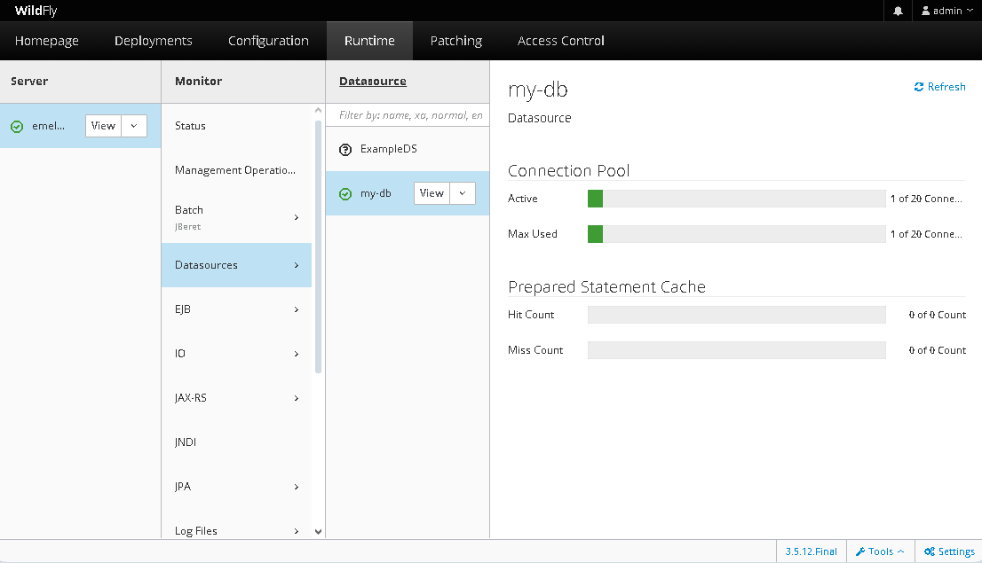
Database + Wildfly (3)
Можно выполнить Test (в выпадающем списке)
Что будет если получить несколько подключений?
Что будет если их не закрыть?

Slide 12
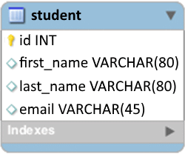
ORM
Student
ORM
- Id : int
- firstName : String
- lastName : String
- email : String
…
EclipseLink (JPA)
Hibernate (JPA)
NHibernate (.Net)
Entity Framework (.Net)
Doctrine (PHP)
Tryton (Python)

Slide 13
JPA Entities
@Entity
public class Student {
@Id
private Long id;
private String name;
// getters and setters
}
//Дефолтный конструктор без параметров
@Entity(name="Student")
public class Student {
@Id // TABLE, SEQUENCE, IDENTITY
@GeneratedValue(strategy = GenerationType.AUTO)
private Long id;
private String name;
// getters and setters
}

Slide 14
JPA Entities (Generator)
@TableGenerator(
name = "empGen",
table = "ID_GEN",
pkColumnName = "GEN_KEY",
valueColumnName = "GEN_VALUE",
pkColumnValue = "EMP_ID",
initialValue = 0,
allocationSize = 50)
@Id
@GeneratedValue(strategy = TABLE, generator="empGen")
int id;
@SequenceGenerator(
name = "MAIN_SEQ",
sequenceName = "GEN_ID",
initialValue = 1
allocationSize = 50)
@Id
@GeneratedValue(strategy = SEQUENCE, generator="MAIN_SEQ")
int id;
@Id
@GeneratedValue(strategy = SEQUENCE) // hibernate_sequence
int id;

Slide 15
JPA Entities (orm.xml)
<?xml version="1.0" encoding="UTF-8" ?>
<entity-mappings version="2.2"
xmlns="http://xmlns.jcp.org/xml/ns/persistence/orm"
xmlns:xsi="http://www.w3.org/2001/XMLSchema-instance"
xsi:schemaLocation="
http://xmlns.jcp.org/xml/ns/persistence/orm
http://xmlns.jcp.org/xml/ns/persistence/orm_2_2.xsd">
<sequence-generator name="MAIN_SEQ" sequence-name="GEN_ID" allocation-size="5"/>
<entity class="org.datanucleus.samples.jpa.tutorial.Product" name="Product">
<table name="JPA_PRODUCTS"/>
<inheritance strategy="JOINED"/>
<attributes>
<id name="id">
<generated-value strategy="AUTO"/>
</id>
<basic name="name">
<column name="PRODUCT_NAME" length="100"/>
</basic>
<basic name="description">
<column length="255"/>
</basic>
</attributes>
</entity>
</entity-mappings>
@Id
@GeneratedValue(strategy = SEQUENCE, generator="MAIN_SEQ")
int id;

Slide 16
JPA (persistence.xml)
resources\META-INF\persistence.xml
resources\META-INF\orm.xml //Файл для мэпинга данных по умолчанию
<?xml version="1.0" encoding="UTF-8"?>
<persistence version="2.2"
xmlns="http://xmlns.jcp.org/xml/ns/persistence"
xmlns:xsi="http://www.w3.org/2001/XMLSchema-instance"
xsi:schemaLocation="
http://xmlns.jcp.org/xml/ns/persistence
http://xmlns.jcp.org/xml/ns/persistence/persistence_2_2.xsd">
<persistence-unit name="my-db">
<jta-data-source>java:jboss/datasources/my-db</jta-data-source>
<properties>
<property name="hibernate.hbm2ddl.auto"
value="create-drop" /> <!–- update -->
<property name="hibernate.show_sql"
value="false" />
</properties>
<mapping-file>ormap.xml</mapping-file>
<jar-file>lib/MyOrderApp.jar</jar-file>
</persistence-unit>
</persistence>
Если сущности лежат в других jar-файлах, то их нужно указывать

Slide 17
JPA (persistence.xml) (2)
<?xml version="1.0" encoding="UTF-8"?>
<persistence . . .>
<persistence-unit name="my-db">
<jta-data-source>
java:jboss/datasources/my-db
</jta-data-source>
<!-- включаем только указанные классы -->
<class>com.acme.Order</class>
<class>com.acme.Customer</class>
<class>com.acme.Item</class>
<exclude-unlisted-classes/>
</persistence-unit>
</persistence>

Slide 18
JPA Entities (Table)
@Entity
@Table(name = "tb_student",
uniqueConstraints={
@UniqueConstraint(columnNames={"name", "family"}, name = "cs1"),
@UniqueConstraint(columnNames={"passport"}, name = "cs2"),
},
indexes={
@Index(columnList = "name, age DESC", name = "ix1", unique = true),
@Index(columnList = "address", name = "ix2", unique = false)
}
)
public class Student {
@Id
private Long id;
private String name;
private String family;
private Integer age;
private String passport;
private String address;
}

Slide 19
JPA Entities (Column)
@Entity
@SecondaryTables({
@SecondaryTable(name="stud_def")
})
public class Student {
@Id
private Long id;
@Column(unique=true, nullable=false, length=50)
private String name;
@Column(name="col_grant", scale=10, precision=2) //NUMERIC(10, 2)
private BigDecimal grant;
@Column(insertable=false, updatable=false)
private boolean major;
@Column(columnDefinition="TEXT not null", table="stud_def")
private String def;
@Column(columnDefinition="integer default 25")
private int age;
}
Таблица Student с колонками (id, name, col_grant, age)
Таблица stud_def с колонками (id, def)

Slide 20
JPA Entities (Column 2)
@Entity
public class Student {
@Transient
private Integer age;
@Column(name = "b_date")
@Temporal(TemporalType.DATE)
private Date birthDate;
@Version
private int version;
@Enumerated(EnumType.STRING)
private Gender gender;
@Lob
@Basic(fetch = FetchType.LAZY) //нужен hibernate-enhance
private byte[] attachment;
}
public enum Gender { MALE, FEMALE }
<groupId>org.hibernate.orm.tooling</groupId>
<artifactId>hibernate-enhance-maven-plugin</artifactId>
<version>5.3.28.Final</version>

Slide 21
JPA Entities (Column 3)
@Entity
@Access(AccessType.FIELD) //из-за @Id и так будет AccessType.FIELD
public class Simple {
private Integer id;
@Version
@Access( AccessType.FIELD )
private Integer version;
@Id
public Integer getId() {
return id;
}
public void setId( Integer id ) {
this.id = id;
}
}
По умолчанию внутри класса будут использоваться либо только поля, либо только getter-ы (по первой аннотации).

Slide 22
JPA Entities (Composite Column)
//Выносим часто повторяющийся набор полей в отдельный объект (если возможно, то лучше использовать наследование)
@Embeddable
public class ContactPerson {
@Column(name="name")
private String firstName;
private String lastName;
private String phone;
}
@Entity
public class Company {
. . .
@Embedded //@EmbeddedId
@AttributeOverrides({
@AttributeOverride(name="firstName", column=@Column("cp_name")),
@AttributeOverride(name="lastName", column=@Column("cp_name2"))
})
private ContactPerson contactPerson;
}
//HQL: SELECT c.contactPerson.firstName FROM Company c
Таблица Company (cp_name, cp_name2, phone, . . .)

Slide 23
JPA Entities (Composite PK)
@Embeddable //equals and hashCode override
public class AccountId implements Serializable {
String accountNumber;
String accountType;
}
@Entity
public class Account {
@EmbeddedId
AccountId id;
@MapsId("accountNumber") //Мэпим часть ключа на данное поле
String accountNumber;
}
-----------------------------------------------------------------
public class AccountId implements Serializable {
String accountNumber;
String accountType;
}
@Entity
@IdClass(AccountId.class)
public class Account {
@Id
private String accountNumber;
@Id
private String accountType;
}

Slide 24
JPA Entities (Composite PK 2)
public class EmpPK {
public Integer id;
public String name;
}
@Entity
@IdClass(EmpPK.class)
public class Employee {
@Id Integer id;
@Id String name;
@OneToOne //Организация отношения 1 к 1 с композитным ключом
@PrimaryKeyJoinColumns({
@PrimaryKeyJoinColumn(name="ID", referencedColumnName="EMP_ID"),
@PrimaryKeyJoinColumn(name="NAME", referencedColumnName="EMP_NAME")})
EmployeeInfo info;
...
}
@Entity
@IdClass(EmpPK.class)
public class EmployeeInfo {
@Id @Column(name="EMP_ID")
Integer id;
@Id @Column(name="EMP_NAME")
String name;
...
}

