Slide 1
Level 1b
Documentation
https://github.com/UMC-Utrecht-RWE/ConcePTION-Level1b

Slide 2
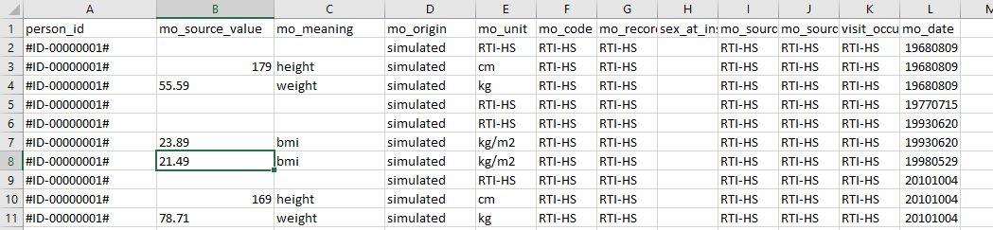
Primary aim
To asses how (syntactic) study variables are in the CDM of a database (DAP)
(if weight is a relevant study variable we need to know in which tables, and which columns and which cell value’s )
Previous attempts to let the databases document this themselves failed. The delivered information did not often match reality.
Mainly meant for programmers and PI’s not for DAP’s. Programmers need this information to develop there code and sampling data. PI’s can check if all needed study information is available.
Outputs are simple, no HTML reporting or fancy graphs

Slide 3
Secondary aim
To asses which coding systems and codes are found in the data and relate this to the code lists

Slide 4
Place in the pipeline
A part of the quality assessment
It is independed because some basic checks are done at the beginning. So in theory it can run in all stages.
The most logical place is to run after level 1 because simple assumptions (semantics) of the CDM need to be met
Level 1
Level 1b
Level 2
Level 3

Slide 5
Execution procedure
Run script locally
DAP’s run the scrip locally
The output is uploaded to DRE
On DRE the meta files can be filled and it can be verified if all needed information is in the CDM
If the meta files are filled, a test script need to be applied to test if the filled meta files are valid: AnalyseLevel1bDREScript
If valid, download the meta files so they can be used for the analytical script.
If there any changes in the CDM along the way the procedure starts again from the beginning.
DAP
Upload to anDRE
Fill meta files program
Run check script on anDRE
PI
Download and provide to programmers
Syntactic modifications

Slide 6
Needed parameters to set in to_run.R
A reference to the CDM .csv files
Via a path:
StudyName <- NULL
path_to_fill <- “C:/CDMfolder”
Via a studyname/folder name in CDMinstances
StudyName <- “studyname”
path_to_fill <- NULL
The CDM tables you want to analyze. By default all tables are analyzed.
t.interest <- c("SURVEY_OBSERVATIONS", "MEDICAL_OBSERVATIONS“)
OR
t.interest <-NULL

Slide 7

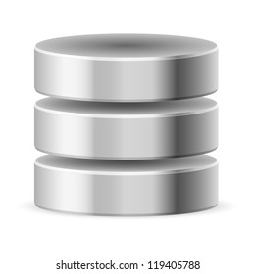
Main principle of the script (1)
Load csv’s into SQLite database
person_id | mo_meaning | mo_value | date
p001 | covid_test | pos | 20000101
p004 | covid_test | pos | 20000102
p002 | covid_test | pos | 20000103
p003 | covid_test | neg | 20000104
.csv
Delete date and id variables
person_id | mo_source | mo_value | date
p002 | bmi | 25 | 20200105
p003 | bmi | 23 | 20200106
Count duplicate rows
person_id | mo_meaning | mo_value | date | mo_source
p001 | covid_test | pos | 20000101
p004 | covid_test | pos | 20000102
p002 | covid_test | pos | 20000103
p003 | covid_test | neg | 20000104
p002 |  | 25 | 20200105 | bmi
p003 |  | 23 | 20200106 | bmi
Save as .rds
Advantage to use database
1 table per CDM table instead of multiple
Possibility to add indexes: https://www.brentozar.com/training/think-like-sql-server-engine/
You do not have to read the whole table if you need only a part of it
Less change of memory issues and no need for loops to prevent this giving unreadable code
For appending column names and order need to be alike
Create output

Slide 8
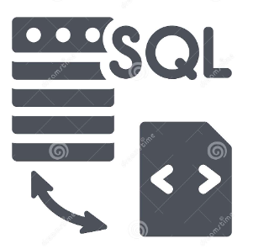
Main principle of the script (2)
Load csv’s into SQLite database
person_id | mo_meaning | mo_value | date | mo_source
p001 | covid_test | pos | 20000101
p004 | covid_test | pos | 20000102
p002 | covid_test | pos | 20000103
p003 | covid_test | neg | 20000104
p002 |  | 25 | 20200105 | bmi
p003 |  | 23 | 20200106 | bmi
Delete date and id variables
Count duplicate rows
mo_meaning | mo_value | mo_source
covid_test | pos
covid_test | pos
covid_test | pos
covid_test | neg
 | 25 | bmi
 | 23 | bmi
Save as .rds
Create output
Aim: id’s and dates are not relevant to asses the study variables

Slide 9
Main principle of the script (3)
Load csv’s into SQLite database
mo_meaning | mo_value | mo_source
covid_test | pos
covid_test | pos
covid_test | pos
covid_test | neg
 | 25 | bmi
 | 23 | bmi
Delete date and id variables
Count duplicate rows
mo_meaning | mo_value | mo_source | N
covid_test | pos |  | 3
covid_test | neg |  | 1
 | 25 | bmi | 1
 | 23 | bmi | 1
Save as .rds
Create output
Aim: by aggregation the amount of information reduces drastically
Better overview of what is in the data
Further coding is less cpu and memory demanding.
Note that, unfortunately, bmi in this example is not aggregated

Slide 10
Main principle of the script (4)
Load csv’s into SQLite database
mo_meaning | mo_value | mo_source | N
covid_test | pos |  | 3
covid_test | neg |  | 1
 | 25 | bmi | 1
 | 23 | bmi | 1
Delete date and id variables
Count duplicate rows
.rds
Save as .rds
Because the size of the files are reduced .rds files may be considered workable in terms of performance and the need of looping to prevent memory issues will not be expected. Therefore, it was considered that a sqlite database was less needed in this intermediate step.
The advantages of using rds files (which is also a matter of personal opinion)
Files are easier to access for an R user
Further coding is more flexible in R
Create output

Slide 11

Main principle of the script (5)
Load csv’s into SQLite database
Delete date and id variables
.csv/.rds
Count duplicate rows
Save as .rds
Create output
Minor modifications are made to come from the intermediate .rds to the output files. Post processing will be done on DRE because study specific information is needed (code lists/meta files).

Slide 12
Summary of the main steps of the script (1)
Set paths needed for the program (99_path.R)
Delete all output files in g_output folder
Load needed functions (IMPORT_PATTERN.R, GetColumnNamesCDM.R)
Load needed packages (packages.R)
Retrieve DAP name and instance date from CDM_SOURCE.csv for naming output files (GetInfoOutputFiles.R)
Get meta information from CDM. The excel from this location https://drive.google.com/file/d/1hc-TBOfEzRBthGP78ZWIa13C0RdhU7bK/view should is copied to p_meta and need to be refreshed if it is changed in the cloud. The table names and column names that are part of the common data model are retrieved from this file using the function GetColumnNamesCDM.R. This is done in the to_run.R row 62-81.
Determine which tables to analyze based on the variable t.interest and the retrieved information from step 6
Per CDM table that needs to be analyzed, it imports the csv’s, checks if column names are available and correct, and appends the table in a SQL database. (GetCounts.R). If column names are invalid, they are removed. If column names are missing then an empty column is added. This because appending requires equal table semantics.
Per CDM table, the data columns and id columns are cut of and 2 file types are created and saved as .rds file in g_intermediate (GetCounts.R). See next slide for examples
WHERECLAUSE: this is a file with distinct rows and a column (N) with the number of rows counted for that distinct row.
AWNSERS: here all the columns all the distinct values are stored and counted. This file can be prevented by setting GetCountsColumns <- F
Create outputs in .csv and .rds format (Step_002_CreateOutput). If PI’s want to access the files csv files are outputted. If only needed for further processing .rds files are outputted.
WHERECLAUSE (.csv): only action that is needed is setting counts less than 5 to “<5” because of privacy concerns
AWSERS (.csv): only action that is needed is setting counts less than 5 to “<5” because of privacy concerns
CODELIST: the code list files are focusing on the combination n of a coding system with a code and are analyzed on DRE to see if all expected codes are in the data.

Slide 13
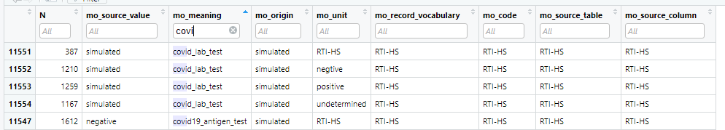
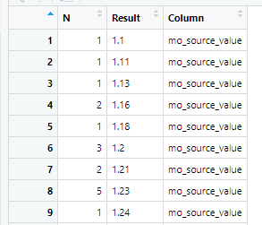
Step 9 main outputs
WHERECLAUSE
AWSERS

Slide 14
Further development opportunities
Since it is working on a distinct interface of the data some simple quality checks can be done via this set of tables with higher performance. This checks only report if an assumption is met or not and it is obliged to fix this.
If a simple set of assumptions is checked the level 1b may better to run before level 1 instead of after.
Replace the google drive file with the CDM description to GitHub
Split the script GetCounts.R in sub steps. First load sqlite database, then do the counts
Add indexes on sql database and see if it goes faster.
Detect continues values and delete them like id’s and dates (Use AI) OR standardize the CDM further
Save .rds file without date and dap name. these files are intermediate
TEMP/FILE/DATA are used as generic names in the code if it is a data frame on which the code continues working with. Change this to meaningful names if wanted.
Set used function to module
Estimating meta information using AI/chatgpt?

