Slide 1
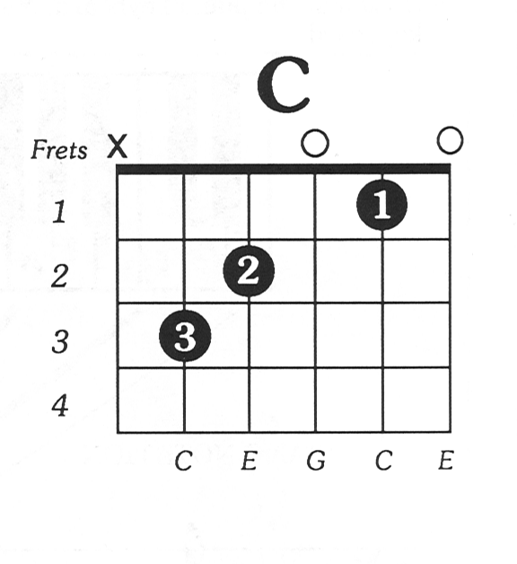
CHORD
Classifier of HOmologous Recombination Deficiency
Luan Nguyen
05/04/2019

Slide 2
Training

Slide 3
Training samples
Group | No. samples
BRCA1 | 25
BRCA2 | 65
none | 1042
Sum | 1132/3124
Samples originate from the Hartwig Medical Foundation (HMF)
BRCA1/2 deficient | BRCA proficient (‘none’)
For BRCA1 or BRCA2: Complete loss of the gene region, or LOH + pathogenic somatic mutation, or LOH + pathogenic germline mutation | For BRCA1 and BRCA2: No complete loss of the gene region, and No LOH, and
Mutations: Known pathogenic in ClinVar/ENIGMA; or Frameshift | Mutations: Benign somatic mutation or lower, or Germline missense mutation or lower

Slide 4
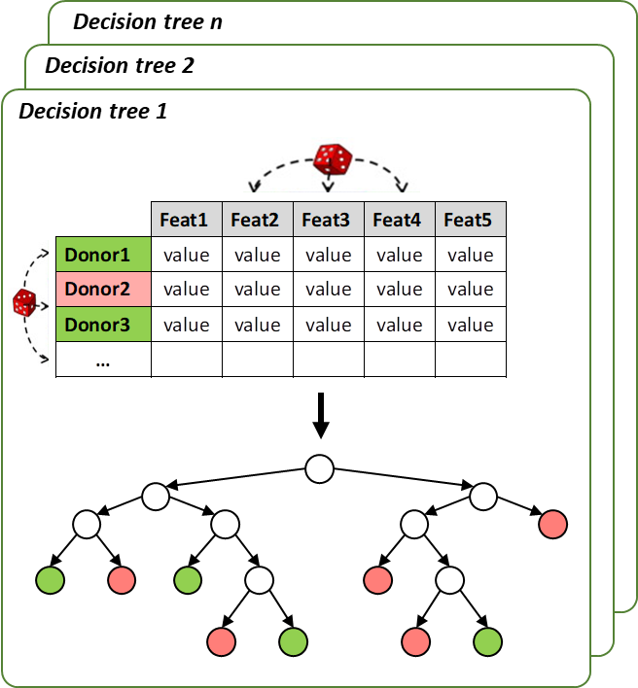
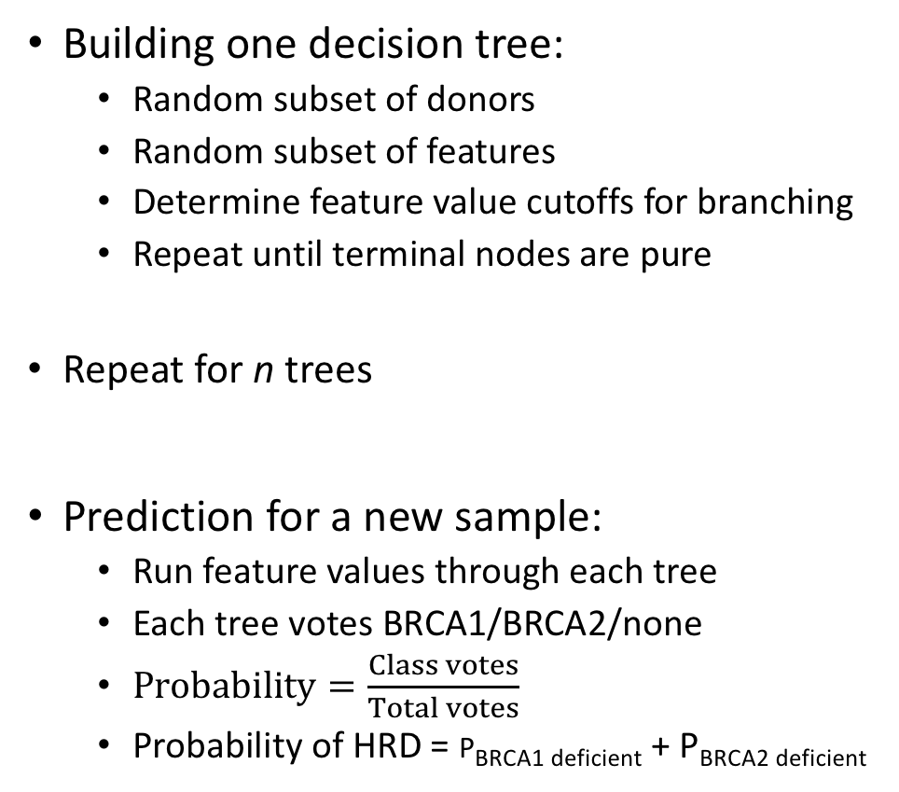
Random forest
Building one decision tree:
Random subset of donors
Random subset of features
Determine feature value cutoffs for branching
Repeat until terminal nodes are pure
Repeat for n trees
Prediction for a new sample:
Run feature values through each tree
Each tree votes BRCA1/BRCA2/none
$Probability=\frac{Class votes}{Total votes}$
Probability of HRD = P_{BRCA1 deficient} + P_{BRCA2 deficient}

Slide 5
Features
Type | Contexts | Features | No. features
SNV | Base substitution | C.A, C.G, C.T, T.A, T.C, T.G | 6
Indel | Indels within repeat regions Indels with flanking microhomology Other indels | ins.rep, del.rep: (within repeats) ins.mh, del.mh: (flanking microhomology) ins.none, del.none: (other) | 6
SV | SV type/length | DEL_0e00_1e03_bp DEL_1e03_1e04_bp DEL_1e04_1e05_bp DEL_1e05_1e06_bp DEL_1e06_1e07_bp DEL_1e07_Inf_bp … same for DUP and INV TRA (has no length) | 16
Used relative contribution (per variant type) to correct for differences in total mutational load across patients

Slide 6
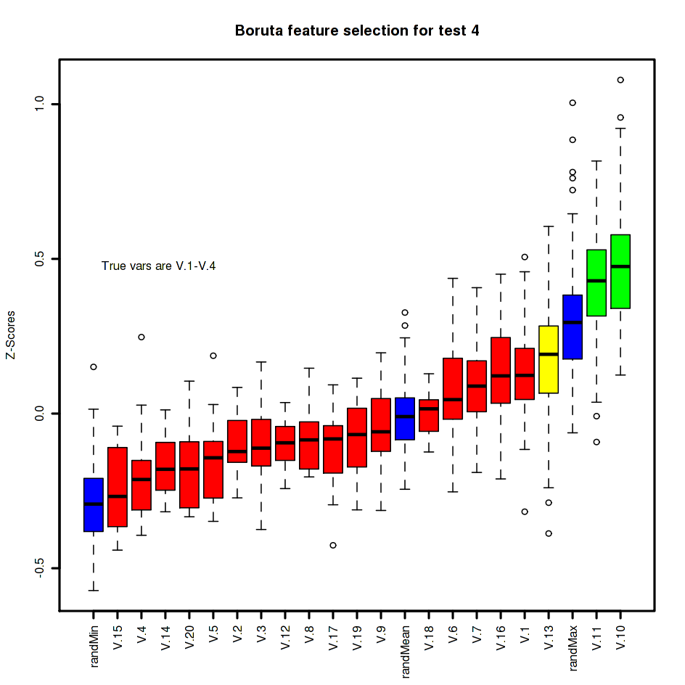
Training procedure
Univariate (t-test) feature selection
Keep positively correlated features with t-test p-value < 0.01 (BRCA1/2 vs none)
Remove negatively correlated features
Boruta feature selection
Up/downsample to deal with class imbalance
Try all combinations (with repeated 10-fold CV):
BRCA1: 1.00x (=no resampling), 0.50x, 0.25x
none: 1.00x, 1.50x, 2.00x
Pick the best based on AUC-PR
Train model with selected features and resampling parameters
Notes:
Boruta:
Create duplicate feature matrix
Shuffle values for each feature column → shadow feature columns
Get highest importance shadow feature → remove features with lower importance
Run multiple iterations

Slide 7
(Nested) Cross-validation
Split dataset in 10 by row (patients)
Test set
Training set
Assessing model performance
Predicting on 10 ‘fake’ new datasets
1
Create 10
train/test sets
…
2
10
Train and test
Training procedure
Predict on test set
Aggregate predictions
Classification statistics

Slide 8
Performance assessed by cross-validation

Slide 9
HRD prediction
Top to bottom, left to right
True positive/true negative rates
ROC curve
Feature importance
Precision, recall, F1 curves
Precision-recall curve

Slide 10
BRCA2 deficiency prediction

Slide 11
BRCA1 deficiency prediction

Slide 12
Predictions on datasets

Slide 13
Hartwig Medical Foundation dataset

Slide 14
External dataset (BRCA-EU)
All samples annotated as BRCA1/2 deficient from HRDetect paper above cutoff
BRCA1/2 deficiency prediction matches annotations
BRCA1/BRCA2 annotations from HRDetect paper

