Slide 1
Windy
Payload That Probably Measures Wind Speed and Direction
By: Rami Lameche

Slide 2
About the windy
Measures wind speed.
Measures wind direction.
Uses a differential pressure sensor and a normal pressure sensor.
It has an HC-05 module, which is used to communicate with it wirelessly for up to 100m (Easier to check if it’s working).
Has a Real Time Clock.
temperature module.
SD card reader.
Uses Arduino nano.

Slide 3
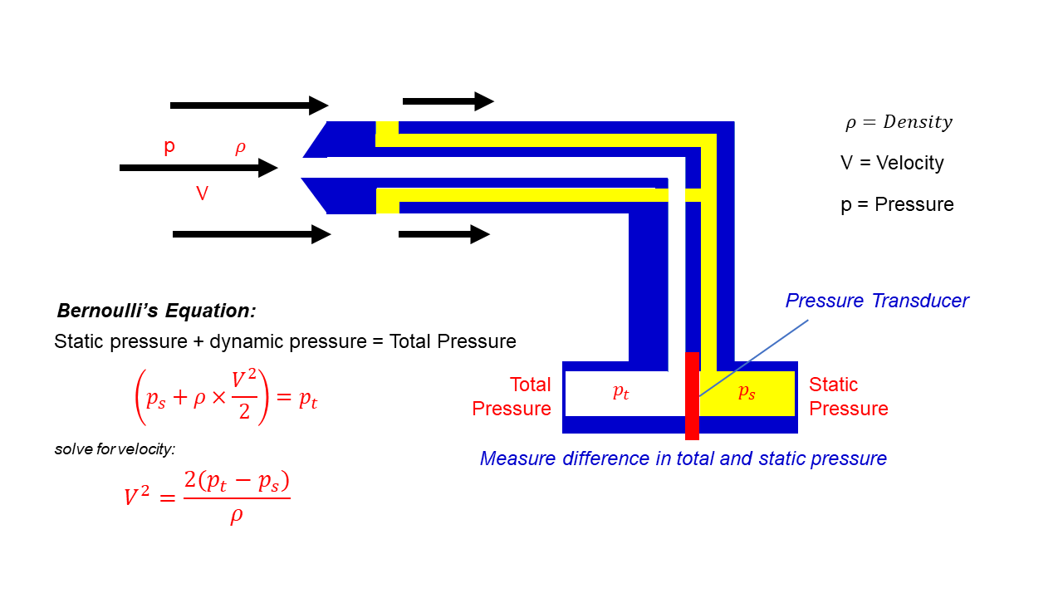
Wind velocity measurement
https://www1.grc.nasa.gov/beginners-guide-to-aeronautics/pitot-static-tube-speedometer/

