Slide 1



Hello Neighbor
Brown Datathon 2020
Citizens Home Financing Challenge
By: Jacob Zuliani, Josue N Rivera, Salvador Balkus, Linda Nguyen

Slide 2
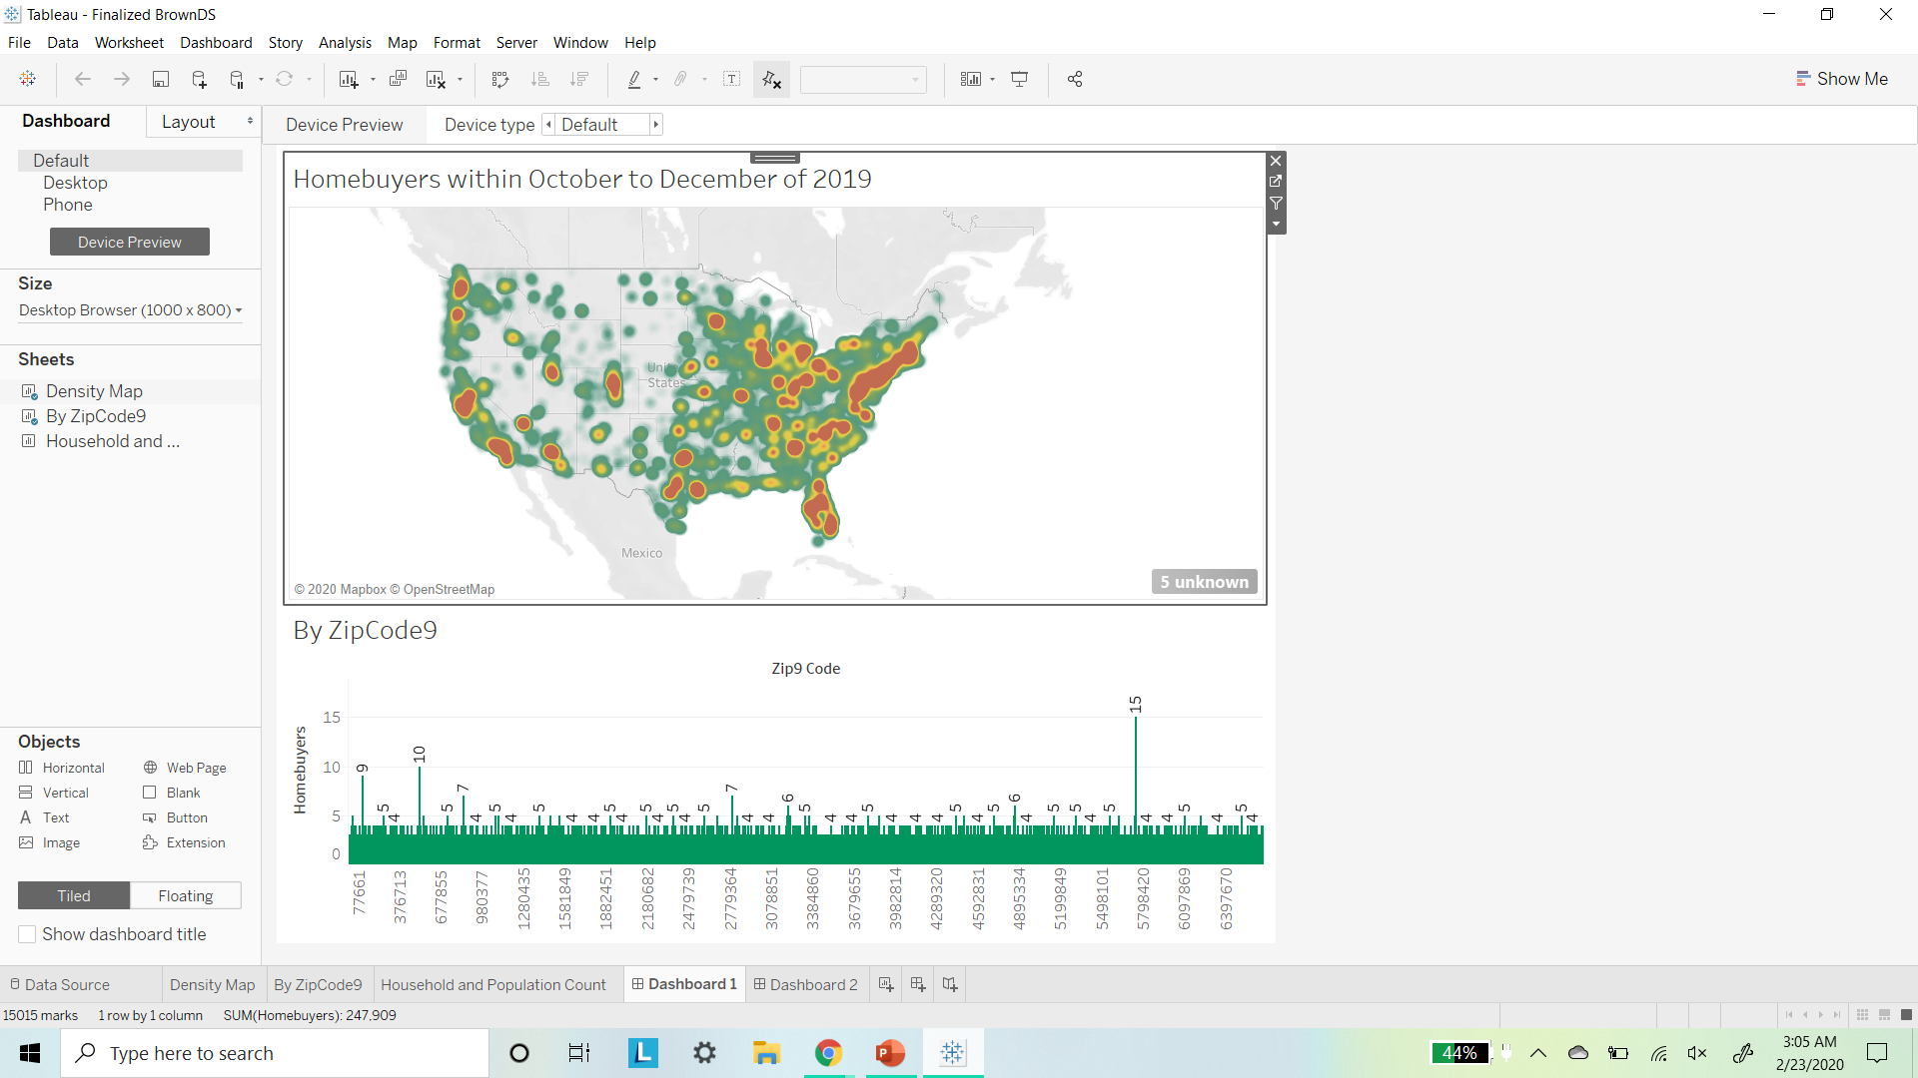

Slide 3
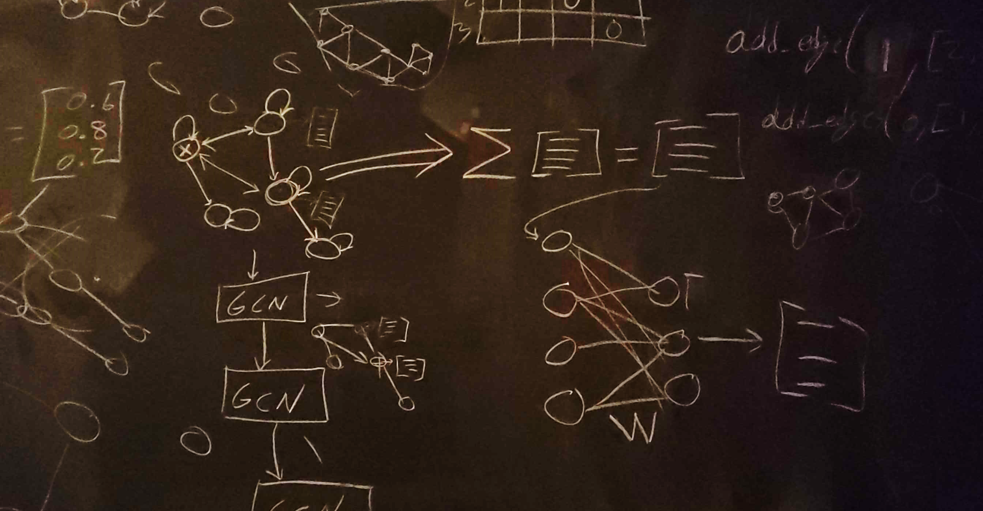

Slide 4
The End
Any Questions?

