Slide 1


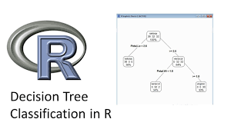
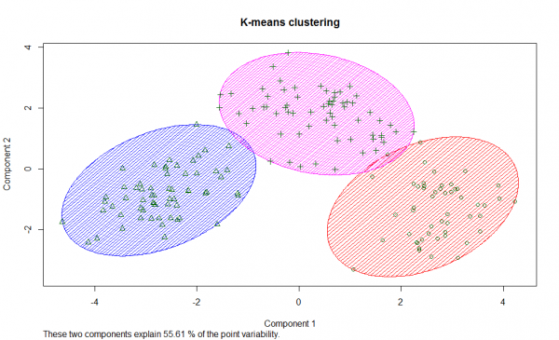
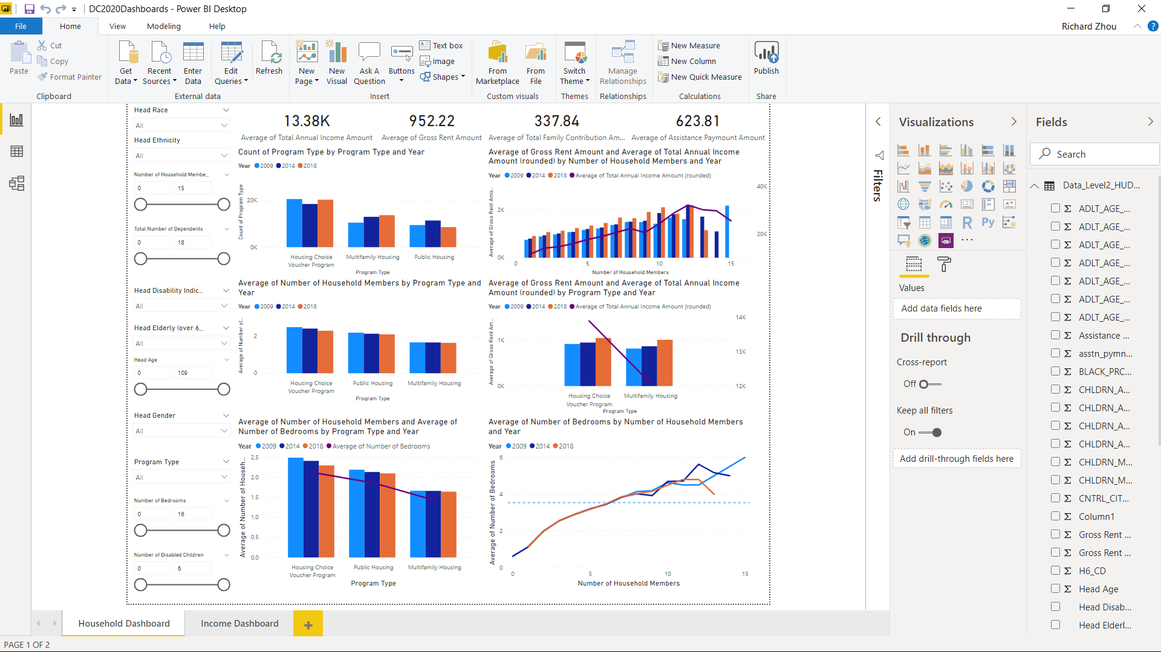
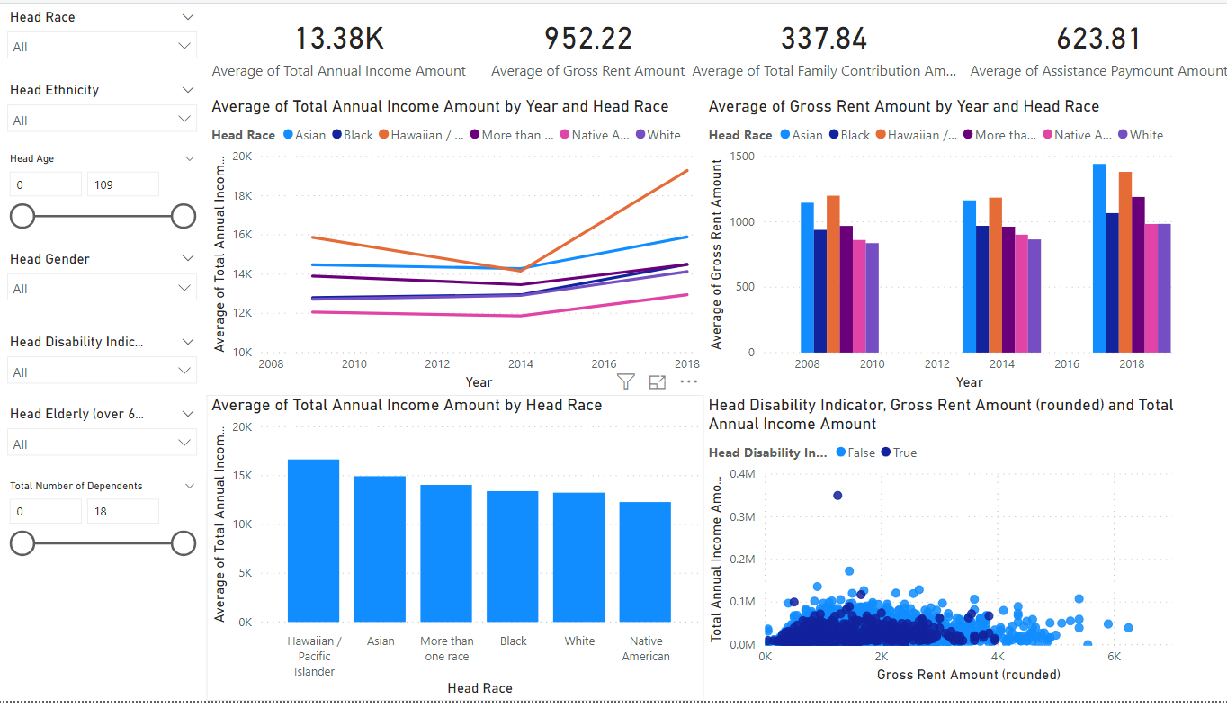
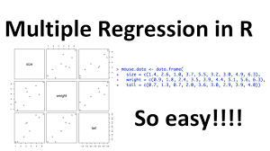

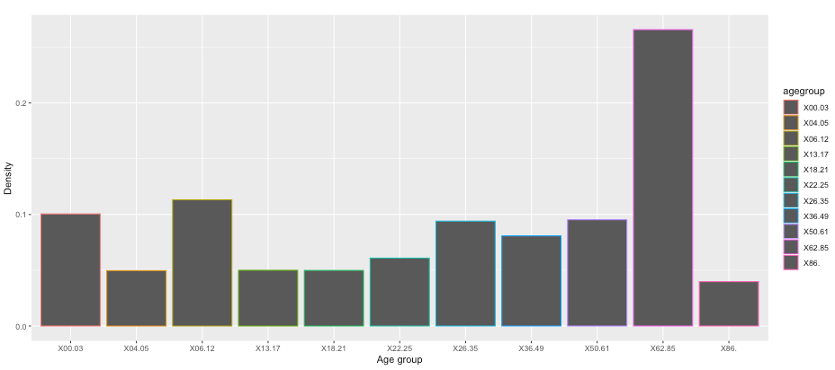
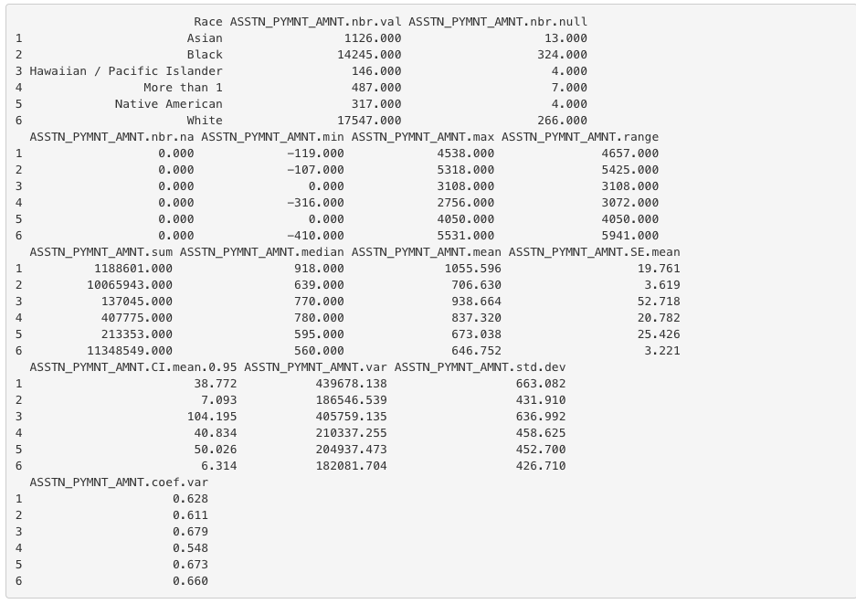
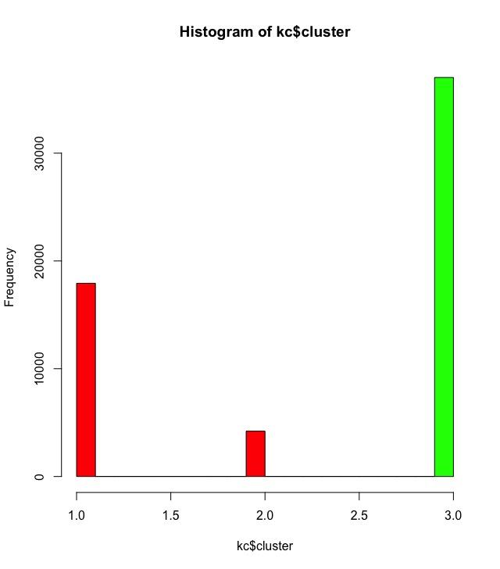
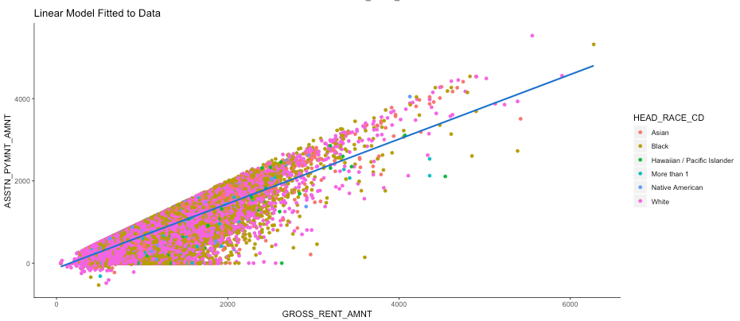
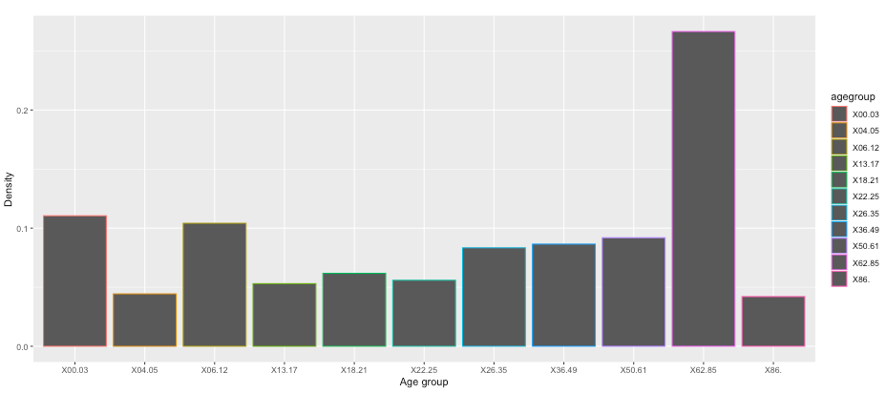
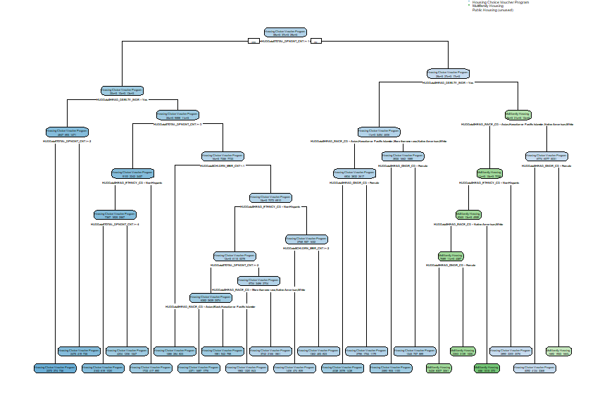
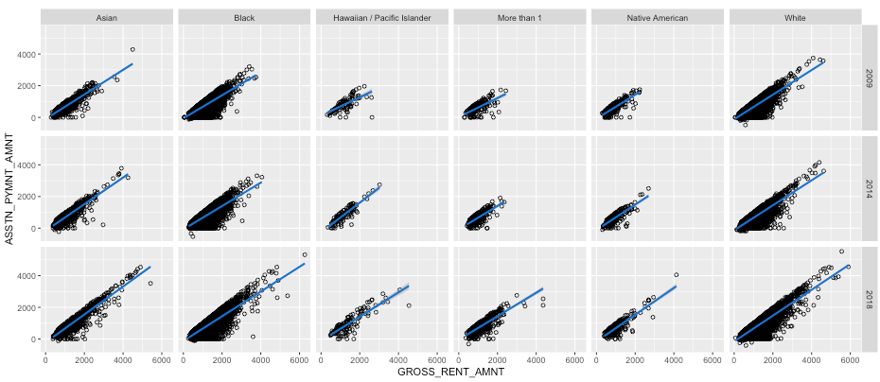

Economic and Social Sustainability: Housing and Urban Development: Housing Assistance Programs
Analysis by: Dacruz Norberto, Daniel Zhu, Richard Zhou, and Dr. Elizabeth Bonsignore
1
Exploratory Analysis in PowerBI
Problem and Scope Overview
How have the household characteristics (e.g., household composition, income, etc.) of HUD’s PH, MH, and HCV programs changed from 2009 to 2018?
The team’s primary end-goal aims to determine data and policy recommendation for HUD regarding mitigate any gaps in the composition of public-housing assistance recipients in the program. In addition, the team will use predictive analytic techniques to forecast if:
Program vouchers will be able to defray the cost of rising housing costs continuing to cover 60% of costs with linear regression
Use Decision Analysis to determine uncover business rules and patterns in those receiving public housing
Predict the composition of applicants/recipients for each program type in the next five years
Team 20047 extrapolated several sub-questions from this initial framing is tied to HUD’s strategic initiatives, and asking:
Can we predict what sorts of households will either need more assistance or no longer be able to afford their rent, even with assistance?
What are differences and trends (if any) regarding the HCV program,
The team created exploratory and statistical dashboards to view changes over time for each HUD assisted housing programs, performed machine learning to answer the questions above, and suggested recommendations based on the results produced by this analysis.
.
3
Machine Learning Analysis in R
Household Dashboard
Income Dashboard
Users can view Household and Income Dashboards in PowerBI.
Use data filters to derive insights to answer questions about the data
All visualizations will update on each dashboard as each filter is applied
Each dashboard displays averages as the relate to each assisted housing program type
The team conducted Decision Tree Analysis, Cluster Analysis, and Linear Regression to find associations amongst the data and predict rent amounts as well as HUD assistance payments for the next 5 years
2
Statistical Analysis in R Shiny
4
Results/Recommendations/Conclusion
Users can use R Shiny interface to view the statistical spread of data points as they relate to the demographic makeup of each assisted housing program type
Measures of dispersion (Statistics)
View is limited to data points relevant to the analysis performed by the team (not all data provided)
University of Maryland Data Challenge https://datachallenge.ischool.umd.edu/ hcil.umd.edu

Slide 2
Economic and Social Sustainability: Housing and Urban Development: Housing Assistance Programs
PowerBI Exploratory Analysis Dashboards
LIVE DEMO OF POWERBI
Household Dashboard
Income Dashboard
University of Maryland Data Challenge https://datachallenge.ischool.umd.edu/ hcil.umd.edu

Slide 3
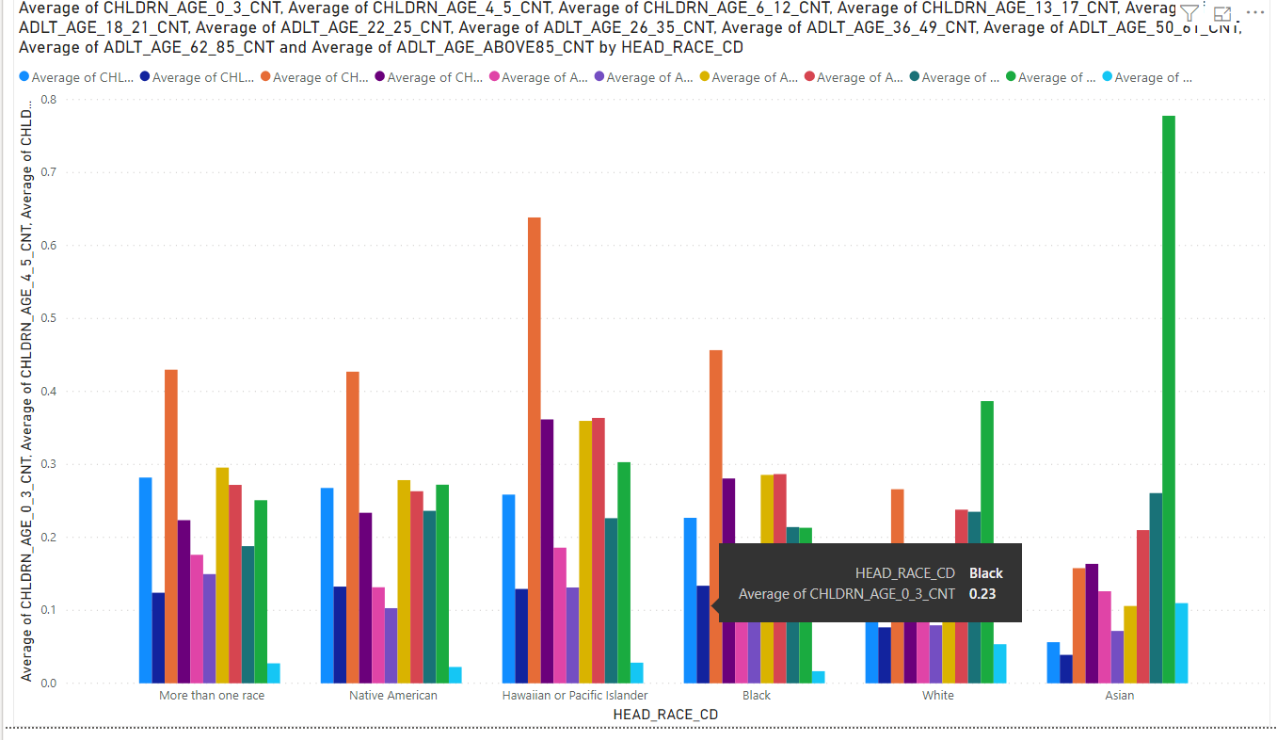
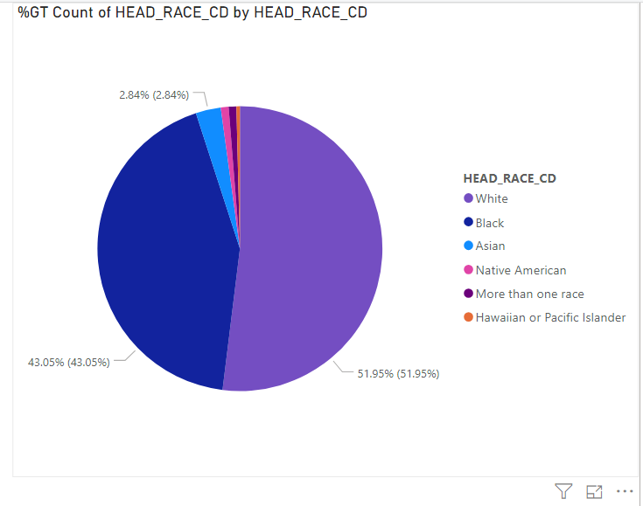
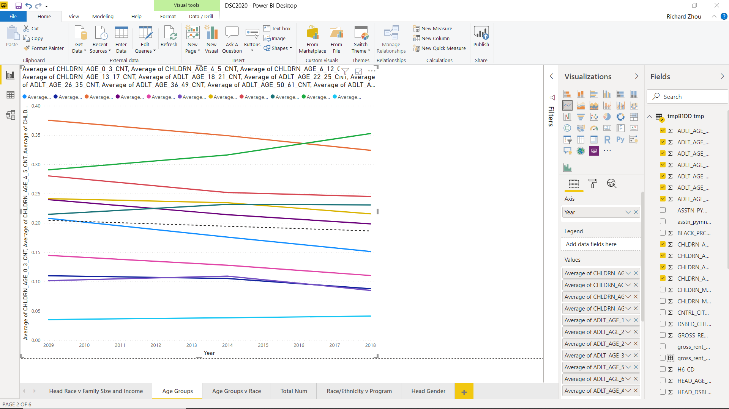
Economic and Social Sustainability: Housing and Urban Development: Housing Assistance Programs
PowerBI Exploratory Analysis Additional Figures
University of Maryland Data Challenge https://datachallenge.ischool.umd.edu/ hcil.umd.edu

Slide 4
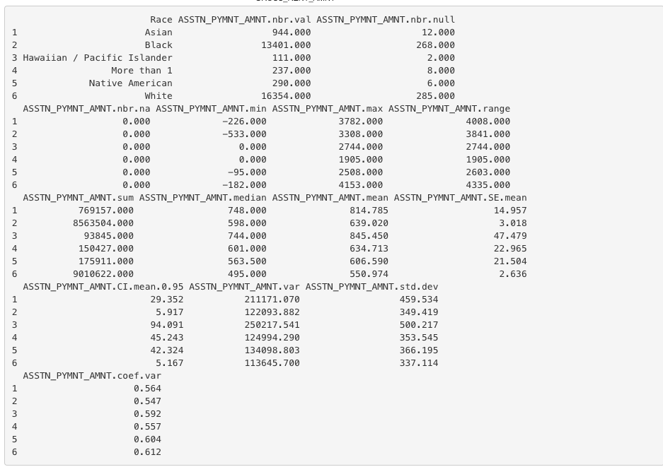
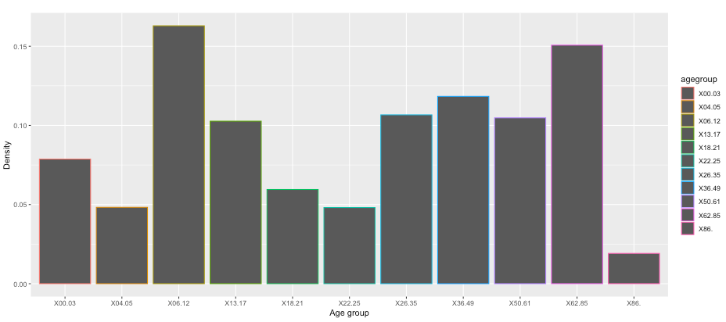
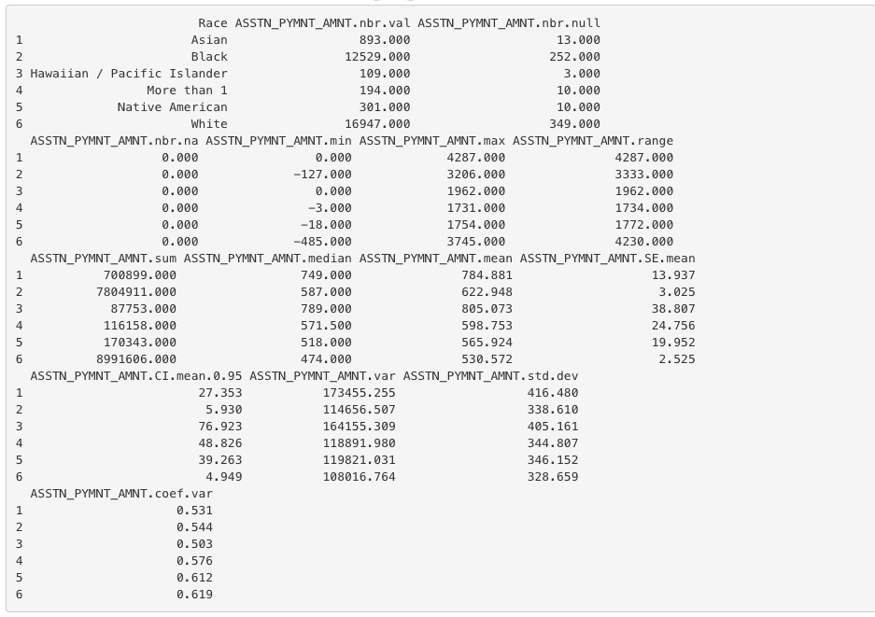
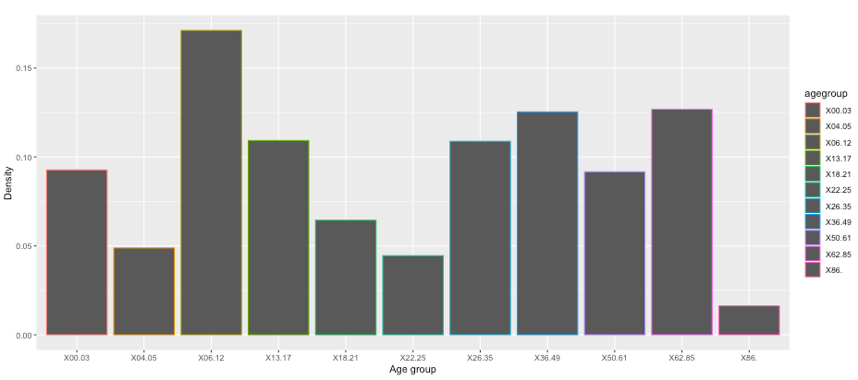
Economic and Social Sustainability: Housing and Urban Development: Housing Assistance Programs
R Shiny App Infographics - Gross Rent vs HUD Payment Linear Regression Prediction
LIVE DEMO OF R-SHINY DASHBOARD
University of Maryland Data Challenge https://datachallenge.ischool.umd.edu/ hcil.umd.edu

Slide 5
Economic and Social Sustainability: Housing and Urban Development: Housing Assistance Programs
Data Analysis: Decision Trees Analysis
University of Maryland Data Challenge https://datachallenge.ischool.umd.edu/ hcil.umd.edu

Slide 6
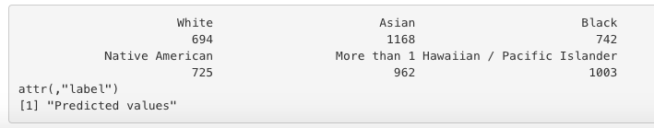
Economic and Social Sustainability: Housing and Urban Development: Housing Assistance Programs
R Shiny App Infographics - Gross Rent vs HUD Payment Linear Regression Prediction
R-SHINY PREDICTIONS
Average Assisted Payment Amounts by Race for all Programs
University of Maryland Data Challenge https://datachallenge.ischool.umd.edu/ hcil.umd.edu

Slide 7
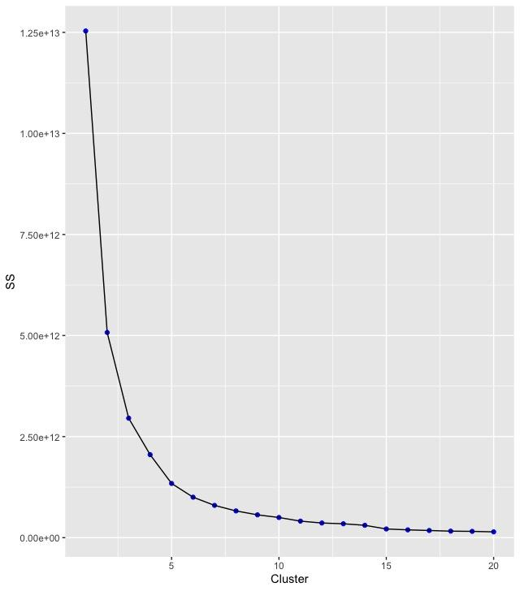
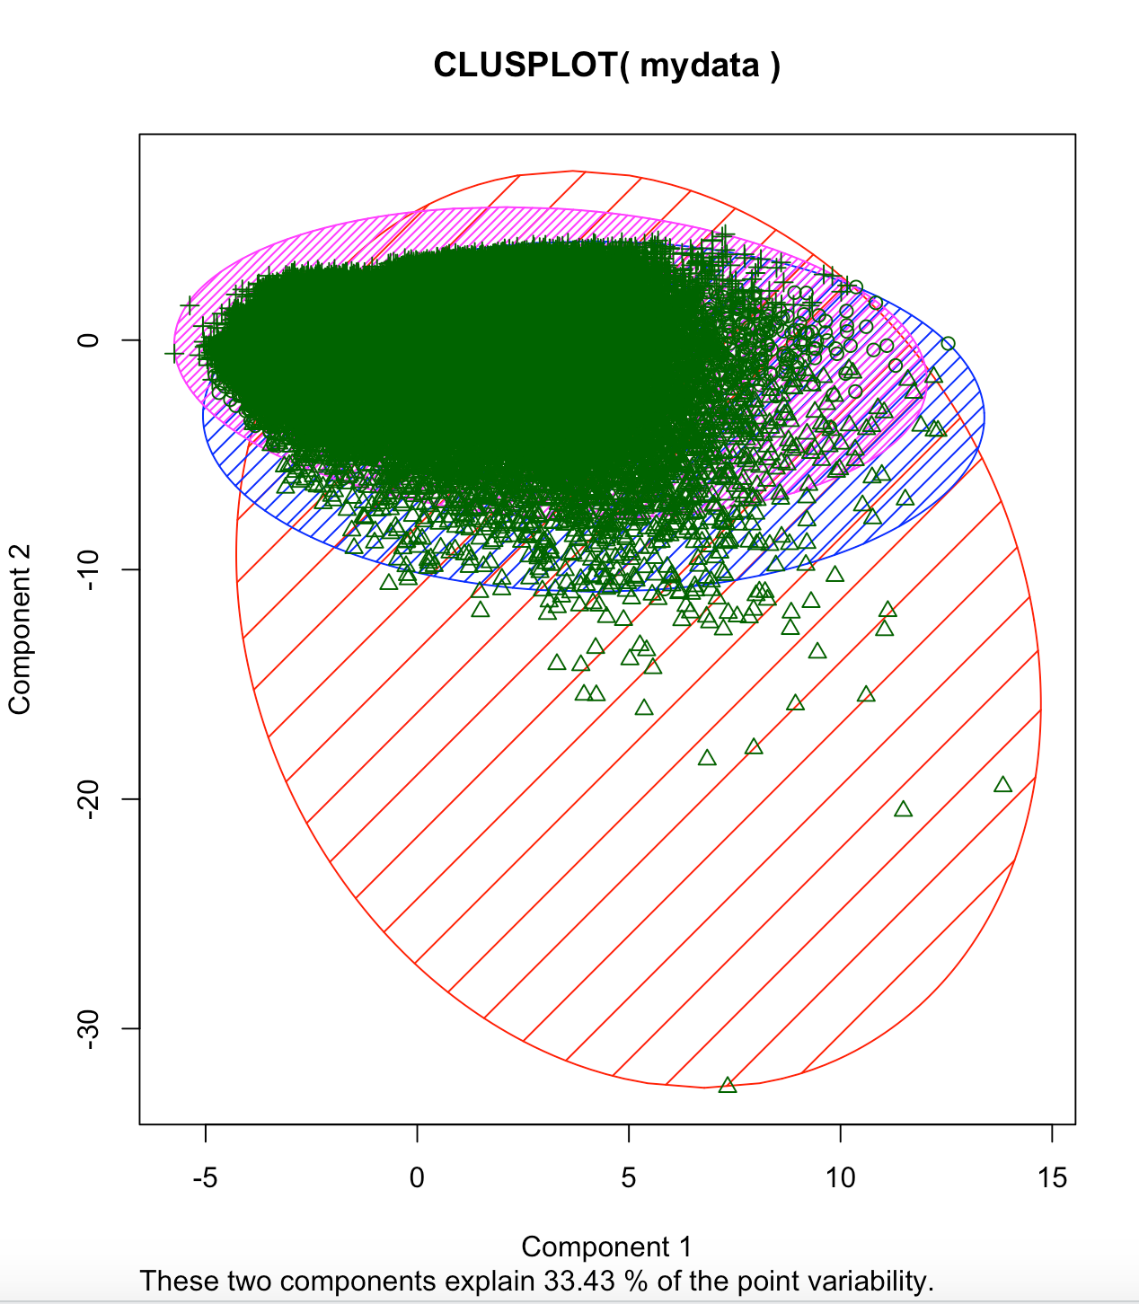
Economic and Social Sustainability: Housing and Urban Development: Housing Assistance Programs
K-means Clustering Analysis
University of Maryland Data Challenge https://datachallenge.ischool.umd.edu/ hcil.umd.edu

Slide 8
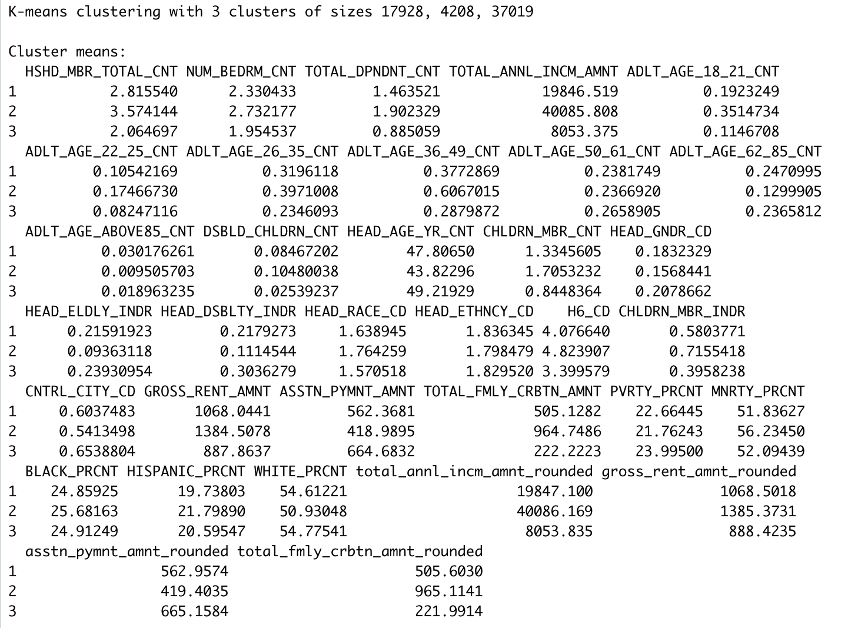
Economic and Social Sustainability: Housing and Urban Development: Housing Assistance Programs
K-means Clustering Analysis
University of Maryland Data Challenge https://datachallenge.ischool.umd.edu/ hcil.umd.edu

