Slide 1
IBM University Engagement Project Submission
“Exploring the Power of Agentic AI with IBM Granite and IBM Bob”

Slide 2

Project Tile – InterviewIQ – Agentic AI Interview Trainer
Domain of Project – Education
Student Name | Recent Passport Photo | Email ID | Mobile number [WhatsApp]
GANGADHARAM UMESH KRISHNAA |  | gangadharamumeshkrishnaa2006@gmail.com | 9949831679

Slide 3
Problem Statement -
Problem Statement: InterviewIQ – Agentic AI Interview Trainer
The Challenge
Interview preparation is often generic, repetitive, and disconnected from the candidate’s actual profile and target role. Candidates may practice random interview questions without knowing which skills they need to improve, how well their answers perform, or what questions are relevant to a specific job description. Personalized feedback and adaptive interview practice are also difficult to obtain without a dedicated interviewer.
The Objective
Build an AI-powered Agentic Interview Trainer that provides personalized, role-specific, and adaptive interview preparation using the candidate’s resume, target role, and job requirements. The solution should:
• Resume-Based Candidate Profiling – Analyze the candidate’s resume using IBM Granite to extract skills, experience, projects, technologies, and other relevant information.
• Job Description Analysis – Analyze the target job description to identify required skills, responsibilities, technical domains, and role expectations.
• Skill Gap Matching – Compare the candidate profile with job requirements to identify strengths, missing skills, and areas requiring improvement.
• Personalized Interview Preparation – Generate an interview strategy and questions based on the candidate’s background, target role, job requirements, and identified skill gaps.
• RAG Knowledge Retrieval – Retrieve relevant information from a curated Interview Knowledge Base containing technical domains, role expectations, behavioral and HR guidance, interview best practices, adaptive interviewing rules, and answer-evaluation criteria.
• Agentic Adaptive Interview – Use watsonx Orchestrate to conduct an interactive interview that dynamically selects the next question and adjusts difficulty based on the candidate’s responses.
• Multi-Domain Interviewing – Evaluate candidates across:
• IBM Cloud & AI Integration – Leverage IBM Granite, watsonx.ai, watsonx Orchestrate, Prompt Lab, and IBM Cloud to build a secure and scalable agentic AI interview-training solution

Slide 4
Proposed Solution -
Proposed Solution: AI-Powered InterviewIQ Agent
The proposed solution is an AI-powered Interview Trainer built using IBM Granite, watsonx.ai, watsonx Orchestrate, and IBM Cloud. It helps candidates prepare for interviews based on their resume, target role, and job description.
The system uses AI and RAG to retrieve relevant interview knowledge and generate personalized questions, feedback, and preparation guidance.
The solution includes:
Candidate Profiling – Analyzes the resume and extracts skills, projects, experience, and technologies.
Job Analysis – Analyzes the job description and identifies required skills and responsibilities.
Skill Gap Analysis – Compares the candidate's skills with the job requirements and identifies areas for improvement.
Adaptive Interview Agent – Uses watsonx Orchestrate to conduct technical, behavioral, and HR interviews and adjust questions based on the candidate's answers.
RAG Knowledge Base – Retrieves relevant interview guidelines, role expectations, technical topics, behavioral guidance, and evaluation criteria.
Answer Evaluation – Evaluates candidate responses and provides scores, strengths, weaknesses, and improvement suggestions.
Performance Report – Provides an overall interview assessment and a personalized improvement roadmap.
The application uses Next.js and React for the web interface, IBM Granite for AI-powered analysis, and watsonx Orchestrate for agentic interview workflows.
Overall, InterviewIQ provides a personalized and adaptive interview experience that helps candidates practice, understand their weaknesses, and improve their interview performance.

Slide 5
Technology Used
• IBM Bob platform – Used for designing and developing the InterviewIQ application and implementing the AI-powered workflow.
• IBM Granite Model – Granite 4.0 H Small – Used for resume analysis, candidate profiling, job description analysis, and AI-powered reasoning.
• IBM Cloud – Provides the secure and scalable cloud infrastructure required to run and integrate the AI services.
• RAG – Used to retrieve relevant interview knowledge first and then generate grounded questions and feedback, making the interview more relevant and reliable.
• IBM watsonx.ai – Used to access and integrate IBM Granite models for AI-powered analysis and generation.
• IBM watsonx Orchestrate – Used to manage the agentic interview workflow, adaptive questioning, RAG retrieval, answer evaluation, and personalized feedback.
• Interview Knowledge Base – Contains role expectations, technical topics, behavioral and HR guidelines, interview best practices, and answer-evaluation criteria for RAG retrieval.
• Next.js & React – Used to build the web-based InterviewIQ interface for resume upload, interview sessions, questions, answers, and feedback.
• IBM watsonx Prompt Lab – Used for developing and testing prompts for the AI components.

Slide 6
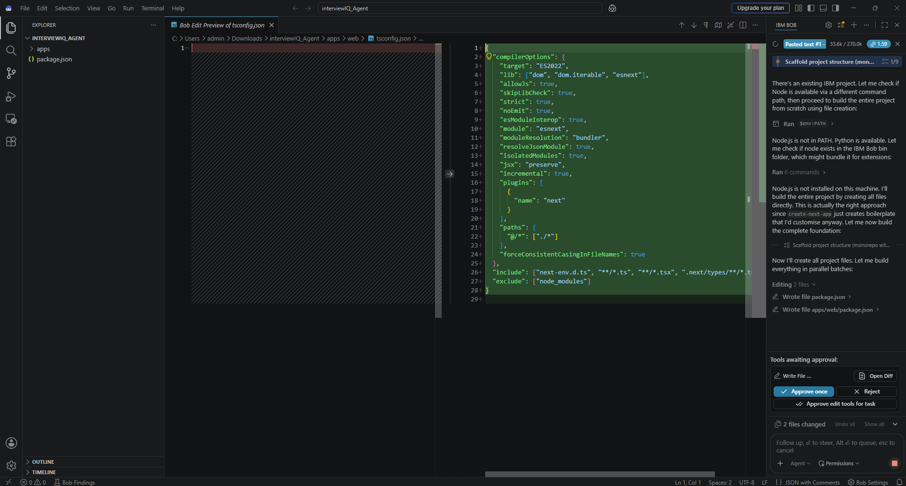
Required Files created using IBM bob -

Slide 7
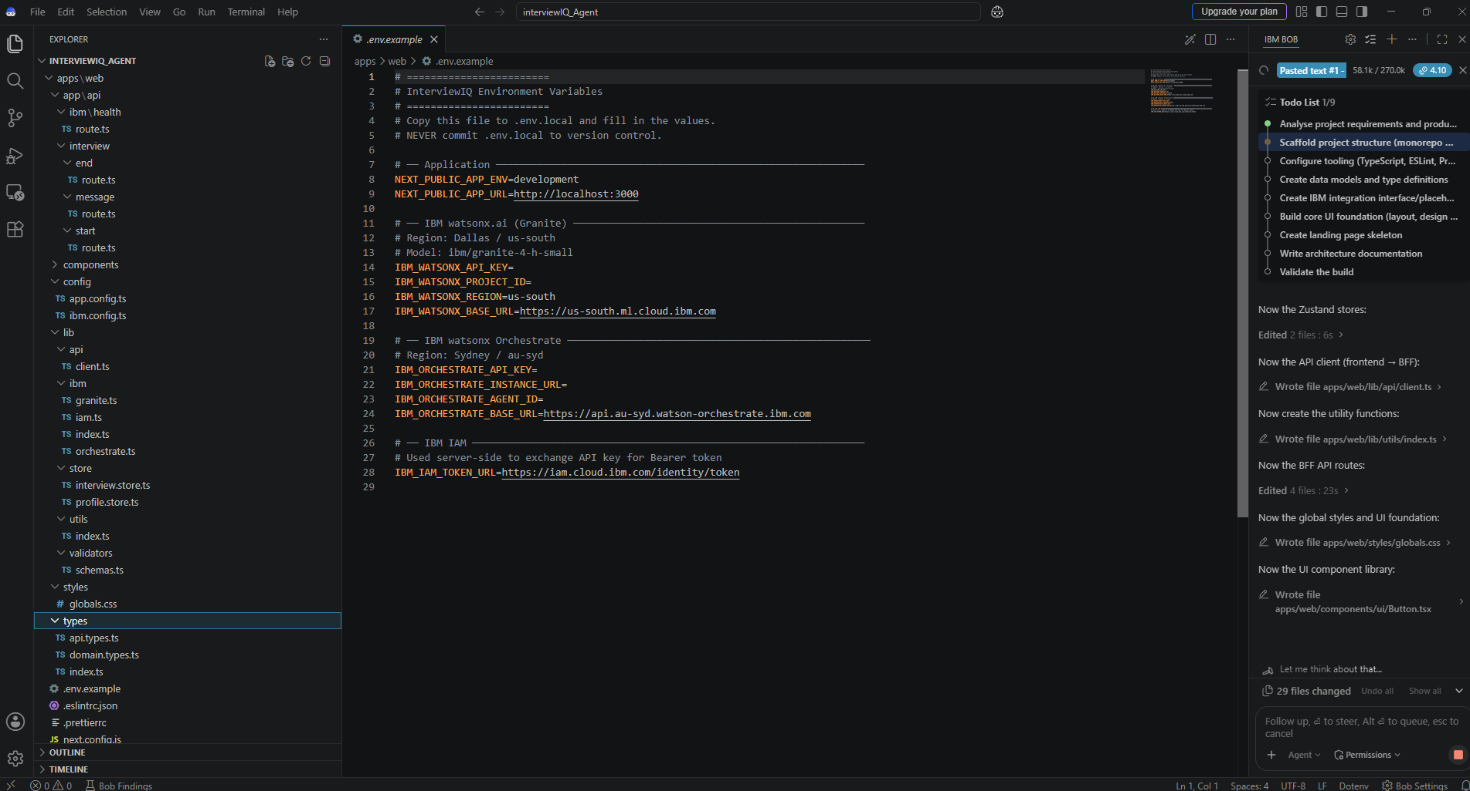
IBM Bob Screenshots:

Slide 8
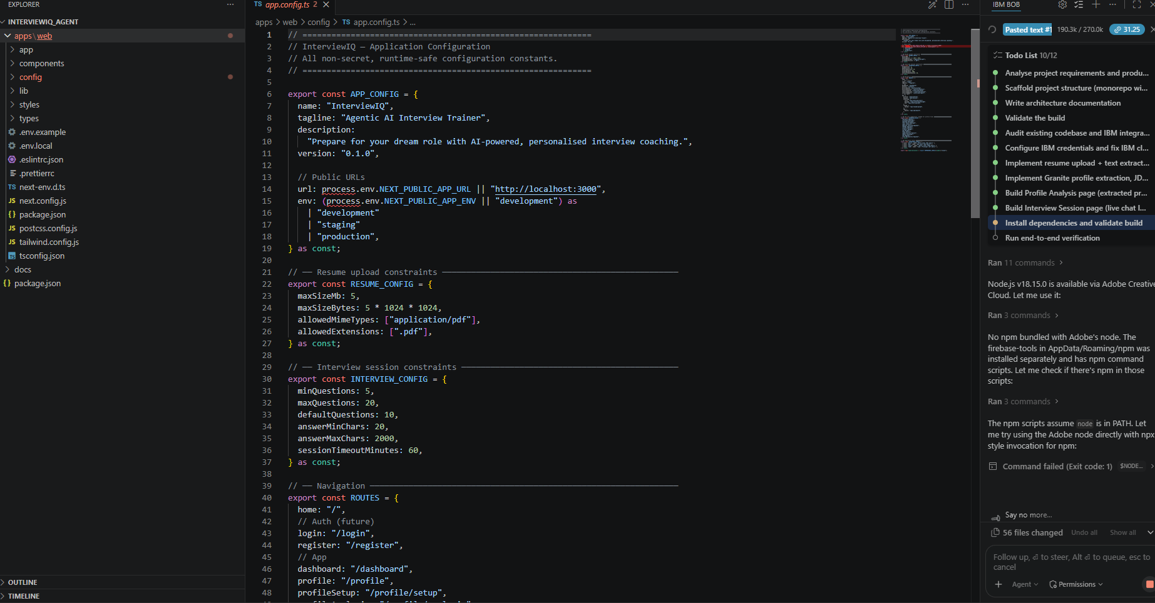

Slide 9
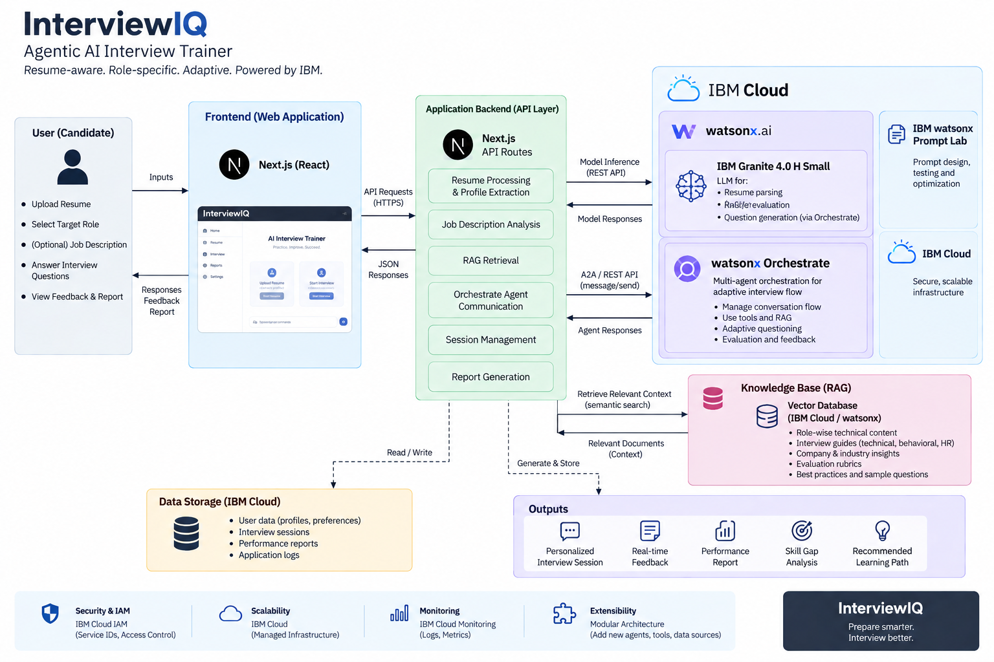
Architecture blueprint for IBM bob:

Slide 10

Role of Agentic AI in the solution
Role of Agentic AI in InterviewIQ
Agentic AI enables InterviewIQ to work as an intelligent and adaptive interview trainer rather than a simple chatbot. Using IBM watsonx Orchestrate and IBM Granite, it coordinates different AI capabilities to provide personalized interview preparation.
The system performs different tasks such as analyzing the candidate’s resume, analyzing job requirements, generating interview questions, evaluating answers, and providing feedback.
Agentic AI provides context awareness, using information such as the candidate’s skills, projects, experience, target role, and job description to make the interview more relevant.
It also supports real-time adaptation. Based on the candidate’s answers and performance, InterviewIQ can adjust the difficulty and type of the next question.
The RAG knowledge base provides relevant interview knowledge, role expectations, technical topics, behavioral guidance, and evaluation criteria to support accurate and relevant responses.
Overall, Agentic AI makes InterviewIQ personalized, adaptive, and goal-driven, acting like a smart digital interview coach that helps candidates practice and improve their interview performance.
.

Slide 11
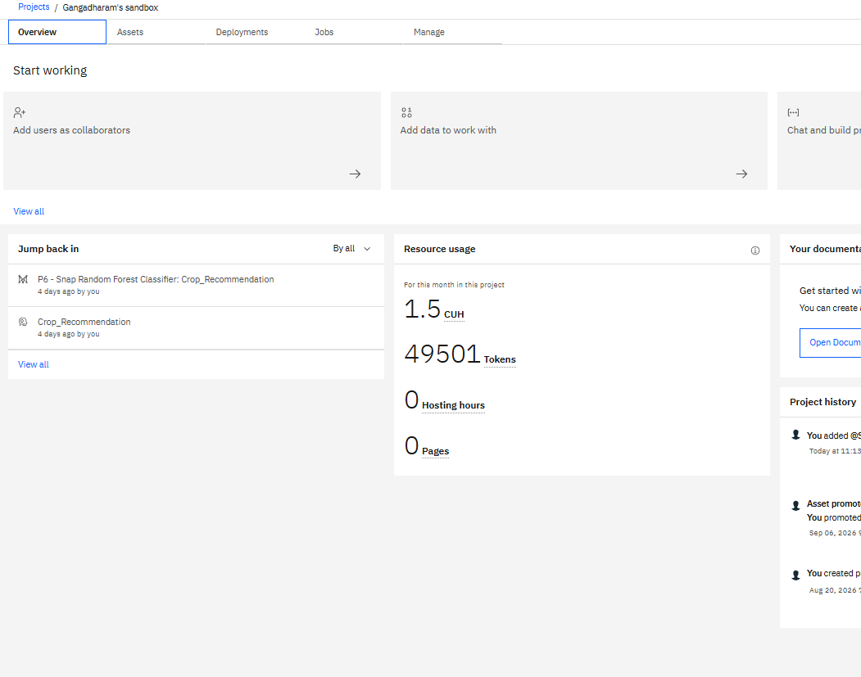
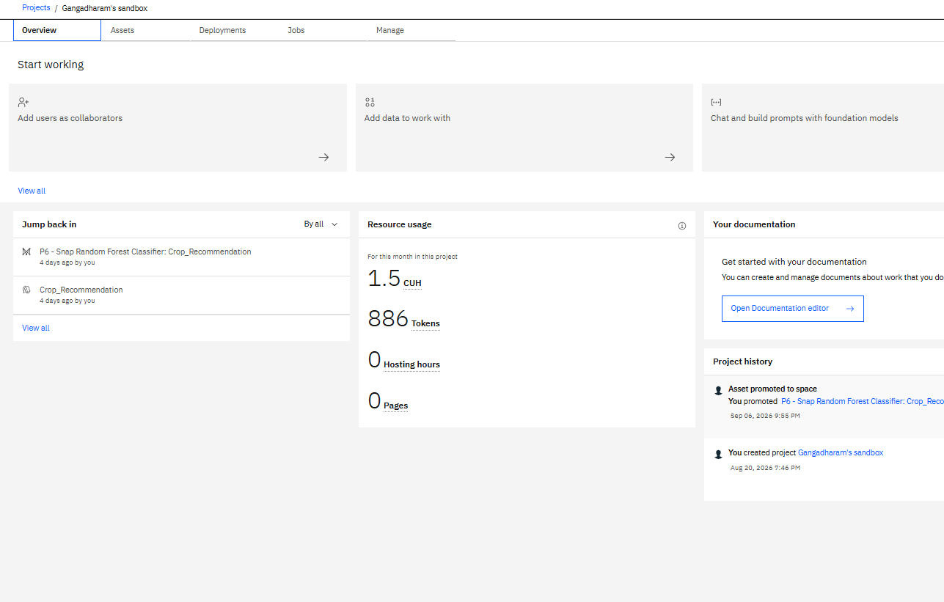
Token Usage
11,761 token are used
Before Prompt
After the Prompt
·
·
·

Slide 12
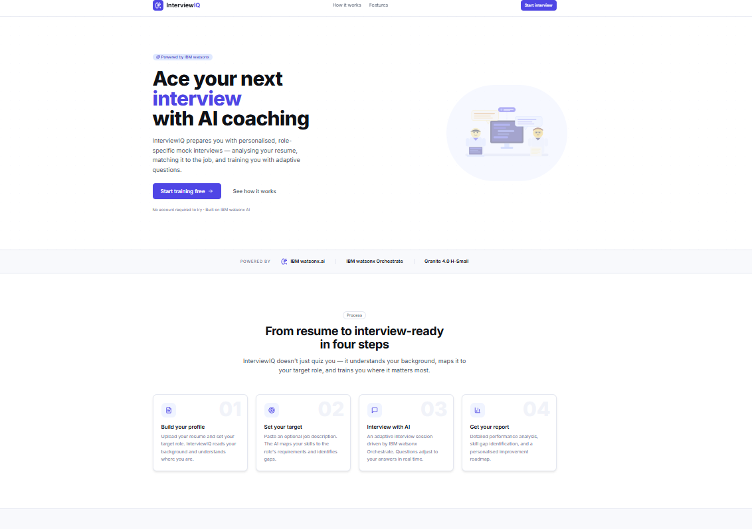
Project Output Screenshot
·
·
·

Slide 13
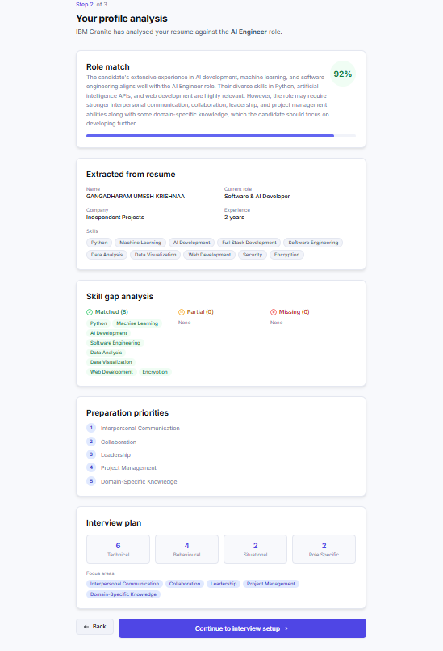
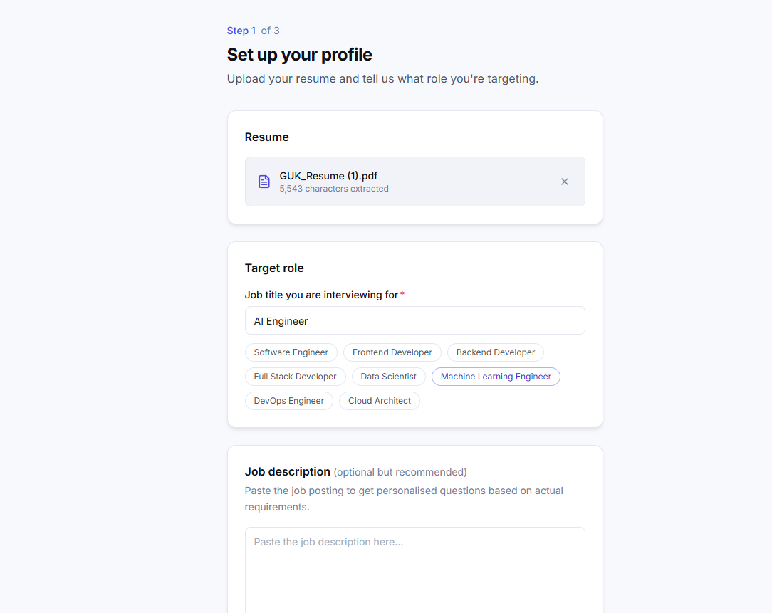
Project Output Screenshot
·
·
·

Slide 14
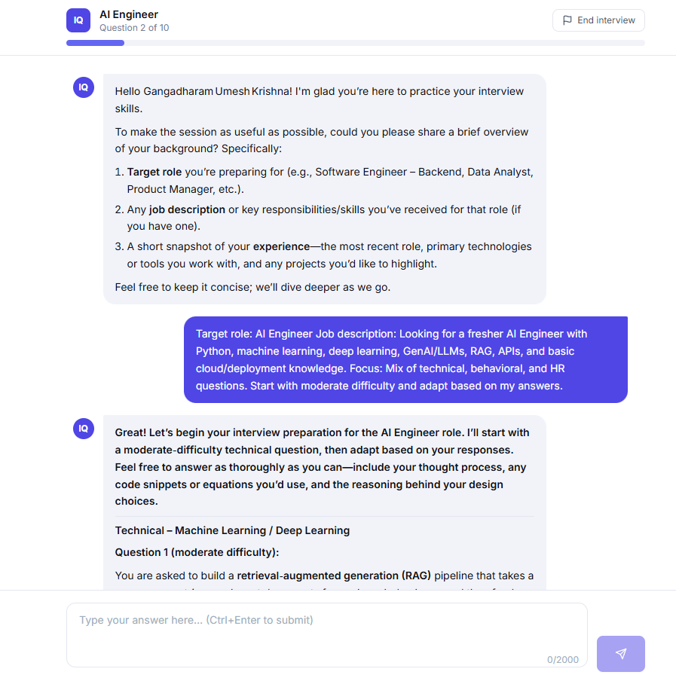
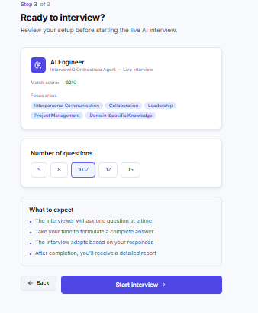
Project Output Screenshot
·
·
·

Slide 15
Novelty and Uniqueness
What Makes InterviewIQ Unique
The proposed InterviewIQ solution stands out by combining Agentic AI, RAG, and personalization into a single intelligent interview-training system.
Agentic Interview Intelligence – Uses AI agents to conduct interviews, evaluate answers, and adapt the next question based on the candidate’s performance.
RAG-Based Accuracy – Retrieves relevant interview knowledge, role expectations, and evaluation guidelines before generating questions and feedback.
Personalized Preparation – Tailors the interview based on the candidate’s resume, target role, job description, skills, and experience.
Adaptive Interview Flow – Continuously adjusts the question type and difficulty based on the candidate’s answers.
Multi-Domain Assessment – Evaluates technical, behavioral, and HR skills in a single interview session.
AI-Powered Feedback – Provides scores, identifies strengths and weaknesses, and gives actionable improvement suggestions after candidate responses.
Personalized Improvement Roadmap – Identifies skill gaps and recommends areas the candidate should focus on to improve interview performance.
IBM-Powered & Scalable – Built using IBM Granite, watsonx.ai, watsonx Orchestrate, and IBM Cloud, providing a reliable foundation for an AI-powered interview platform.
This makes InterviewIQ a smart, adaptive, and personalized AI interview coach, rather than just a static interview-question generator.

Slide 16
Git Hub Link
Github URL –https://github.com/UMESHKRISHNAA2006/InterviewIQ-Agentic-AI-Interview-Trainer
·
·
·

Slide 17
Future Scope
1. Voice-Based AI Interview & Multilingual Support –
The system can be enhanced with a voice-enabled interviewer that allows candidates to answer questions naturally through speech. Support for multiple languages can make InterviewIQ more accessible to candidates from diverse backgrounds.
2. Advanced Interview Analytics –
The system can provide detailed analytics on technical skills, communication, confidence, answer quality, and performance trends, helping candidates track their improvement over multiple interview sessions.
3. Company-Specific Interview Preparation –
InterviewIQ can be enhanced to analyze company-specific job descriptions, interview patterns, and role expectations to provide more targeted preparation for companies such as Microsoft, NVIDIA, Salesforce, and others.
4. Continuous Candidate Progress Tracking –
Future versions can maintain a candidate's interview history and track skill improvement, recurring weaknesses, and progress over time, creating a long-term personalized preparation plan
·
·
·

Slide 18
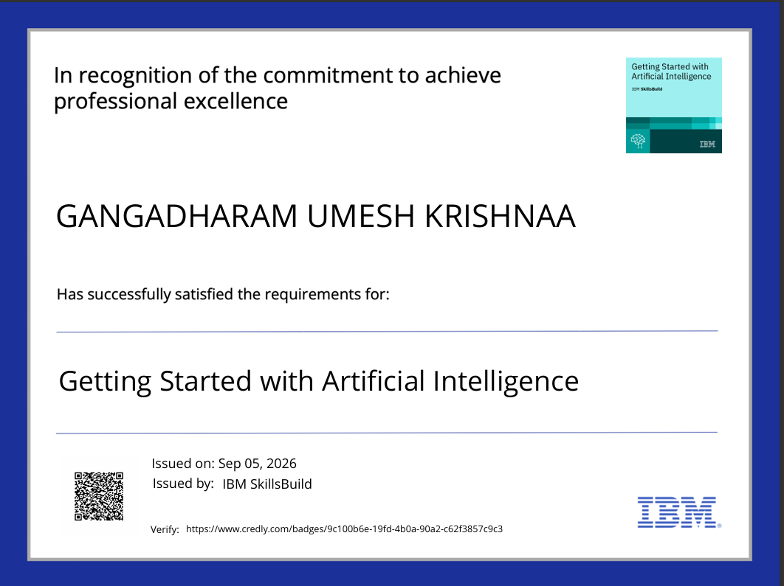
Certificates Earned:
Getting Started with Artificial Intelligence

Slide 19
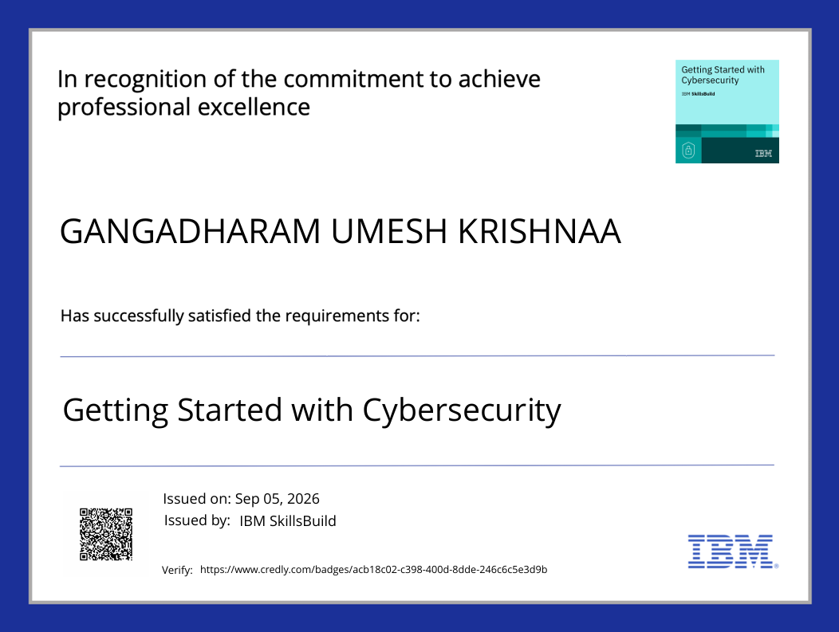
Certificates Earned:
Getting Started with Cybersecurity

Slide 20
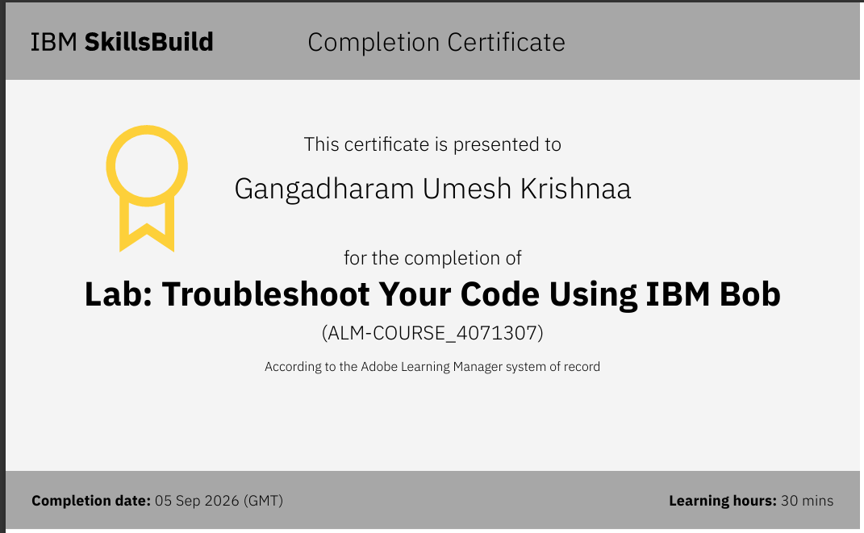
Certificates Earned:​
IBM BOB Certificate

Slide 21


