Slide 1
M
Mise
An AI-native inventory management system for professional kitchens
UMGC · CMSC 495 Capstone · Summer 2026
Dan Nunes · Robert Lee · Adan Medina · Spencer Renfro · Arth Thakkar · JJ Escandor
Notes:
We're the team behind Mise, an AI-native inventory management system built for our UMGC CMSC 495 capstone. Over the next few minutes we'll cover the problem, the MVP we built, a walkthrough of the application, the architecture, and what we learned.

Slide 2



THE PROBLEM
Kitchens lose money to what they can't see
Food waste
Over-ordering
No operational visibility
Ingredients expire before they're used. The cost is real but rarely visible until it's already lost.
Without reliable stock and par-level data, ordering is guesswork — surplus becomes waste.
Menu decisions are made without knowing what's actually on hand or what's about to expire.
Mise targets the gap between what a spreadsheet records and what a kitchen actually needs to act on.
Notes:
Restaurants and small food businesses lose money in three predictable ways: ingredients expire before they're used, stock gets over-ordered, and menu decisions are made without visibility into what's on hand. Mise targets the gap between what a spreadsheet records and what a kitchen needs to act on.

Slide 3



THE SOLUTION
Mise — a smart inventory dashboard, delivered as an MVP
Tracks what matters
Quantity, par level, and expiration for every ingredient — with low-stock and expiring-soon items flagged automatically.
AI-suggested dishes
Recommends dishes that use up at-risk ingredients before they become waste. A rule-based fallback keeps the feature working if the AI is unavailable.
Server-computed truth
Stock status, at-risk value, and dish availability are computed on the server — every screen shows the same numbers.
Honest framing: Mise is an MVP — a working foundation with clear room to grow, not a finished production platform.
Notes:
Mise is a smart inventory dashboard for kitchen managers. It tracks quantity, par levels, and expiration dates, and automatically flags what's low or about to expire. The AI layer recommends dishes that use up at-risk ingredients, with a deterministic rule-based fallback if the AI is unavailable. All business logic is computed on the server, so every screen shows the same trustworthy numbers. To be clear about scope: what we're presenting is an MVP — a strong working foundation, not a finished production platform.

Slide 4
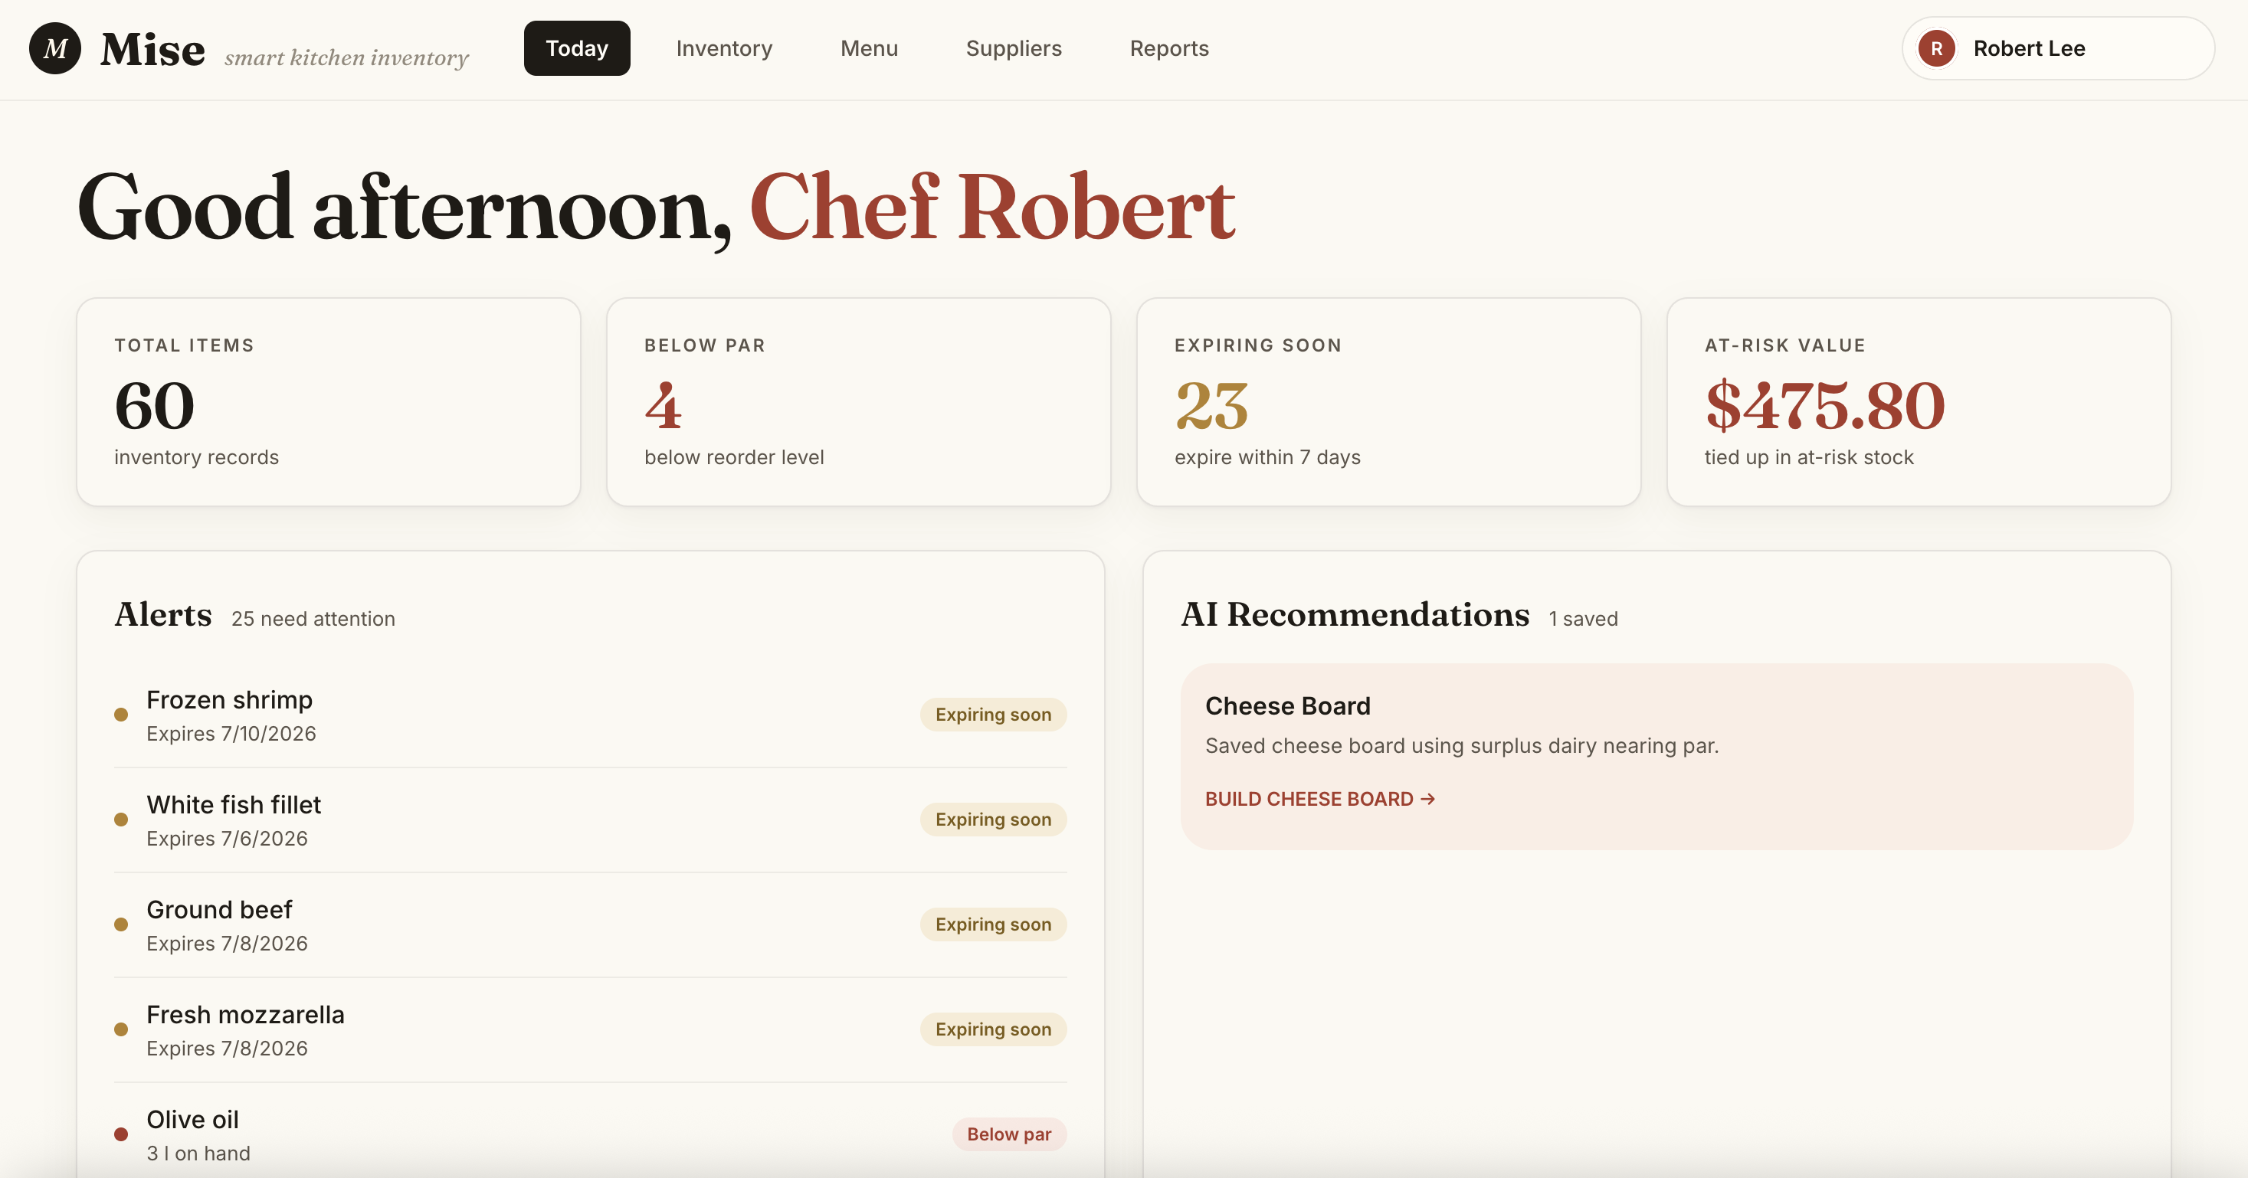
APPLICATION · 1 OF 5
Today — the daily operating view
KPIs, live alerts for expiring and below-par items, and saved AI recommendations — computed from inventory data, not manually flagged.
Notes:
A manager signs in through Firebase authentication and lands on the Today view: total items tracked, items below par, items expiring within seven days, and the dollar value currently at risk. The alerts panel lists the specific items driving those numbers. Nothing here is manually flagged — it's computed live from the inventory data.

Slide 5
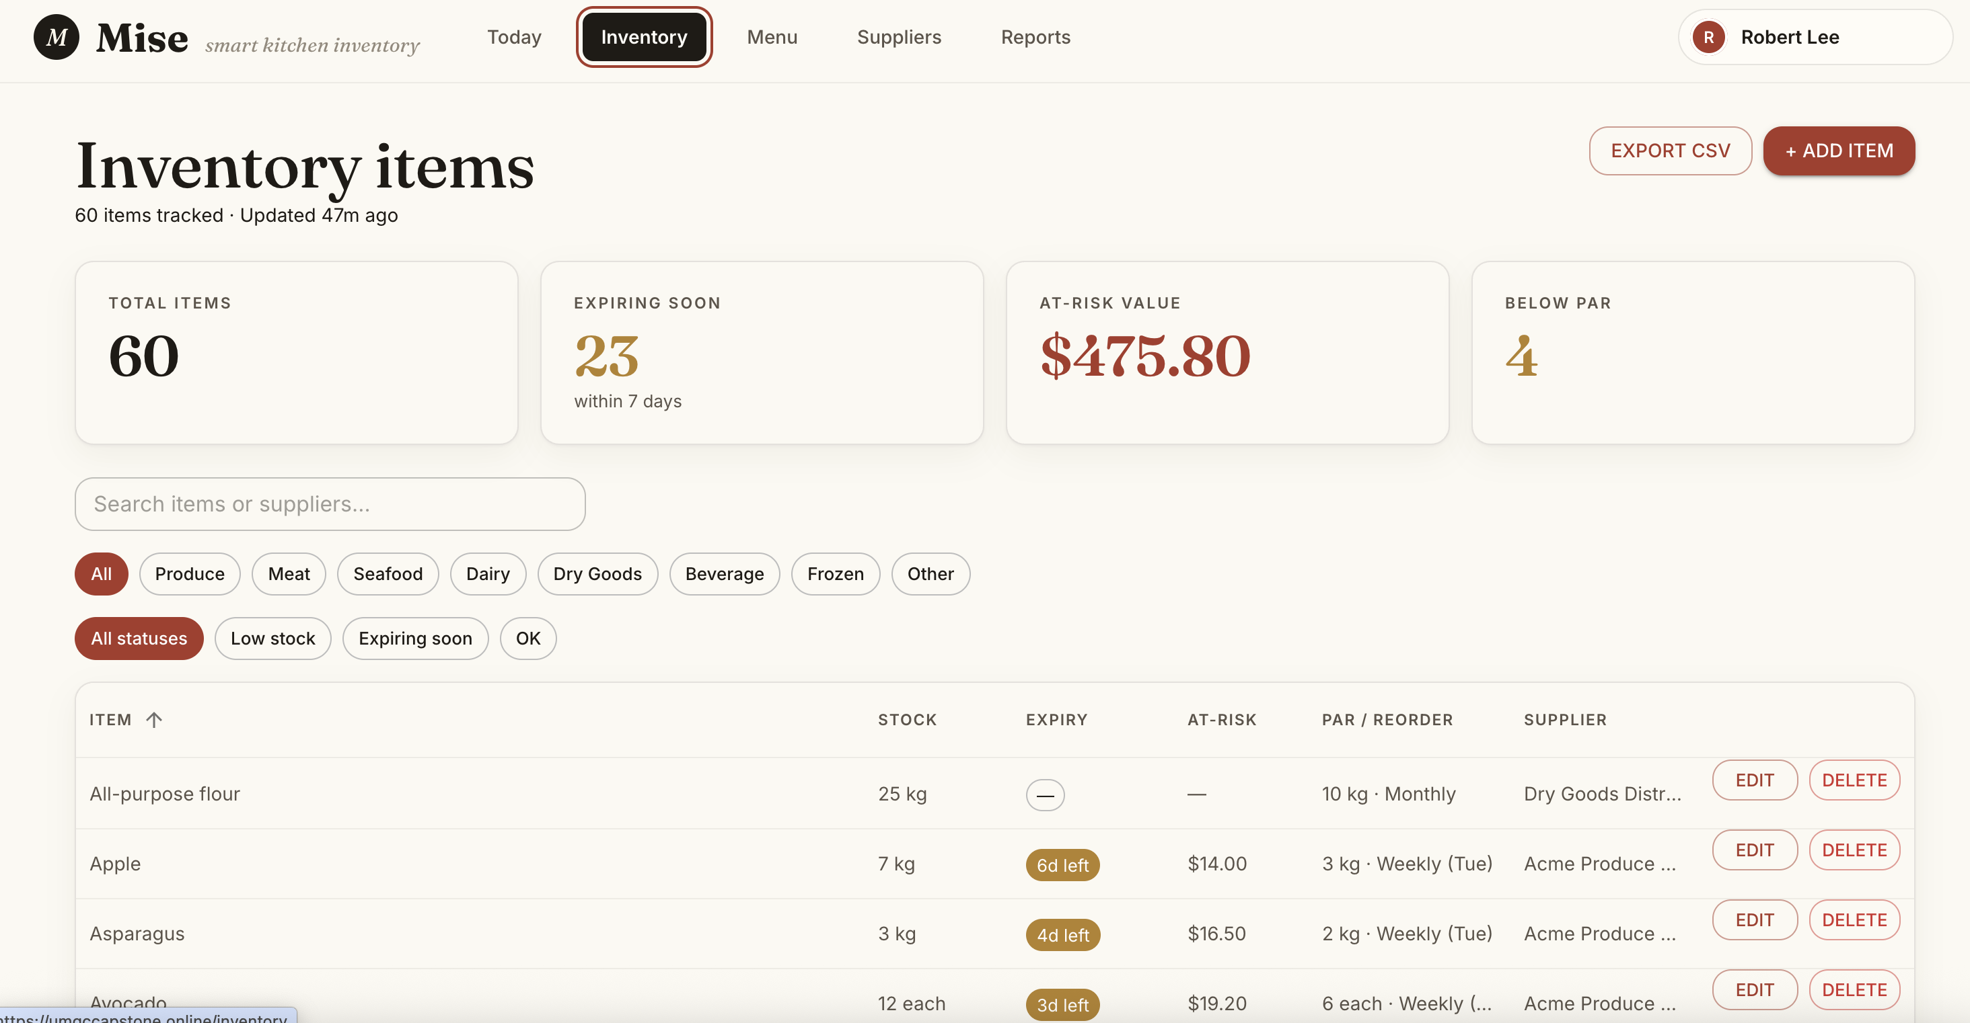
APPLICATION · 2 OF 5
Inventory — one source of truth
Add, edit, and filter ingredients by category or status. Every row shows the same server-computed status as the dashboard.
Notes:
On the Inventory page the manager can add, edit, and filter ingredients — by category, low stock, or expiring soon. Each row shows the same server-computed status seen on the dashboard, so there's no disconnect between screens. Inventory can also be exported to CSV.

Slide 6
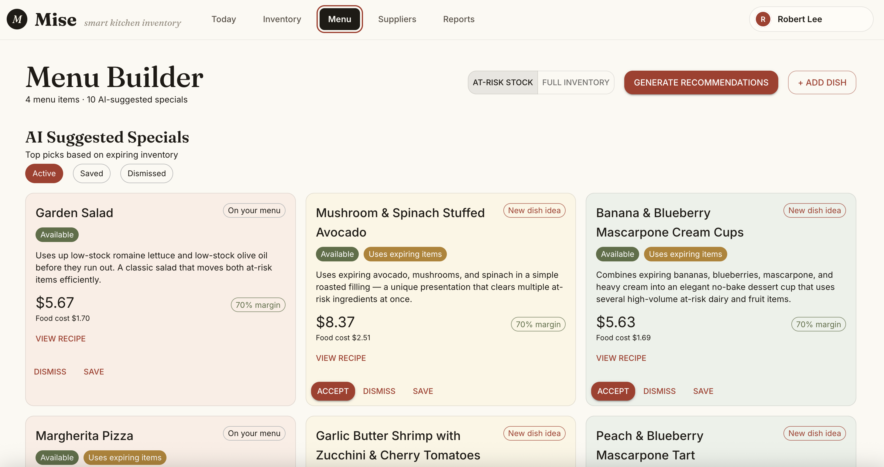
APPLICATION · 3 OF 5
Menu Builder — AI-suggested specials
Each suggestion names the dish, the at-risk ingredients it uses, cost and margin, and why it makes sense now. Fallback suggestions are clearly labeled.
Notes:
The Menu Builder is where the AI comes in. Mise sends the current at-risk inventory to the model and gets back dish suggestions — name, ingredients, food cost and margin, and a short explanation of why the dish makes sense right now. The manager can accept, save, or dismiss each one. If the AI is unreachable, a rule-based fallback produces a suggestion through the same flow, clearly labeled so nothing is hidden from the user.

Slide 7
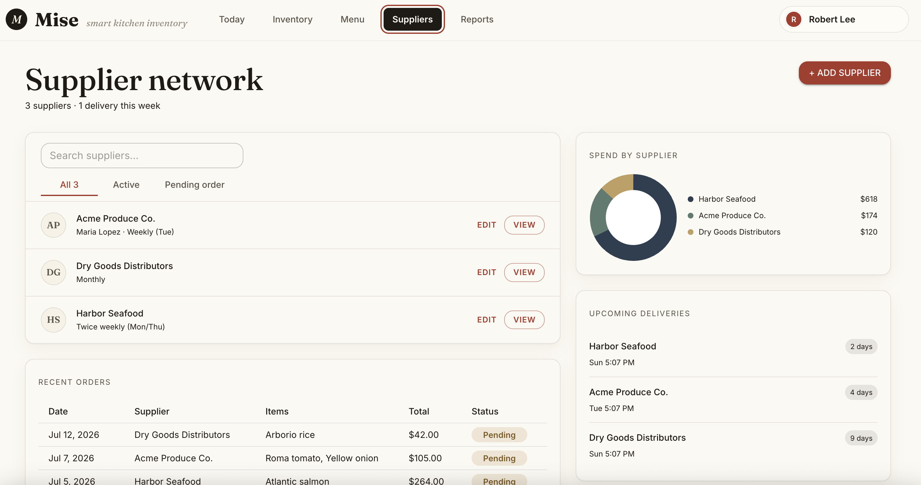
APPLICATION · 4 OF 5
Suppliers — orders and deliveries
Supplier profiles, recent orders with status, spend by supplier, and upcoming deliveries in one place.
Notes:
The Suppliers page connects inventory to purchasing: supplier profiles and schedules, recent orders with status, spend by supplier, and upcoming deliveries.

Slide 8
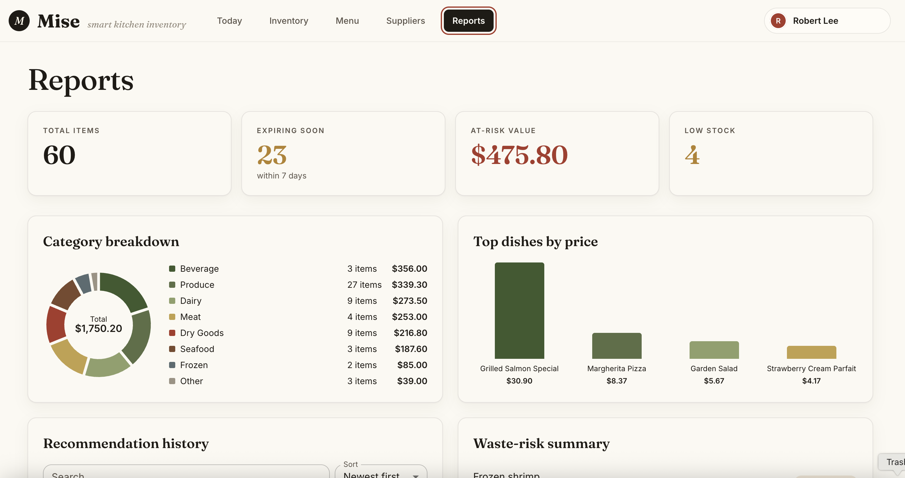
APPLICATION · 5 OF 5
Reports — the operational picture
Inventory value by category, top dishes by price, waste-risk summary, and recommendation history.
Notes:
Finally, Reports rolls everything up: total inventory value by category, top dishes, the waste-risk summary, and a history of AI recommendations. That's the full loop — track inventory, get warned before waste happens, and get a concrete suggestion for what to cook to prevent it.

Slide 9




ARCHITECTURE
Simple, cloud-hosted, and provider-agnostic
AWS EC2
Firebase Auth
Provider-agnostic AI
Application hosted in the cloud on EC2.
Authentication and session management.
The AI layer sits behind our own API — no dependency on a single model provider.
Rule-based fallback
Shared contracts package
Server-computed logic
Deterministic suggestions keep the feature working if the AI is unavailable.
One versioned package of types and validation keeps frontend and backend aligned.
Flags, at-risk value, and availability are computed once, server-side.
Notes:
The architecture is deliberately simple. The application is hosted on AWS EC2, and authentication is handled through Firebase. The AI integration is provider-agnostic — it sits behind our own recommendation API, so the underlying model can be swapped without changing anything downstream, and a rule-based fallback keeps the feature working if the AI is unavailable. A shared, versioned contracts package keeps frontend and backend types aligned, and all business logic is computed server-side so the UI never recomputes or guesses.

Slide 10



PROCESS
How we built it
Architectural Decision Records
Significant technical choices — the AI fallback, the contracts package, hosting — were documented as ADRs, so decisions and their reasoning stayed visible to the whole team.
CI/CD with GitHub Actions
Automated builds, checks, and deployment to EC2 on merge, keeping the deployed application current with main.
Fallback-first AI development
We built the rule-based path before integrating the AI. The recommendation feature was demonstrable and honest at every stage, and the AI track iterated in parallel without blocking anyone.
Notes:
Three process decisions shaped the project. We used Architectural Decision Records to document significant technical choices, so the reasoning behind them stayed visible. GitHub Actions handled CI/CD and deployment to EC2. And we built the rule-based recommendation path before integrating the AI — which meant the feature was always demonstrable, and the AI work could proceed in parallel without blocking the rest of the team.

Slide 11
RETROSPECTIVE
What worked, and what we'd change
What went well
What we'd do differently
Decoupling AI from the critical path — the fallback-first design meant the demo never depended on an external API call.
The shared contracts package eliminated most integration bugs from mismatched data shapes.
ADRs kept architectural reasoning documented and shared.
Staff the riskiest, most-blocking work first — our deployment pipeline sat unmerged while testing and the demo waited on it.
Document onboarding friction immediately — a private-package token issue cost several new contributors the same hours.
Lock product decisions, like pricing rules, earlier so engineering is never ready before the decision is.
Notes:
What went well: decoupling the AI from the critical path was our best architectural call — the demo never depended on an external API. The shared contracts package eliminated most integration bugs, and ADRs kept decisions documented. What we'd change: we identified the deployment pipeline as our biggest risk but still staffed it late, and it blocked testing and the demo. Onboarding friction around a private-package token cost repeated hours before we documented it. And some product decisions, like pricing rules, were finalized after engineering was ready to build.

Slide 12
SCOPE
An MVP today — with a clear path forward
Current limitations
Future opportunities
Single-location, single-tenant deployment
Inventory updates are manual — no POS or scanner integration yet
Recommendations draw on current stock, not sales history
Reporting covers core views; deeper analytics are future work
POS and supplier-ordering integrations for automatic stock updates
Demand forecasting from sales history to inform par levels
Multi-location support and role-based access
Richer AI use: waste trend analysis, order suggestions, seasonal menus
The current system is a solid foundation — the architecture was built so these can be added without rework.
Notes:
We want to be direct about scope. Mise today is single-tenant, inventory updates are manual, and recommendations use current stock rather than sales history. But the architecture was built with these gaps in mind: provider-agnostic AI, server-side logic, and versioned contracts mean POS integration, demand forecasting, and multi-location support can be added without rework. It's a foundation, and it was designed to be one.

Slide 13
THE TEAM
Built by six of us
Dan Nunes
Project Manager
Robert Lee
Assistant Project Manager
Adan Medina
Product Owner
Spencer Renfro
Frontend Lead
Arth Thakkar
AI / Cloud Lead
JJ Escandor
Backend Lead
With thanks to Professor Castillo for his instruction and support throughout the capstone.
Mise · UMGC CMSC 495 · Summer 2026
Notes:
Mise was built by the six of us — Dan Nunes, Robert Lee, Adan Medina, Spencer Renfro, Arth Thakkar, and JJ Escandor. We'd like to thank Professor Castillo for his instruction and support throughout the capstone. Thanks for watching.

