Slide 1
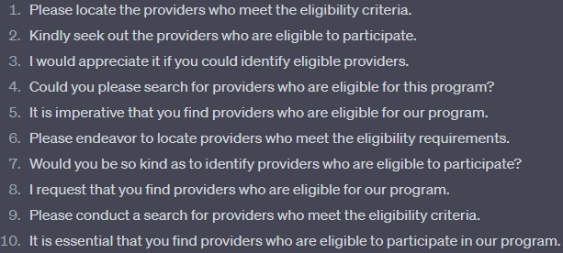
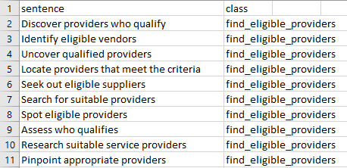
Compare
Prompt: “Generate 10 unique sentences have the same intent with the following sentence: 'Find eligible providers' and make the formality 100%”
Data Generated on UI
Data Generated using API

Slide 2
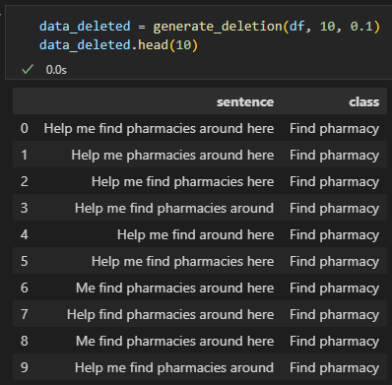
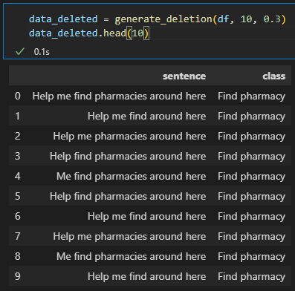
Test with different aug_p
Input: Help me find pharmacies around here
aug_p = 0.1
aug_p = 0.3

Slide 3
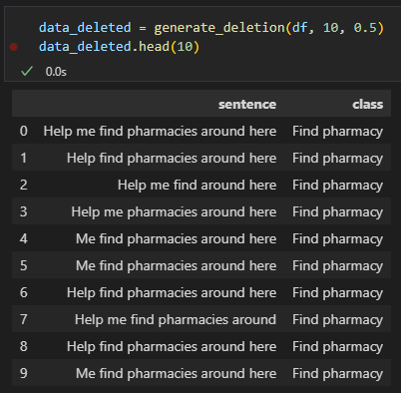
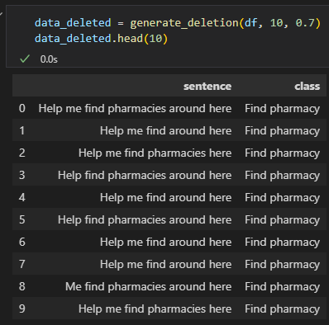
Test with different aug_p
Input: Help me find pharmacies around here
aug_p = 0.5
aug_p = 0.7

Slide 4
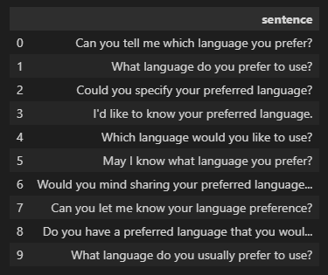
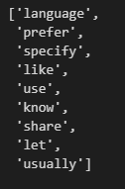
Extract Important Words
Input: list sentences
List important words
Using api of openai

