Slide 1
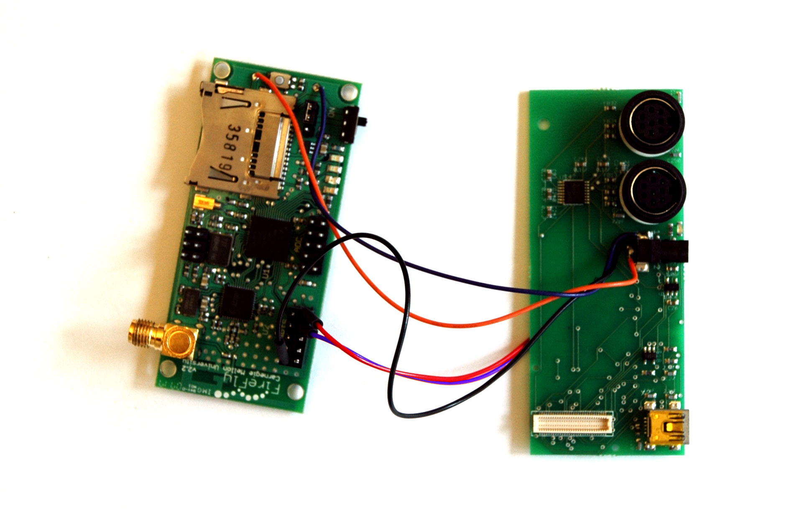

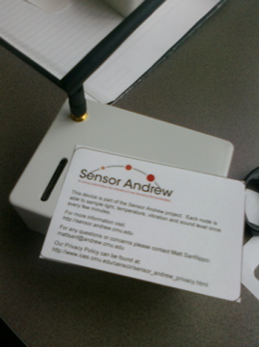
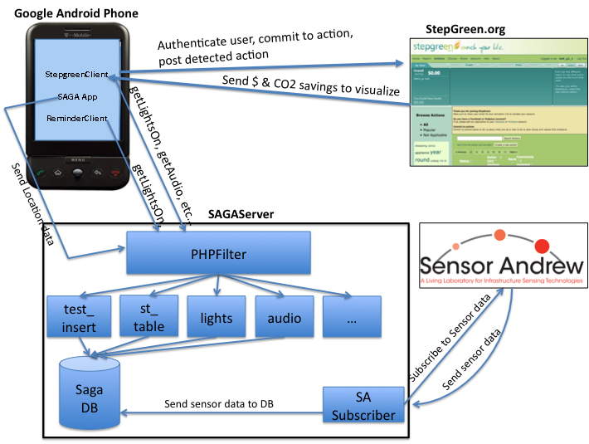
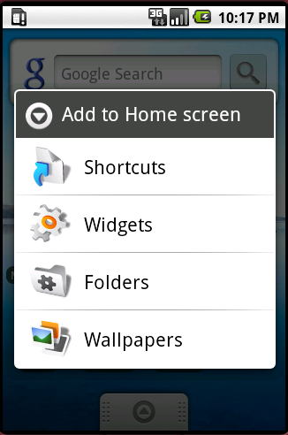
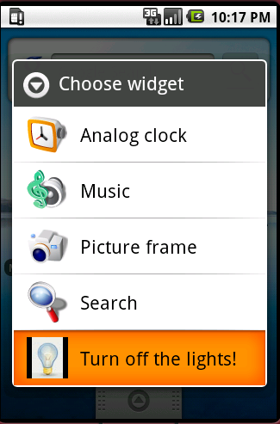
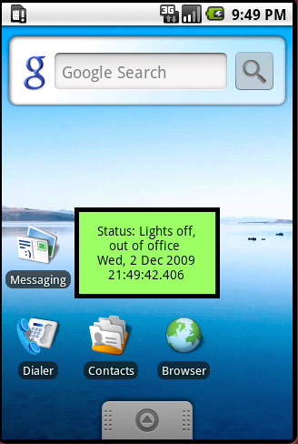
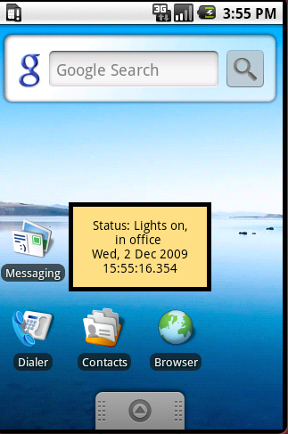
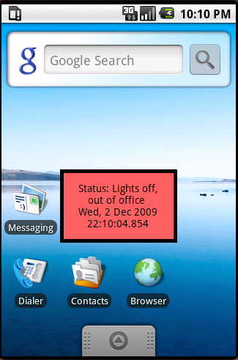


Sensor Andrew Google Android:
Combining Static and Mobile Sensing to Encourage Sustainable Practices
Tawanna Dillahunt (HCII) and Stephanie Rosenthal (CSD)
PROBLEM: Supporting Sustainable Practices
Existing technology requires users to input or confirm their behaviors, which is susceptible to errors – automatic sensing is one solution to this problem
Sensing behaviors like forgetting to turn lights off requires knowledge of the user’s current state and a static sensor in each room
Sensor Andrew Hardware
Google Android G1 Phone
Packaged Sensor Andrew Node
APPROACH: Combining Mobile and Static Sensing
1. Static Sensors: Sensor Andrew
Collect light, audio, temperature, acceleration, and
voltage levels in NSH and GHC offices
2. Mobile Sensors: Google Android
Collect personal location information
3. Central Database
All sensor data is collected in a database
Applications can access and analyze the data
4. PHP Filters and Analysis
PHP scripts analyze and filter the data and are easily reused or added as new applications need them
5. Independent Applications
Independent applications can connect to the database through PHP scripts to access the data
SAMPLE APPLICATION: Turn Off the Lights
FUTURE WORK
Reminder Widget shows the status of their lights with a corresponding background color: green to display sustainable actions, yellow to show the use of lights while inside the office and red to indicate unsustainable behavior.
Stepgreen Application: Automatically post sustainable actions to Stepgreen.org and show overall carbon and monetary savings.
Detect new activities
ACKNOWLEDGMENTS
Thanks to Anthony Rowe, Mario Berges, Christian Kohler, and Denzil Ferreira for their help and advice on this project.

