Slide 1
A STUDY OF GRAPH PARTITIONING TECHNIQUES FOR FAST INDEXING AND QUERY PROCESSING OF A LARGE RDF GRAPH
MS Thesis in Computer Science
by
Dinesh Barenkala
University of Missouri-Kansas City, 2013
Acknowledgments
University of Missouri Research Board
National Science Foundation Grant No. 1115871

Slide 2
Supervisory Committee
Praveen Rao, Ph.D., Chair
Yugyung Lee, Ph.D.
Lein Harn, Ph.D.

Slide 3
Outline
Introduction
Background
  RDF and SPARQL
Indexing and querying a large RDF graph
  Problem statement
  Graph partitioning
Implementation
  Architecture and Strategies
Performance Evaluation
Conclusion and Future Work

Slide 4
Introduction (1/2)
RDF Data Model
  Increasing importance in the WWW and many other domains
    Healthcare and Defense
  More suited for certain kinds of knowledge representation compared to relational data model
Companies looking towards RDF and other Semantic web technologies for Data Management
  Best Buy, New York Times, Pfizer, etc

Slide 5
Introduction (2/2)
Very large RDF datasets available today
  YAGO2 [WWW ‘11]
  LUBM (http://swat.cse.lehigh.edu/projects/lubm/)
  Uniprot RDF (http://www.uniprot.org/downloads)
  DBPedia [WWW ‘07, ISWC ’07]

Slide 6
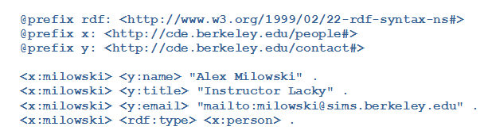
Background (1/2)
RDF (Resource Description Framework)
  Family of WWW Consortium specifications
  Triple format (subject, predicate, object)
    Subject & predicate – URI
    Object – URI / Literal
Notes:
RDF is a flexible and extensible way to represent information about Web resources in the World Wide Web
URI – Uniform Resource Identifier

Slide 7
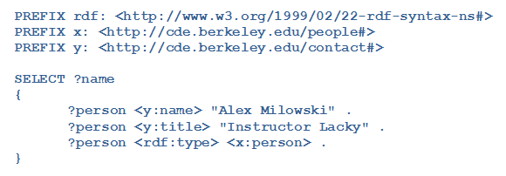
Background (2/2)
SPARQL
  Popular query language for RDF data
Notes:
SPARQL Protocol and RDF Query Language

Slide 8
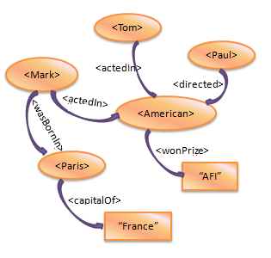
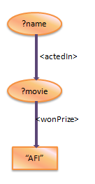
Example
SELECT ?name
{
?name <actedIn> ?movie .
?movie <wonPrize> “AFI” .
}
Result:
?name
<Tom>
<Mark>

Slide 9
Related Work
Recently developed scalable RDF stores
  Column Store / Vertical Partitioning [VLDB 2007]
  Hexastore [PVLDB 2008]
  RDF-3X [VLDBJ 2010]
  BitMat [WWW 2011]
Approach (local environment)
  Store RDF triples using an RDBMS
  Translate SPARQL queries into SQL queries
  Execute SQL queries using an RDBMS

Slide 10
The Story So Far…
We have developed a new approach for indexing and querying RDF graphs called RIS
  Treats graphs as “first-class citizens” during indexing and querying
  Our experiments have shown that RIS can outperform RDF-3X on small RDF graphs for large SPARQL queries
How can RIS deal with large RDF graphs with millions of vertices and edges?

Slide 11
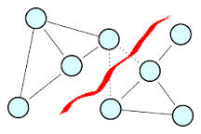
Problem Statement
Design new methods to partition a large RDF graph into smaller RDF graphs
  Then we can use RIS for indexing and query processing (local environment)
  But we need to handle cut edges

Slide 12
Proposed Solution
Three different types of partitioning strategies
  Strategy T1
    Without removing rdf:type and literals
  Strategy T2
    Unweighted graph
  Strategy T3
    Weighted graph to balance partitions
2-hop traversal along cut edges to avoid missing potential matches

Slide 13
Graph Partitioning Algorithm (1/2)
METIS [SIAM Journal on Scientific Computing]
  http://glaros.dtc.umn.edu/gkhome/metis/metis/overview
    gpmetis – partition a graph
Notes:
‘Metis’ is the Greek word for wisdom.

Slide 14
Graph Partitioning Algorithm (2/2)
gpmetis:
  Partitions a graph into specified # of parts
  Syntax:
    gpmetis [options] graphfile nparts
    where
    graphfile → input graph file
    nparts → number of partitions
  Generated output file is graphfile.part.nparts

Slide 15
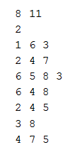
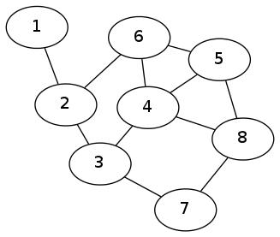
gpmetis (1/5)
Input file format
  First line is header
  Line format: W V1 E1 V2 E2 …
  Vertex weight = 1 and Edge weight = 1

Slide 16
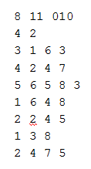
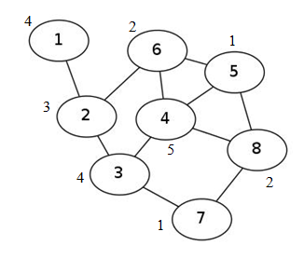
gpmetis (2/5)
Variable vertex weights and Edge weight = 1
  Line format: W V1 E1 V2 E2 …

Slide 17
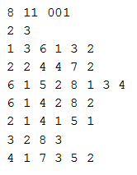
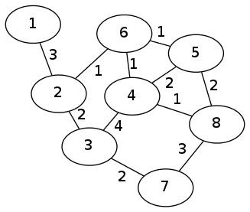
gpmetis (3/5)
Vertex weight = 1 and Variable edge weights
Line format: W V1 E1 V2 E2 …

Slide 18
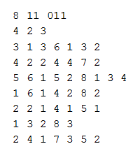
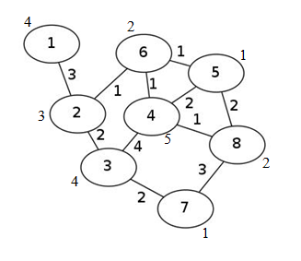
gpmetis (4/5)
Variable vertex weights and edge weights
Line format: W V1 E1 V2 E2 …

Slide 19
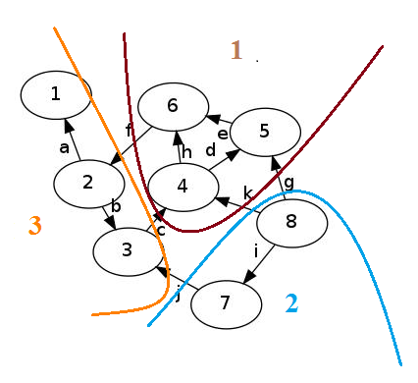
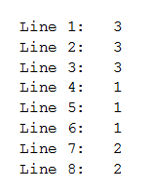
gpmetis (5/5)
Output file; nparts = 3

Slide 20
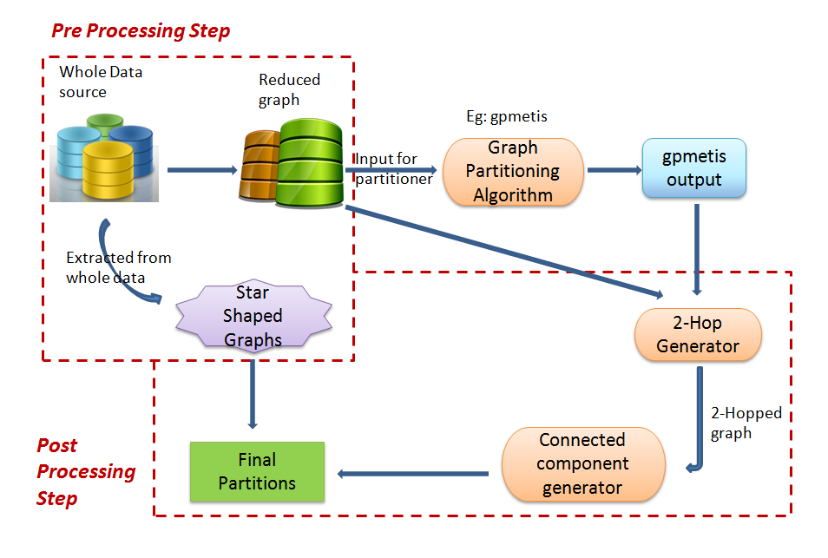
Proposed Design

Slide 21
Pre Processing Step
Extract Star Shaped graphs
Assign unique IDs to all vertices and edges
Generate the graph with IDs
Generate input file for gpmetis
  Based on various graph partitioning strategies

Slide 22
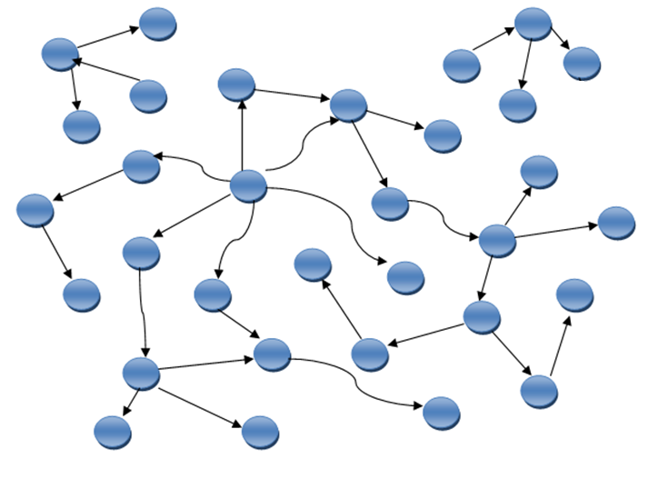
Example: Original Graph

Slide 23
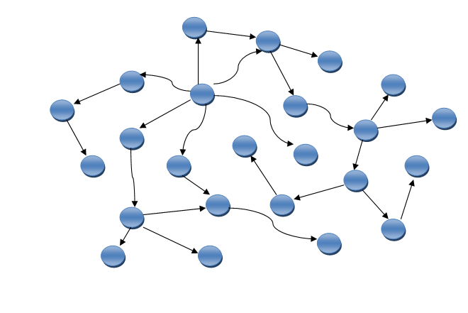
Example: Preprocessed Graph
Notes:
Add a simple edge rdf:type and literal

Slide 24
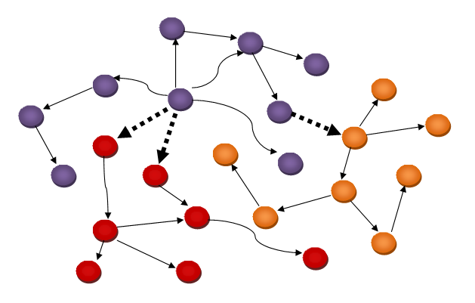
Example: Partitioned Graph

Slide 25
Post Processing Step
Gathering the RDF triples in partitions
Identify cut edges
Compute 2-hop traversal for each partition along cut edges
Extract connected components
Replace IDs with actual URIs and literals
Add extracted Star Shaped graphs

Slide 26
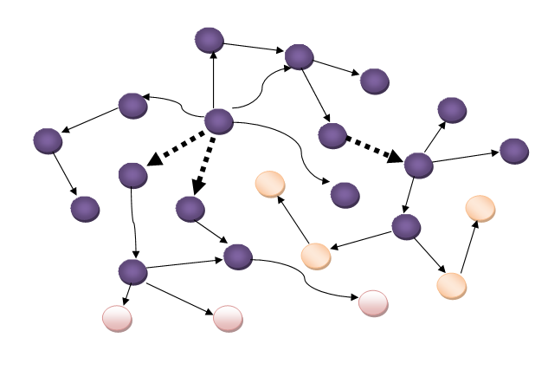
Example: 2-hop Traversal
Notes:
Highlight the cut edges

Slide 27
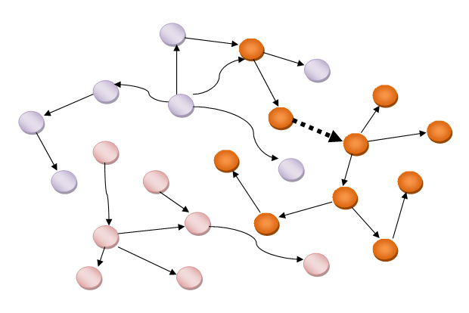
Example: 2-hop Traversal

Slide 28
Graph Partitioning Strategies (1/2)
Strategy T1
  Use the entire RDF graph
Strategy T2
  Extract triples with rdf:type (predicate)
  Extract triples with literals (objects)
  Un-weighted graph – every edge and vertex have weights equal to 1
  Add back the extracted edges during 2-hop traversal

Slide 29
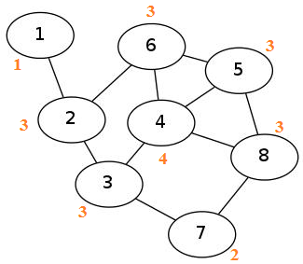
Graph Partitioning Strategies (2/2)
Strategy T3
  Extract triples with rdf:type (predicates)
  Extract triples with literals (objects)
  Give weights to vertices
    Weight = degree of that vertex
    For balanced partitioning –
    because we removed some edges
    in advance
  Add back the extracted edges
  during 2-hop traversal

Slide 30
Creating Partitions Suitable for RIS
Hierarchical approach
  Let’s partition the graph using T2 (or T3)
  For each partition, apply the same strategy to create smaller partitions

Slide 31
Performance Evaluation (1/2)
Hardware configuration
  16GB primary memory
  Four 3.30GHz core processors
Software
  Ubuntu 11.10
  C++
  Java
  Jdbm2 package – persistence storage of maps on disk
Graph Partitioning Algorithm
  gpmetis [SIAM Journal on Scientific Computing]
  http://glaros.dtc.umn.edu/gkhome/metis/metis/overview

Slide 32
Performance Evaluation (2/2)
Dataset
  YAGO2 – extension of YAGO
    Spatial and temporal knowledge
    Automatically built from Wikipedia, GeoNames and WordNet
#Subjects | #Predicates | #Objects
32,012,507 | 94 | 28,984,072
#Triples | #Vertices
195,048,654 | 29,484,037

Slide 33
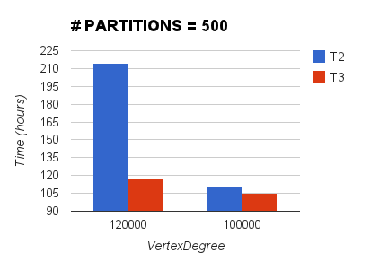
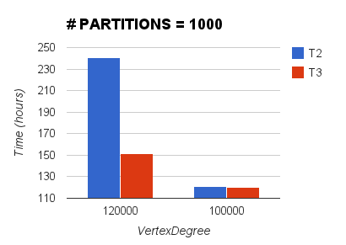
Total Graph Partitioning
Notes:
Talk about T1; T2 has irregular graphs so it struggles during 2 hop

Slide 34
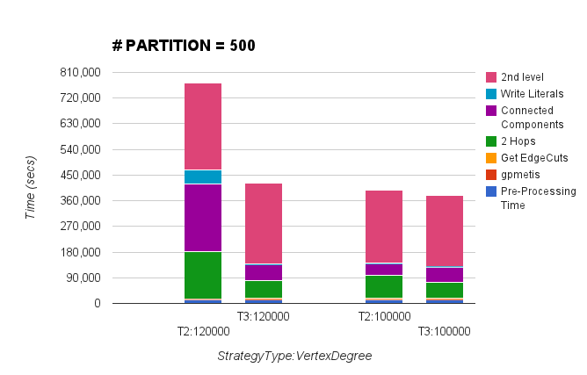
Graph Partitioning (Stack)

Slide 35
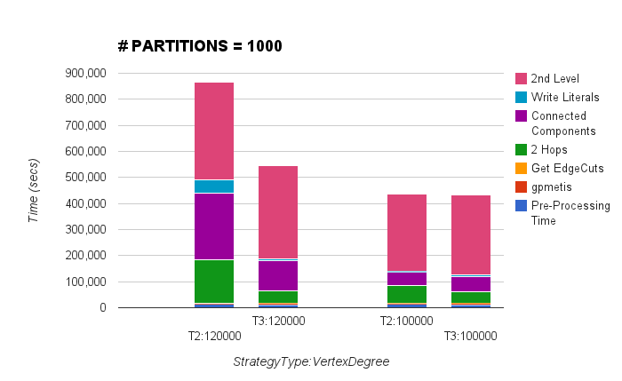
Graph Partitioning (Stack)

Slide 36
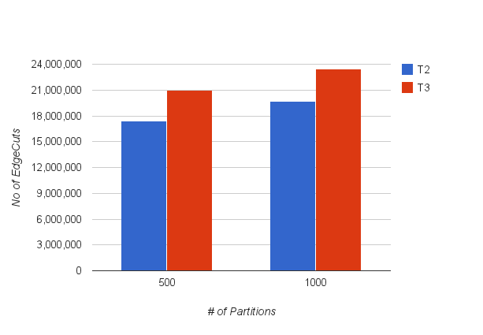
Cut edges

Slide 37
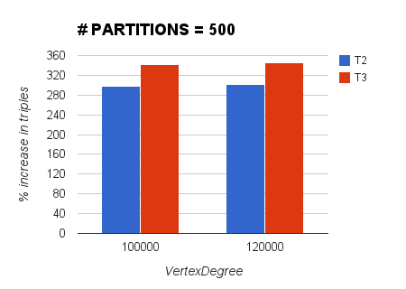
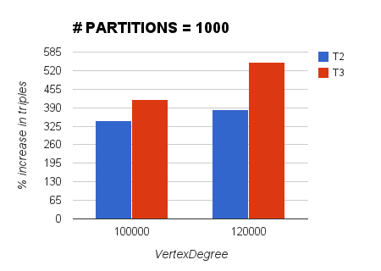
Total # of Triples

Slide 38
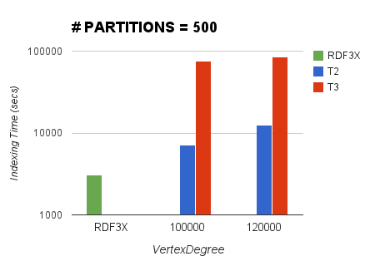
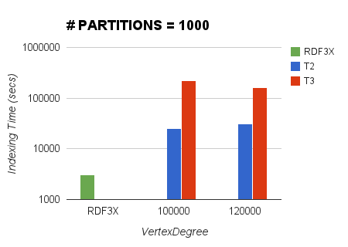
Indexing

Slide 39
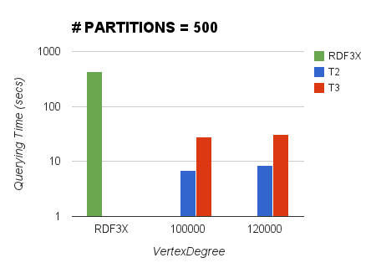
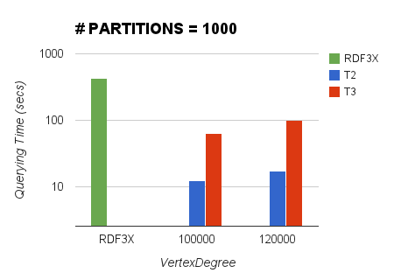
Querying (1/3)
Query 1

Slide 40
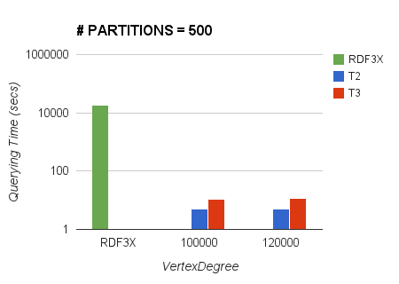
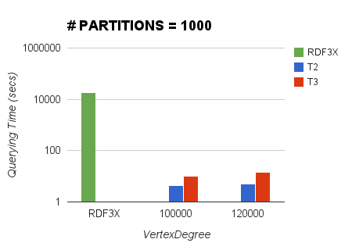
Querying (2/3)
Query 2

Slide 41
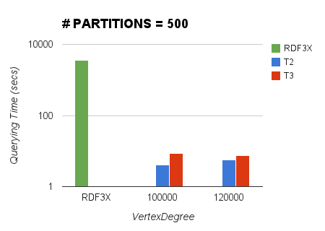
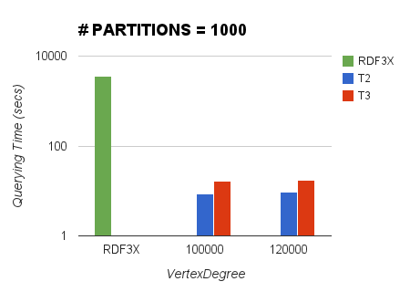
Querying (3/3)
Query 3

Slide 42
Discussion: Why we missed results?
Threshold for high degree vertex during 2-hop traversal
Query diameter > 2 in all cases

Slide 43
Comparison: T2 vs T3
T2 does better…
  Less cut edges
  Indexing
  Querying (time)
T3 does better…
  Graph Partitioning
  Querying (results)

Slide 44
Conclusion & Future Work
Studied the two graph partitioning strategies and showed that partitioning and querying weighted graph is better than un-weighted graph.
In the future, we plan to investigate further on missing results and try other graph partitioning algorithm - hmetis.

Slide 45
References
George Karypis and Vipin Kumar. A Fast and High Quality Multilevel Scheme for Partitioning Irregular Graphs. SIAM Journal on Scientific Computing, December 1998. (http://glaros.dtc.umn.edu/gkhome/metis/metis/overview)
Lefteris Sidirourgos, Romulo Goncalves, Martin Kersten, Niels Nes, and Stefan Manegold. 2008. Column-store support for RDF data management: not all swans are white. Proc. VLDB Endow. 1, 2 (August 2008), 1553-1563.
Thomas Neumann and Gerhard Weikum. 2010. The RDF-3X engine for scalable management of RDF data. The VLDB Journal 19, 1 (February 2010), 91-113. DOI=10.1007/s00778-009-0165-y http://dx.doi.org/10.1007/s00778-009-0165-y
Cathrin Weiss, Panagiotis Karras, and Abraham Bernstein. 2008. Hexastore: sextuple indexing for semantic web data management. Proc. VLDB Endow. 1, 1 (August 2008), 1008-1019.
Medha Atre, Vineet Chaoji, Mohammed J. Zaki, and James A. Hendler. 2010. Matrix "Bit" loaded: a scalable lightweight join query processor for RDF data. In Proceedings of the 19th international conference on World wide web (WWW '10). ACM, New York, NY, USA, 41-50. DOI=10.1145/1772690.1772696 (http://doi.acm.org/10.1145/1772690.1772696)

