Slide 1
A New Filtering Index for fasT Processing of sparql queries
Srivenu Paturi
Computer Science & Electrical Engineering
University of Missouri-Kansas City
August 17th 2013
Acknowledgements
National Science Foundation under Grant No. 1115871

Slide 2
MS Thesis Committee
Praveen Rao, Ph.D., Committee chair
Yugyung Lee, Ph.D.
Lein Harn, Ph.D.

Slide 3
Agenda
Introduction
Background & Motivation
Architecture of RIS
Bloom Filters and Bloom Counters
Indexing System
Querying System
Implementation
Performance Evaluation
Conclusion

Slide 4
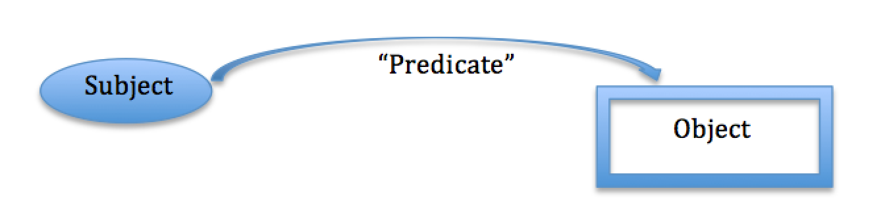
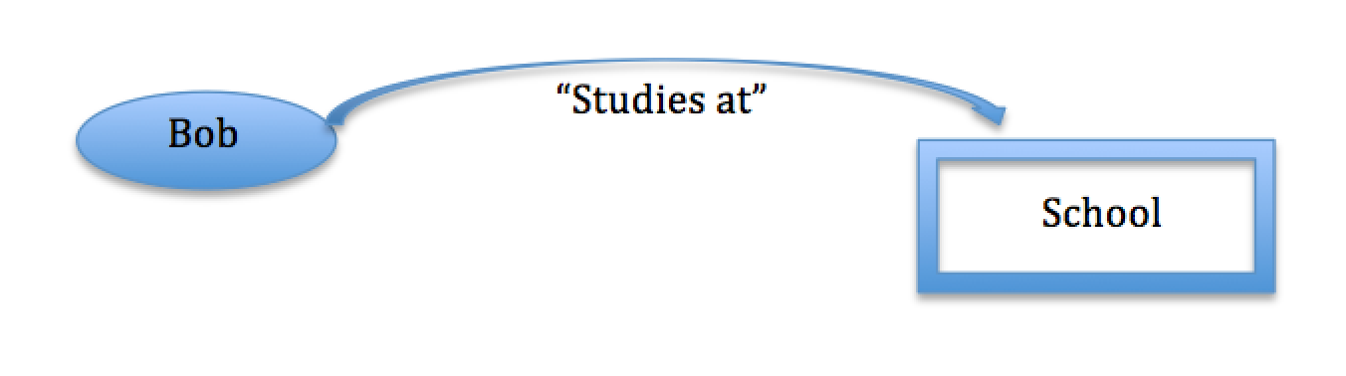
Introduction
Resource Description Framework (RDF)
Example: “Bob studies at school”
RDF represents resources as a directed, labeled graph where a pair of adjacent nodes denotes two things and the directed, labeled edge represents their relationship.

Slide 5
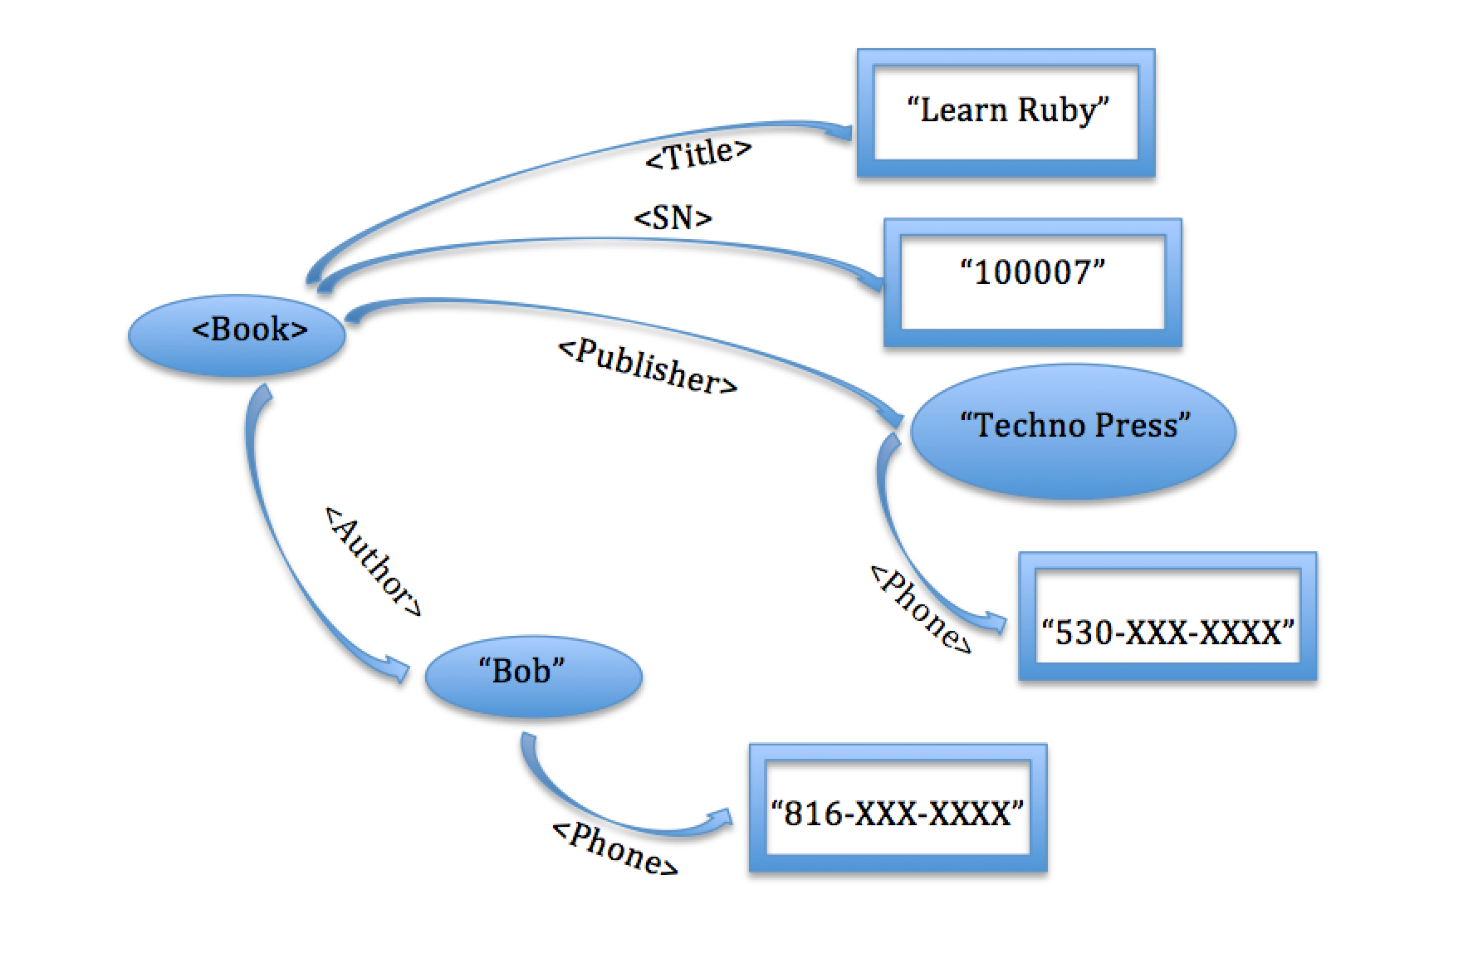
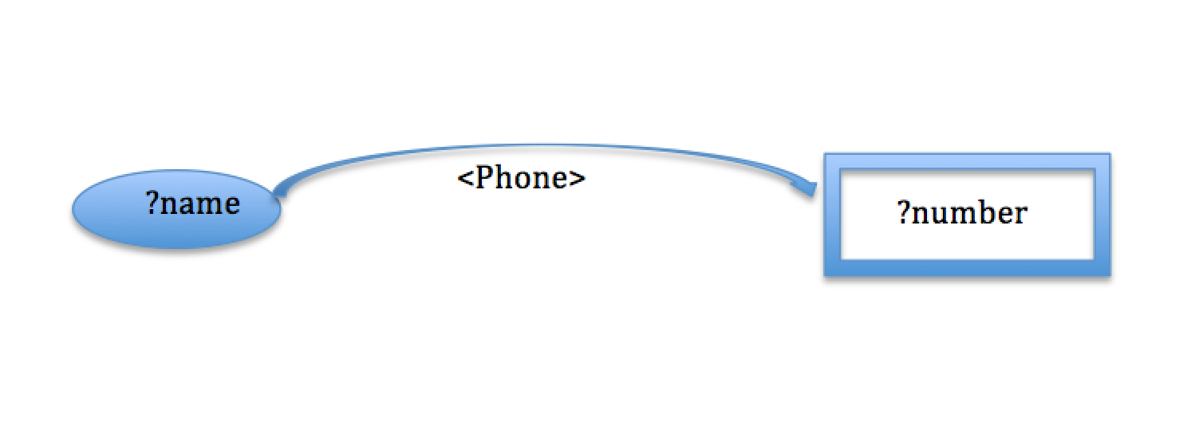
Data Model & Query Language
RDF Dataset
SPARQL Query
SELECT ?name, ?number
WHERE
{
?name <phone> ?number .
}
Output
?name | ?number
<Techno Press> | <530-XXX-XXXX>
<Bob> | <816-XXX-XXXX>

Slide 6





Emerging Applications
Linked Data
31 billion triples (Sep 2011)
Uniprot
Protein knowledge database
YAGO
Graphs from Wikipedia
RDFa
Other Companies
The New York Times, BBC,
Best Buy, Pfizer,
and many more…

Slide 7
Related Work
Recently developed scalable RDF stores
Column Store / Vertical Partitioning [VLDB 2007]
Hexastore [PVLDB 2008]
RDF-3X [VLDBJ 2010]
BitMat [WWW 2011]
Approach
Store RDF triples using an RDBMS
Translate SPARQL queries into SQL queries
Execute SQL queries using an RDBMS

Slide 8
Motivation
Join processing is expensive for large RDF queries
Queries can have up to 20 joins; query optimization can be very slow
Our hypothesis
By treating graphs as “first-class” citizens during indexing and query processing, SPARQL queries can be processed faster

Slide 9
Proposed Approach: RIS
Design a filtering index that can index graphs as “first-class” citizens
Use the filtering index to prune away most of the RDF data that does not match a query and produce candidate matches
Verify the candidate matches using well-know RDF query processing tools (e.g., Apache Jena) to get the true matches

Slide 10
Architecture of RIS
Indexing
Querying
RDF Graphs
RIS Indexing System
RIS Index
RIS Filtering Querying System
RDF Query
RDF Results
RIS Index
Notes:
Brighter colors for pictures

Slide 11
Bloom Filters
A bloom filter is a memory efficient data structure (usually a bit array) to determine the probability of the presence of an element in a sample set.
Data Bloom Loading
Data Set
Data Bloom Filters
Data Bloom Filters
Data Bloom Filters
Query Bloom Loading
Bloom Comparison
Query Set
Query Bloom Filters
Result
(0/1)
Query Bloom Filters
Data Bloom Filters
Query Bloom Filters

Slide 12
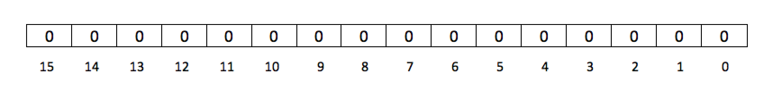
Bloom Filters Example (1)
Bloom Filter Initialization
Let the size N of the bloom filter B be - 16
Let the number of hash functions be - 3
Hash function H1 be - ((5x + 4) % 20)%16
Hash function H2 be - ((9x + 10) % 20)%16
Hash function H3 be - ((2x + 11) % 20)%16
Initialized Data Bloom Filter
Input Data Set S
Let the input Set S be - {3, 14, 19}
Input Query Set Q
Let the input Set Q be - {3, 11}
Hint: Expected result should be FALSE as the element ’11’ is not present in the data set S.

Slide 13
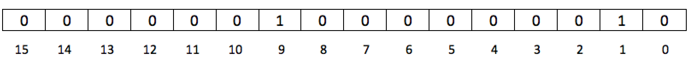
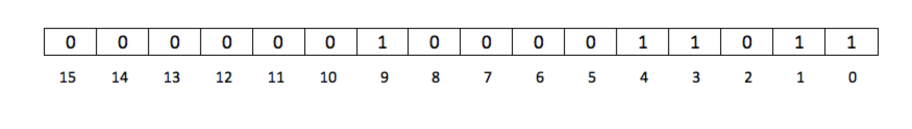
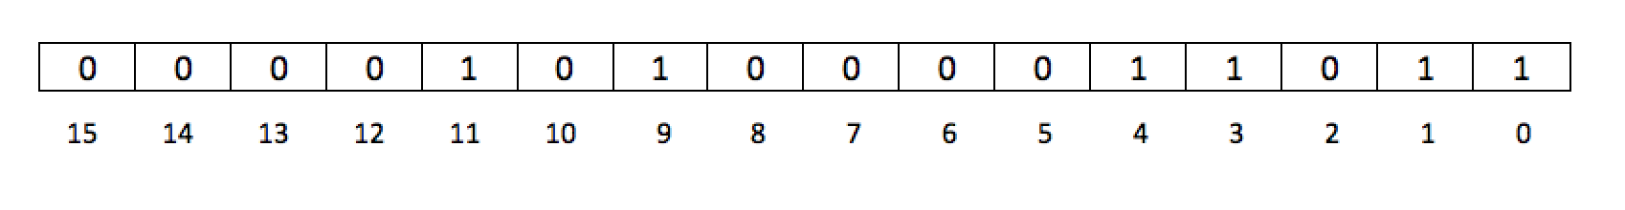
Bloom Filters Example (2)
Construction of input data set S {3, 14, 19}
1. Inserting the set element ‘3’
2. Inserting the set element ‘14’
Final Bloom Filter Data Set
3. Inserting the set element ‘19’

Slide 14
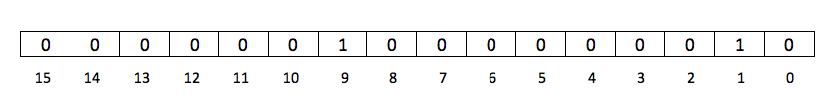
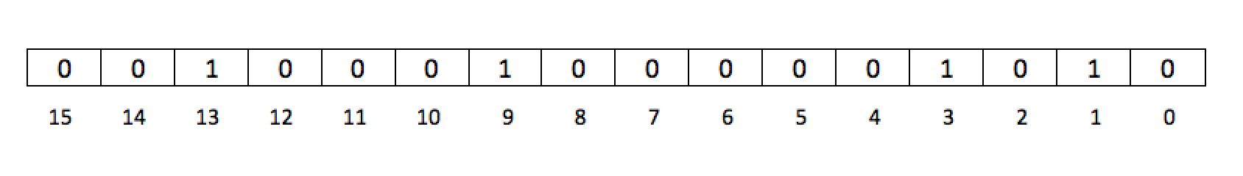
Bloom Filters Example (3)
Construction of input query set S {3, 11}
1. Inserting the set element ‘3’
Final Bloom Filter Query Set
2. Inserting the set element ‘11’

Slide 15
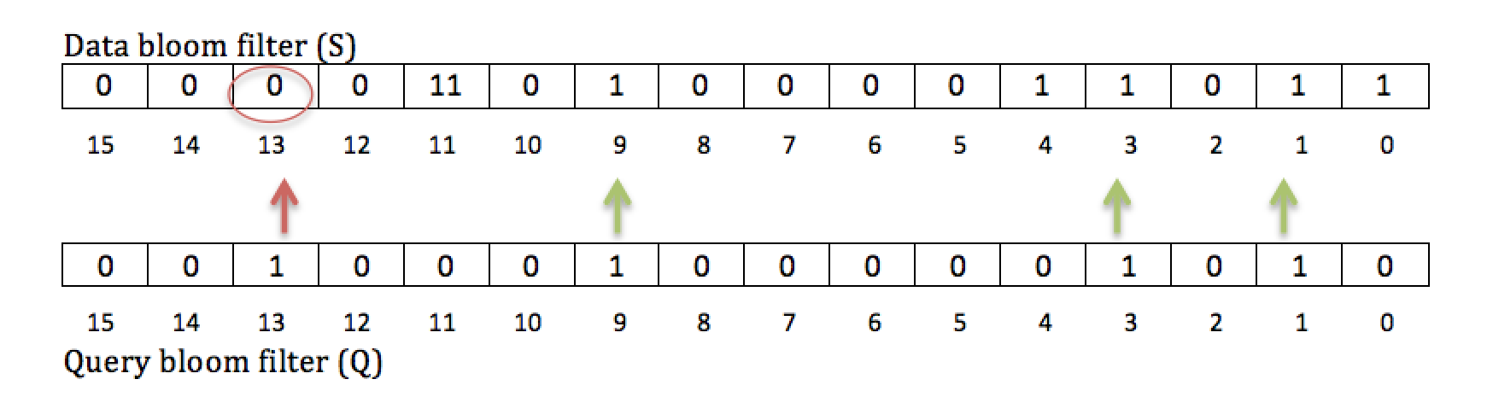
Bloom Filters Example (3)
Bloom Filters Comparison
Comparison Result
FALSE : The data set S does not contain the query set Q.
Data Bloom Filter (S)
Data Bloom Filter (Q)

Slide 16
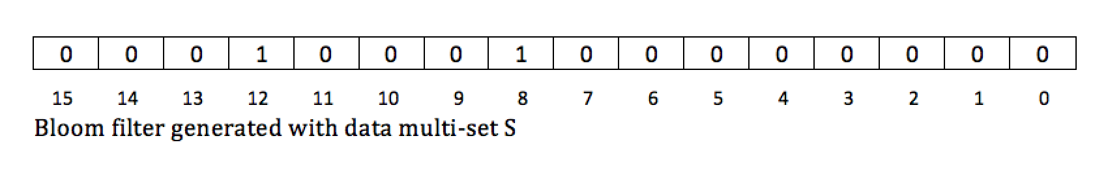
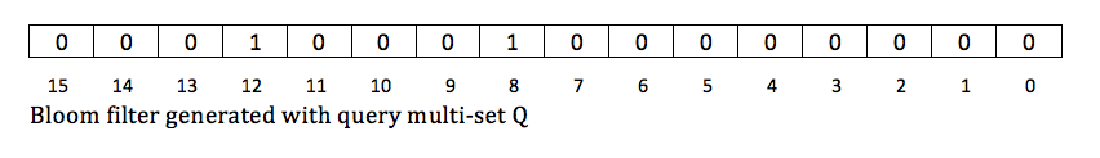
Bloom Filters Drawback
Bloom Filters are not very efficient when dealing with multi-sets.
Example
Let the bloom filter parameters be the same as in the above example.
Let the Data multi set S be {3, 3, 6, 8, 8}
Let the Query multi set Q be {3, 6, 6, 6}
Hint: Expected result should be FALSE as the element ’6’ is not present thrice in the data set S.
Data Bloom Filter (Q)
Comparison Result : TRUE (False Positive Match)
Data Bloom Filter (Q)

Slide 17
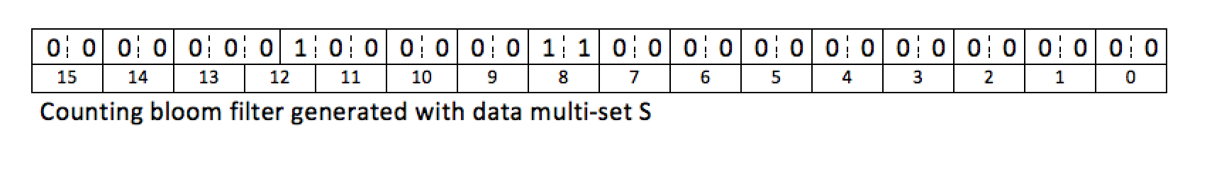
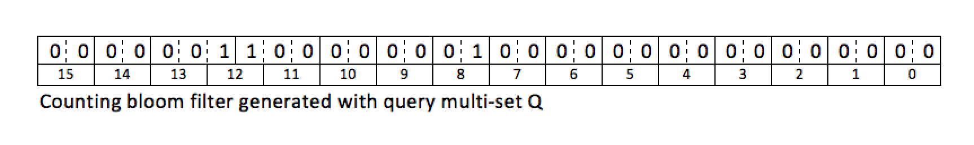
Counting Bloom Filters
A counting bloom filter is a counting extension of a regular bloom filter.
Example
Let the size of the counting bloom filter be 16 with a 2 bit counter capacity.
Let the number of hash function be 1 [((8x + 4) % 20)%16].
Let the Data multi set S be {3, 3, 6, 8, 8}
Let the Query multi set Q be {3, 6, 6, 6}
Data Counting Bloom Filter (S)
Comparison Result : FALSE
(As expected, multi-set Q is not present in multi-set S)
Query Counting Bloom Filter (Q)

Slide 18
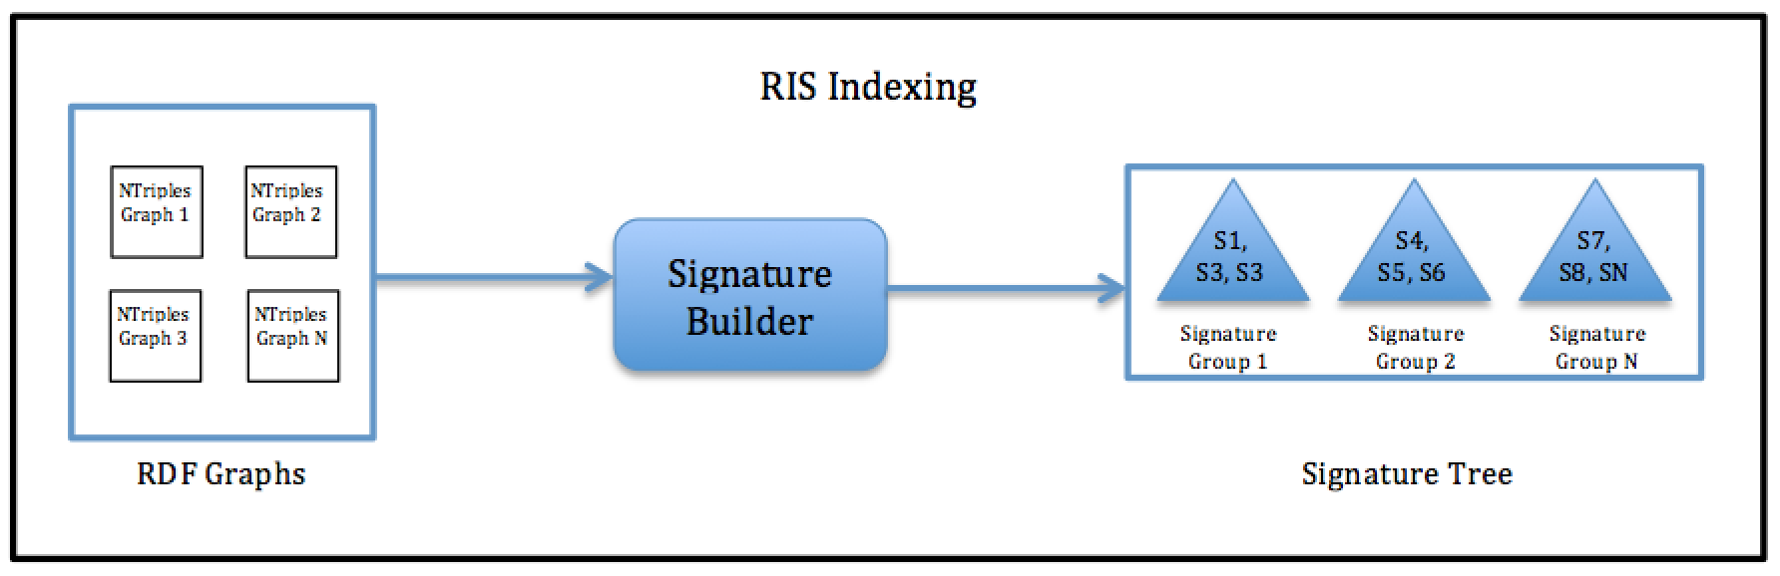
Indexing System(1)
Generating Ntriple variable graph permutations
Constructing the signature trees
Loading signatures into the bloom counters

Slide 19
Indexing System(2)
Generating Ntriple graph permutations
example: <a> b <c> .
<a> b <c> .
<a> b ? .
<a> ? <c> .
? b <c> .
<a> ? ? .
? b ? .
? ? <c> .

Slide 20
Signature Trees (1)
Signature
A signature is a collection of similar graph data
The signature graphs are grouped recursively based on the Cardinal similarity
Seed Pick Size: Limit on the number of graphs to consider for deciding most dissimilar graphs
Fanout: Each group has a limit on the number of graphs it can contain
Signature Tree
A tree structure is constructed using all the signatures for quick traversals
A parent node is the union of all its children

Slide 21
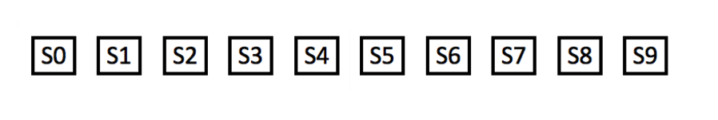
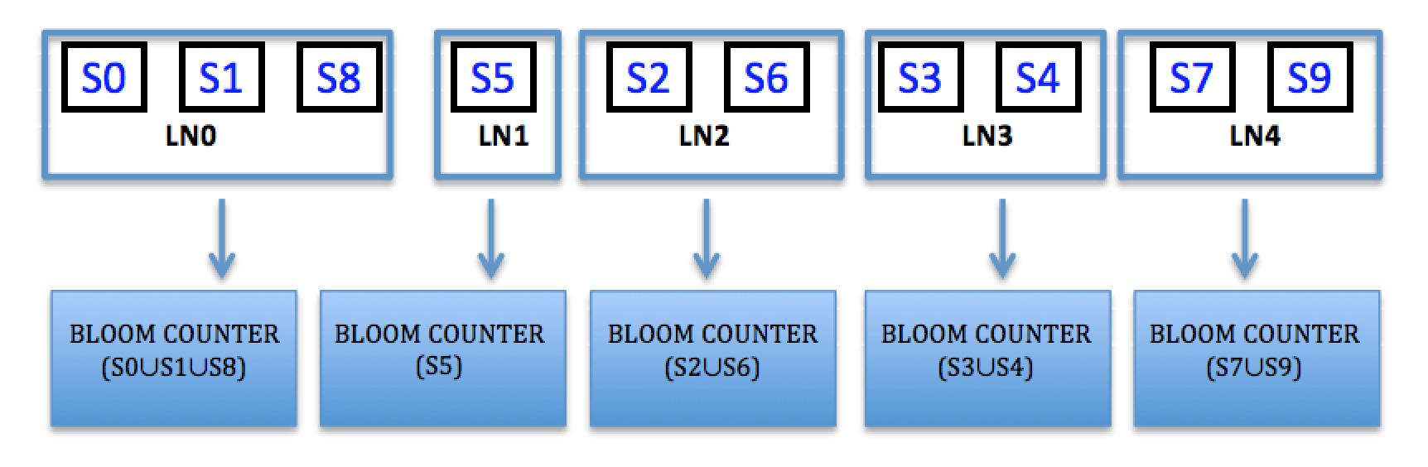
Signature Trees (2)
Example
Initial set of graphs
Signatures nodes with bloom counters

Slide 22
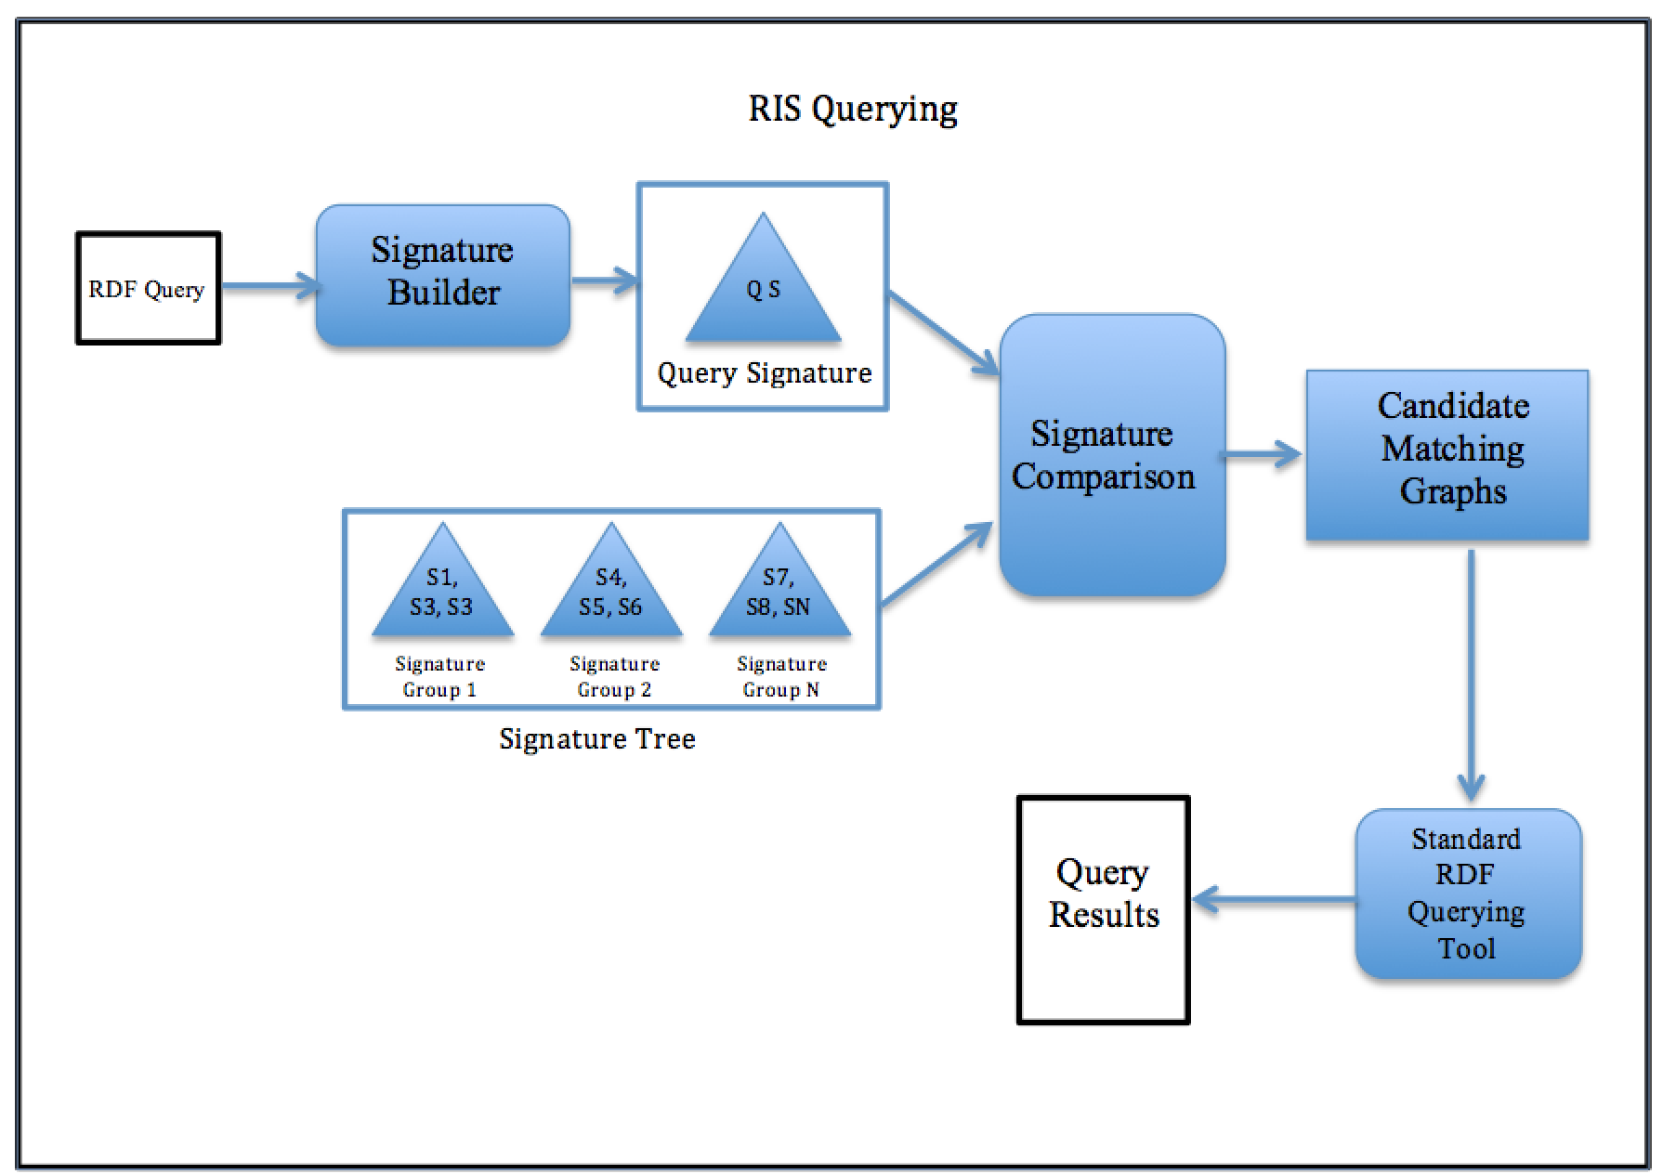
Querying System (1)
Notes:
Make fonts bigger

Slide 23
Querying System(2)
Generating the query signature
Comparing query signature with index signature tree
Filtering the candidates
Querying the identified candidate graphs

Slide 24
Implementation
Hardware Info
8GB primary memory
Four 3.30GHz core processors
Software Info
Ubuntu 11.10
C++ (g++ 4.6.1)
SPARQL Querying Tools
Apache Jena
RDF-3x

Slide 25
Performance Evaluation (1)
Dataset Used
Lehigh University Benchmark (LUBM)
50 Billion Triples
Compared with RDF-3X (VLDBJ, 2010)
Queries Used
Q1
16 joins (big)
4 results
Q2
21 joins (big)
10 results
Q3
22 joins (big)
0 results
Q4
6 joins (small)
2481 results

Slide 26
Performance Evaluation(2)
Strategy
Varying Fanout
Fanout (250, 500, 1000, 2000)
Constant Seed Pick Size
Varying Seed Pick Size with constant Fanout
Seed Pick Size (100, 200, 400, 800)

Slide 27
Varying Fanout (1)
Indexing

Slide 28
Varying Fanout (2)
Querying Q1(big)

Slide 29
Varying Fanout (3)
Querying Q2(big)

Slide 30
Varying Fanout (3)
Querying Q3(big)

Slide 31
Varying Fanout (4)
Querying Q4(small)

Slide 32
Varying Seed Pick Size (1)
Indexing

Slide 33
Varying Seed Pick Size (2)
Querying Q1(big)

Slide 34
Varying Seed Pick Size (3)
Querying Q2(big)

Slide 35
Varying Seed Pick Size (4)
Querying Q3(big)

Slide 36
Varying Seed Pick Size (5)
Querying Q4(small)

Slide 37
Conclusion
We have shown significant improvement in speed for queries with both large & small number of joins
Treating graphs as the ‘first class citizens’ helps us to prune away unwanted graphs while querying
We have shown that RIS outperforms RDF-3X

Slide 38
References
Lefteris Sidirourgos, Romulo Goncalves, Martin Kersten, Niels Nes, and Stefan Manegold. 2008. Column-store support for RDF data management: not all swans are white. Proc. VLDB Endow. 1, 2 (August 2008), 1553-1563.
Thomas Neumann and Gerhard Weikum. 2010. The RDF-3X engine for scalable management of RDF data. The VLDB Journal 19, 1 (February 2010), 91-113. DOI=10.1007/s00778-009-0165-y http://dx.doi.org/10.1007/s00778-009-0165-y
Cathrin Weiss, Panagiotis Karras, and Abraham Bernstein. 2008. Hexastore: sextuple indexing for semantic web data management. Proc. VLDB Endow. 1, 1 (August 2008), 1008-1019.
Medha Atre, Vineet Chaoji, Mohammed J. Zaki, and James A. Hendler. 2010. Matrix "Bit" loaded: a scalable lightweight join query processor for RDF data. In Proceedings of the 19th international conference on World wide web (WWW '10). ACM, New York, NY, USA, 41-50. DOI=10.1145/1772690.1772696 http://doi.acm.org/10.1145/1772690.1772696

