Slide 1
DATABASE

Slide 2
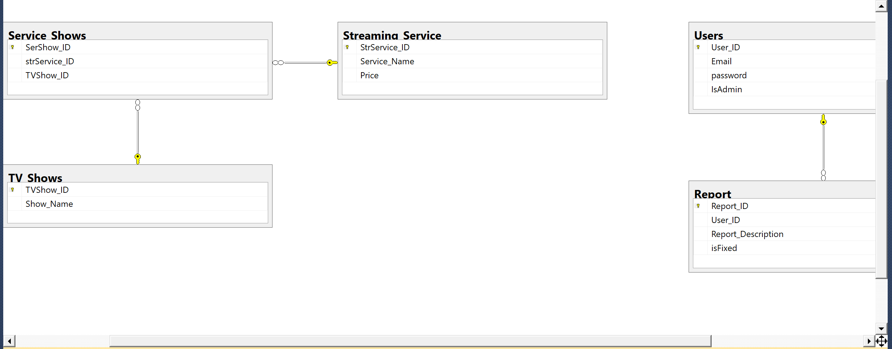

Slide 3
Create database TV_service
use TV_service
create table Users(
User_ID int not null
identity(1,1),
Email nchar(50) not null,
password int null,
IsAdmin bit null,
constraint UsersPK PRIMARY KEY (User_ID)
);
create table Streaming_Service(
StrService_ID int not null
identity(1,1),
Service_Name varchar(50) not null,
Price float null,
constraint Streaming_ServicePK PRIMARY KEY (StrService_ID)
);

Slide 4
create table TV_Shows(
TVShow_ID int not null
identity(1,1),
Show_Name varchar(50) not null,
constraint TV_ShowsPK PRIMARY KEY(TVShow_ID)
);
create table Service_Shows(
SerShow_ID int not null
identity(1,1),
strService_ID int not null,
TVShow_ID int not null,
constraint Service_ShowsPK PRIMARY KEY(SerShow_ID),
constraint Service_Shows_Streaming_ServiceFK FOREIGN KEY (StrService_ID)
REFERENCES Streaming_Service (StrService_ID),
constraint Service_Shows_TV_ShowsFK FOREIGN KEY (TVShow_ID)
REFERENCES TV_Shows (TVShow_ID)
);
create table Report(
Report_ID int not null
identity(1,1),
User_ID int not null,
Report_Description varchar(300) null,
isFixed bit null,
constraint ReportPK PRIMARY KEY(Report_ID),
constraint Report_UsersFK FOREIGN KEY (User_ID)
REFERENCES Users (User_ID)
);

Slide 5
insert into Users(Email, password, IsAdmin) VALUES ('jabl@MAIL.UMKC.EDU',20131009,0)
SELECT* FROM Users
insert into TV_Shows(Show_Name) VALUES ('Sling')
SELECT* FROM TV_Shows
insert into Streaming_Service(Service_Name, Price) VALUES ('youtube',22.5)
SELECT* FROM Streaming_Service
insert into Report(User_ID, Report_Description, isFixed) VALUES (2, 'still cannot work well', 0)
SELECT* FROM Report
insert into Service_Shows(strService_ID, TVShow_ID) values (6,6)
SELECT* FROM Service_Shows

Slide 6
SELECT * FROM Users;
update Users set Email = 'mxiong6886@gmail.com'where User_ID = 2;
delete from Users where User_ID = 9 ;
select *from TV_Shows;
UPDATE TV_Shows set Show_Name = 'The Get Down' where TVShow_ID = 6;
select * from Streaming_Service;
delete from Streaming_Service where StrService_ID = 9;
select * from Streaming_Service;
select *from Service_Shows;
select *from Report;

Slide 7
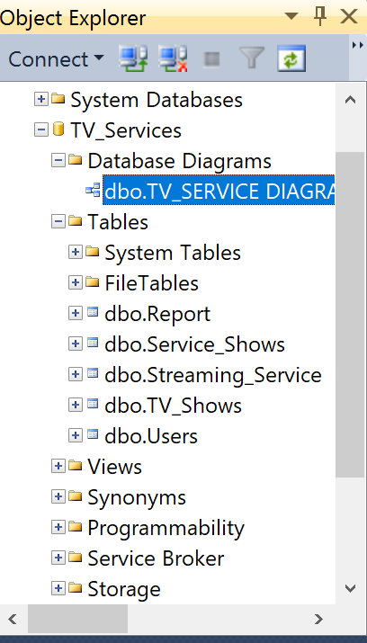

Slide 8
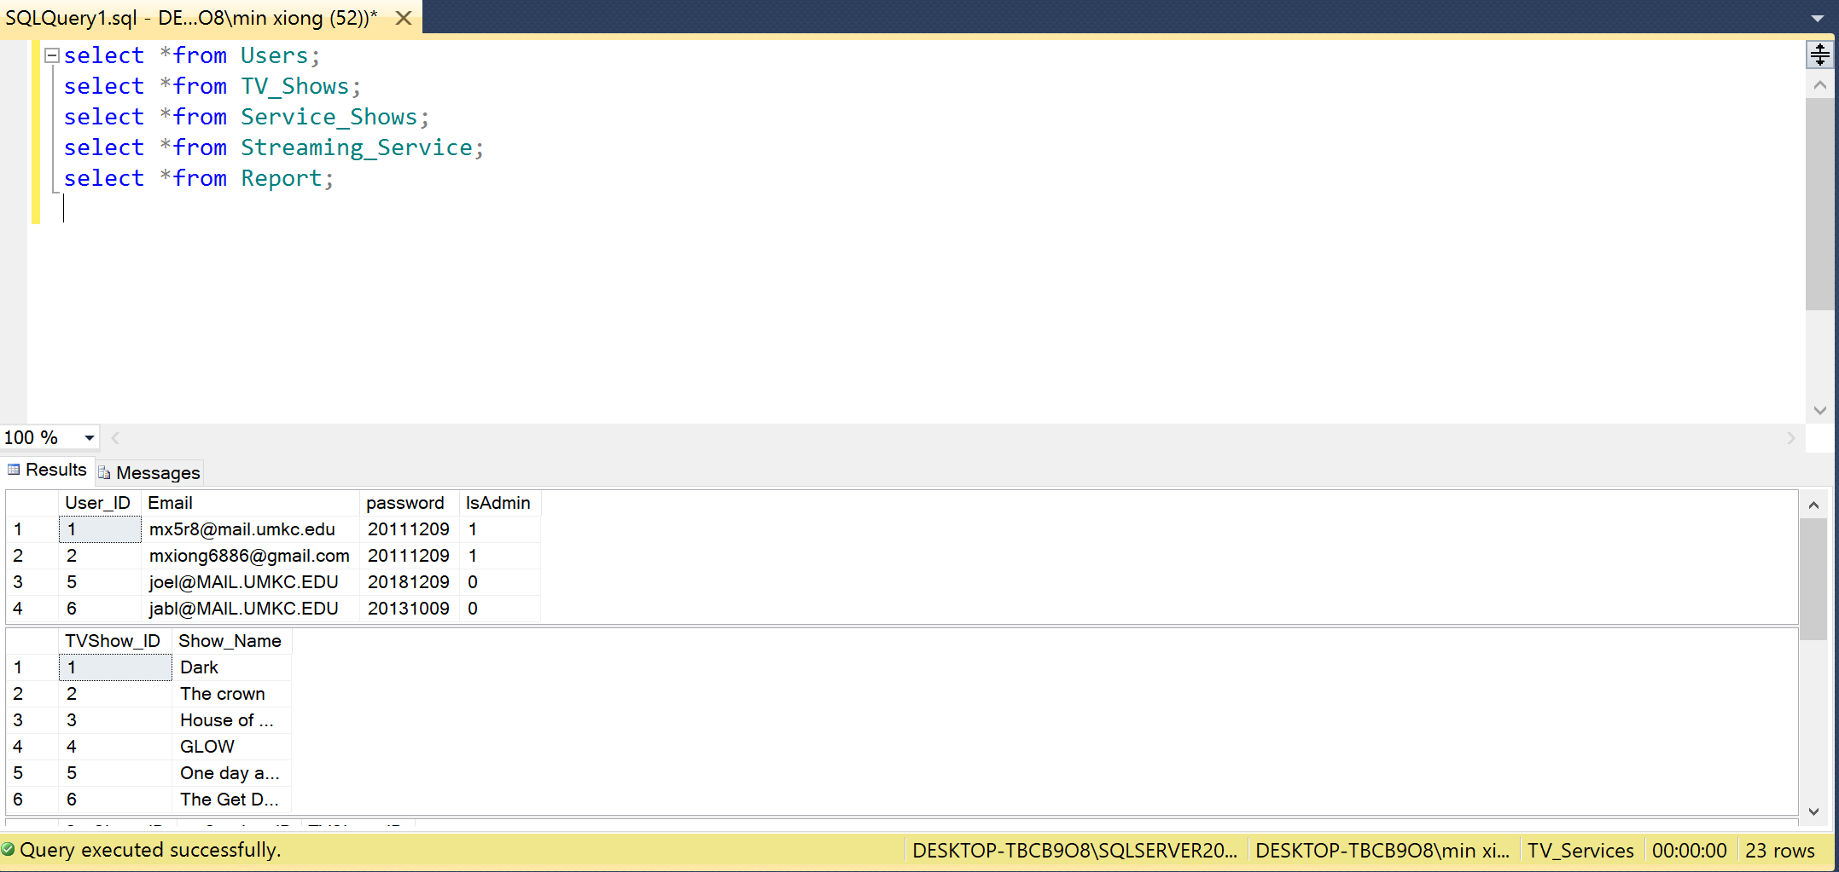

Slide 9
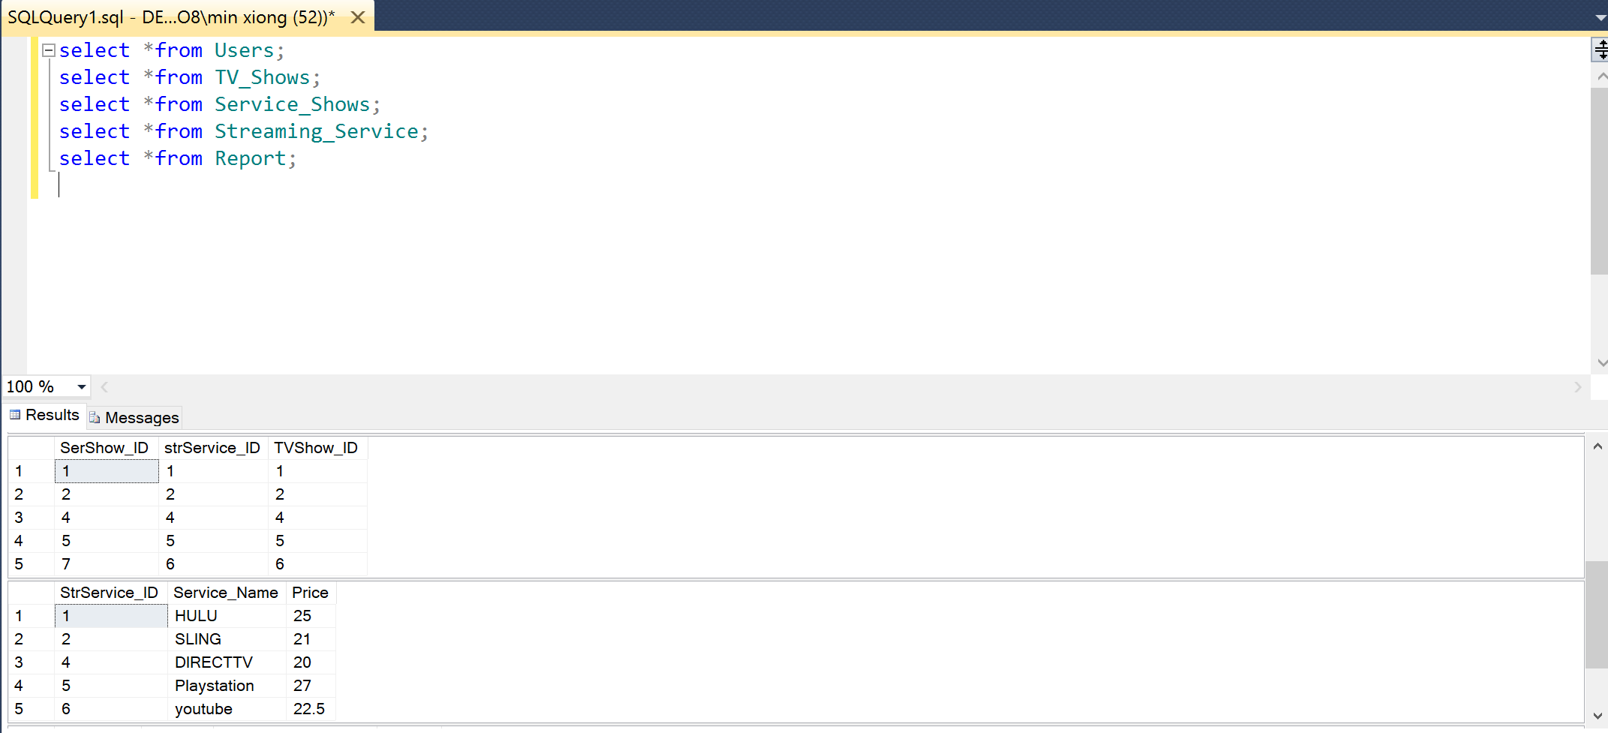

Slide 10
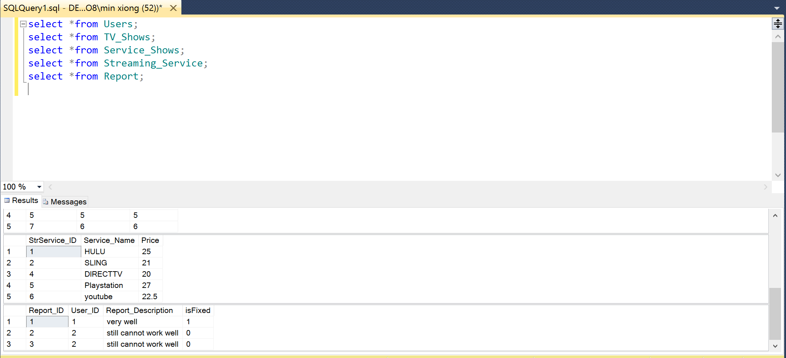

Slide 11
Next step:
Use SSMS to connect to AZURE SQL database!
https://docs.microsoft.com/en-us/azure/sql-database/sql-database-connect-query-ssms

