Slide 1

Group 1 Commerce Bank Project

Slide 2
Team Members
Sushant Acharya
UX Designer, Tester
Kole Keeney
Developer-Front End
Ozzie Loewen
Project Manager
Thomas Starr-Timberlake
Developer-Full Stack

Slide 3
What are We Using?
ASP.Net Core for backend development
Bootstrap CSS framework for frontend development
Database is made with SQLite

Slide 4
Frameworks In Use
ASP.Net Identity
ASP.Net Authorization
Entity Framework (EF)
Razor Pages
Visual Studio

Slide 5
What Our Prototype Includes
Register a New User
Manage Account +
Login Page
Transactions Page
Notifications Page
Stretch Goals

Slide 6
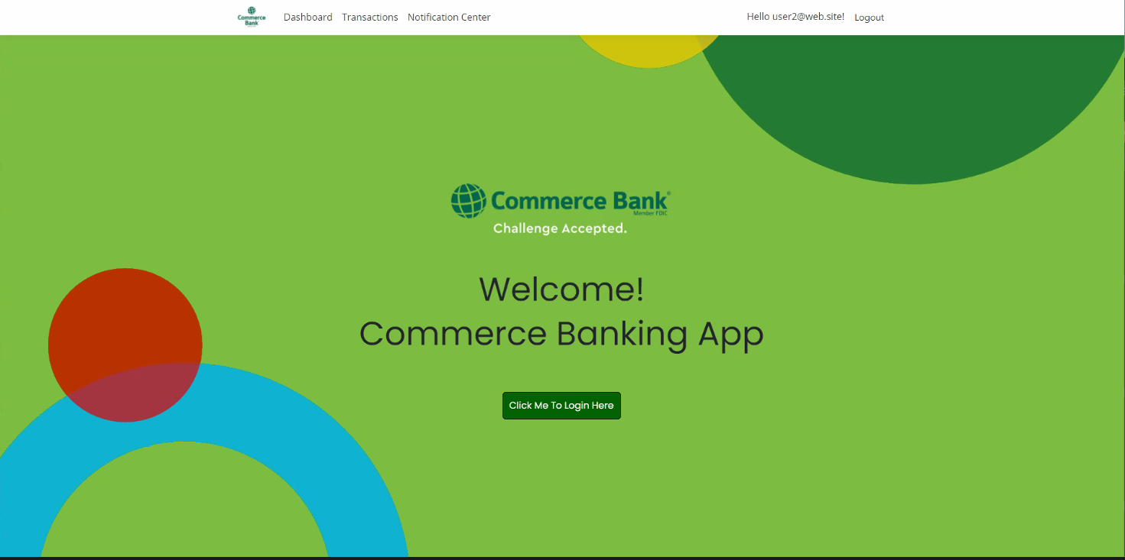

Slide 7
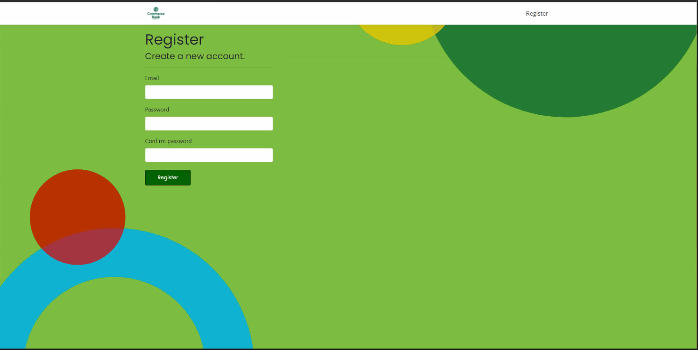
Register a New User

Slide 8
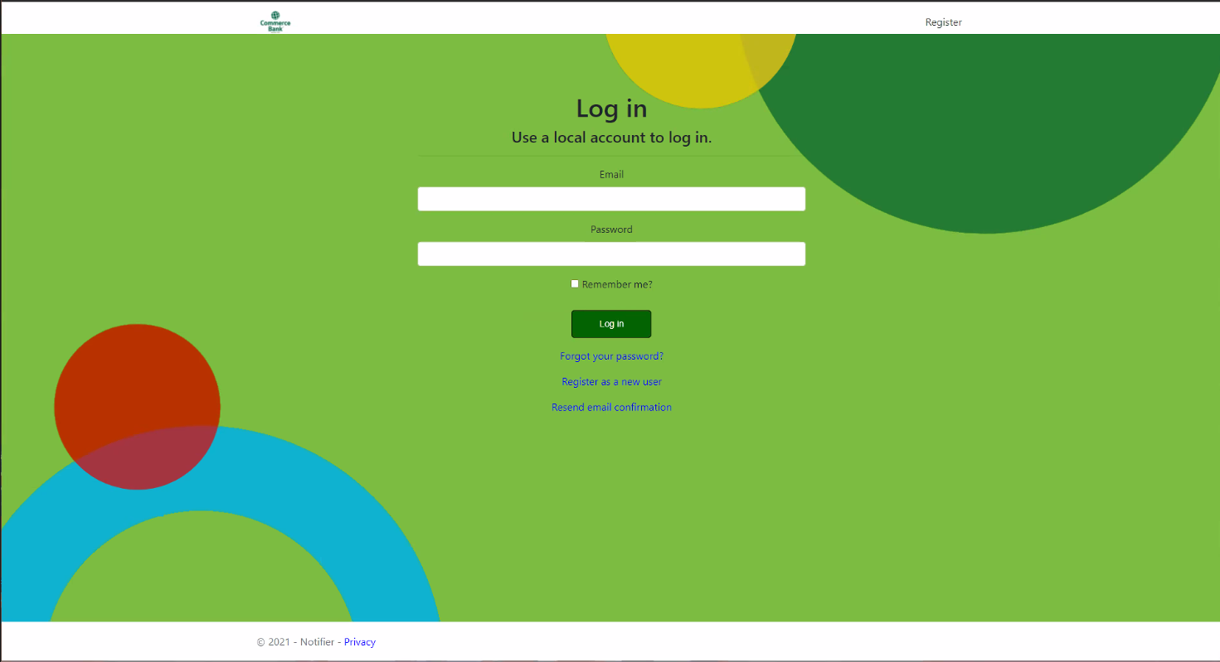
Login Page

Slide 9
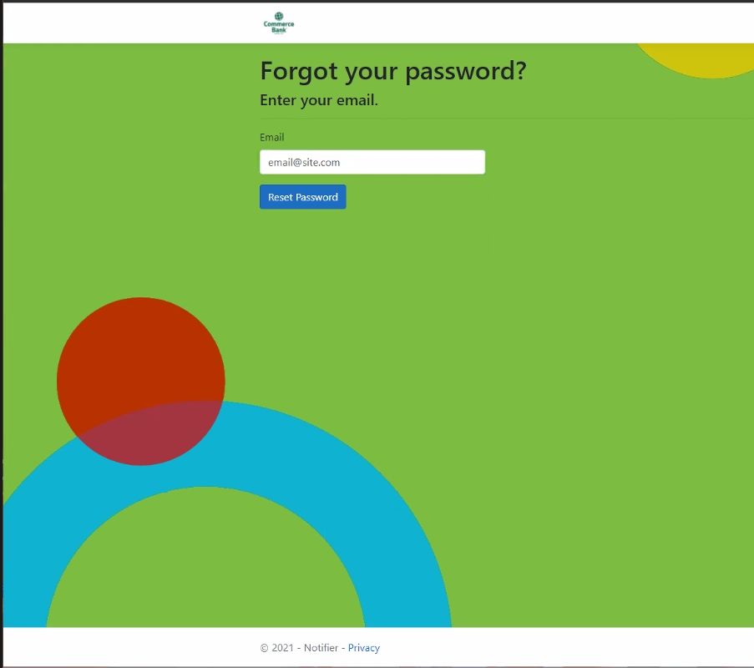
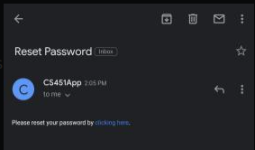
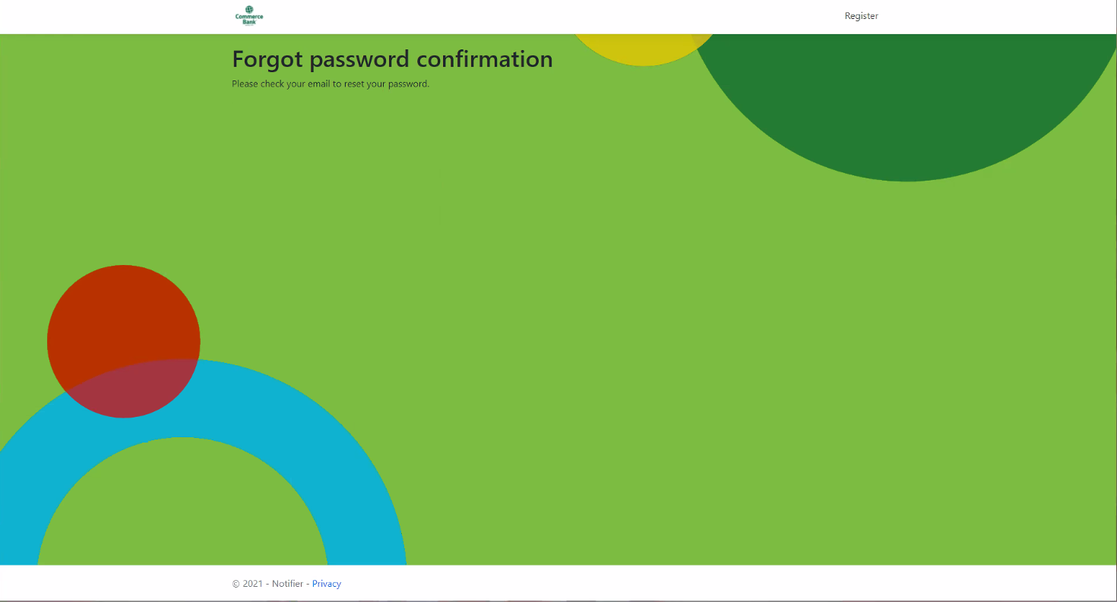
Forgot Password

Slide 10
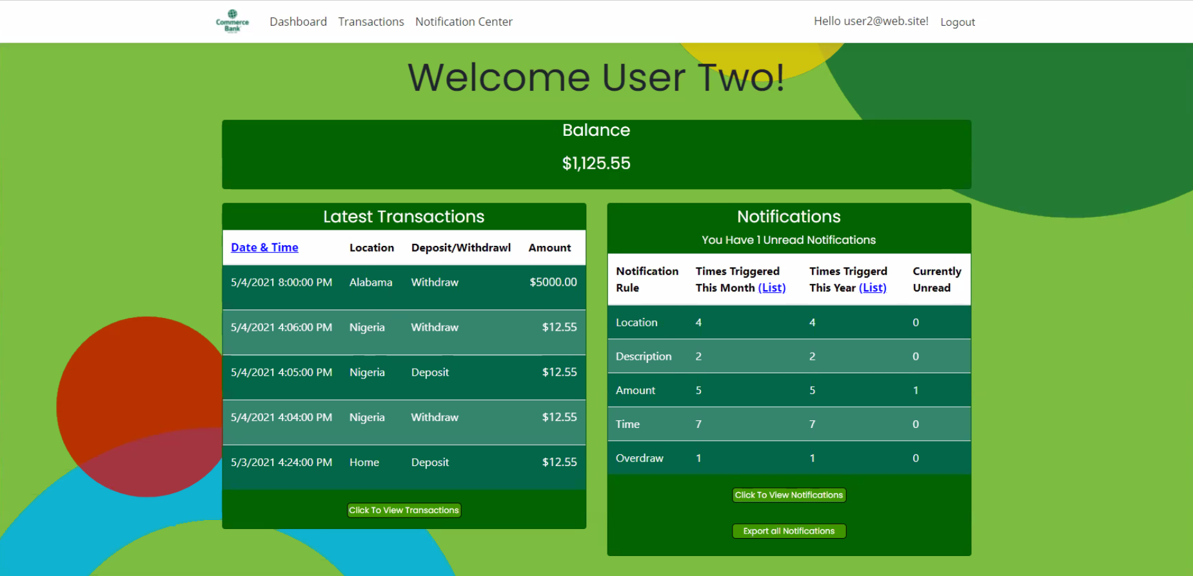
Dashboard

Slide 11
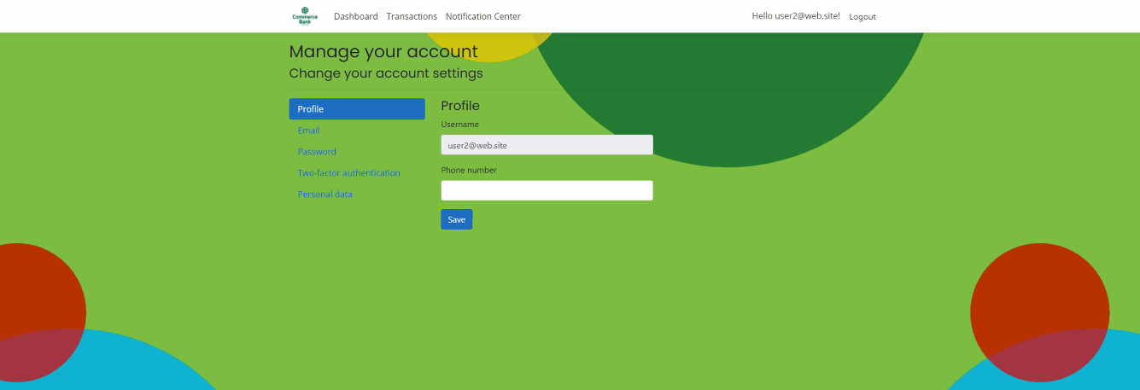
Manage Your Account-Profile

Slide 12
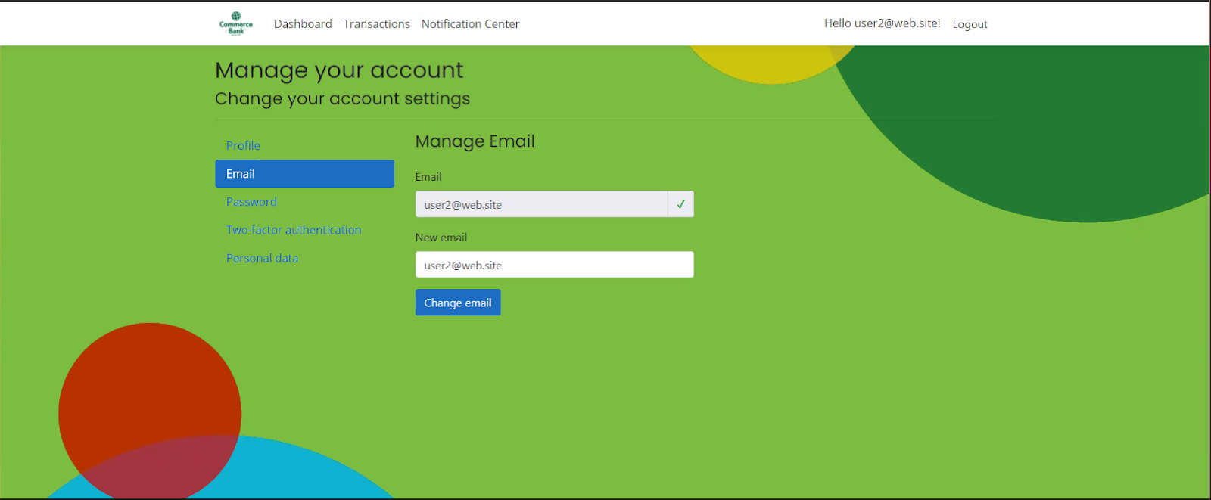
Manage Your Account-Email

Slide 13
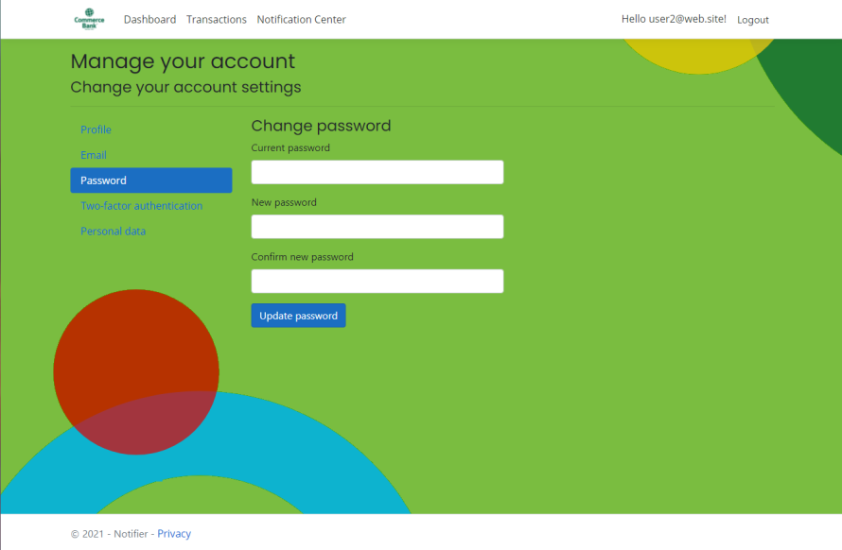
Manage Your Account-Password

Slide 14
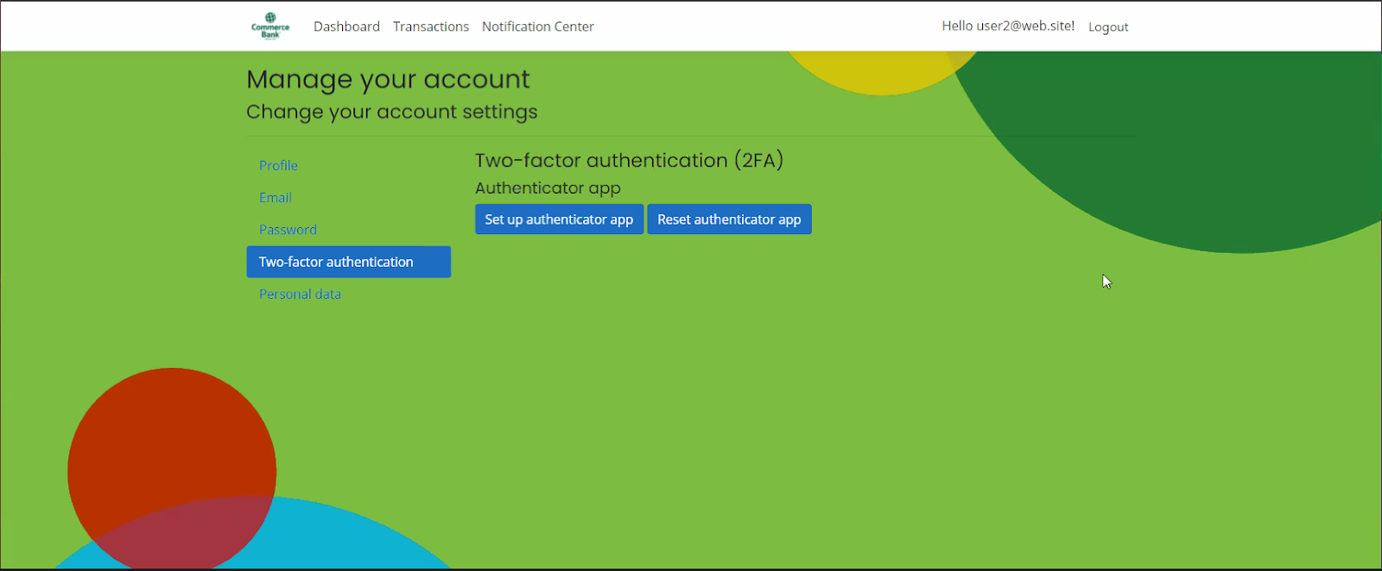
Manage Your Account Two-factor authentication

Slide 15
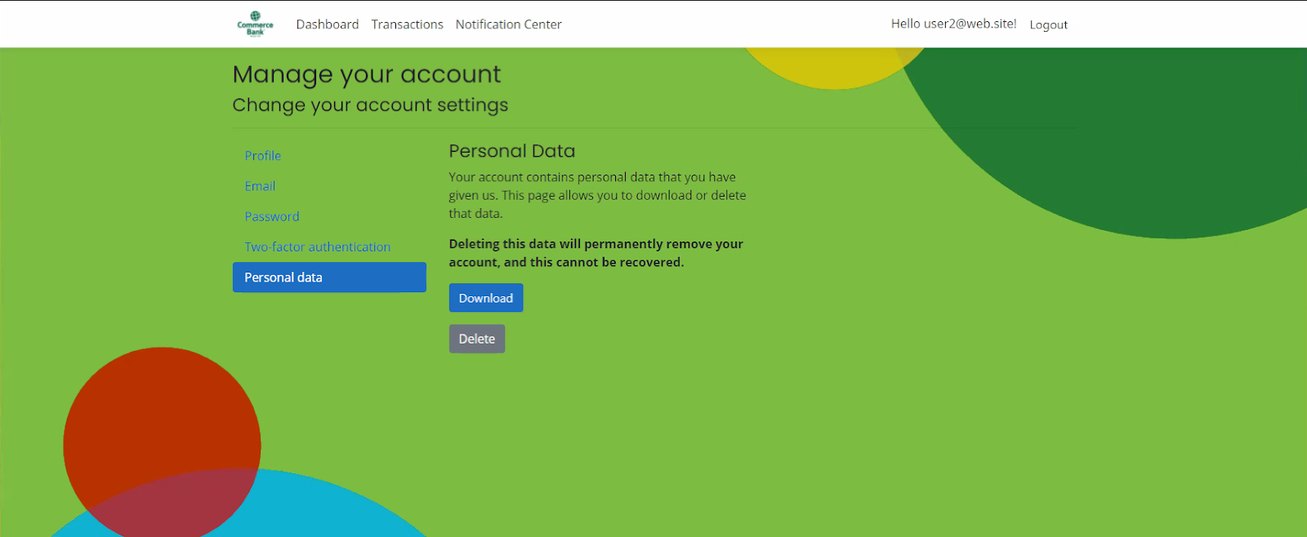
Manage Your Account Personal Data

Slide 16
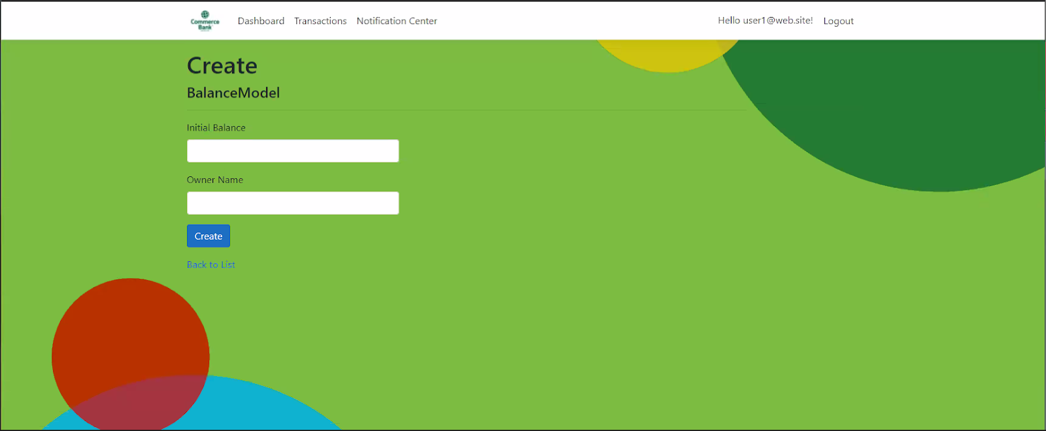
Transaction Page

Slide 17
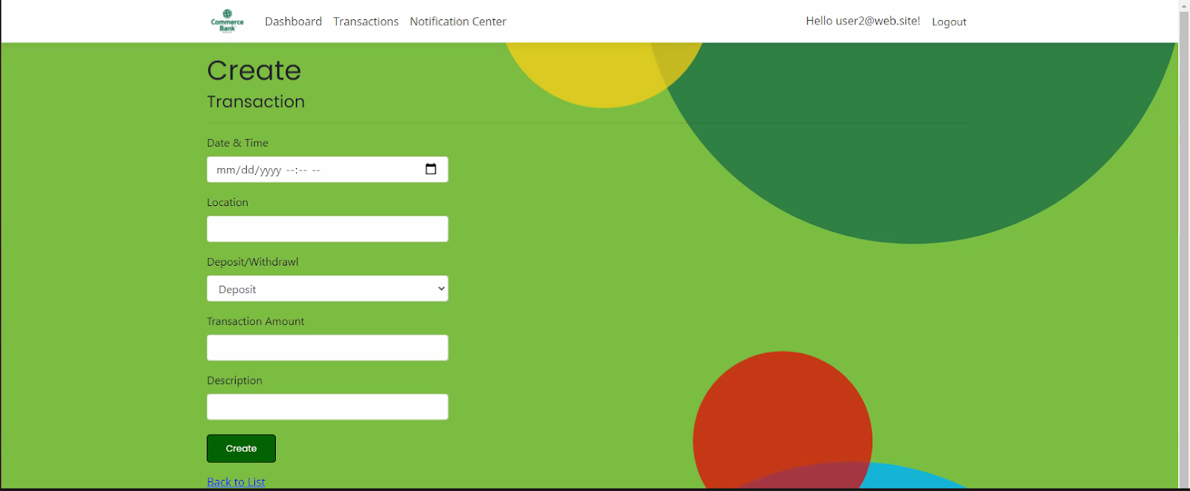
Transaction Page- Creation

Slide 18
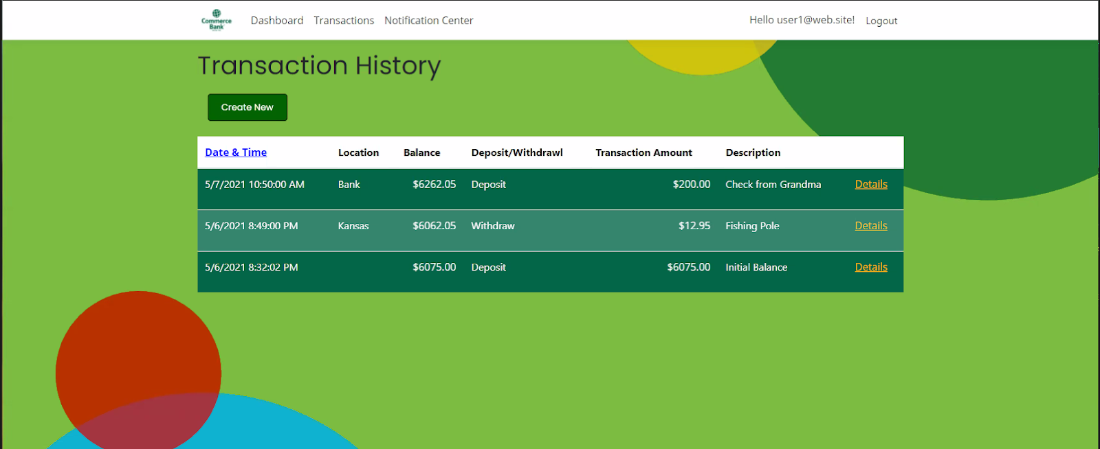
Transaction Page- History

Slide 19
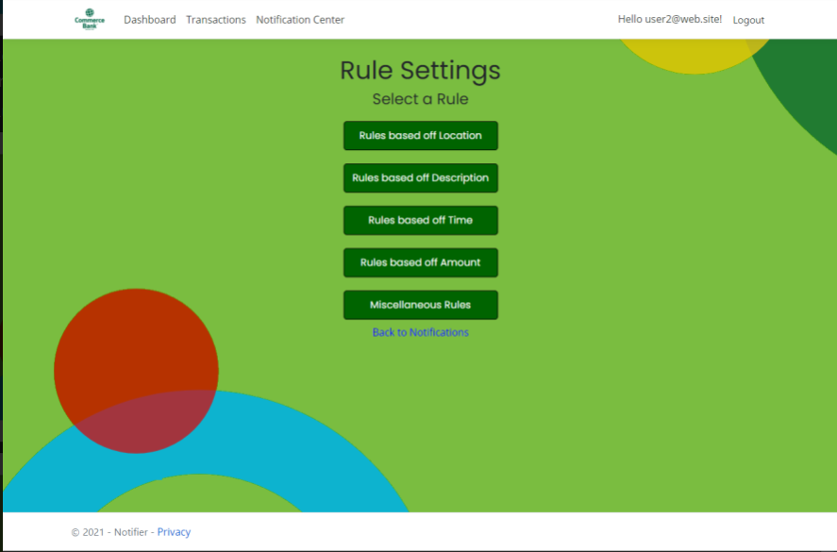
Notifications- Rule Settings

Slide 20
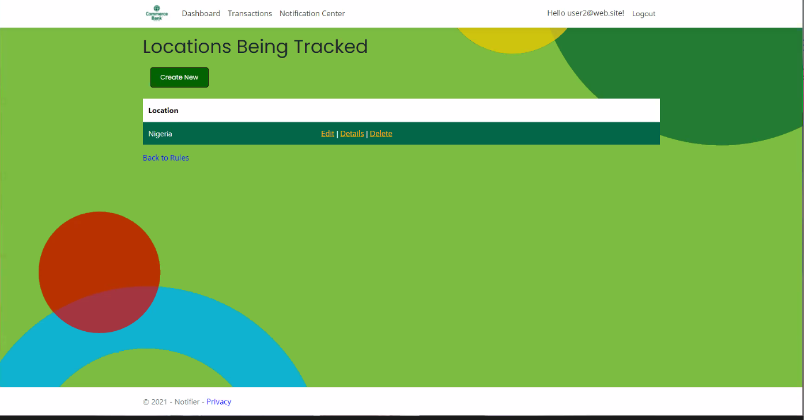
Notifications- Location

Slide 21
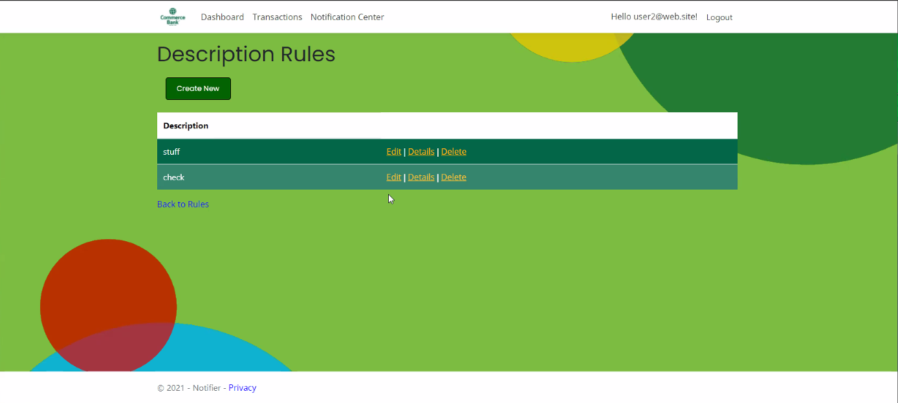
Notifications- Description

Slide 22
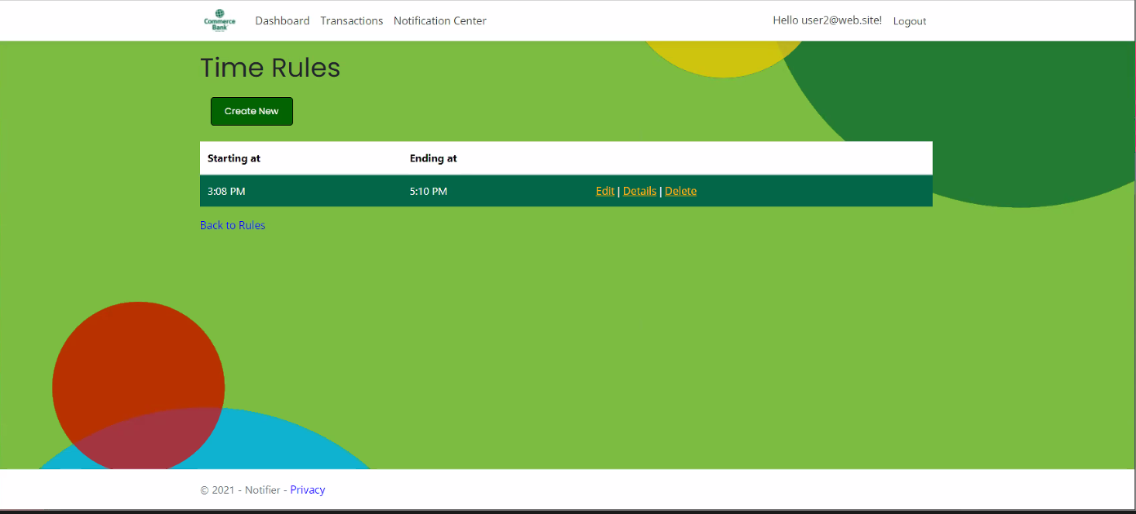
Notifications- Time

Slide 23
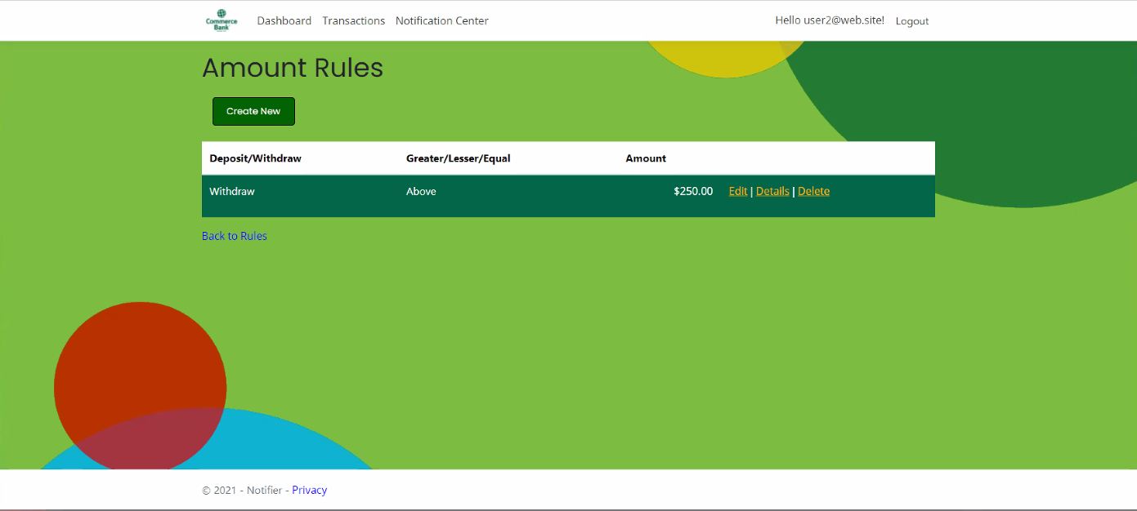
Notifications- Amount

Slide 24
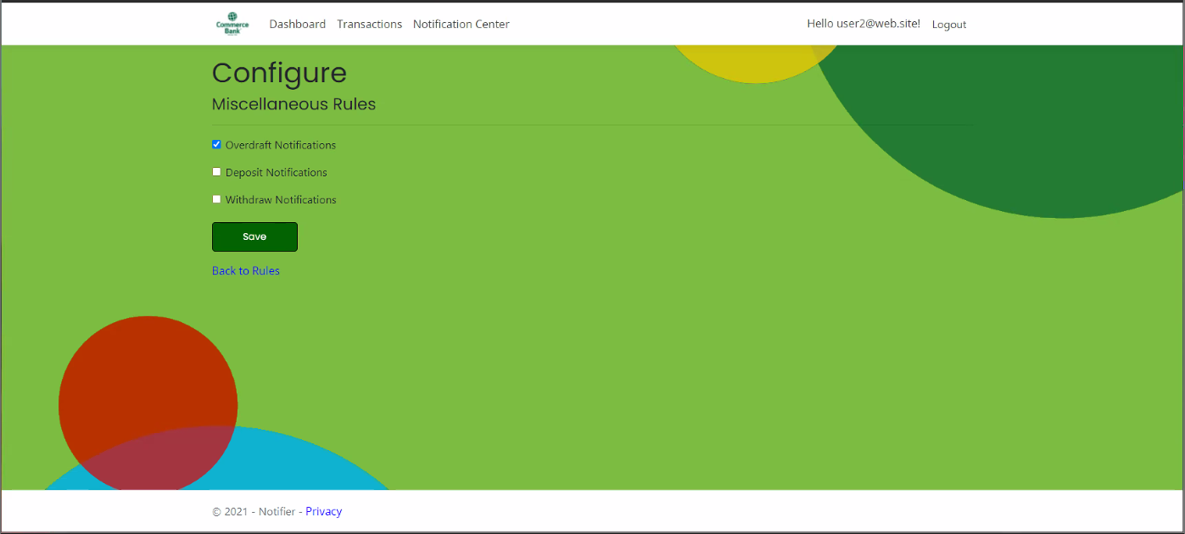
Notifications- Miscellaneous

Slide 25
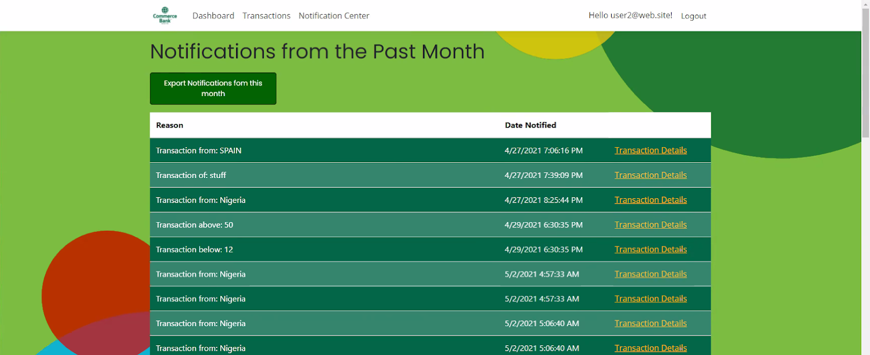
Notifications- Past Month

Slide 26
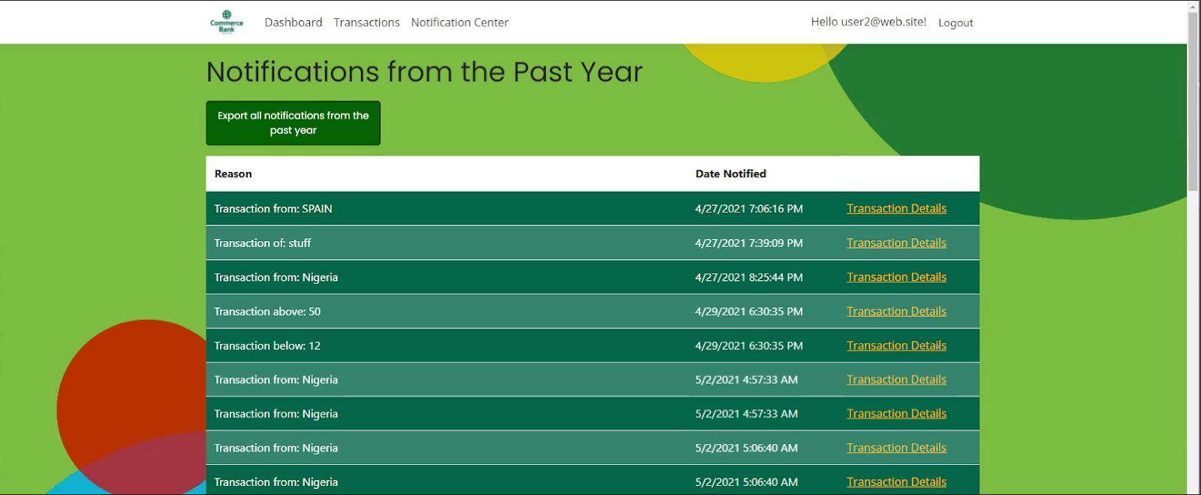
Notifications- Past Year

Slide 27
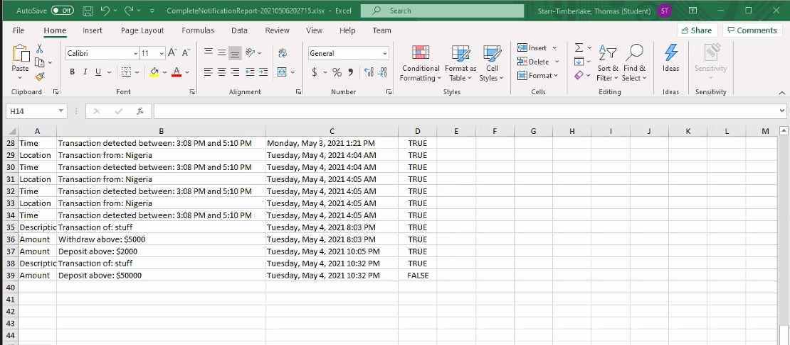
Notifications- Export

Slide 28
Stretch Goals
Options for user if they forgot their username or password
Use pull requests/code review approved by a group member within your source control
‘Remember Me’ Function

