Slide 1
BIT Project
Group 13: Seth Witzki, Brennan Campbell, Ishrak Habib, Michael Do

Slide 2
Overview
Project goal
Develop a secure network for employees of Monstrosity Inc.
Effective web traffic filtering for customers and employees
Secure email
Onsite database hosting
Penetration test plan

Slide 3
secure networking

Slide 4
WatchGuard Firebox
Comprehensive advanced network security platform.
Widely deployable, enterprise-grade security and threat visibility tools suitable for any organization, regardless of budget, size, or complexity.
Keeps your network free of zero day threats.
Protect users, devices, and data across your entire network from a single platform.
Built-In SD-WAN for improved network resiliency and performance.
Implements SSL Inspection & Protection to detect malware hidden in encrypted traffic.
Deploys security automation from cloud storage system, blocks threats, updates signatures, and kills malware.
Helps makes WIFI vigorously secure for customers and enterprises.

Slide 5
Web filtering

Slide 6
Barracuda network
Enforce Corporate Policies
SSL-filtering and inspection capabilities provide policy enforcement on social-media and search platforms
Protect Against Web-Based Threats
Keep networks and users safe by blocking spyware downloads, preventing viruses, and restricting requests to malicious websites by leveraging intelligence from thousands of collection points worldwide.
Content Filtering
Barracuda Web Security Gateway
Can be customized to restrict specific websites or look for patterns in web addresses
Image/multimedia safe search feature prevents search engines from displaying objectionable thumbnail images in search results.
Administrators can also create policies that control web-file downloads based on file type

Slide 7
Cisco Umbrella
Allow and block lists
Can set a specific filter to allow/block sites regardless of the content web filtering settings applied.
Block bypass
allows certain individuals to access specific web filtering categories that are normally blocked on your network.
Policy tester
Run simulations to check if policies are enforced the way intended

Slide 8
Email Filtering

Slide 9
Proofpoint
Uses NexusAI to identify impostor/phishing emails, malware and spam
Can also detect/block non-malware threats such as business email compromise (BEC) scams.
Multilayered content analysis, reputation analysis, and sandboxing
Analyzes and detects emails with malicious URLs or attachments and block ransomware and polymorphic malware
Can remove phishing emails containing URLs poisoned post-delivery or unwanted emails from internal accounts that are compromised.
can be done with one click or automatically, even if emails were forwarded or received by other users.

Slide 10
Mimecast
Uses several commercially licensed anti-virus engines for broader malware signature detection
Static File Analysis
The file itself is evaluated for packing, abnormal code, embedded suspicious objects, etc. without executing it.
The file can either be delivered, blocked, or passed on to the Sandbox for further analysis.
Safe File Conversion
Convert Office and PDF files to a safe file format for immediate delivery to employees
Employees can then request the original file and have it scanned on-demand before delivery.

Slide 11
Barracuda Network
Automatic incident response to malicious emails
Provides remediation options to address issues faster and more efficiently.
Admins can send alerts to impacted users and remove malicious email directly from their inboxes.
Integrates directly with Microsoft Office 365 APIs to detect attacks coming from both internal and external sources.
AI-based threat detection learns your business’s unique communication patterns to detect personalized fraud in real-time to protect against business email compromise and account takeover.

Slide 12
Intrusion detection

Slide 13
Checkpoint IPS
Real-Time protections
Constantly updated with new defenses against emerging threats
The protections are pre-emptive, providing defenses before vulnerabilities or exploits are created.
Virtual Patching
Combines the IPS functionality with a concerted patching strategy to help network administrators to handle and secure the network between upgrades and patches

Slide 14
Data Backup and Database

Slide 15
On-site Database Server
Dell PowerEdge T640 (Main Server)
Has Hardware Raid Capabilities (Can be set Raid 1 or 0 depending on requirements)
Intel Xeon Processor
Larger Storage Available
Hot Swappable
Powerful, Versatile and Scalable
Cost Effective in the Long Run

Slide 16
On-site Database Server
Dell PowerEdge T30 (Backup Server)
Intel Xeon Quad-Core Processor
Room for 6 disks
Comes in a lower price point.
Not Hot Swappable
No RAID capabilities.

Slide 17
Database Server Specification
Dell PowerEdge T640
Chassis with up to 8" x 3.5 SAS/SATA Hard Drives, Tower Configuration
Intel® Xeon® Gold 5218 2.3G, 16C/32T, 10.4GT/s, 22M Cache, Turbo, HT (125W) DDR4-2666.
32GB RDIMM, 3200MT/s, Dual Rank Memory
C2, RAID 0 for HDDs or SSDs (Matching Type/Speed/Capacity)
1.2TB 10K RPM SAS 12Gbps 512n 2.5in Hot-plug Hard Drive, 3.5in HYB CARR

Slide 18
Online BACKUP SOLUTION
Acronis (Optional)
Cloud Back Up solution.
Standard/Advanced options available.
Yearly Licenses comes with maintenance.
Back up server, workstation etc.
Back Up frequency can be set easily to daily, weekly, monthly etc.
Easy to use.

Slide 19
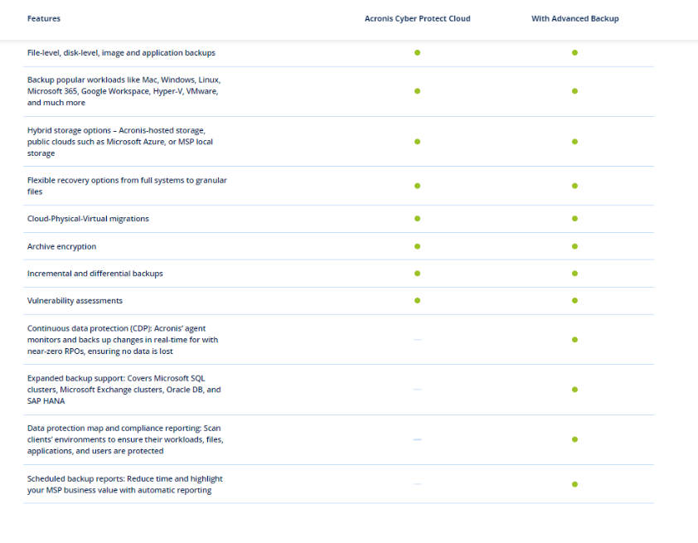
Online backup solution

Slide 20
Cybersecurity

Slide 21
Why it matters
Technology is essential in all of our lives
Sensitive information must not be accessible to just anyone
Any issues that do arise must be addressed as early as possible

Slide 22
Penetration Testing
Should be done once a year
Ideally around September/October – Just before the holiday season
Test for obvious vulnerabilities
Not all vulnerabilities are created equal
Attempt to exploit
May involve SQL injection, password cracking, and other techniques
Report

Slide 23
Wireshark
Live capture
Coloring rules for fast analysis
Save and restore captured data

Slide 24
Perfection is a myth
Technology is constantly evolving; So are hackers’ methods
Wireshark does not allow you to directly modify your network, just scan it
All security systems have some shortcomings, and those must be considered

Slide 25
Bitdefender small office security
Complete protection for Windows, Mac, Android, and iOS devices
Light on system resources, so productivity is not affected
Quick installation

Slide 26
Employee training
Employees should be formally trained to handle cybersecurity threats
This should be updated and repeated regularly—At least quarterly
Employees should be taught to:
Distinguish between real and fake (Trojan horses vs. genuine programs, phishing scams vs. real deals, etc.)
Identify and report a security breach or other unusual activity
Create and maintain secure passwords

Slide 27
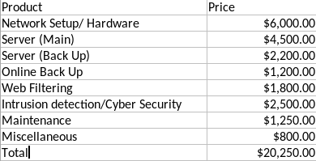
PRICING
The cost depends on the client’s specific product requirements according to their choosing.
Estimated Cost: $18,000 - $25,000.

Slide 28
Thank you!
Questions?

