Slide 1

Web Application
Final Presentation

Slide 2


Presented By:
Atticus Parris: UX, Scrum Master
Benaiah Kilen: Back-End, UI
Zach Gharst: Database Administrator
Andrew Poitras: UI, Testing
William Keke: Front-End, UX

Slide 3
REQUIREMENTS:
Web application
Database
Unit Testing
UX
Front End
Login Page
Notification Rules
Notifications
Transaction Summary
Home Page
Stretch Goals
Source Control
Session for remembering user
Notifications via email or text
Final presentation:
Working Application
Home Page
Ability to set up notifications
Notifications trigger
Reporting
General public speaking
Professional attire
Security scan?
Takeaways
What did we learn?
Any setbacks? How did we overcome?
Suggestions for future projects

Slide 4
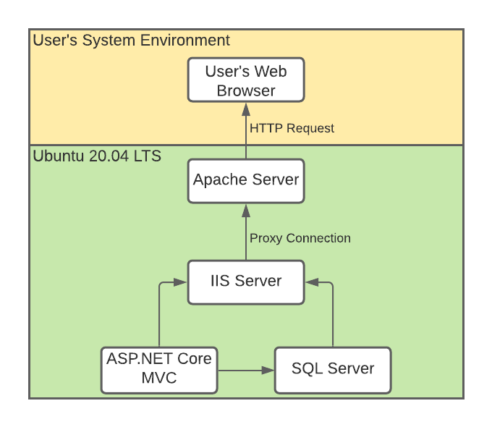
Tools and Architecture
HTML/CSS Using Bootstrap
C#.NET MVC Design Pattern
xUnit Testing
MSSQL Server

Slide 5
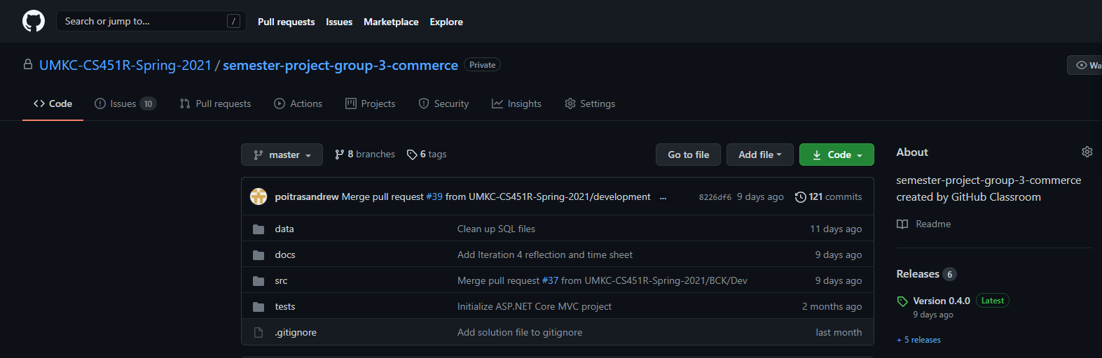
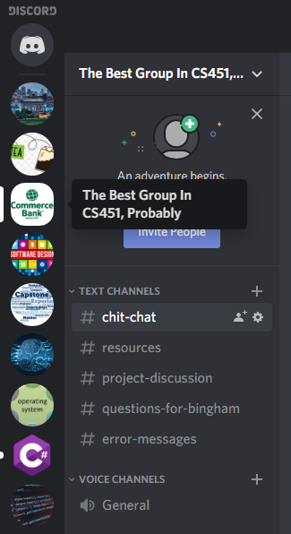
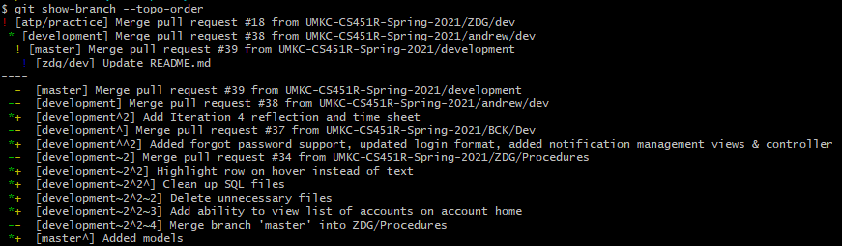
Source Control / Communication

Slide 6
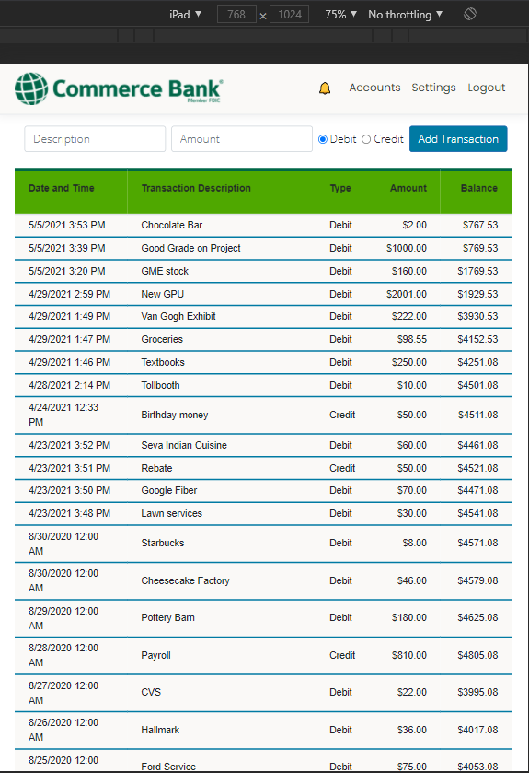
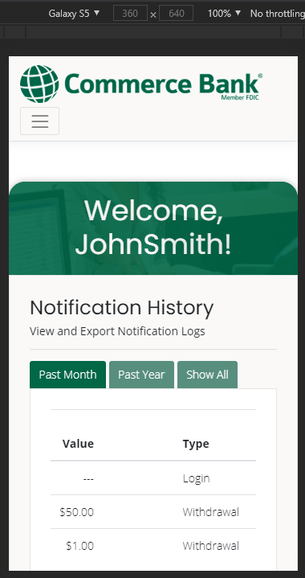
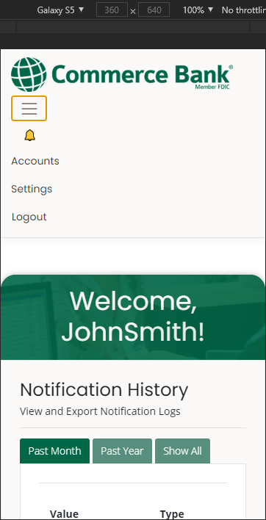
Mobile View

Slide 7
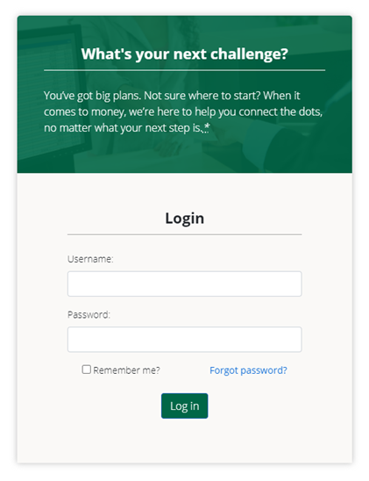
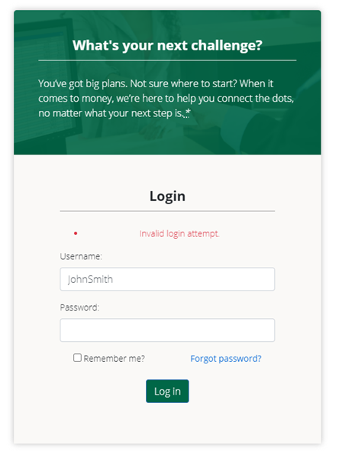
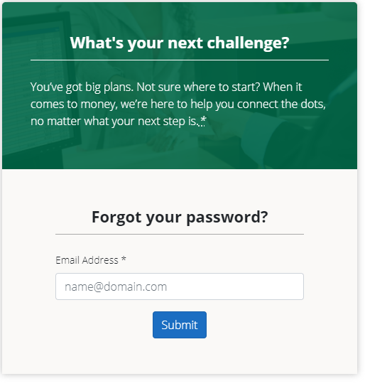
Login Page

Slide 8
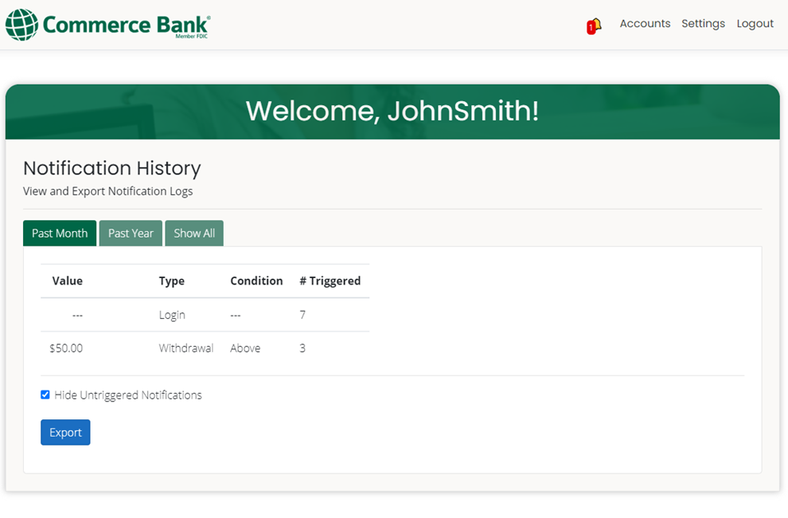
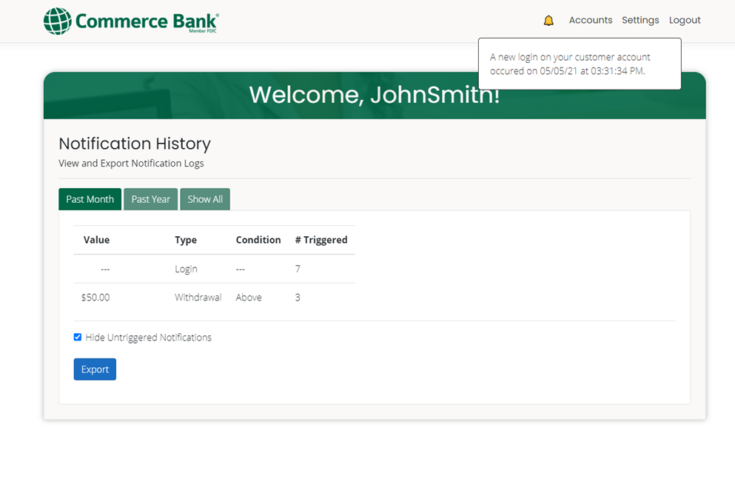
Dashboard

Slide 9

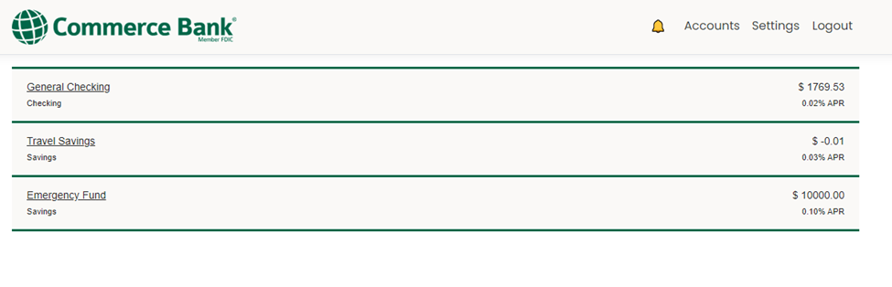



Multiple Accounts

Slide 10
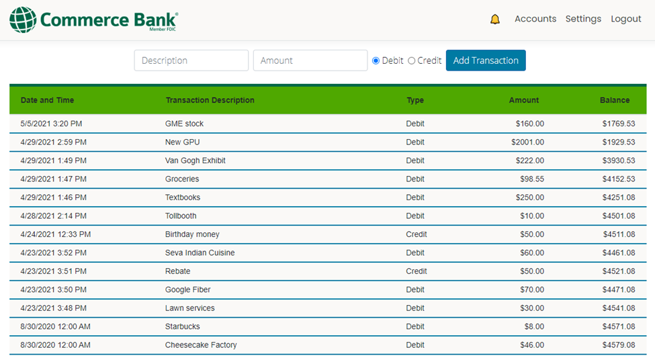
Transaction Summary

Slide 11
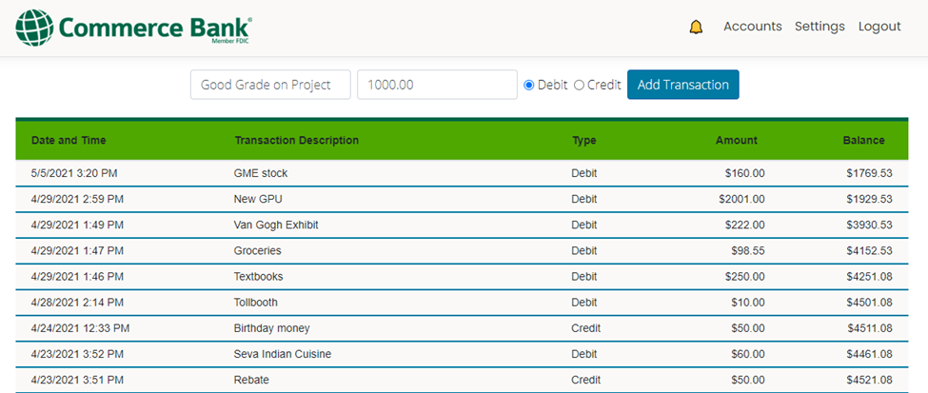
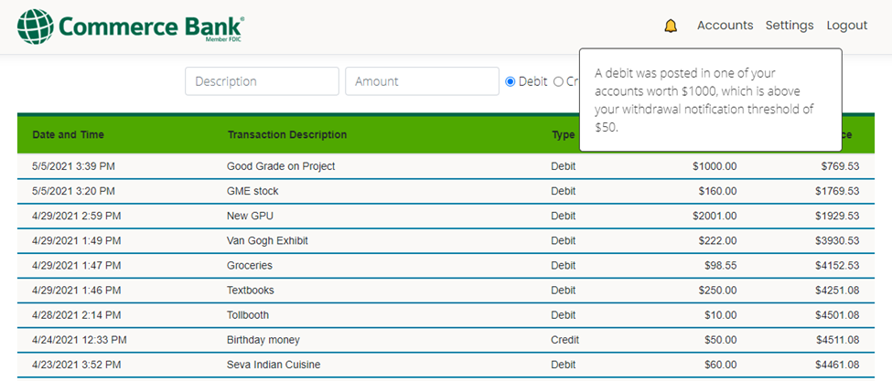
Transaction Summary

Slide 12
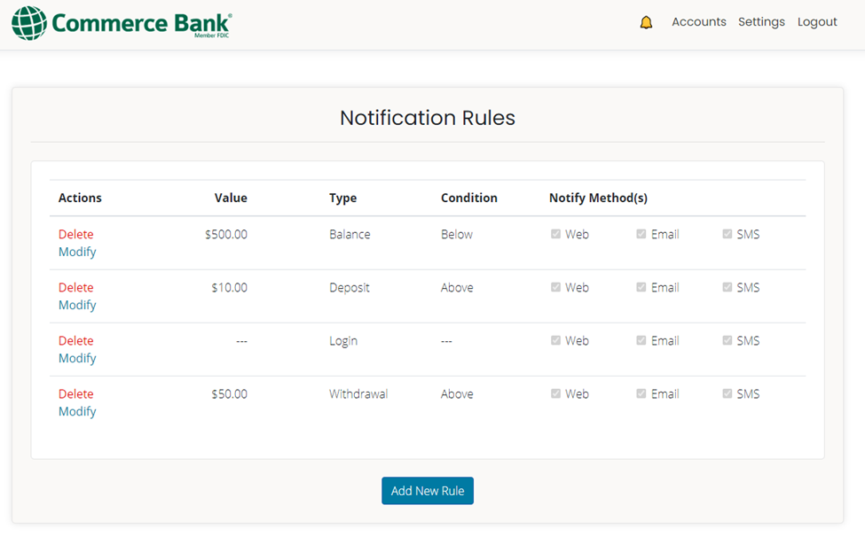
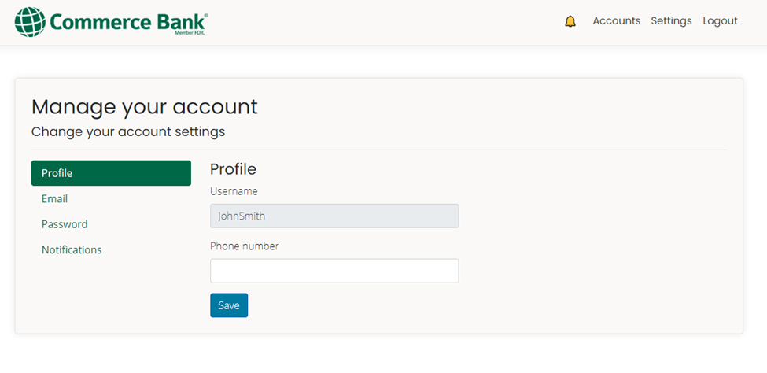


Notifications

Slide 13
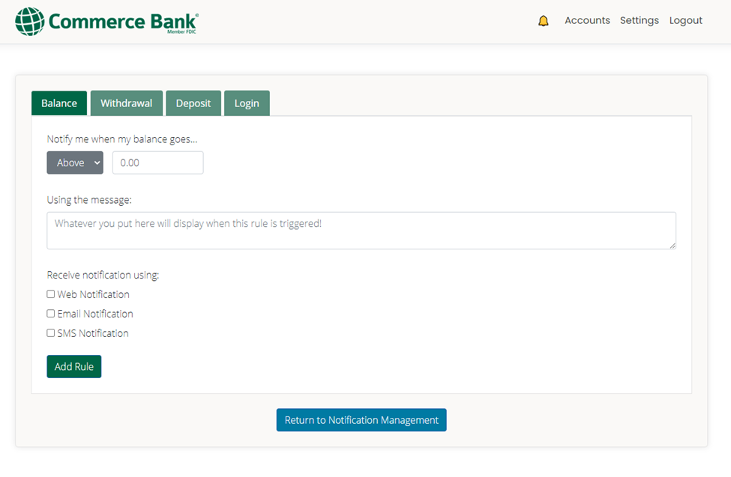
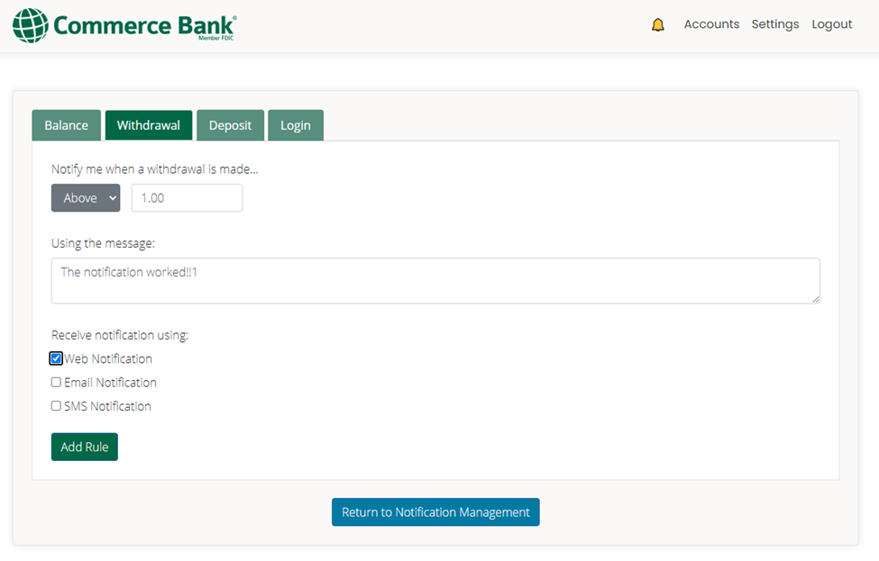
Notifications

Slide 14
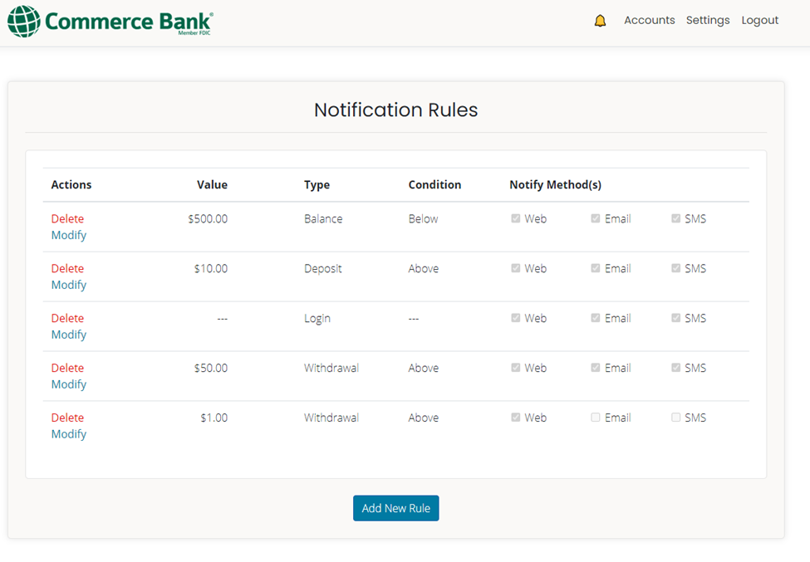
Notifications

Slide 15
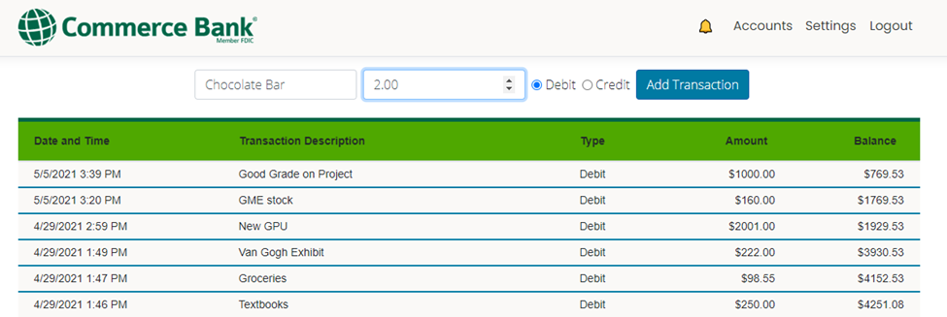
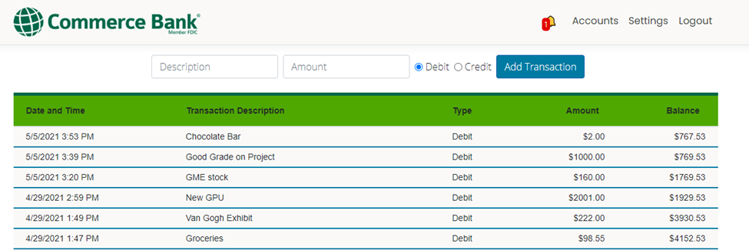
Notifications

Slide 16
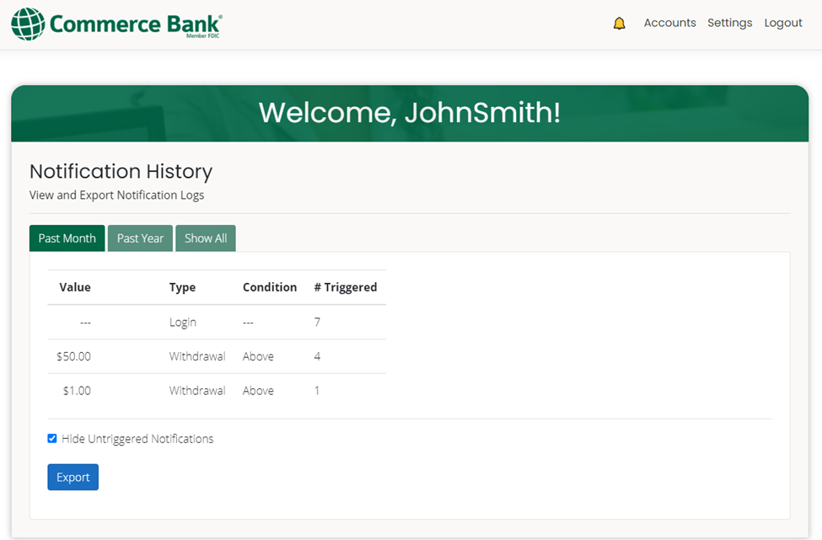
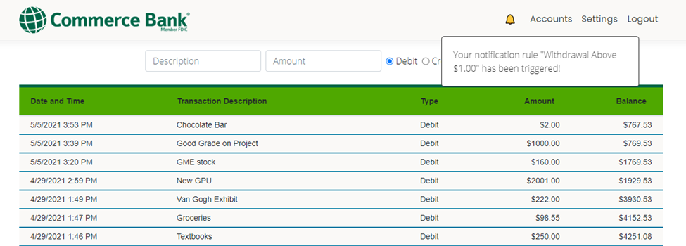
Notifications

Slide 17
Database
We used SQL Server 2019 as our Relational Database Management System. It provides persistent data storage, processing, and retrieval for the data needed by the application.
Some of our interesting stats:
6 major revisions across 5 iterations
14 tables and 60+ data fields
11 stored procedures for returning/modifying/creating data: 236 LOC
1 very large and complicated trigger when a transaction is made to check for possible notifications: 139 LOC

Slide 18
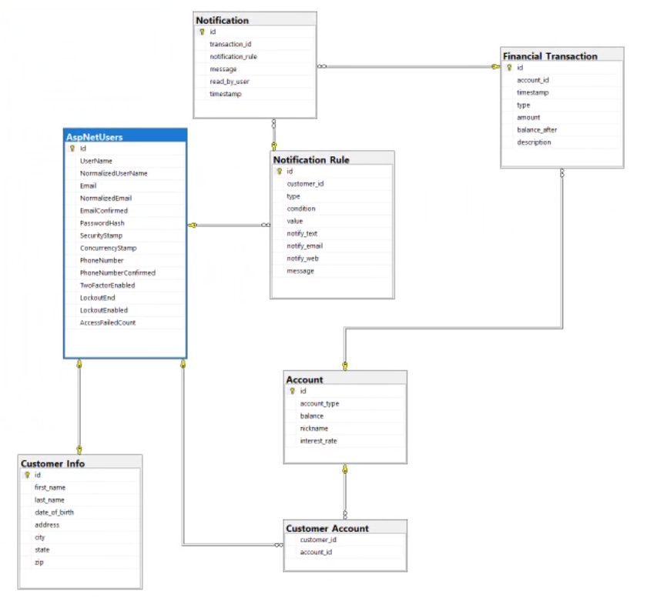
Database

Slide 19
Database
We have made important considerations for data integrity and security:
Developers have their own database password hidden in their usersecrets environment.
The application only interacts with the database with parameterized Stored Procedures.
There are separate SQL Server users for administrators and customers. Even if a customer somehow got around our safeguards, they wouldn’t have access to anything other than executing the existing stored procedures.
Instead of relying on our own methods for user identification (password hashing, salting, session creation), we use .NET Identity. Identity is built by experts, it’s unit testable, and fulfills the requirements of our product.
There are checks for data constraints on the front-end, the controller, and the database. We assume there is not just maliciousness, but also mistakes that might happen, and we try to avoid and mitigate any damage. For this reason, we also only give the least amount of privilege needed to perform a task.

Slide 20
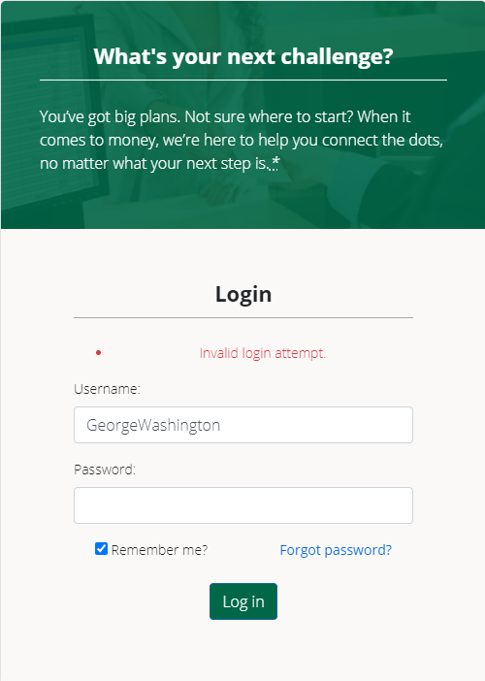
Testing
Combination of manual testing and unit testing
Code Coverage Metrics
Xunit
Unit testing was done on Controller functions
Arrange, Act, Assert

Slide 21


Testing
We had some difficulties with mocking the database and the user
Mocking databasecontext
Mocking User

Slide 22
Setbacks and Takeaways
Falling back on documentation.
New, experiences learning (MVC, Bootstrap)
Future goals: More security for future product
Overall experience

Slide 23
Interactive Demo
URL: commerceG3.ddns.net
Username: JohnSmith
Password: !Password123

